Slide 1
American beaver
(Castor canadensis)

Slide 2
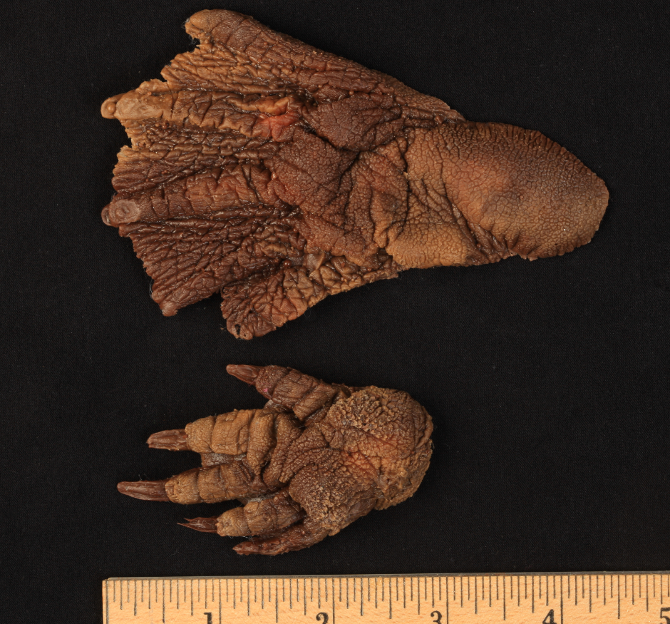
American beaver

Slide 3
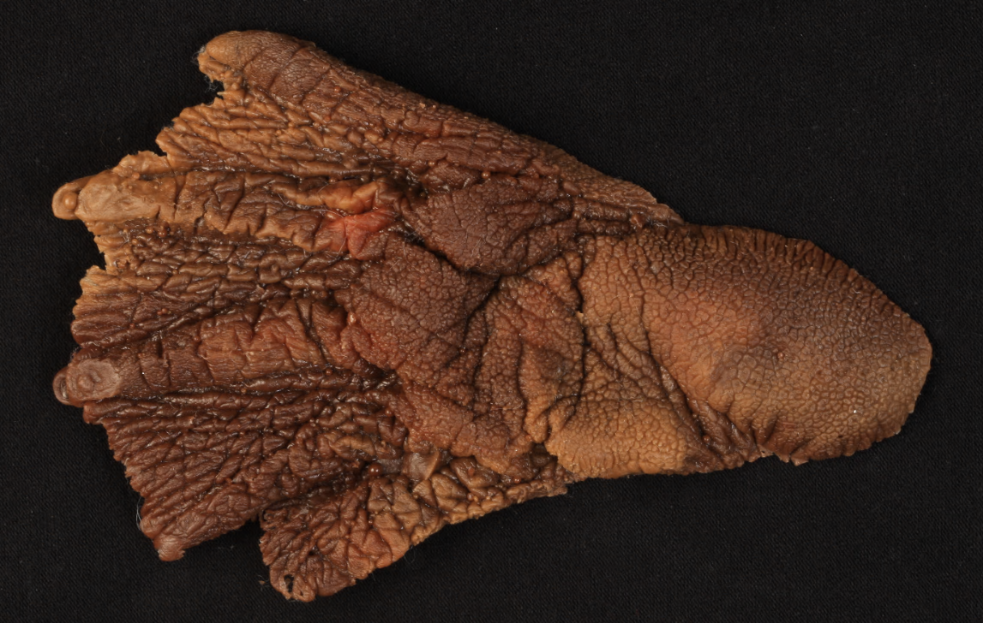
American beaver
hind foot

Slide 4
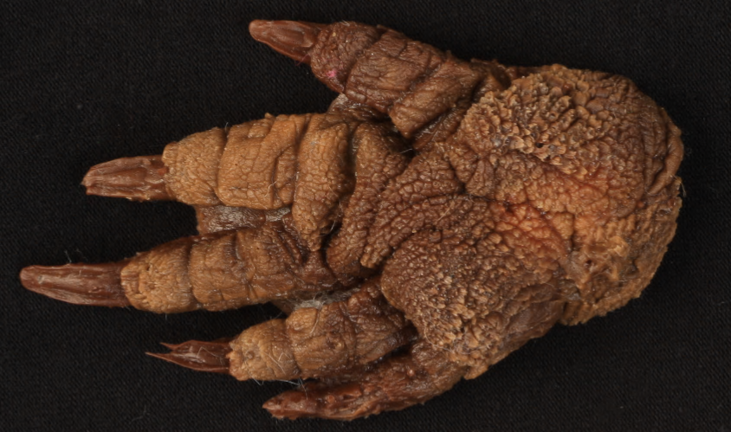
American beaver
front foot

Slide 8
coyote
(Canis latrans)

Slide 9
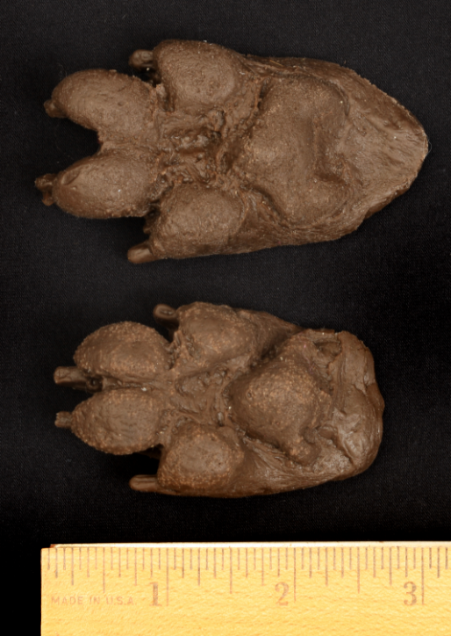
coyote

Slide 10
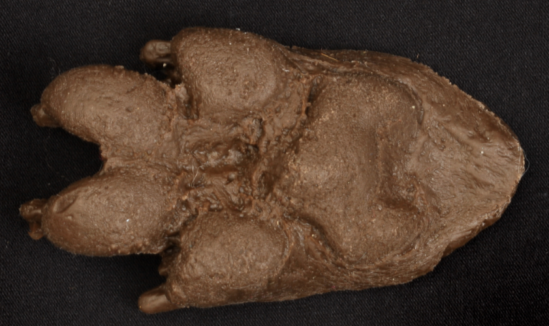
coyote
hind foot

Slide 11
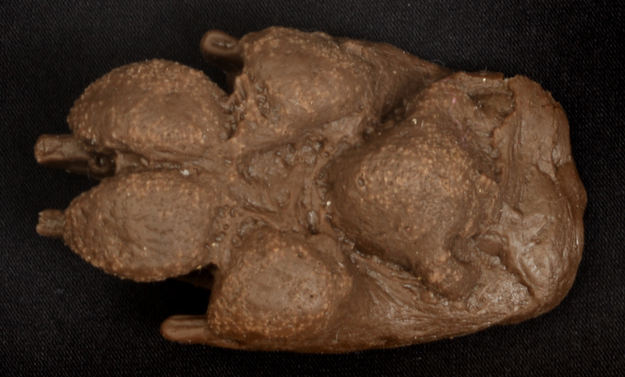
coyote
front foot

Slide 15
white-tailed deer
(Odocoileus virginianus)

Slide 16
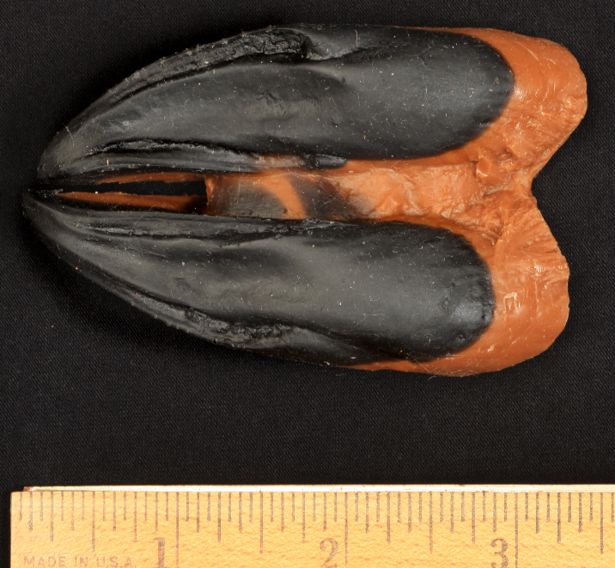
white-tailed deer

Slide 17
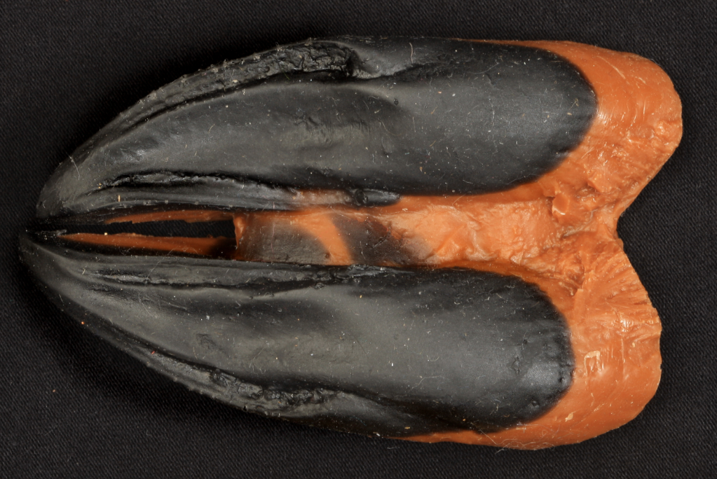
white-tailed deer

Slide 20
American mink
(Neovison vison)

Slide 21
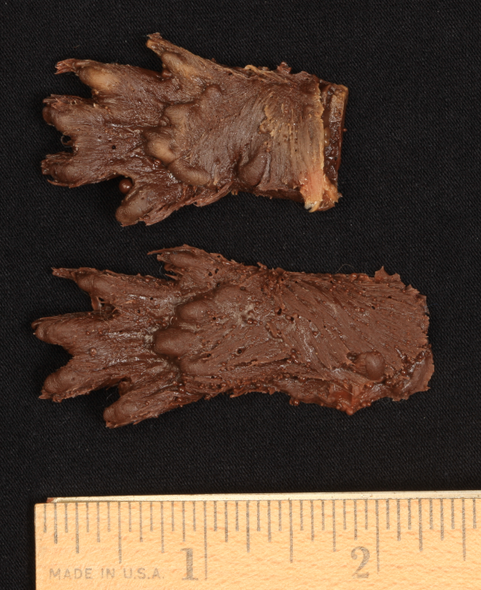
American mink

Slide 22
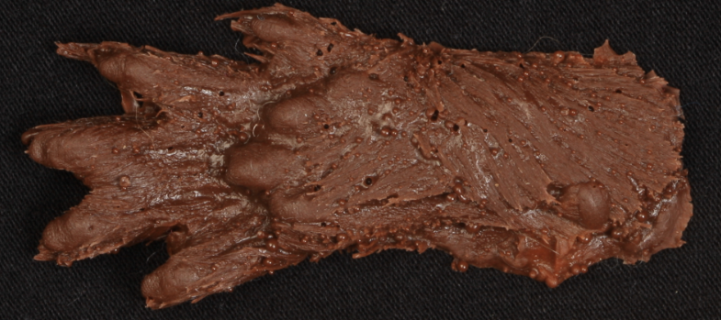
American mink
hind foot

Slide 23
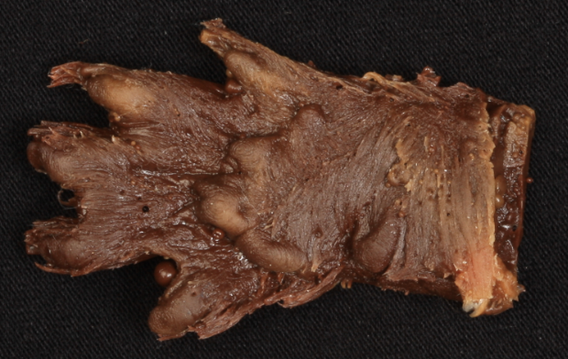
American mink
front foot

Slide 27
muskrat
(Ondatra zibethicus)

Slide 28
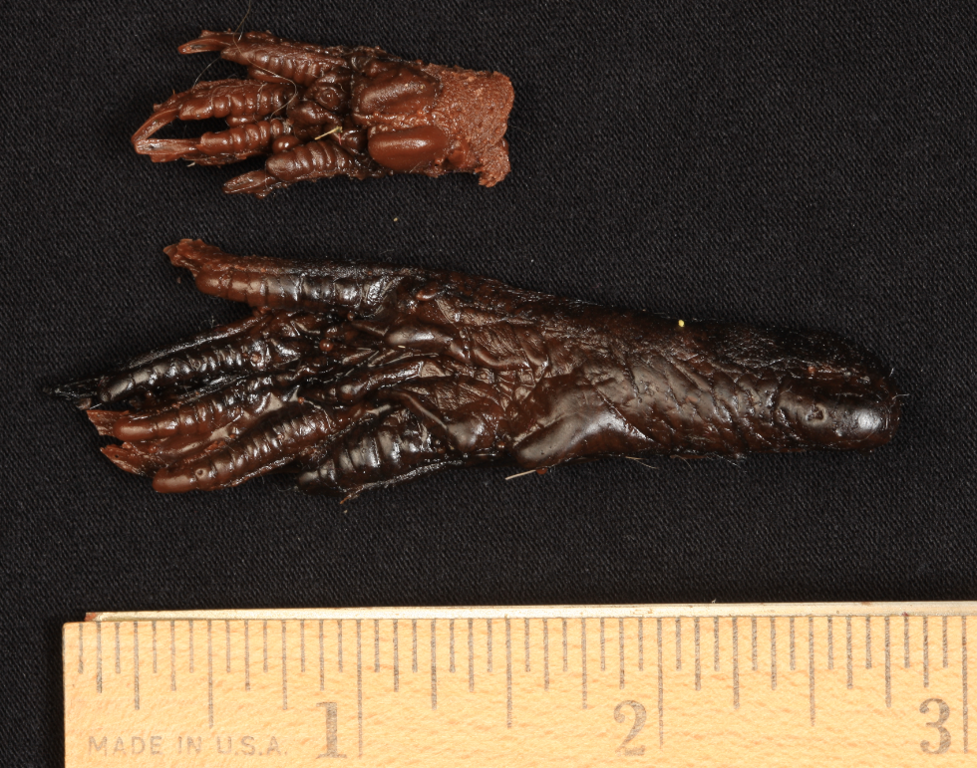
muskrat

Slide 29
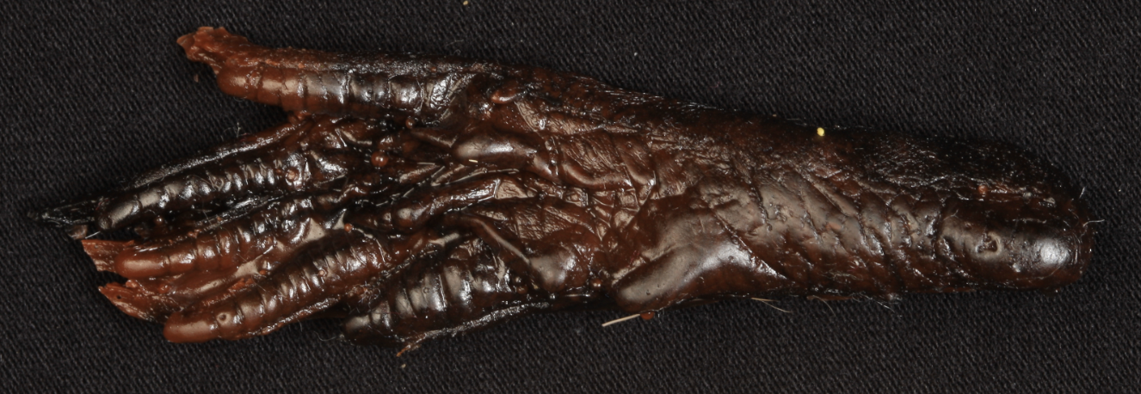
muskrat
hind foot

Slide 30
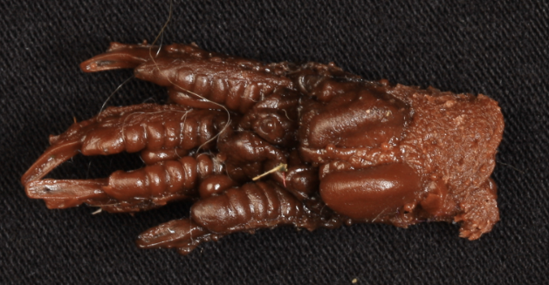
muskrat
front foot

Slide 34
Virginia opossum
(Didelphis virginiana)

Slide 35
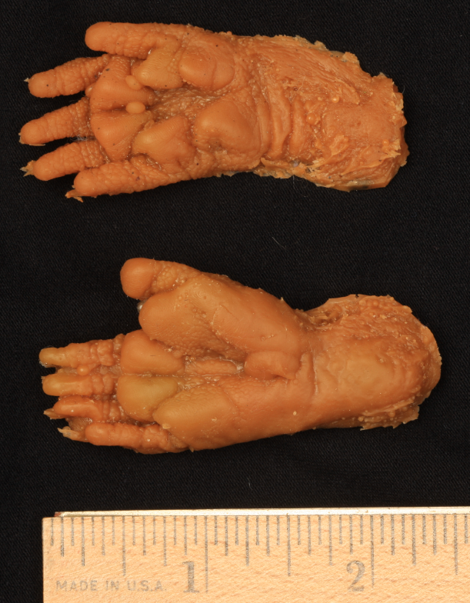
Virginia opossum

Slide 36
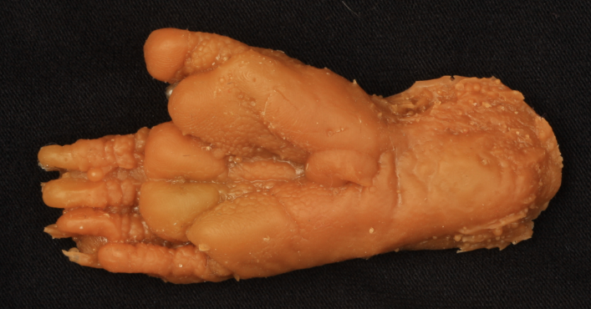
Virginia opossum
hind foot

Slide 37
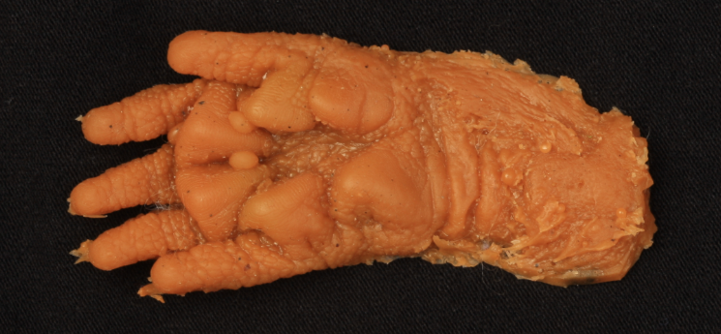
Virginia opossum
front foot

Slide 41
raccoon
(Procyon lotor)

Slide 42
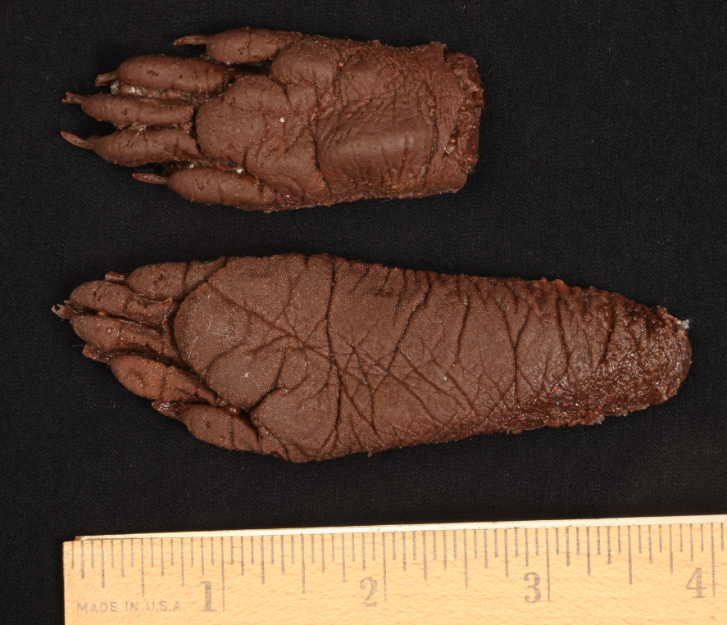
raccoon

Slide 43
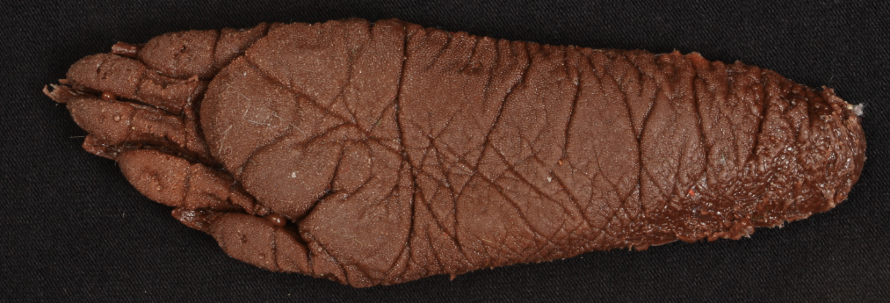
raccoon
hind foot

Slide 44
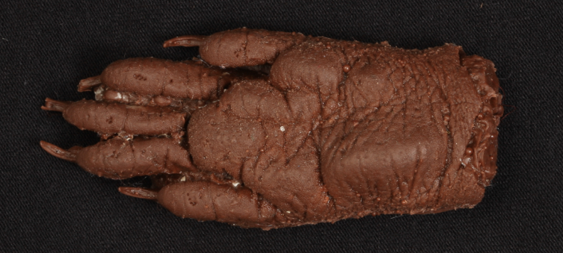
raccoon
front foot

Slide 48
red fox
(Vulpes vulpes)

Slide 49
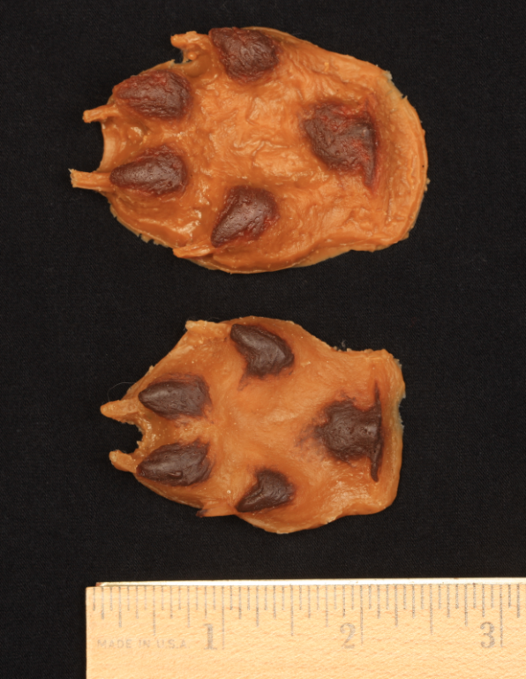
red fox

Slide 50
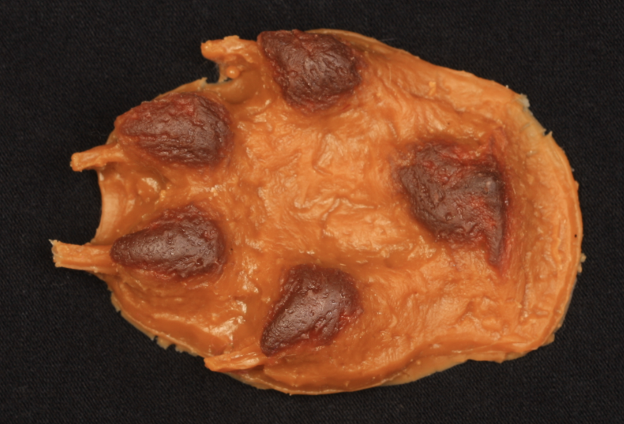
red fox
hind foot

Slide 51
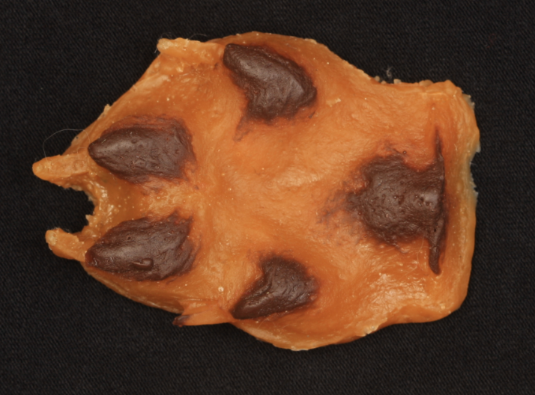
red fox
front foot

Slide 55
striped skunk
(Mephitis mephitis)

Slide 56
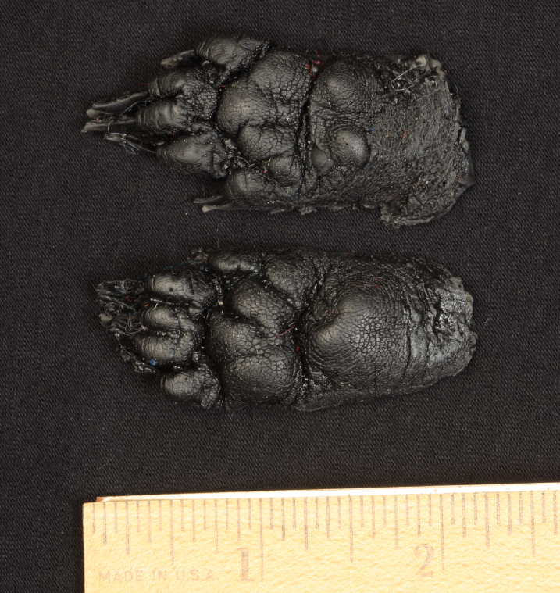
striped skunk

Slide 57
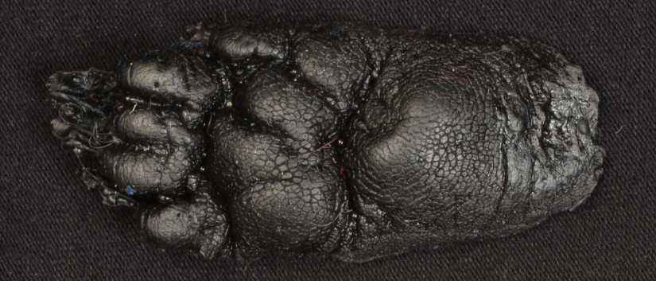
striped skunk
hind foot

Slide 58
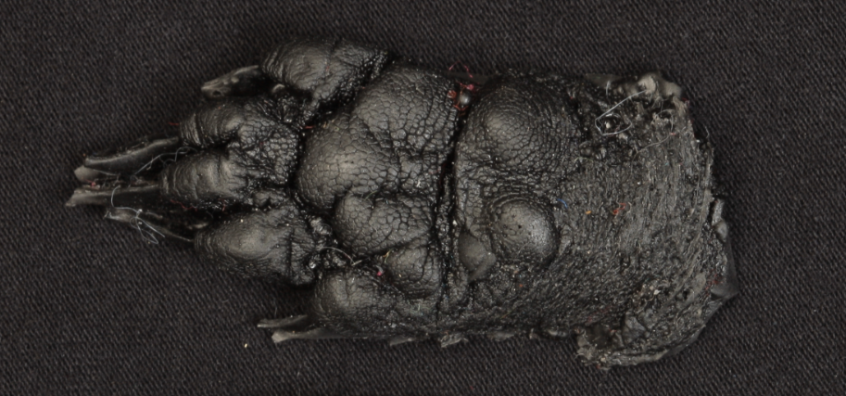
striped skunk
front foot

Slide 62
squirrel

Slide 63
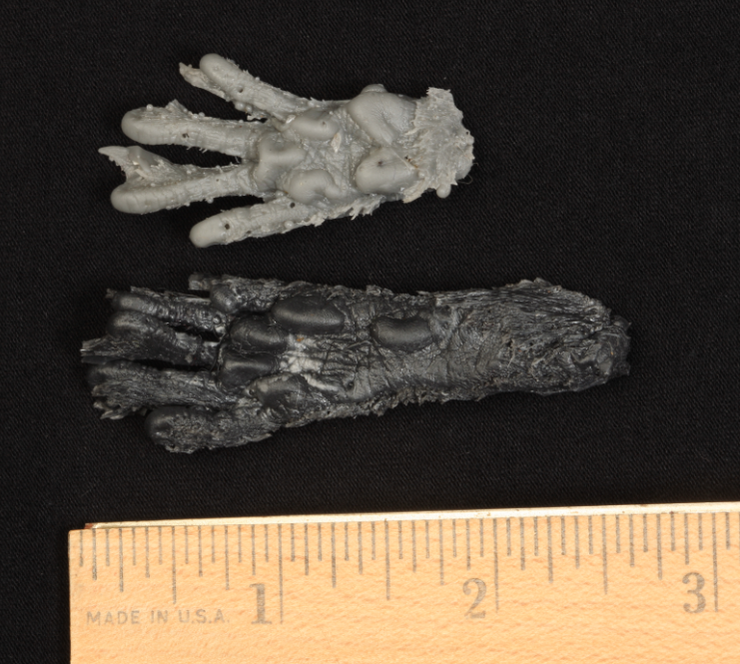
squirrel

Slide 64
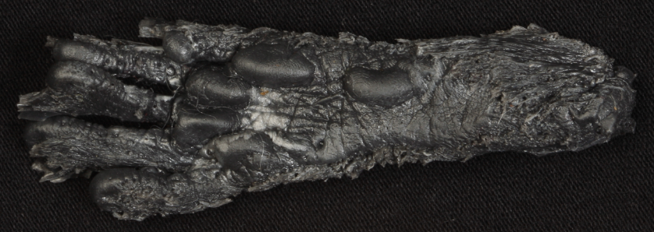
squirrel
hind foot

Slide 65
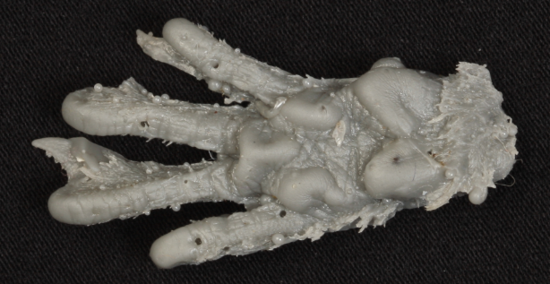
squirrel
front foot

