Slide 1
The State of Conservation in Illinois: 2022

Slide 2
Overview

Slide 3
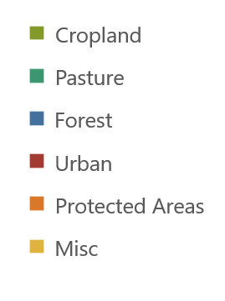
Where to seek conservation value and ecosystem services
4%
4%
7%
13%
5%
67%

Slide 4
Conservation Lands Breakdown
The vast majority of protected conservation lands in the state are publicly owned, with privately held land and water making up only 5.5%.
Across both public and private, ownership is much more common than easements.

Slide 5
Expanding the Umbrella
Areas do not have to be legally protected in order to provide a conservation benefit.
The Conservation Reserve Program and Forestry Development Programs both partner with private landowners to ensure conservation practices on their land.
These two programs alone include roughly as much land as all formal protection combined.
Different programs contribute to goals like biodiversity and climate mitigation in different ways
*CRP - Conservation Reserve Program, CREP - Conservation Reserve Enhancement Program, CSP - Conservation Stewardship Program, IRAP - Illinois Recreational Access Program

Slide 6
State Lands

Slide 7
Natural Land Acquisitions

Slide 8
IRAP

Slide 9
Illinois Recreational Access Program
Hunters and anglers receive access to private land through DNR leases
Landowners receive habitat management planning and financial assistance
IRAP currently enrolls 26,000 acres across 47 counties at a cost of $1,735,000
Some of this is funded through federal grants

Slide 10
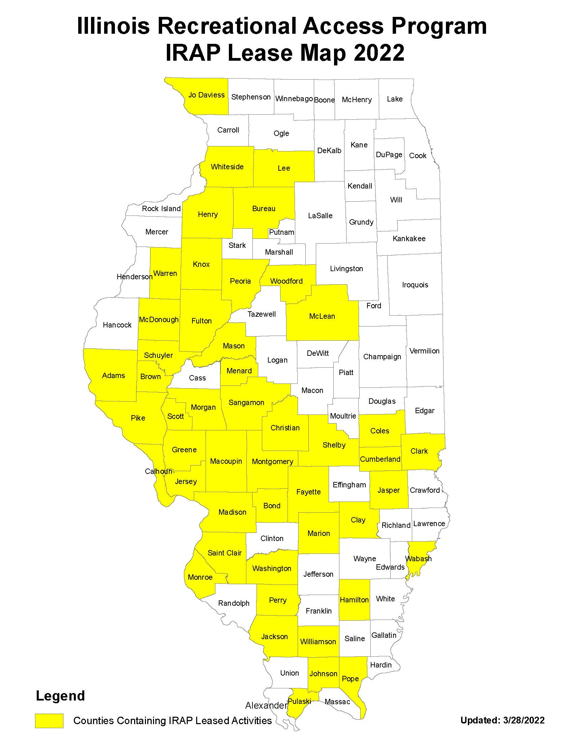
IRAP Expansion Opportunities
Targeting high-demand counties with growth bonuses
Advertising program to CRP, EQIP, and WRP landowners
Promoting the benefits of pollinator planting

Slide 11
Forestry Development

Slide 12
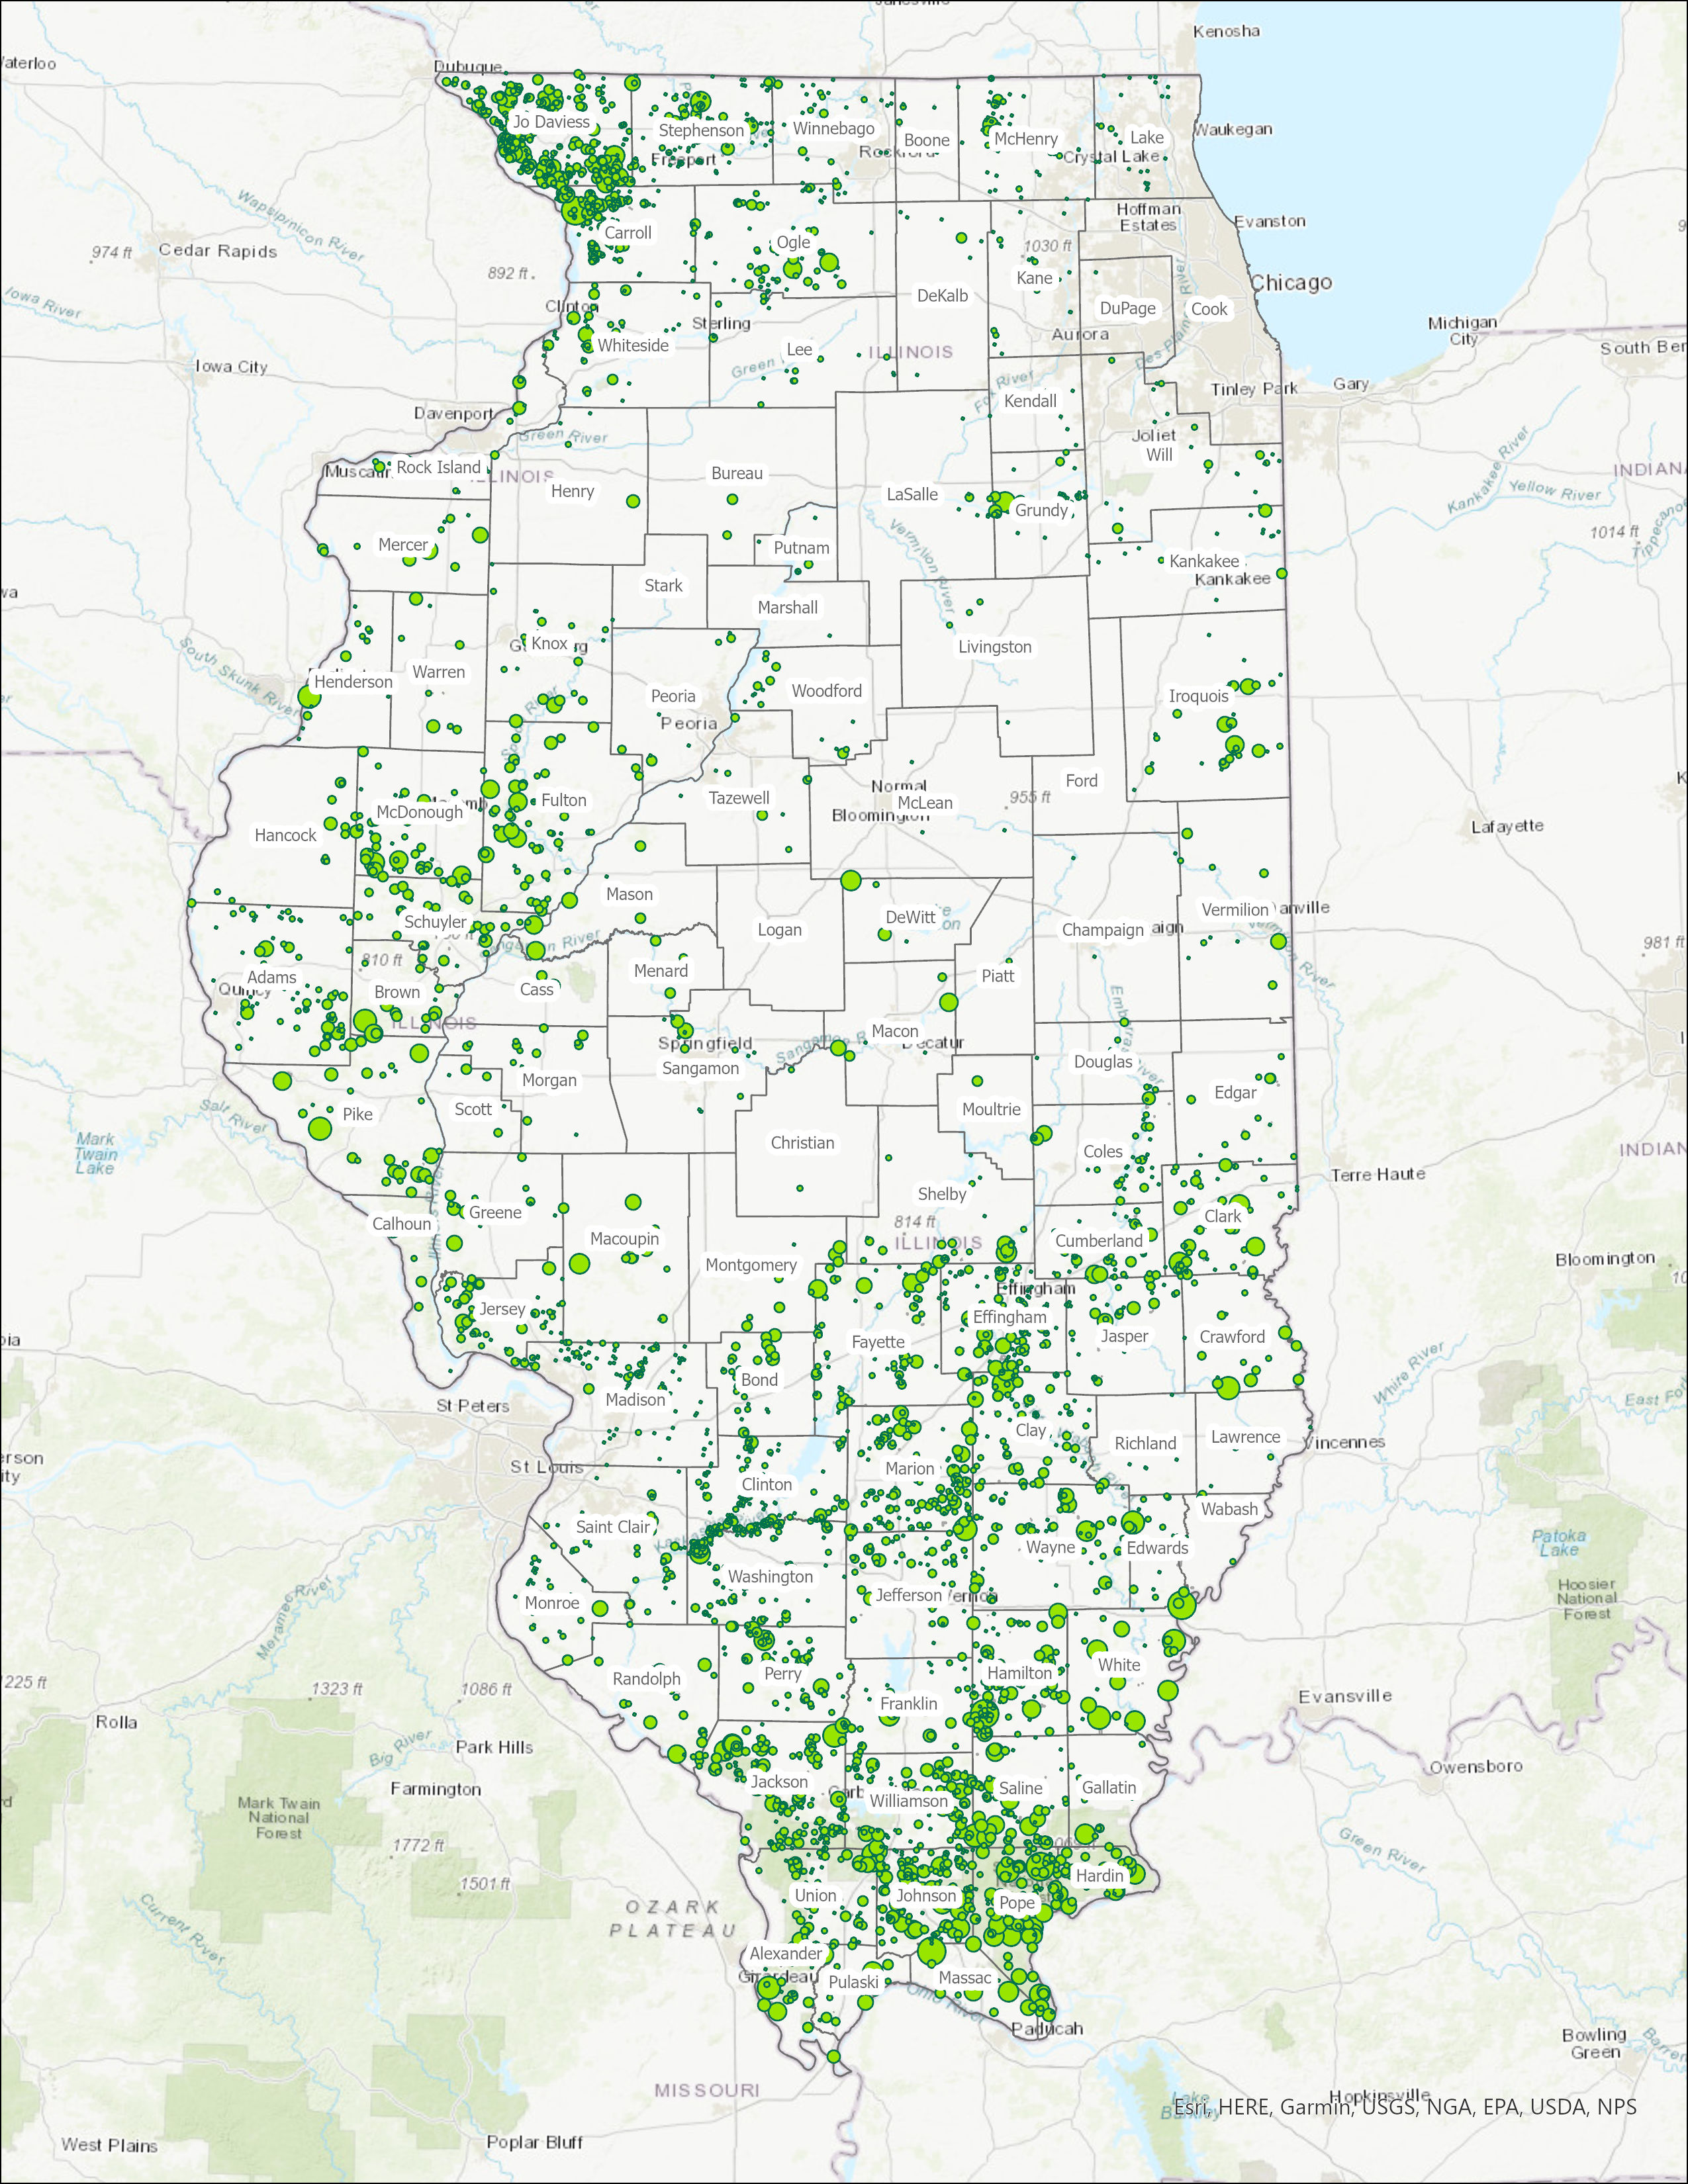
Forestry Cost-Share Program
Private forest owners receive financial and technical assistance with management
timber stand improvement
control of exotic species
wildlife habitat.
Limited only by the number of interested landowners and District Foresters
Nearly 10,000 properties currently enrolled

Slide 13
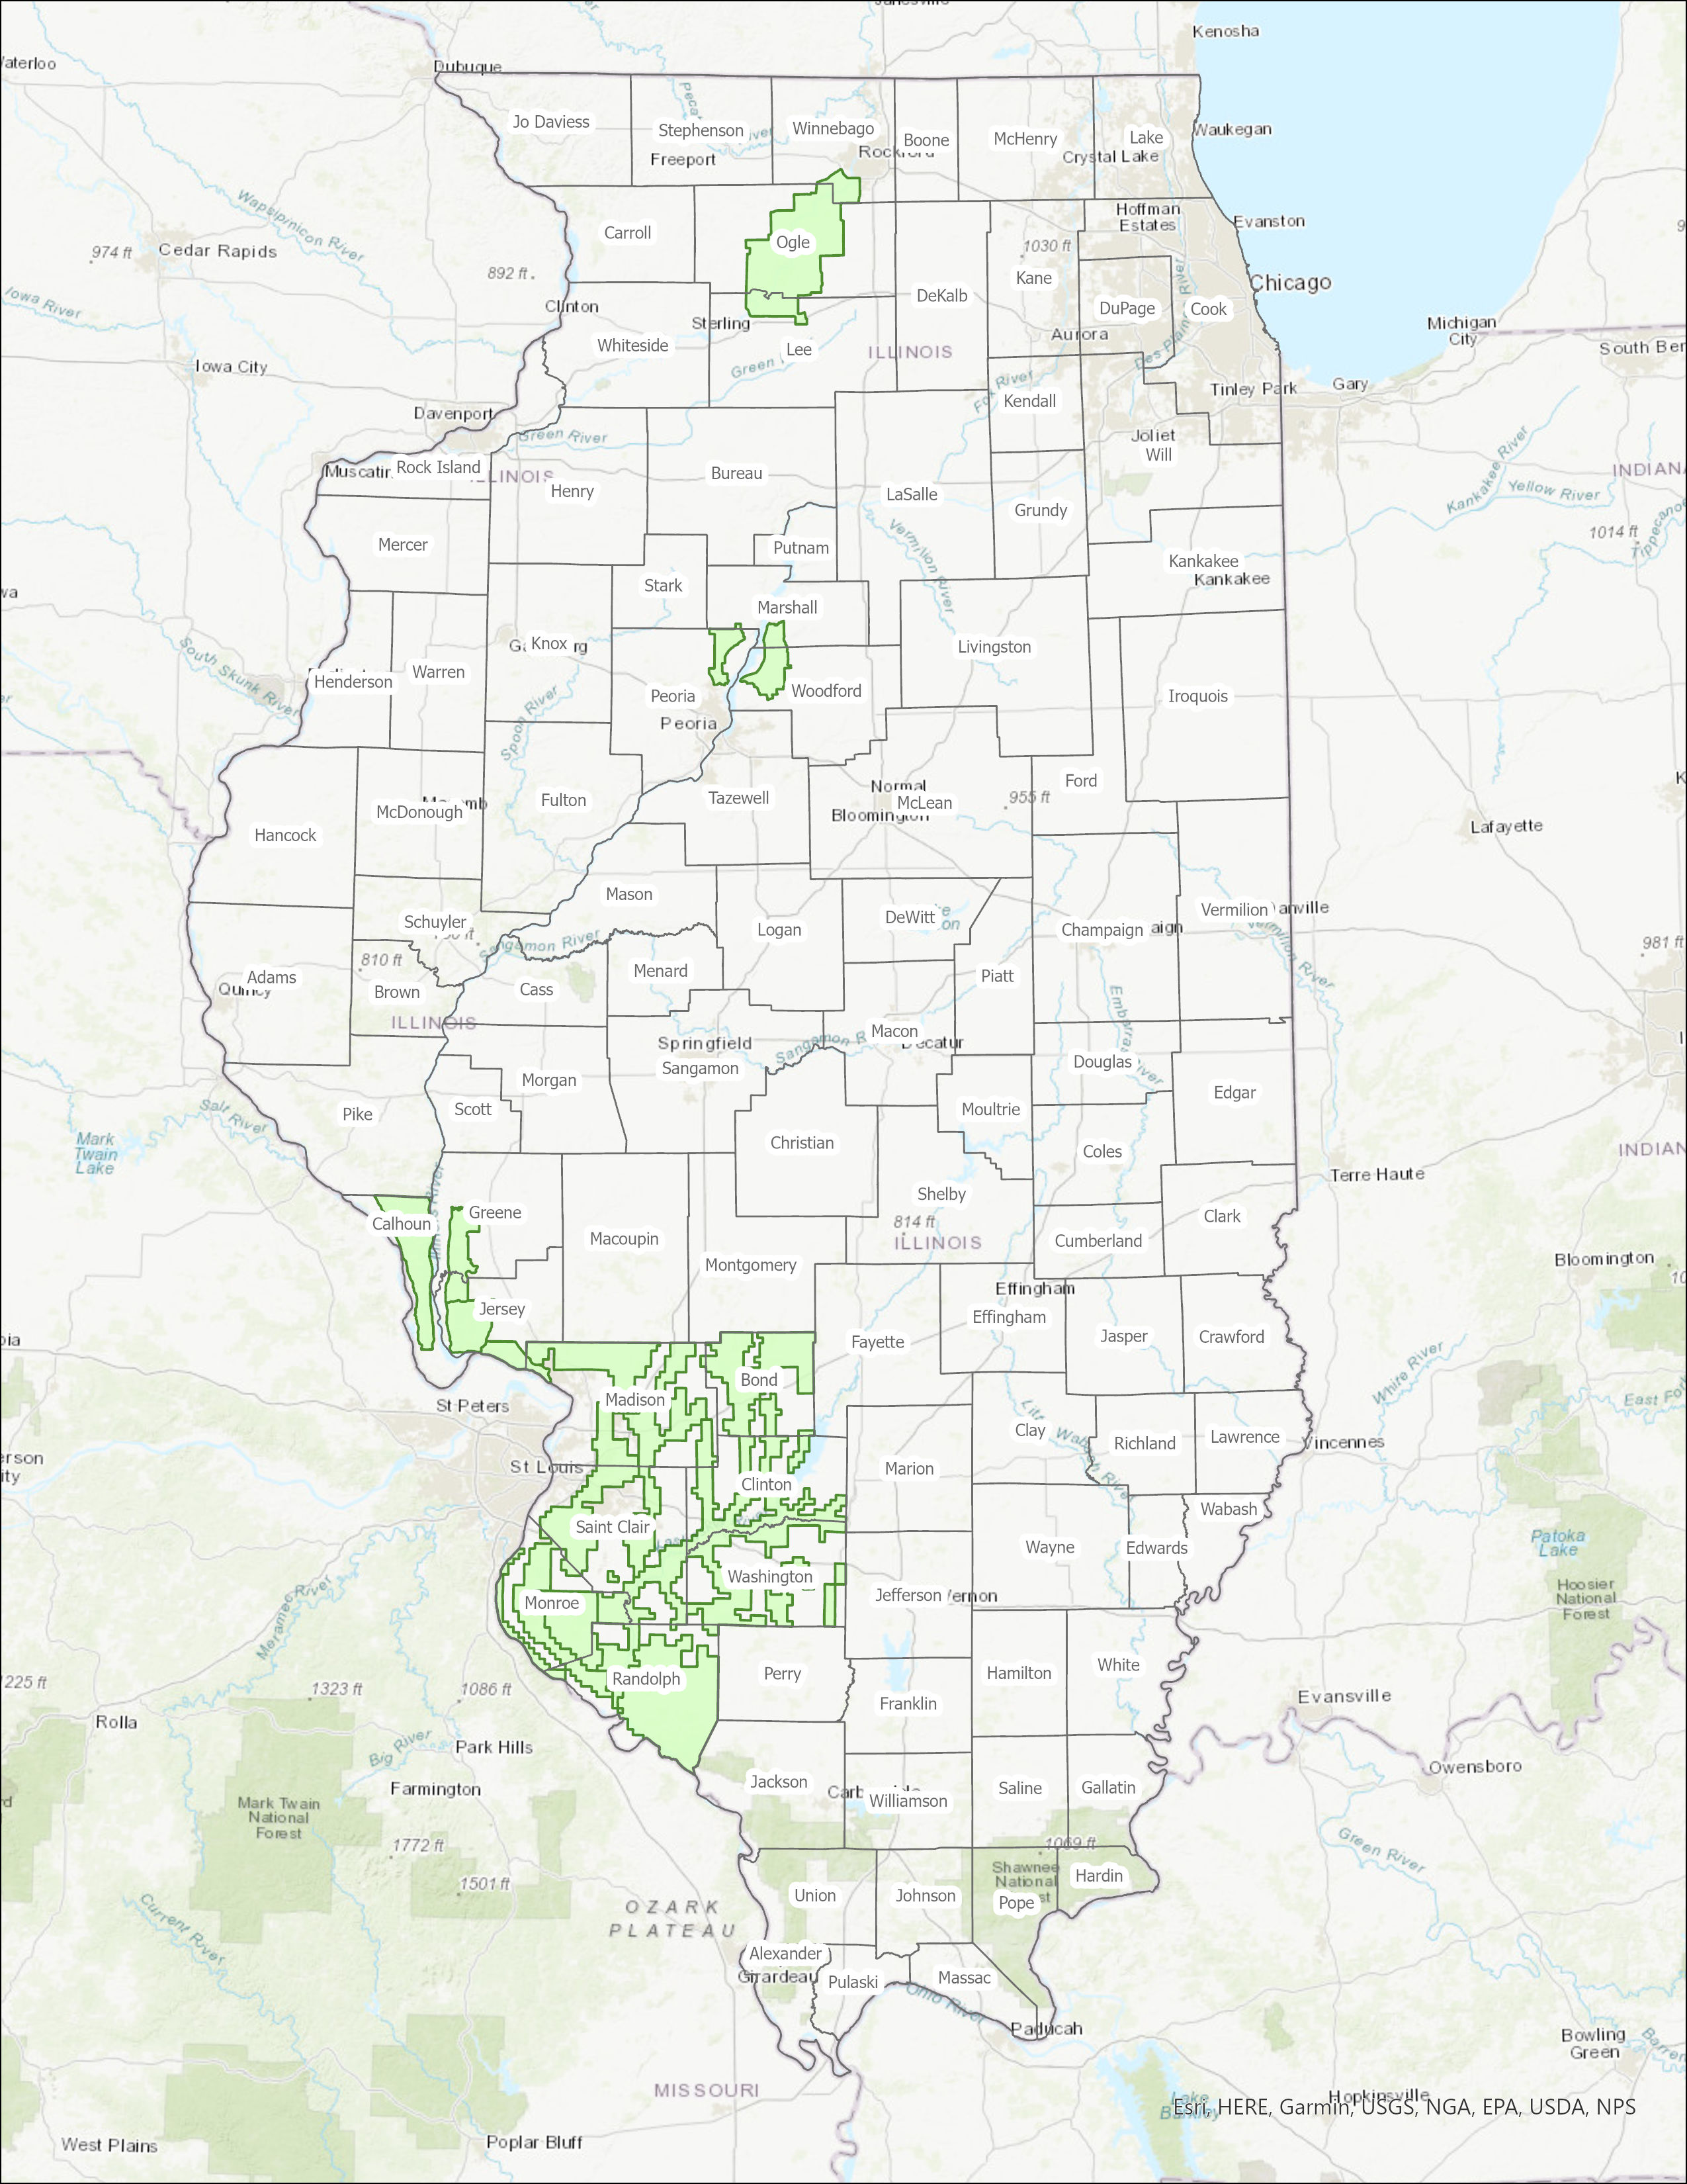
Forestry Legacy Program
Encourages the voluntary protection of privately owned forest lands through conservation easements or land purchases
Recreation
Wildlife habitat,
Timber products.
Administered by the U.S. Forest Service in partnership with State agencies
Currently, there are 3 areas of eligibility in Illinois and 8 properties enrolled.

Slide 14
Illinois Nature Preserves Commission

Slide 15
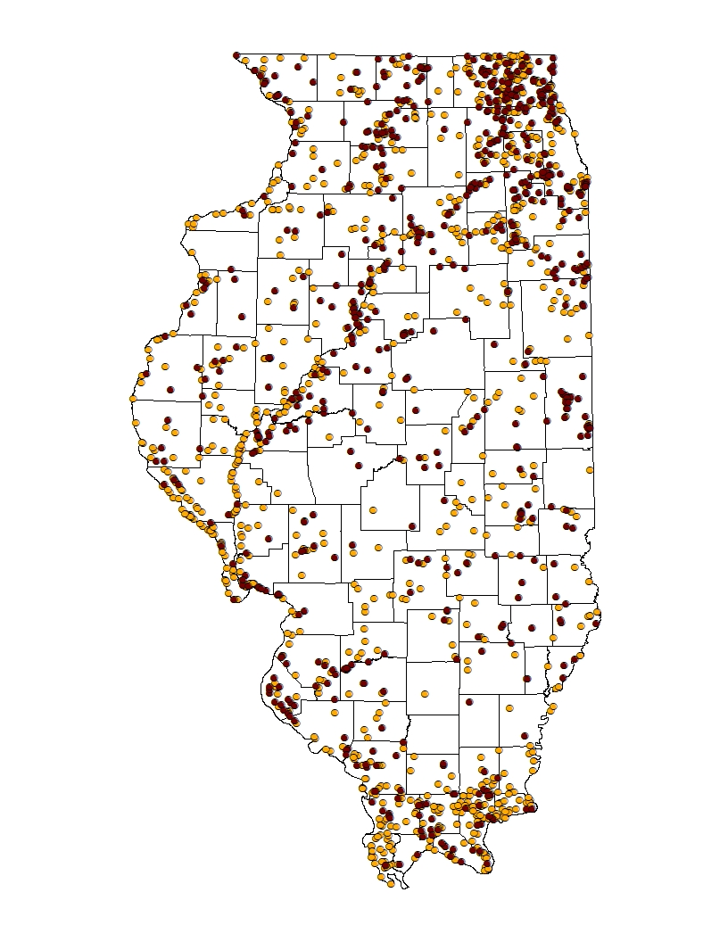
Nature Preserves & Land and Water Reserves
The original INAI work continues….as of February 2022:
1,520 INAIs (shown in tan) totaling approximately 491,110 acres.
618 INAIs with all or portions protected by INPC (shown in brown) totaling 120,996 acres (nature preserves and land & water reserves)
Other INAIs may be protected under conservation easement mechanisms besides INPC programs.

Slide 16
Additional Programs

Slide 17
Encouraging Conservation
Open Space Lands Acquisition and Development: DNR grants to local governments for public parks and open space.
Conservation Stewardship Program: DNR certification of land under a conservation management plan to receive reduced property taxes.
Stream Bank Stabilization and Restoration Program: IDOA program demonstrating effective, inexpensive vegetative and bio-engineering techniques for limiting stream bank erosion and preserving aquatic habitats.
Solar Pollinator Program: IDNR certifies solar sites that meet criteria for providing pollinator habitat at solar facilities.

Slide 18
Sources
Land Use data from
USDA Economic Research Service
Protection and Conservation data from
Illinois Department of Natural Resources
Prairie State Conservation Coalition
Openlands
Protected Planet
USDA Farm Service Agency
Template from
Slides Carnival

Slide 19
Partners for Fish and Wildlife Program
Jason Bleich
U.S. Fish and Wildlife Service
Illinois Private Lands Office

Slide 20
Mission
“Working with others to conserve, protect, and enhance fish, wildlife, and plants and their habitats for the continuing benefit of the American people.”
“To achieve voluntary habitat restoration on private lands through financial and technical assistance for the benefit of Federal Trust Species.”
Migratory birds
T & E species
Native Wildlife Habitat
Biological integrity and environmental health

Slide 21
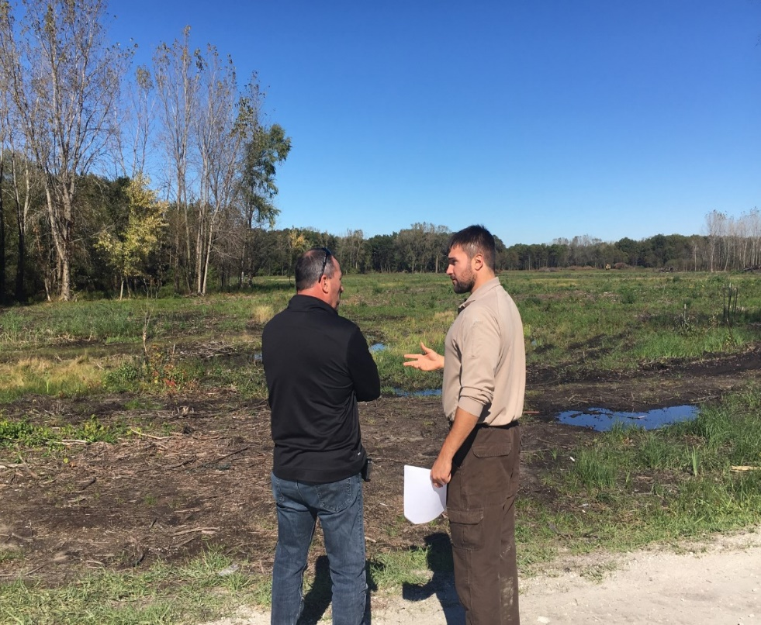
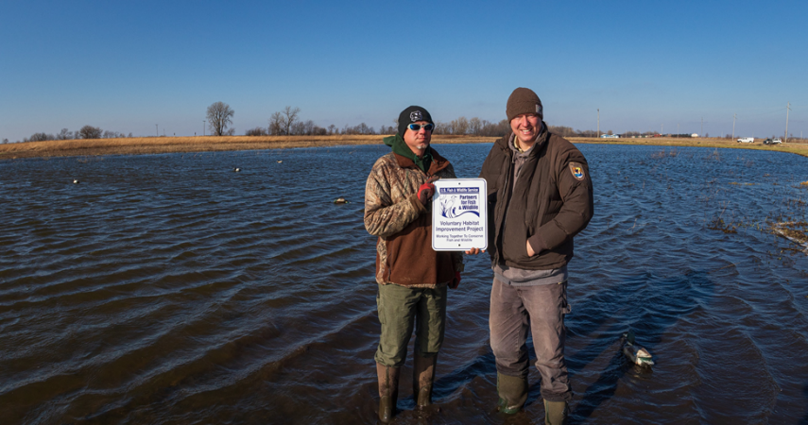
WHO
WHO WE WORK WITH:
Private Landowners
Recreational landowners, farmers, hunters, fishermen, anyone with private land
Municipalities and local groups
Towns, Cities, Counties, Schools
Essentially anyone or any areas outside of federal and state – owned land

Slide 22
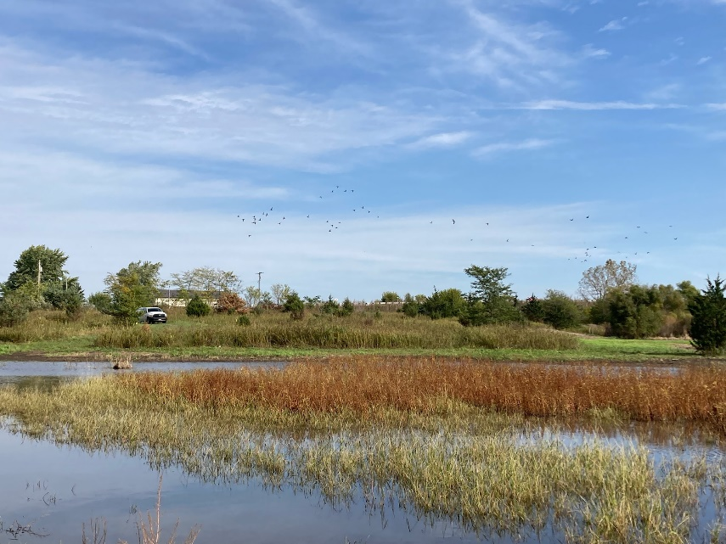
What we do
Habitat Restoration and Enhancement
Prairie Restoration
Wetland Restoration
Oak Savanna
Upland & Bottomland Forest

Slide 23
Where
Statewide
Focus Areas
Illinois River
Mississippi River
North ½ of Illinois
Prairie Pothole Region

Slide 24
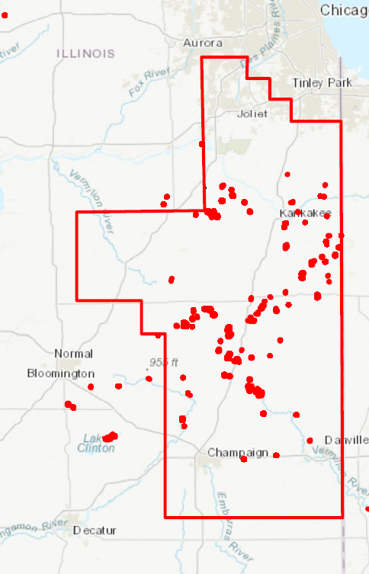

Slide 25
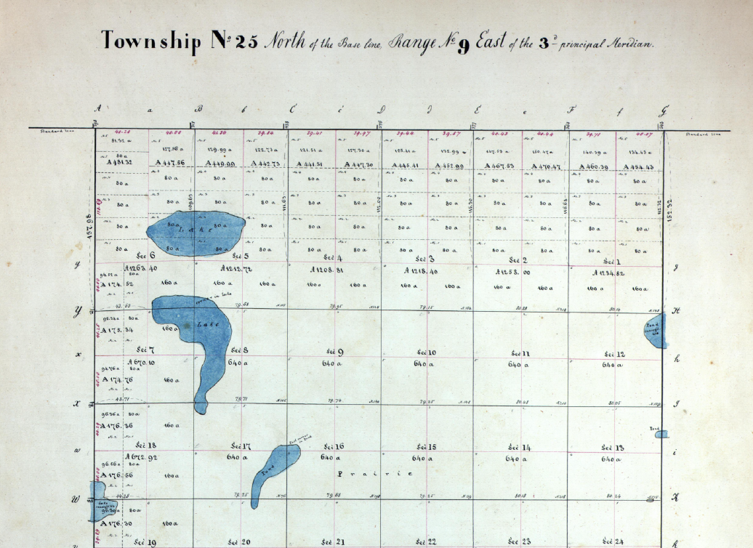
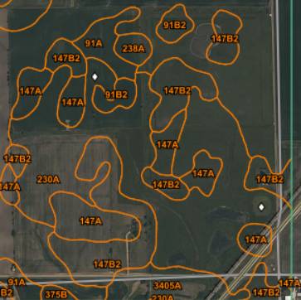
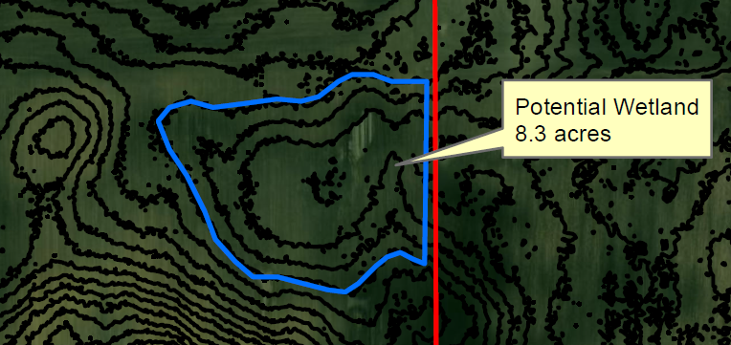
HOW
Aerial Imagery
Historical Imagery
Soils Maps
LiDAR
Topo Surveys

Slide 26
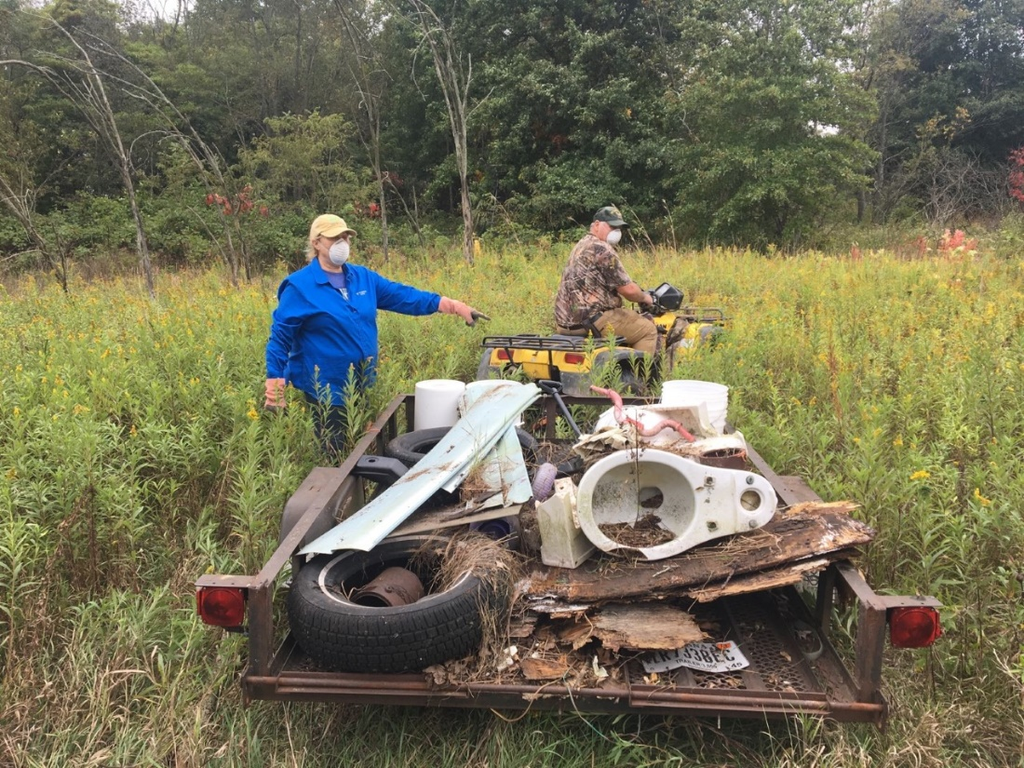
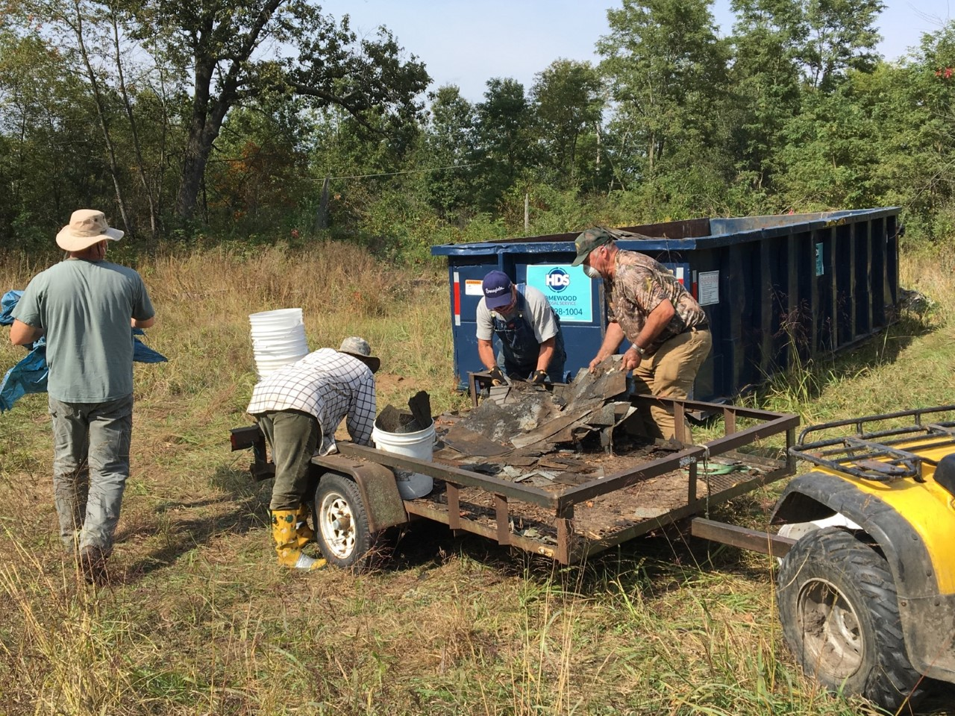
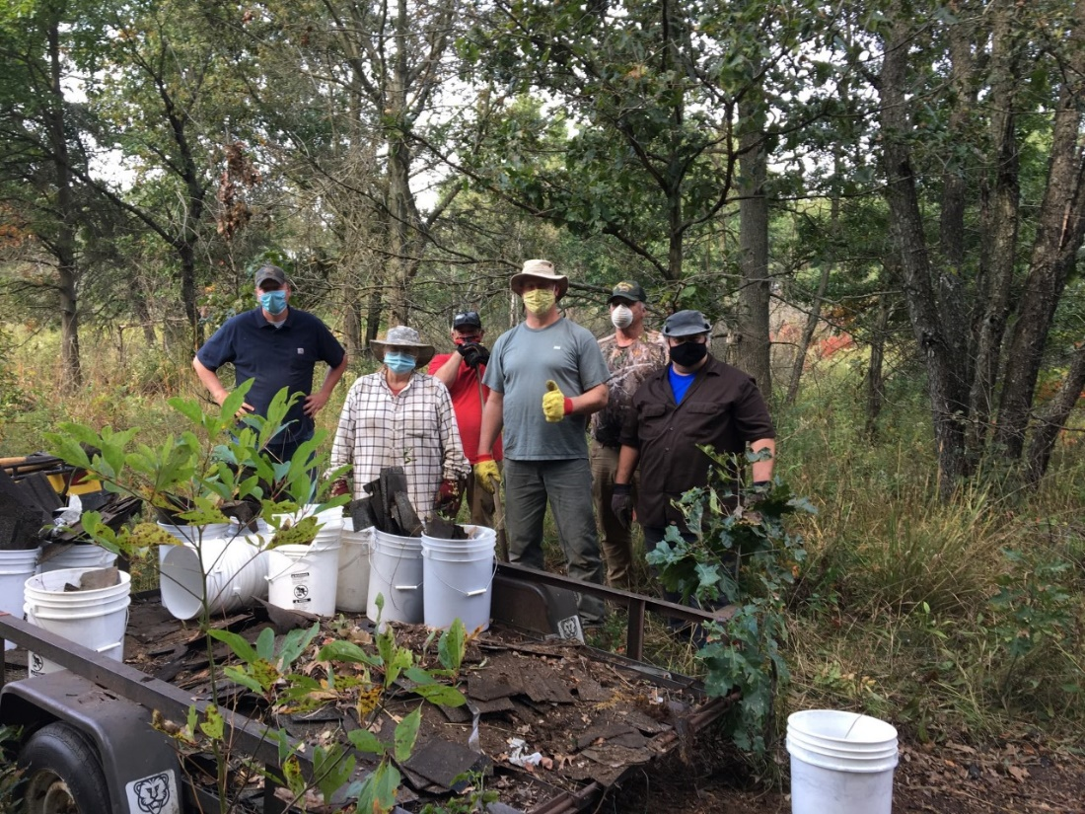
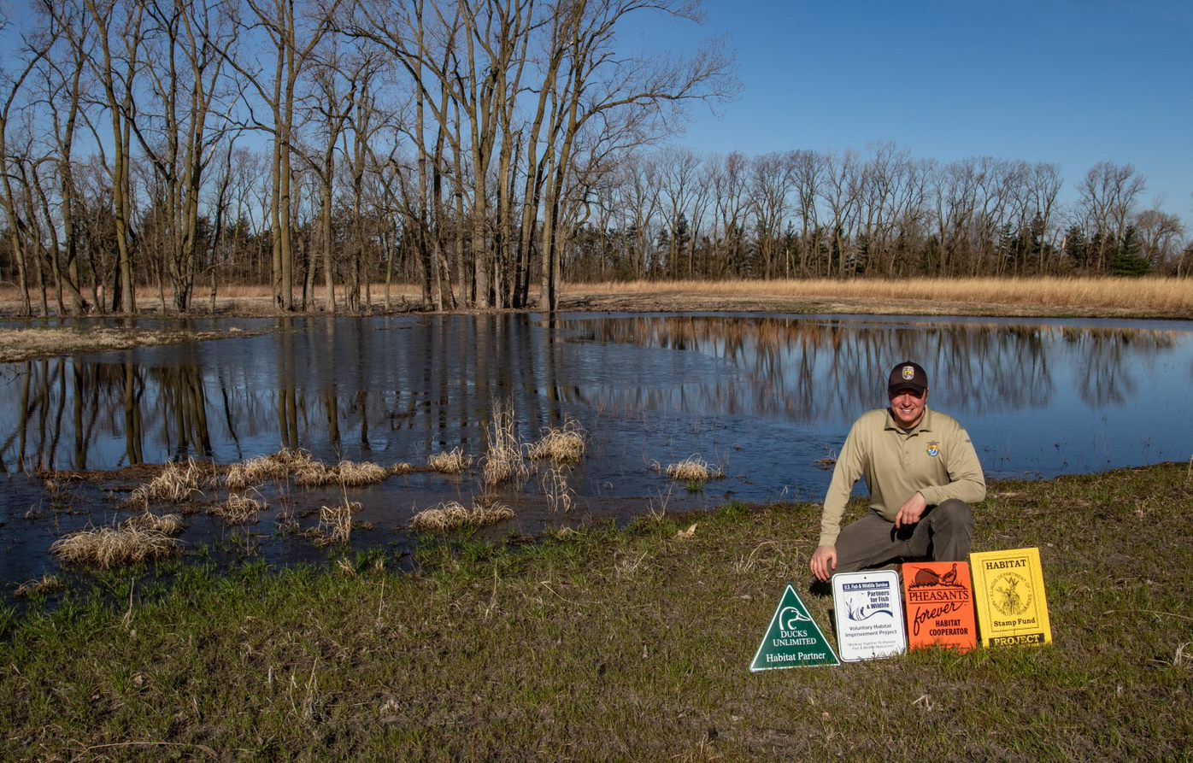
NGOs and Friends Groups

Slide 27
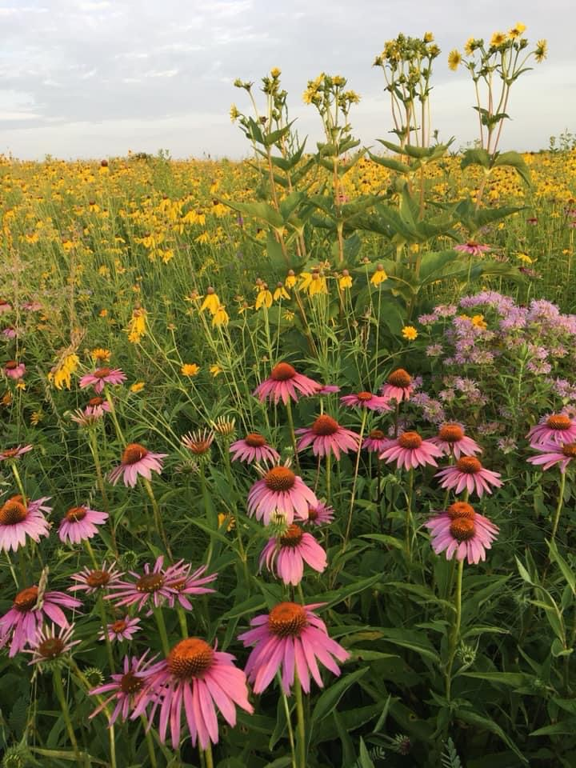
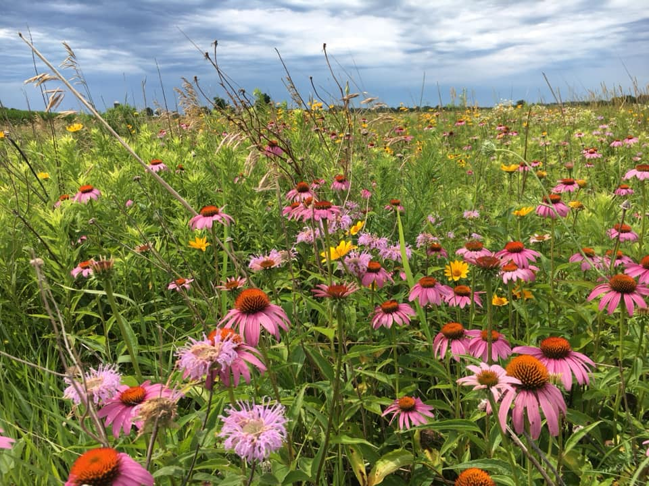
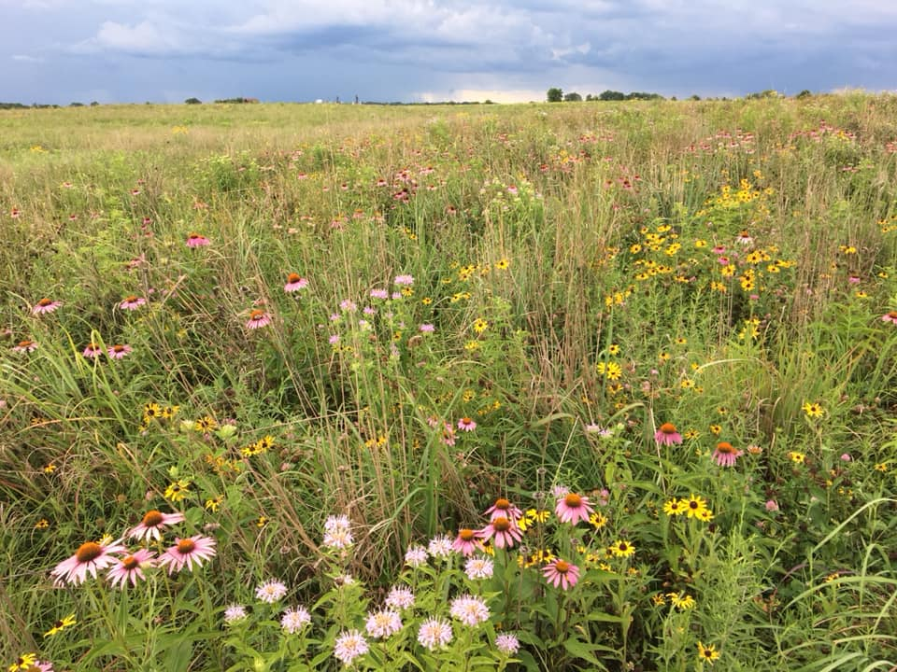
RECENT PROJECTS

Slide 28
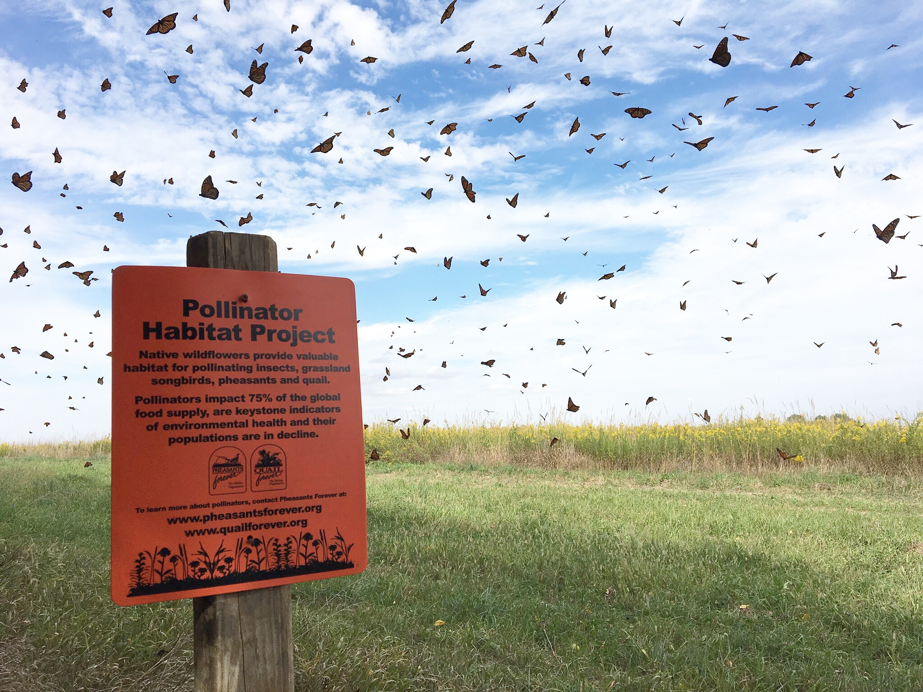

Slide 29
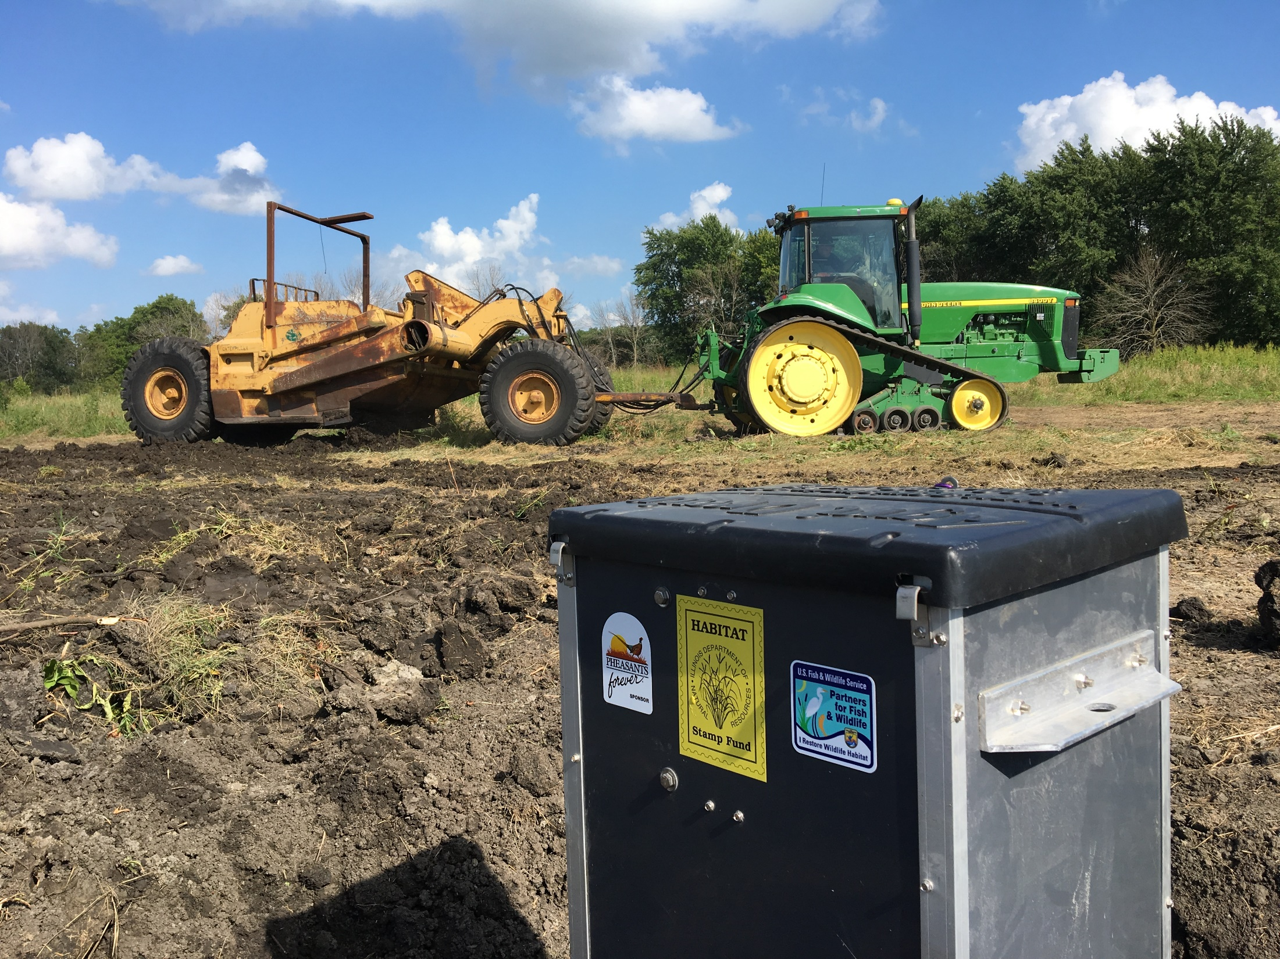

Slide 30
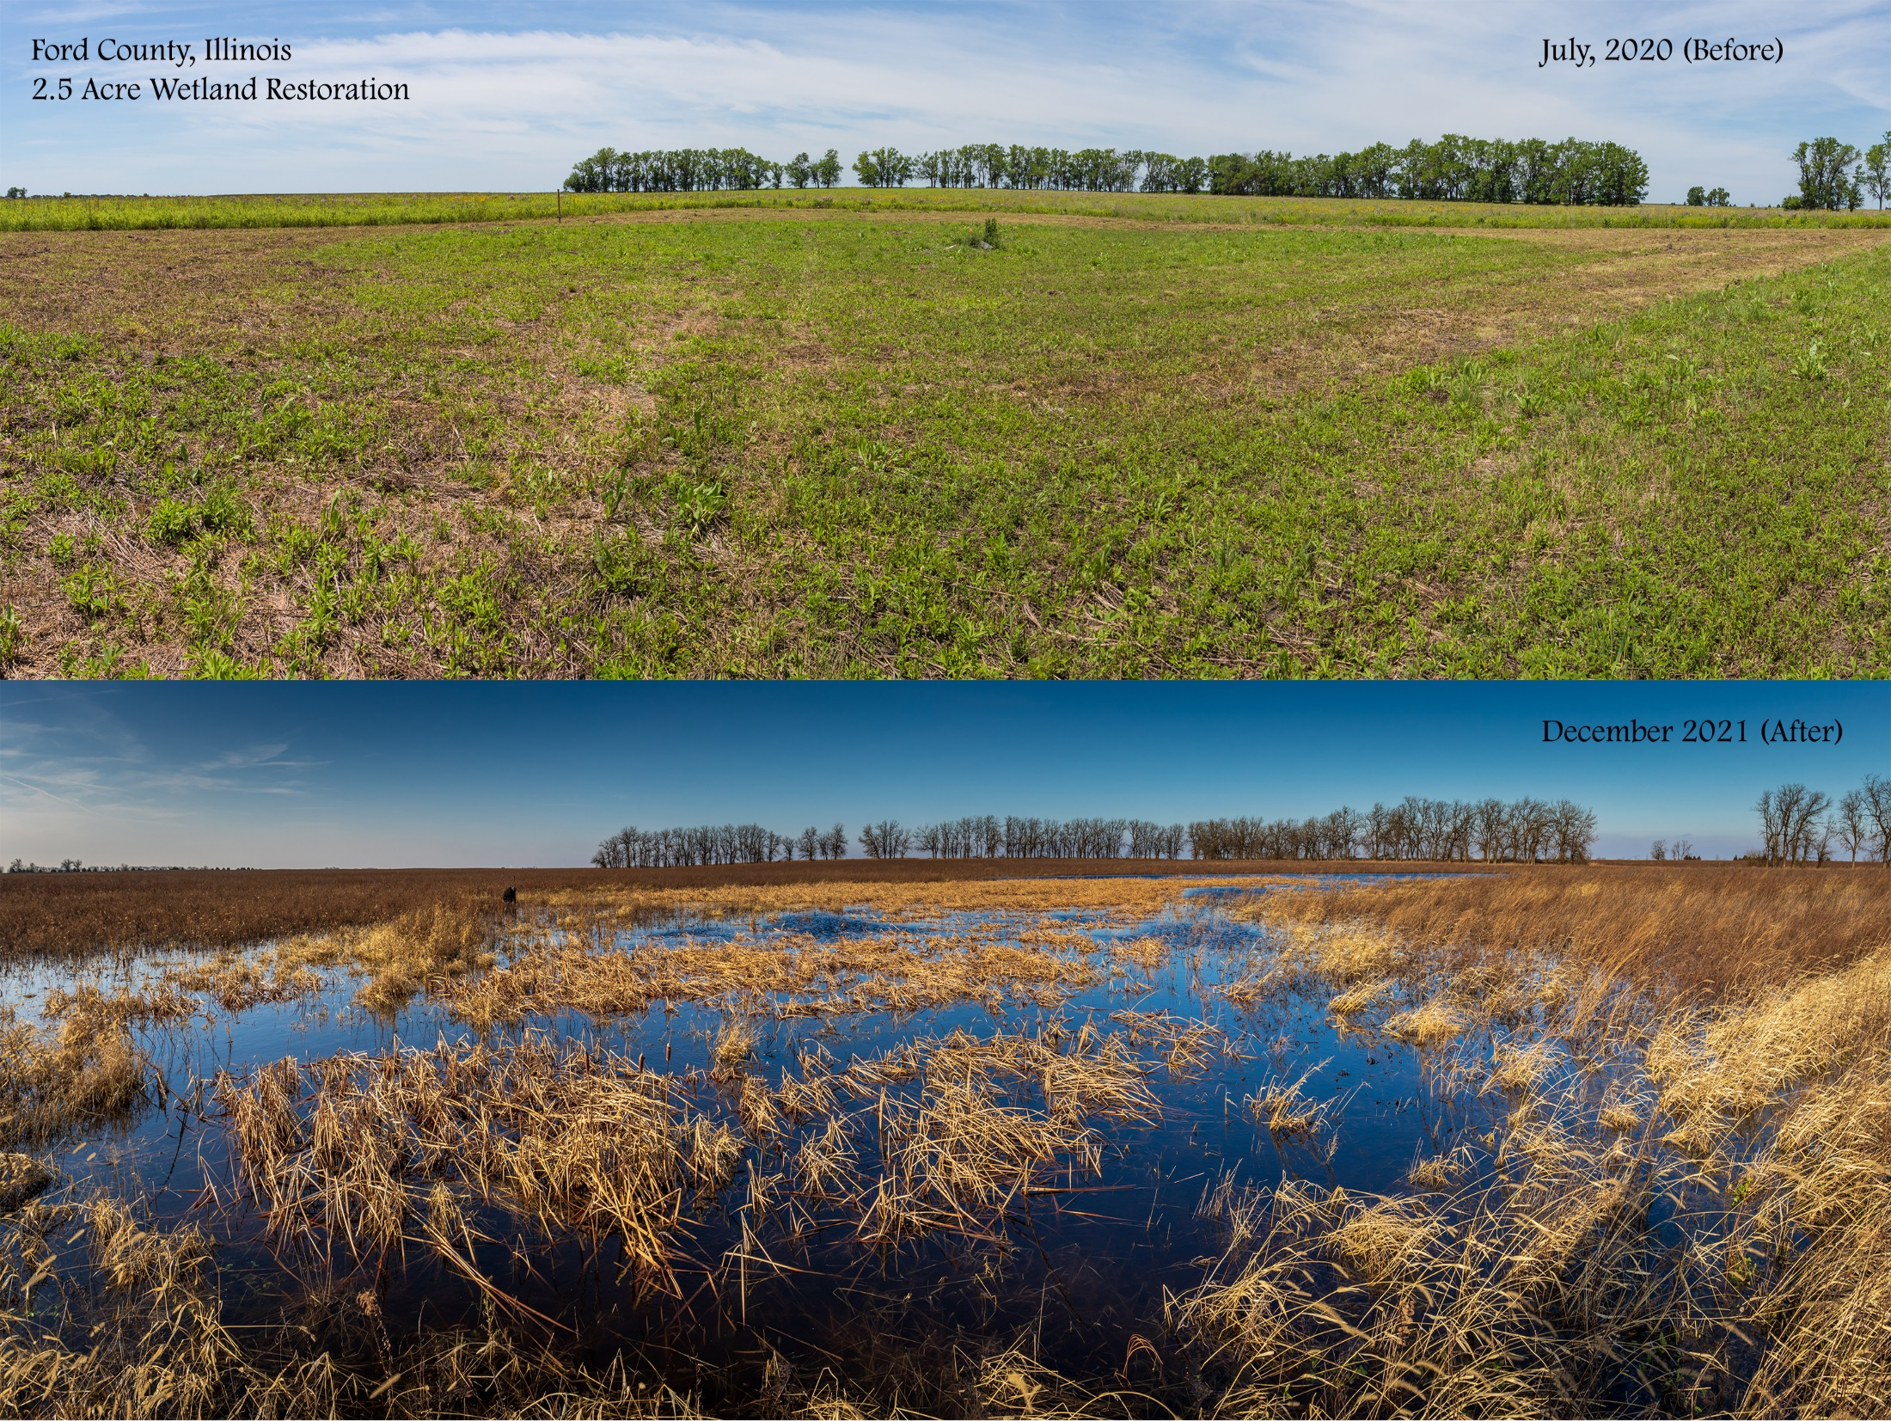

Slide 31
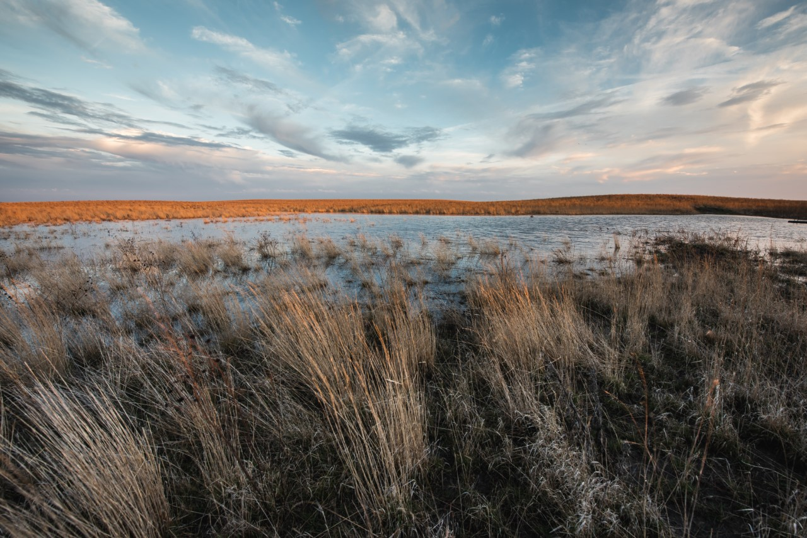

Slide 33
Programmatic Requirements
Reimbursable cost-share
Need some contribution / investment from landowner and other partners
10-year agreements
No minimum / maximum acreage
Constraints
No federal or state-owned property
Projects already receiving federal funding

Slide 34
Questions?
Contact Information:
Jason Bleich – Private Lands Biologist
Cell: (217) 372-7594
Email: jason_bleich@fws.gov
Thank you for your time!

Slide 35
Illinois Department of Transportation
Right of Way Conservation

Slide 37
Prescribed Burning
Mowing Weed/brush Control
Integrated Vegetation Management
Restoration Projects
Selective Herbicides Team Section IVM Plans
12

Slide 38
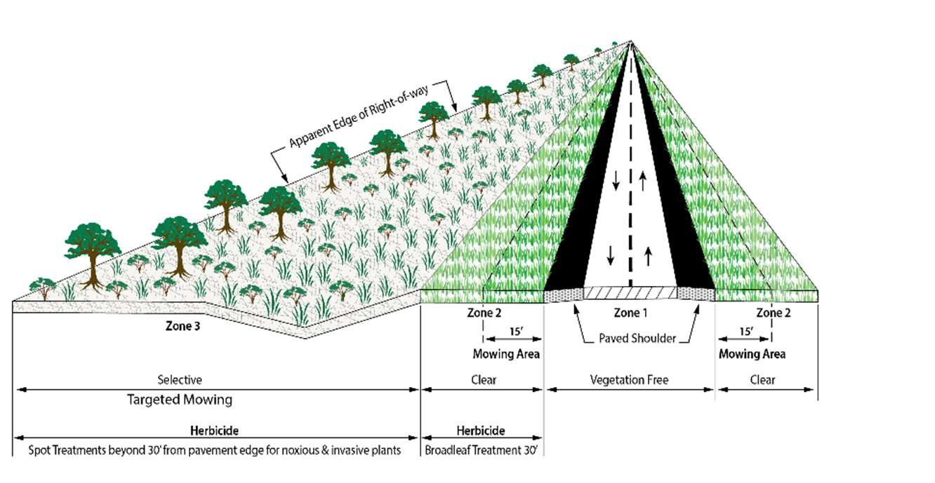
13

Slide 39
Updated mowing policy
M
owing
Created SAVE mowing
It is the Department’s policy to provide wildlife habitat and to preserve and encourage native vegetation on ROW.
14

Slide 40
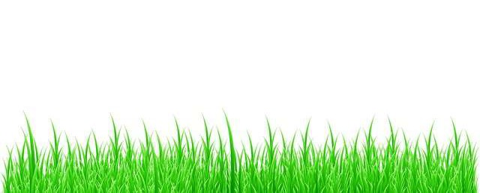
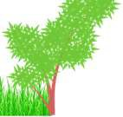
C_{L}
Existing
Access control fence clear of invasive brush. Invasive weeds sprayed.
SAVE Mowing
(Strategically Applied Vegetation Exemption)
Mow Safety Strip
Year One (2022)
Mow safety strip and one pass along fence.
Mow 15 ft.
Mow Safety Strip
Year Two (2023)
Mow safety strip and one pass 15ft. from fence.
Mow 15 ft.
Mow Safety Strip
Year Three (2024)
Leave 30ft. Along fence and mow out remainder.
Mow
17

Slide 41
Early detection of infestations
Weed & Brush Control
Spot treatment of areas
Better, more efficient treatments of infestations
Better, more efficient equipment Cleaning said equipment in between
24

Slide 42
Jason Bleich
40

