Slide 1
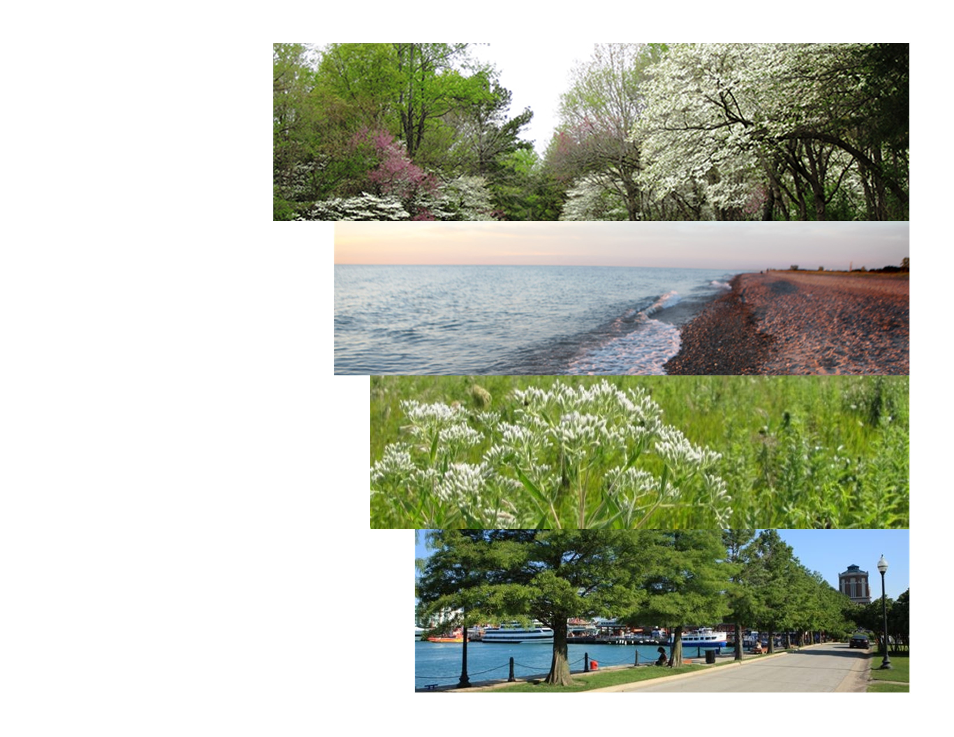
Overview of the 30x30 Initiative

Slide 2
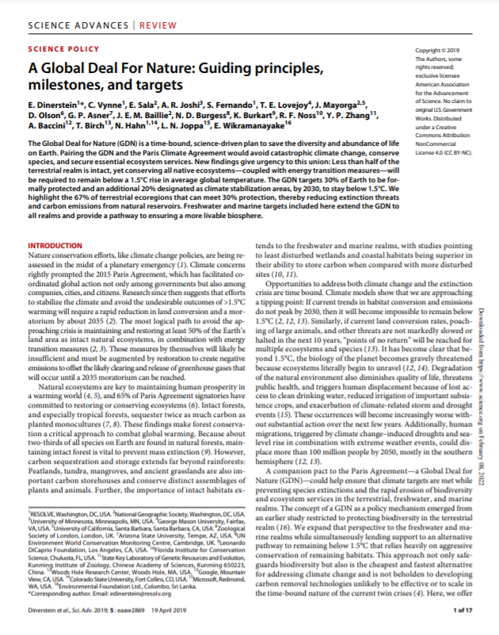
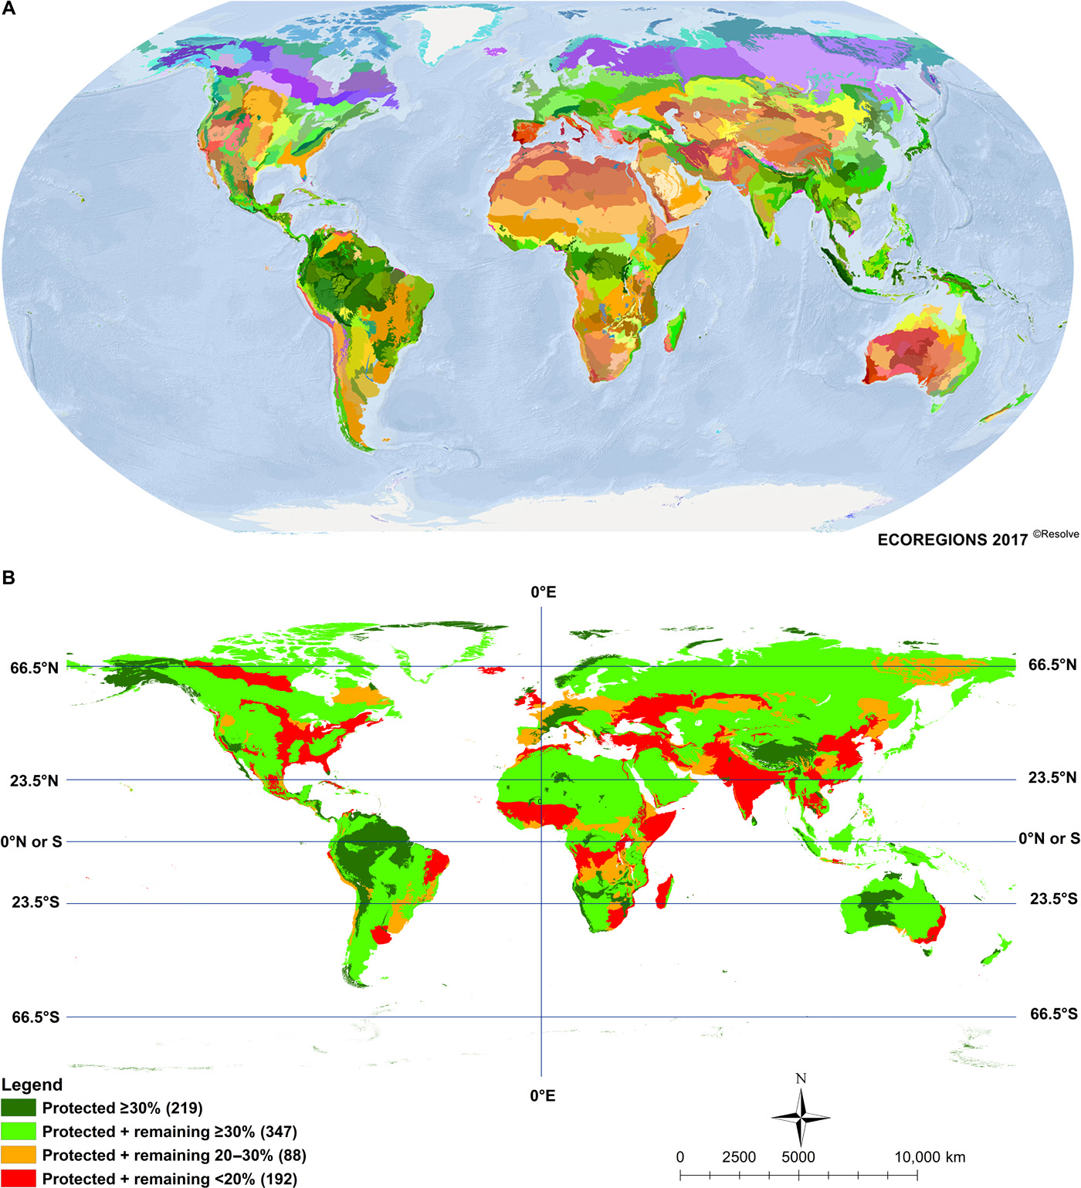
Scientists and Environmental Leaders Call for "Global Deal for Nature" to Protect Half the World's Lands and Seas (Science Advances, 2019)

Slide 3
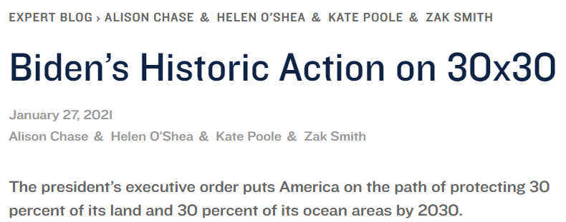
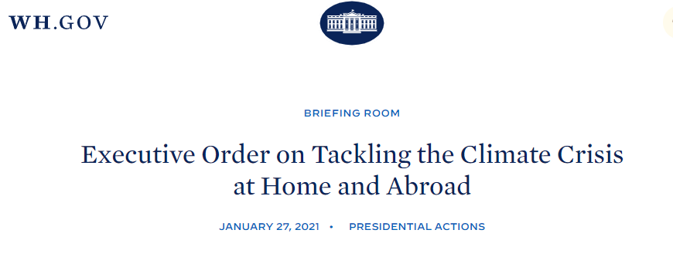
What is 30x30?
America the Beautiful

Slide 4
Conserving and Restoring America the Beautiful: Eight Principles
Pursue a Collaborative and Inclusive Approach to Conservation
Conserve America’s Lands and Waters for the Benefit of All People
Support Locally Led and Locally Designed Conservation Efforts
Honor Tribal Sovereignty; Support Priorities of Tribal Nations
Pursue Conservation and Restoration Approaches that Create Jobs and Support Healthy Communities
Honor Private Property Rights; Support Voluntary Stewardship Efforts of Private Landowners and Fishers
Use Science as a Guide
Build on Existing Tools and Strategies with an Emphasis on Flexibility and Adaptive Approaches

Slide 5
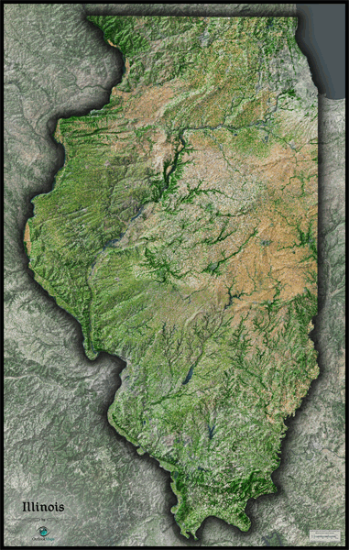

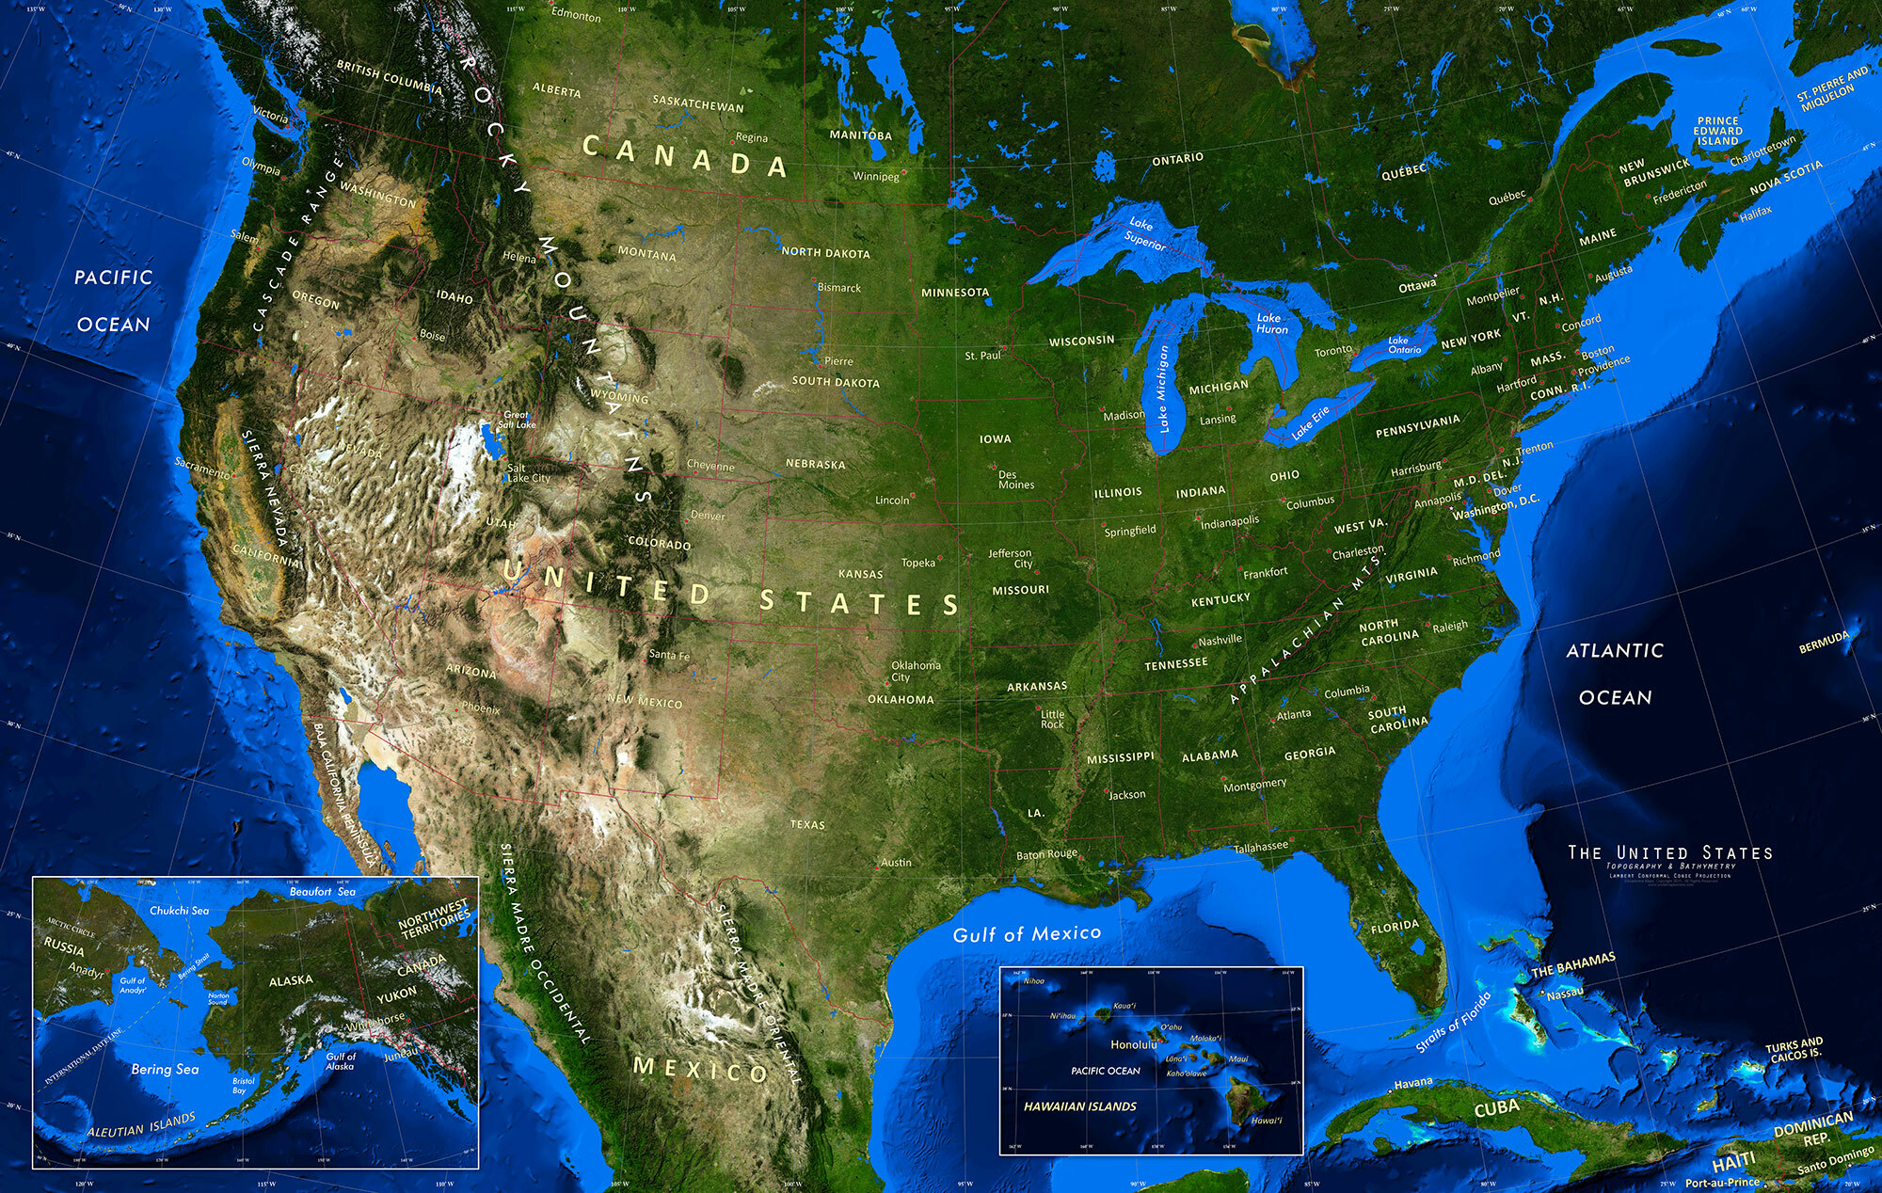

Various Scales

Slide 6
Listening Session Focus Areas
Identify resources that the State has and how they are being utilized to protect land and water resources;
Identify tools, resources, and incentives for landowners and the private sector to restore degraded natural areas and to manage their resources sustainably;
Identify financial resources from the private sector, philanthropy, and public sources to expand protections and to help manage lands and waters for conservation;
The ability of the State to manage more public lands for the benefit of future generations; and
Strategies to conserve and protect 30% of Illinois' land and water by 2030.

Slide 7
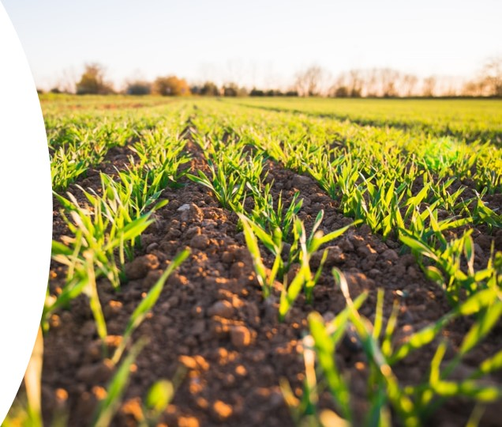
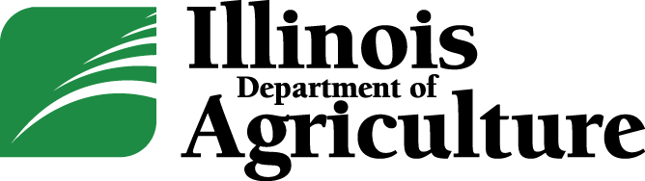
Agricultural Sector Overview
Brian Rennecker, Bureau Chief of Land and Waters

Slide 8

Our Vision
To promote and regulate agriculture in a manner
which encourages
farming and agribusiness while protecting Illinois' consumers and our natural resources.

Slide 9
Our Belief
Agricultural sustainability
rests on the principle that we must meet the needs of the present without compromising the ability of future generations to meet their own needs

Slide 10
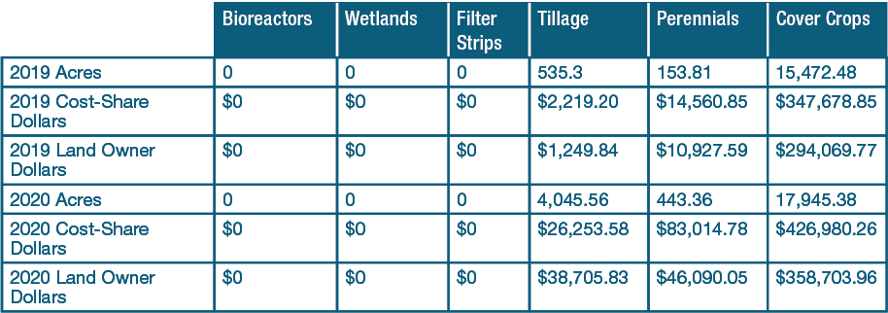
Partners for Conservation
In 2019, the partners for conservation cost-share program targeted $2.89 million in allocations for statewide implementation.
In 2020, it was $2.40 million.
Notes:
The IDOA, in partnership with SWCDs, administers directed programs through the Partners for Conservation cost-share program. PFC encourages increased nutrient management, conservation tillage, and the implementation of cover crops into a crop management regime to slow erosion, improve soil health, enhance water infiltration, smother weeds, control pests and diseases, and increase biodiversity. In 2019, PFC targeted $2.89 million, and in 2020, $2.40 million, in allocations for statewide implementation.

Slide 11
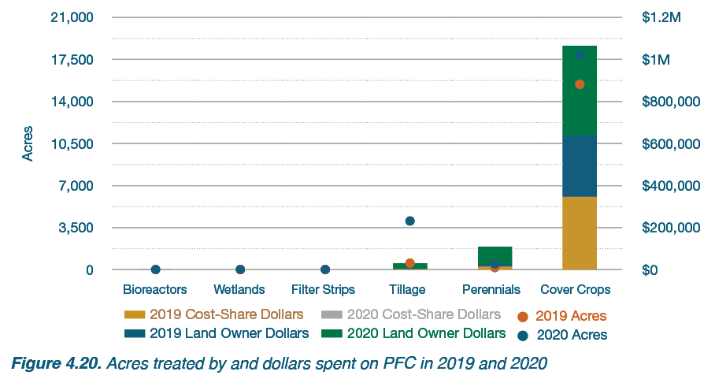
Partners for Conservation
Combined partners for conservation resources from 2019 and 2020 covered approximately 56% of costs
Up from 52% during 2017-18
Remaining paid by applicants or landowners.
Notes:
Combined PFC resources from 2019 and 2020 covered approximately 56% (up from 52% during 2017-18) of conservation adoption costs, with the balance paid by applicants or landowners. Conservation practices that are eligible for PFC cost-share assistance include terraces, grassed waterways, water and sediment control basins, grade stabilization structures, crop residue management, cover crops, and nutrient management plans. From 2019 to 2020, landowners completed 1,925 projects. The most common PFC conservation practice during this time was cover crops

Slide 12
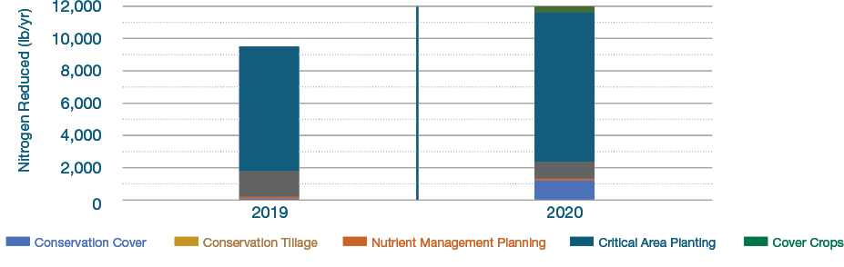
Partners for Conservation
Through PFC and landowner investments & activities soil erosion was maintained or reduced at or below tolerable soil loss on 60,283 cropland acres.
The revised universal soil loss equation indicates that sediment loading was reduced by 20,006 tons — translating to an estimated 1,100 semi-trailer loads of sediment that did not reach Illinois waterways.
Notes:
Through PFC and landowner investments and activities, soil erosion was maintained or reduced at or below tolerable soil loss on 60,283 cropland acres. The Revised Universal Soil Loss Equation indicates that sediment loading was reduced by 20,006 tons — translating to an estimated 1,100 semi-trailer loads of sediment that did not reach Illinois waterways. NEXT SLIDE These conservation practices not only save the sediment from streams, rivers, and waterbodies, they also reduce soil loss in fields via detachment and movement. In the past two years, 67,499 tons of soil were saved. These practices also reduced nutrient loading to streams throughout the state. Focusing on NLRS practices, this reduction is an estimated 21,535 pounds of nitrate-nitrogen and 10,170 pounds of total phosphorus in 2019-20.

Slide 13
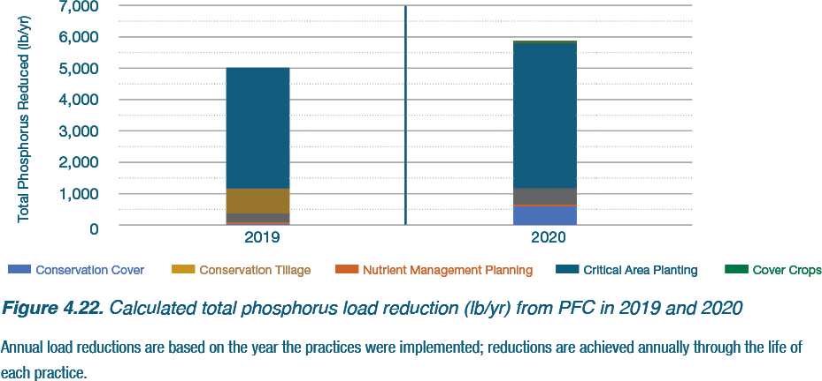
Partners for Conservation
In the past two years, 67,499 tons of soil were saved
These practices also reduced nutrient loading to streams throughout the state by (2019-2020).
21,535 pounds of nitrate-nitrogen
10,170 pounds of phosphorus
Notes:
These conservation practices not only save the sediment from streams, rivers, and waterbodies, they also reduce soil loss in fields via detachment and movement. In the past two years, 67,499 tons of soil were saved. These practices also reduced nutrient loading to streams throughout the state. Focusing on NLRS practices, this reduction is an estimated 21,535 pounds of nitrate-nitrogen and 10,170 pounds of total phosphorus in 2019-20

Slide 14
Fall Covers for Spring Savings
Illinois was the 2nd state to roll out a cover crop incentive-based program, and has funded 150,000 acres of cover crops in the past three application periods
2019: 50K acre program filled in 10 days
  113,000 total acres requested
2020: 50K acre program filled in 10 hours
  185,050 total acres requested
2021: 100K acre program filled in 9 hour
  172,652 total acres requested
Notes:
Fall Covers for Spring Savings is a new program that first rolled out during 2018-19 cropping year. This program allows approved applicants to receive a $5 per acre discount which will be applied toward their crop insurance bill. To be eligible these acres may not be enrolled in any other federal or state program for example (CSP and EQIP). This program is open for 30 days starting in the middle of December and closing in January. Acres availability is on a first come first serve basis.
Fall Covers for Spring Savings each year had an abundance of applications which lead to a very successful application period. During its first year the 50K acres were allocated in the first 10 days. This resulted in a total application request of acres at 113,000. Out of the application period there were application requests from 59 counties. During the 2nd year 2020-21 this application period for the 50k filled in just 10 hours. These applications resulted in a total application request of 185,050 acres. Out of the application period there were applications requests from 87 counties. This last year’s application period which was doubled to 100k acres filled in the first9 hours, which yielded a total acre request of 172,652. Overall data from this application period is still yet to complied.

Slide 15
Looking Ahead
Progress has been made yet much work is still needed
Sustained partnerships are fundamental to long-term impact
Climate change will continue to influence conservation efforts
Notes:
While this report highlights that the sustained effort of the agriculture sector have underscored several vital takeaways making an impact on the states nutrient loss reduction strategies it is still critical that we keep an eye on the amount of nutrients leaving the state to help determine whether current strategy practices are enough to reach reduction goals. Understanding the role climate change and its high-intensity storms play in nutrient loads could help ensure the value of these efforts are not obscured by a wet year like we witnessed in 2019 and even this past year. And knowing that these types of storms will be more frequent gives the state ample time to adapt strategy practices to the changing climate. What we monitored and reported in this report, may not be sufficient in the future. While we can speculate that there will be more climate related impacts on our nutrient loss reduction strategies, we must remember that management strategies that worked in 2019-2020 and today may not be sufficient in years ahead.

Slide 16
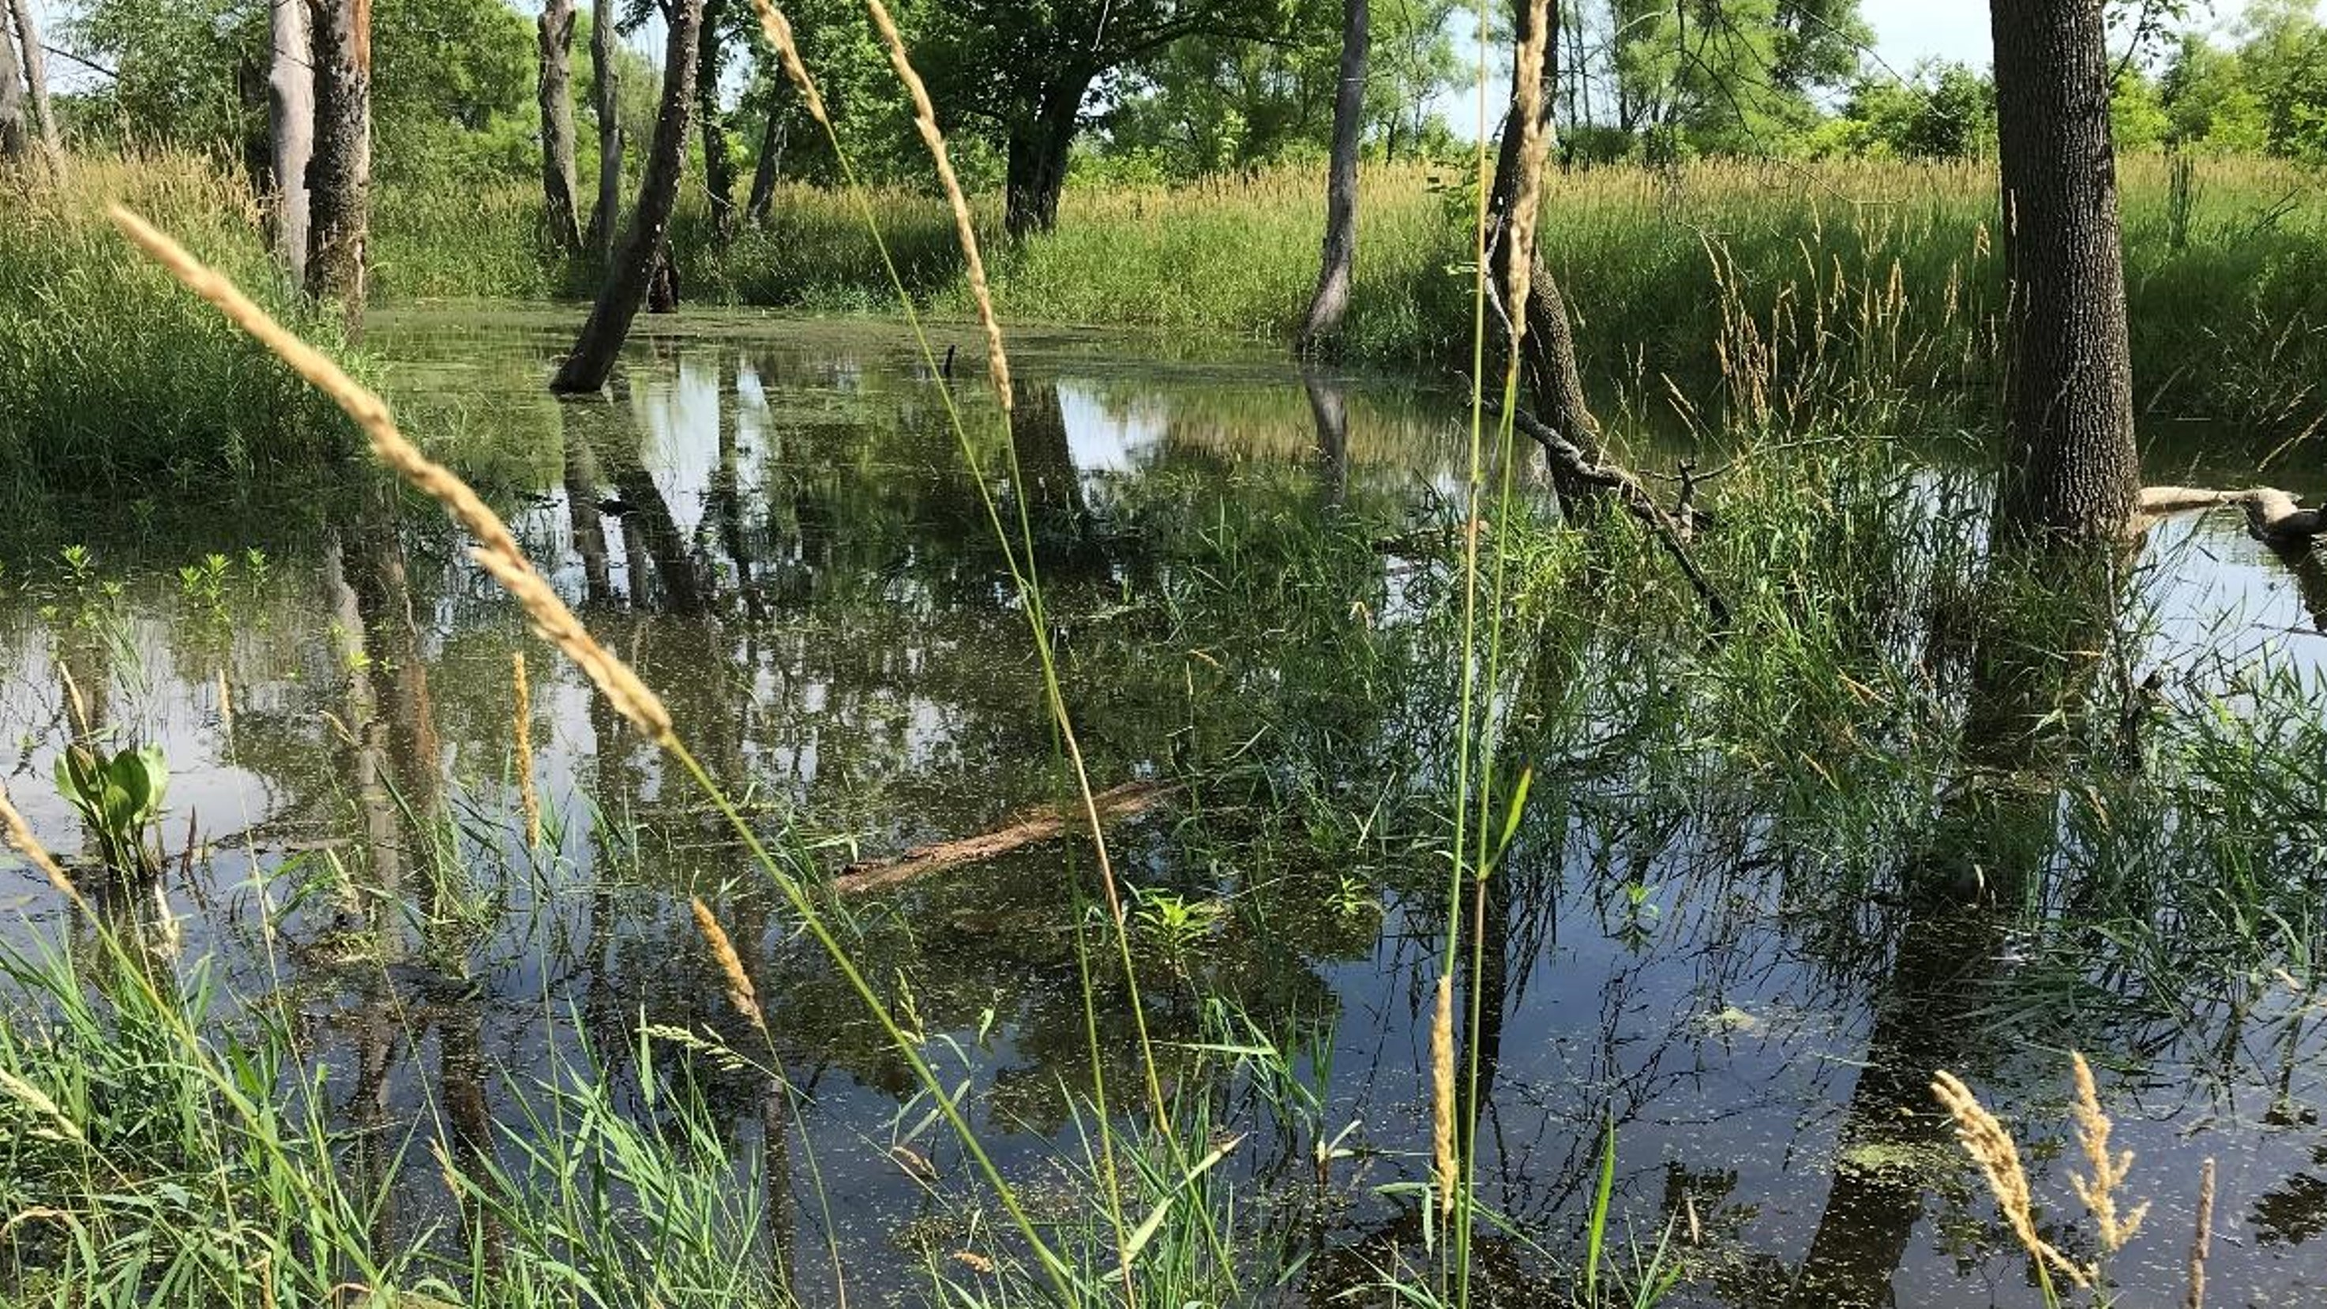

IEPA Ecosystem Programs
Todd Rettig, Deputy Director

Slide 17
IEPA Ecosystem Programs
Traditional conservation of natural systems, biodiversity and ecosystem services involves public ownership of conservation lands with higher ecosystem values.
Conservation and environmental permitting/regulation are separate functions, often housed at separate governmental agencies.
The Illinois EPA does not conserve ecosystems through traditional public ownership of conservation property, instead it funds both private and public projects and activities which are designed to increase ecosystem services, biodiversity and improve natural systems.

Slide 18
Example: Federal Clean Water Act Section 319 Grant Program
Clean Water Act (CWA) Section 319 Nonpoint Source Management Program
  Nonpoint source (NPS) pollution
    rainfall or snowmelt carrying natural and human-made pollutants into lakes, rivers, streams, wetlands, and ground water
    atmospheric deposition and hydrologic modification (unnatural changes to the shape, flow, or biology of streams and other aquatic systems)
  Section 319 funds a wide variety of activities including technical assistance, financial assistance, education, training, technology transfer, demonstration projects and monitoring to assess the success of specific nonpoint source implementation projects.

Slide 19
Environmental Benefits of Section 319 Funding
Annual Pollutant Load Reductions (1990-2018)
1,113,495 lbs Total Nitrogen
499,620 lbs Total Phosphorus
5,592,051 lbs Total Suspended Solids
634,069 tons Sediments
Other Benefits
Local Watershed-Based Planning
In-field and edge-of-field agriculture conservation practices
Streambank and shoreline protection
Wetland creation and restoration
Livestock and pasture management
Tree planting and woodland improvement
Ponds and detention basins
Urban green infrastructure practices

Slide 20
Additional Nonpoint Source Pollution control programs
  IEPA Nonpoint Source Program (319)
  IEPA Green Infrastructure Grants Opportunity Program
  IEPA State Revolving Fund
  IDA Streambank Stabilization and Restoration Program
  IDA Sustainable Agriculture Program
  IDA Soil and Water Conservation Districts
  IDNR Conservation Reserve and Enhancement Program
  IDNR Coastal Grant Program
  NRCS Environmental Quality Incentives Program
  NRCS Conservation Stewardship Program
  NRCS Wetland Reserve Program

Slide 21
319 Program Examples
  Copperas Creek Watershed Project
    Developed locally lead watershed-based plan for Copperas Creek
    Installed streambank stabilization and agricultural best management practices (BMPS) in the Copperas Creek watershed, a tributary of the Mississippi River. BMPs implemented included approximately 2,450 feet of streambank stabilization; 2 acres of filter strips; 3 grade stabilization structures; 3.4 acres of grassed waterways; and 1,365 feet of water and sediment control basins.
  Otter Lake Watershed Plan and TMDL Implementation
    Updated the existing watershed-based plan for the Otter Lake and implemented BMPs to reduce nonpoint source pollution in the Otter Lake watershed. BMPs included 2,413 linear feet of shoreline stabilization, 100 acres of cover crops (50 acres/year for 2 years), 1 water and sediment control basin, 3 ponds, one sediment basin, and wetland restoration.
  Raingarden/Bioswales at Tower Lakes
    Installed 4,971 square foot bioswale (rain garden) restored 0.4 acres of wetland to further absorb and treat the water coming out of the bioswale, and a 7,798 square foot bioswale (rain garden). Construction of the bioswales included excavation, engineered topsoil, and native vegetation.

Slide 22
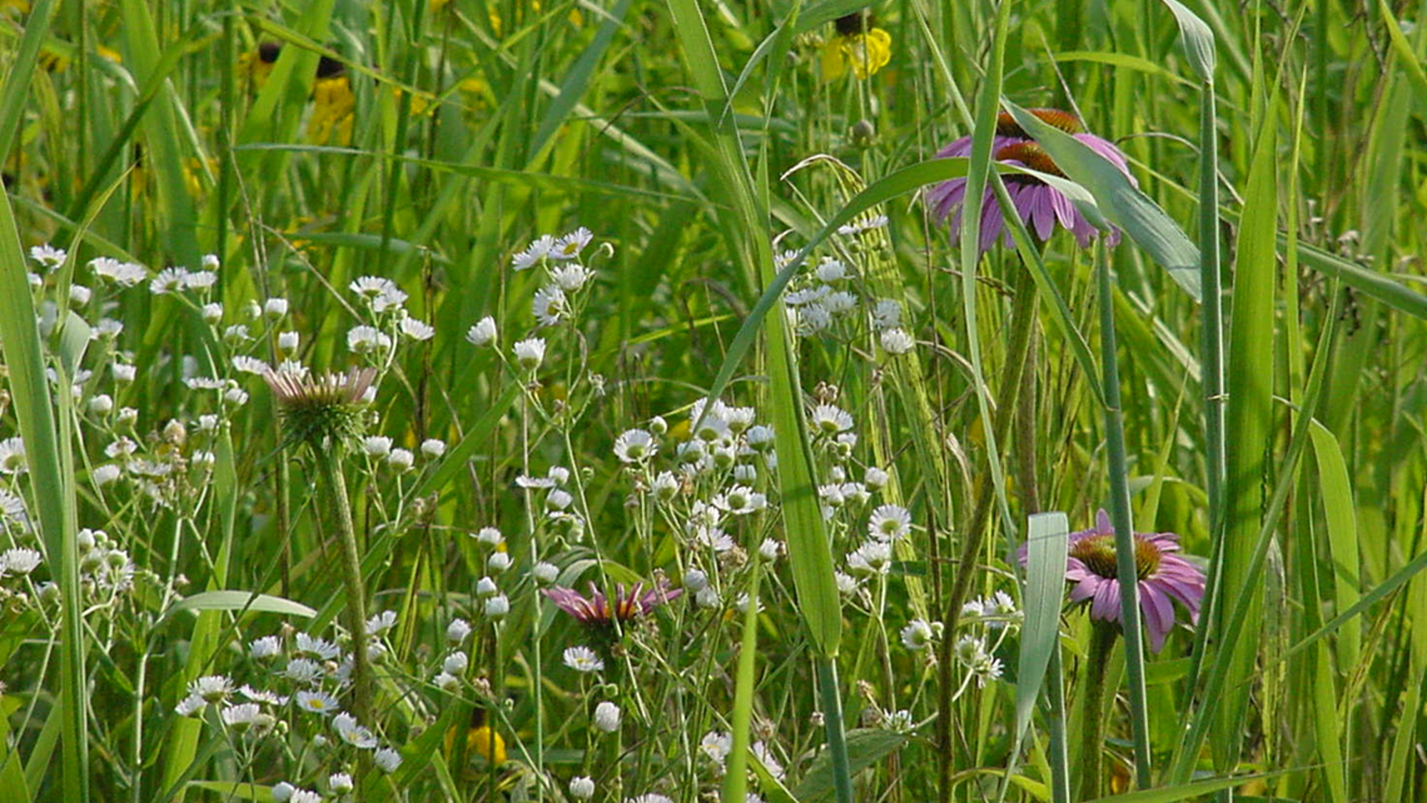

Conservation Reserve Enhancement Program
Michelle Bloomquist, CREP Manager

Slide 23
CREP Goals
Improve Water Quality
  Establish and maintain decreasing long-term trends in annual sediment, nitrogen, and phosphorus loading within the Illinois and Kaskaskia watersheds.
Improve Wildlife Habitat
  Increase the population of avian species of greatest need of conservation, as defined in the Illinois Wildlife Action Plan, on land enrolled in CRP through this CREP by at least 50 percent when compared to similar land managed for agricultural production.
Improve Fish Habitat
  Increase the number of native fish species and environmentally sensitive aquatic insects on average by 15 percent within stream reaches associated with land enrolled in CRP through this CREP when compared to similar streams surrounded by land managed for agricultural production.

Slide 24
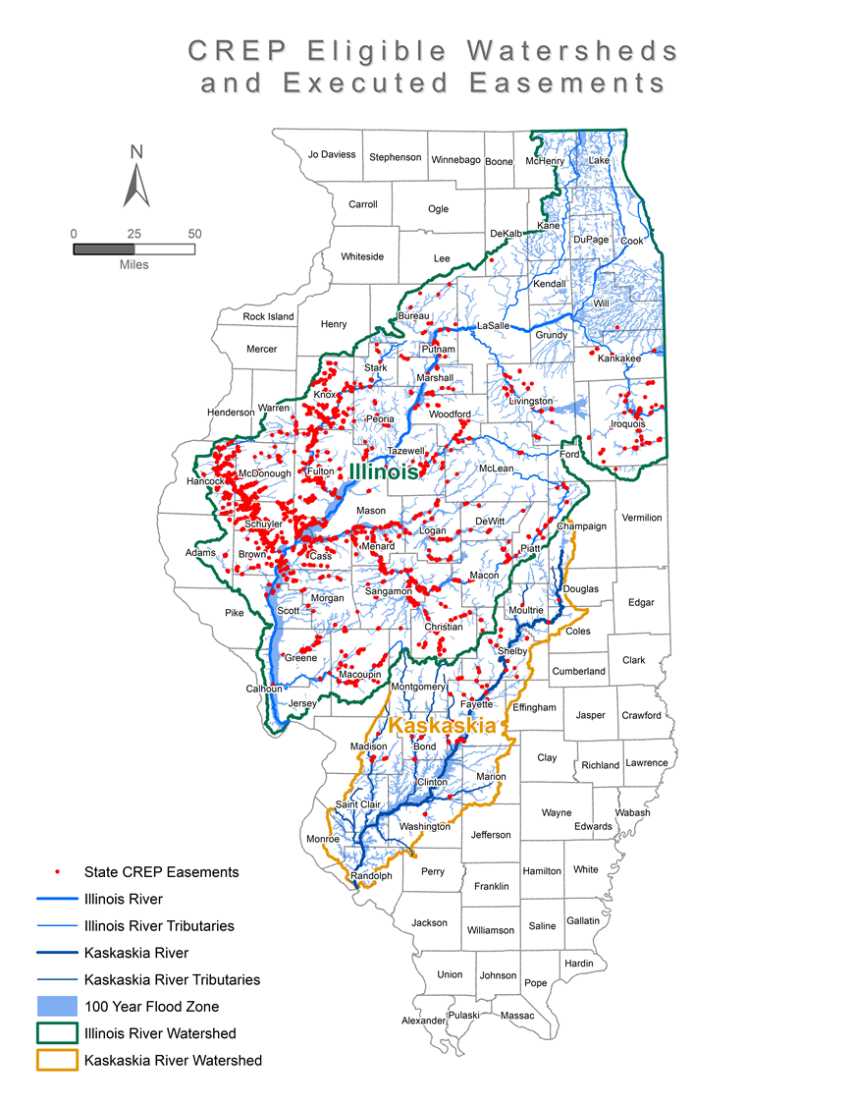
Where is CREP Eligible?
Illinois River watershed
  Enrollment began in 1998
Kaskaskia River watershed
  Enrollment began in 2010
Land located within the 100-year floodplain or a prior wetland outside of the floodplain
Currently 1,324 IL CREP easements, protecting 90,529 acres

Slide 25
The Federal Side of CREP
(Federal CREP)
15-year Federal CREP/CRP contract with FSA on cropland or
marginal pasture
Continuous sign-up period
Enhanced CREP annual rental payment
  25% incentive rate on top of regular CRP soil rental rates
50% cost-share to install conservation practices
All new CREP/CRP contracts must enroll in the State-side of CREP
FSA and NRCS are responsible for establishment and management of the Federal CREP/CRP acres throughout the contract

Slide 26
The State Side of CREP
(Illinois CREP)
Extend and Enhance the conservation benefits provided by the Federal CREP/CRP contract through a conservation easement held by IDNR
Extend - 15-year, 35-year, or perpetual CREP easement (*this may change)
  Timing begins after the Federal CREP/CRP contract ends
Enhance - “Additional Acres” enrolled with the easement
  Land contiguous to the Federal CREP/CRP contract acres, that contribute to the CREP goals
Easement payment to the landowner is a one-time, lump-sum payment after the easement is executed
  Based on the soil rental rate
  Permanent easement = # acres x SRR x 15 years x 30% (*this may change)
    Example: 100 acres x $200 SRR x 15 x 30% = $90,000
IDNR pays the remaining 50% cost-share for conservation practice installation on the Federal CREP acres

Slide 27
Soil and Water Conservation Districts and CREP
SWCDs have been the driving force for CREP at a local level for
over 20 years. Without the assistance of the SWCDs CREP could not exist!
  Perform enrollment
  Conduct monitoring
  Assist with management of existing easements
  Provide a local contact for their CREP landowners

Slide 28
IL CREP Conservation Easements
Easements run with the land, recorded at the County Courthouse
Landowner retains recreational rights to hunt, fish, temporarily camp, etc.
Restricts agricultural use and development
Public access is not required but can be allowed
IDNR and the SWCD work as a team to advise and guide the landowner towards their land management goals on expired Federal CREP/CRP acreage and additional acres.

Slide 29
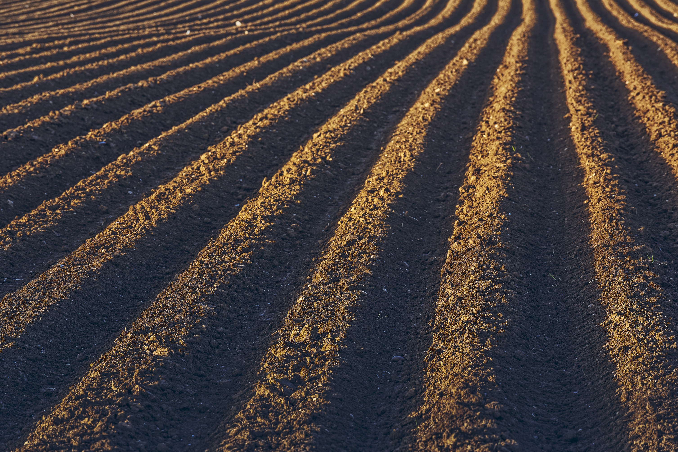
Agricultural Lease Program
Bob Caveny, Farm Program Manager

Slide 30
State Lands
IDNR has 186 Public areas with over 475,000 acres owned by IDNR, and an additional 450,000 managed
IDNR owns ~35,000 acres of tillable acreage (Currently farmed or in CRP)
Tenants help manage many of our parks.

Slide 31
IDNR Agricultural Lands
The leases developed under this program will promote ecologically-sound agricultural practices to improve soil health, minimize soil erosion, improve water quality, and reduce chemical impacts to benefit wildlife populations and their habitats.
IDNR recognizes its responsibility to be a leader in conservation agriculture and strives to develop an agricultural lease program to be used as models for producers throughout the state.
Income generated from agricultural leases supports enhancement or establishment of wildlife habitat and recreational opportunities.

Slide 32
Crop Planning
IDNR develops cropping plans with site staff and local biologists.
Cover Crops are encouraged and will be gradually added to most sites cropping plans over the next few years.
The IDNR is looking to move towards a cover crop/reduced tillage (Strip/Vertical) rotation to build soil health, reduce erosion, and improve water quality. We also will evaluate the use of different cover crop mixes not only to improve soil health but create suitable overwintering habitat for a variety of wildlife species.

Slide 33
Protecting Natural Communities
No neonic treated soybeans are allowed on IDNR sites.
No foliar application of neonics or dicamba allowed on IDNR sites.
No fall tillage (w/o written permission) or fall Nitrogen applications.
Vertical tillage allowed to incorporate some of the residue or cover crop seed.
IDNR collecting soil samples to monitor soil health.
Date restrictions on hay leases for nesting.

Slide 34
Public Comment

Slide 35
CLEAN WATER, HEALTHY SOILS.

Slide 36
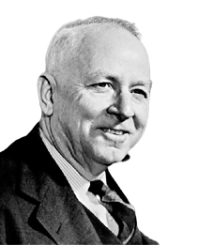











QUOTE OF NOTE
From every conceivable angle - economic, social, cultural, public health, national defense - the conservation of natural resources is an objective on which all should agree.
HUGH HAMMOND BENNETT
Founder of the US Soil Conservation Service

Slide 37
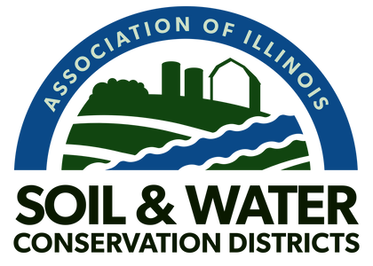

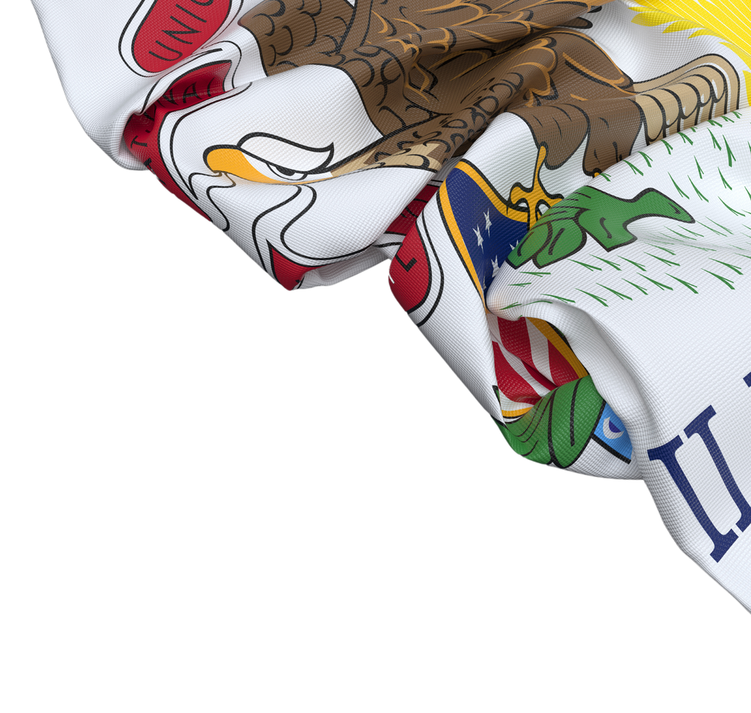
SWCD BACKGROUND
Soil and Water Conservation Districts
work to protect Illinois’ greatest assets – the rich, fertile soils and water resources of the state through strategic conservation efforts.
SWCDs support the mantra "Clean Water, Healthy Soils."

Slide 38
SWCD BACKGROUND
SWCDs have for decades over played a central role in efforts to sustain the viability of Illinois’ natural resources for future generations by working with agricultural and environmental stakeholders.
Illinois SWCDs have a 75+ year track record of getting conservation on the ground on privately owned lands.

Slide 39
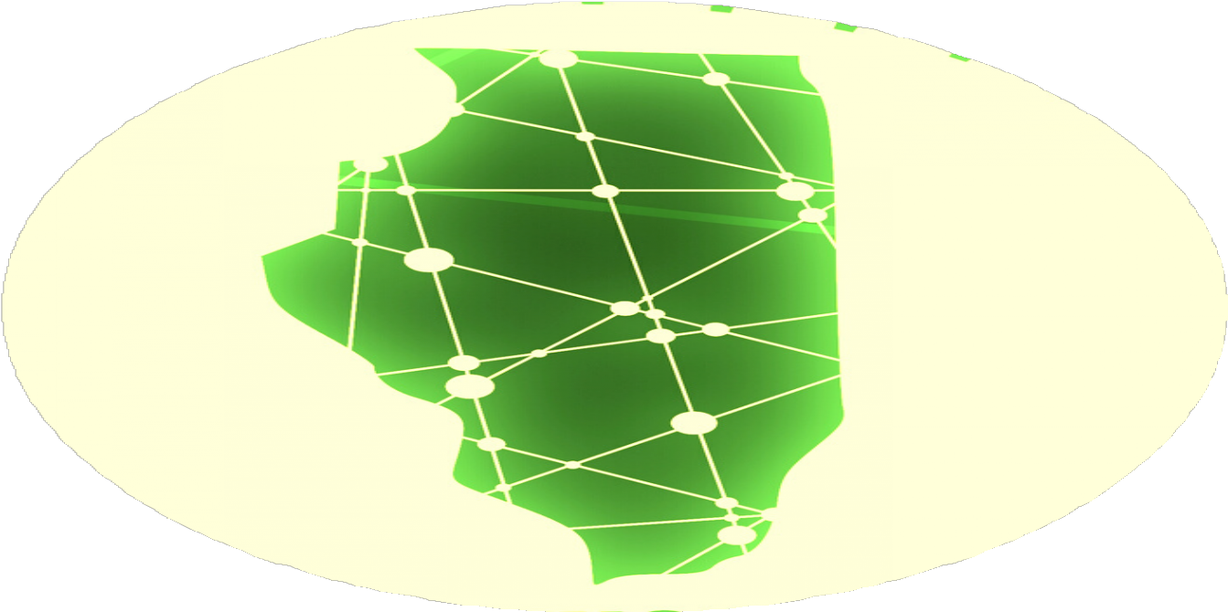

INFRASTRUCTURE
The network of SWCDs represents the local infrastructure for the delivery of state and federal conservation programs in Illinois.
SWCDS, with a presence in every county, are the go-to for program delivery.

Slide 40

SWCD QUICKFACT
SWCDs are considered the multipurpose tool in the tool box for the delivery of state and federal conservation programs in Illinois.
Illinois' total land mass is 95% privately owned. Illinois SWCDs have a 75+ year track record of getting conservation on the ground on privately owned lands.

Slide 41

SWCD QUICKFACT
SWCDs are non-taxing,
non-regulatory, volunteer led units of local government.
SWCD Directors serve unpaid and help to set local conservation policies.

Slide 42

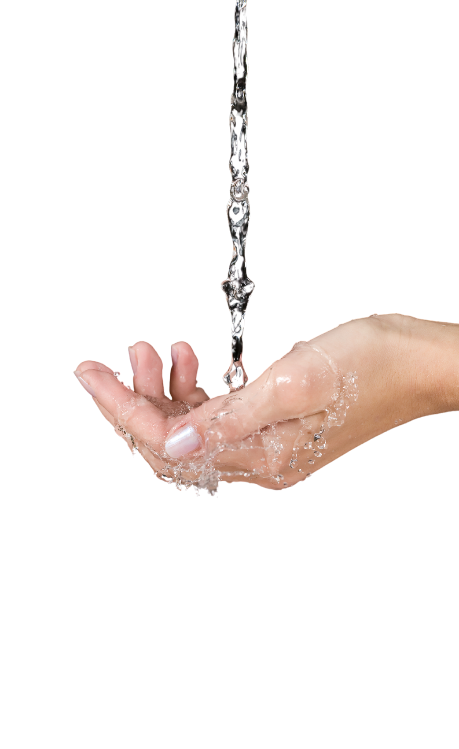
SWCD QUICKFACT
SWCDs support voluntary, locally led strategies that further the adoption of conservation practices.
A strong research, information, and education program is key to a long-term voluntary conservation effort.

Slide 43
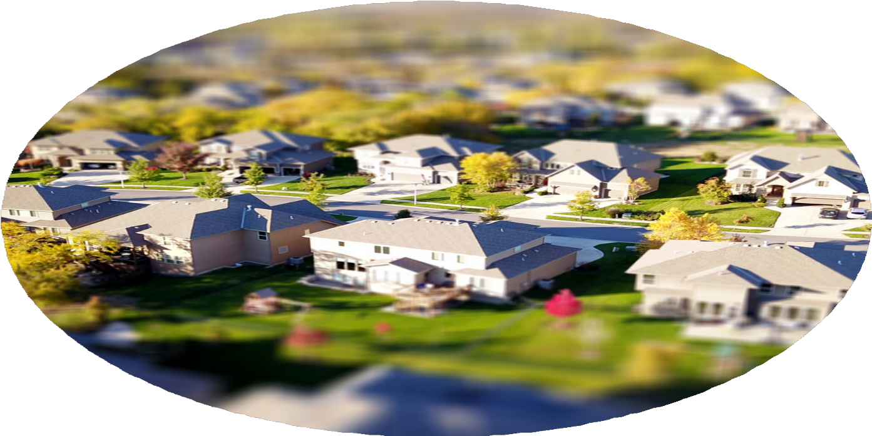

NOT JUST FOR FARMERS!
Not just for farmers! SWCDs work all across the state in urban, suburban, and rural settings alike!
Today's SWCDs serve a variety of "non-traditional" audiences, including municipal officials, developers and a whole new client group - suburban homeowners.

Slide 44
SWCD AREAS OF FOCUS
SWCDS provide a wide range of services which include; flood prevention, erosion control, habitat restoration, sediment control, forestry management, and miscellaneous land use services.
By preventing soil, nutrients and other pollutants from entering waterways, SWCDs reduce the need for costly remedial actions.

Slide 45

SWCDS IN THE NEWS
Urgent action needed to protect water, soil
The Champaign News-Gazette | April 19th, 2020
Soil and water conservation more important now than ever
The Southern Illinoisan | May 7th, 2020
SWCD Directors serve unpaid and help to set
local conservation policies.

Slide 46
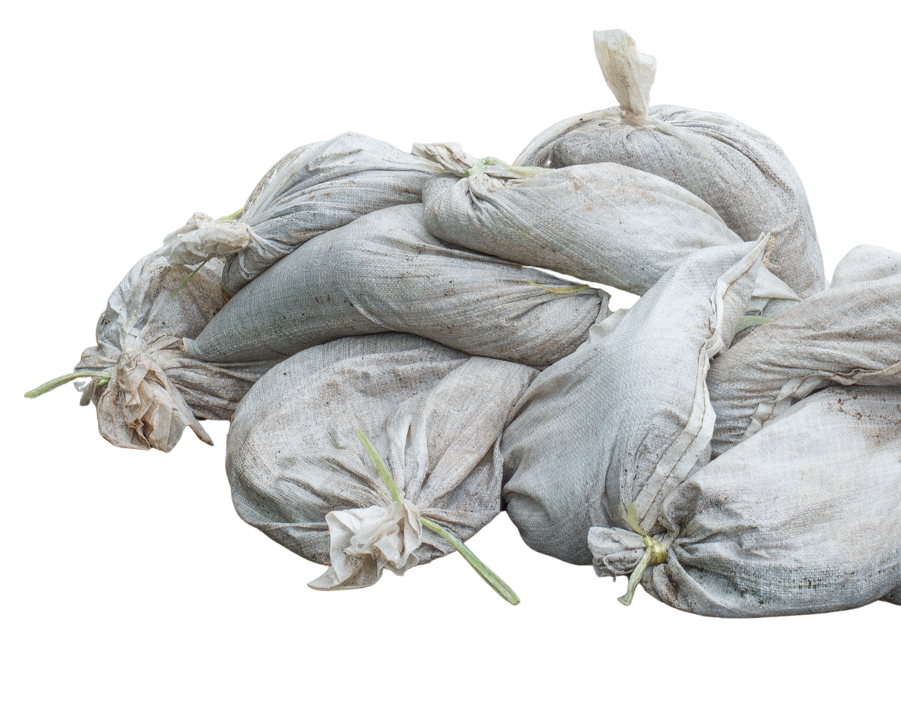
WHY ARE SWCDS IMPORTANT?
SWCDs implement strategies that reduce the potential for costly flooding and protects water quality by controlling erosion and sedimentation.
SWCD help make Illinois more resilient to changing weather and climate.

Slide 47
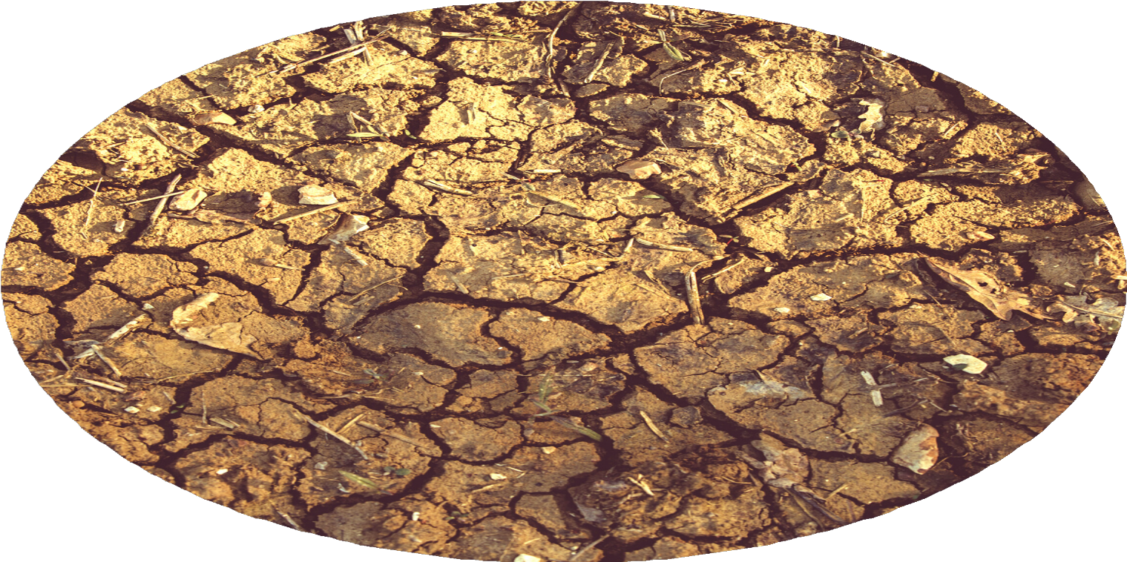

WHY IT MATTERS
Data trends suggests that Illinois is becoming more precipitous, which creates more erosion, which in
turn diminishes water quality.
Illinois SWCDs are working to build resilience to more erratic,
precipitous, and severe weather as well as longer periods of drought in between.

Slide 48
MAJOR POLICY...NLRS: WHAT IT IS
The Illinois Nutrient Loss Reduction Strategy guides state efforts to improve water quality at home and downstream by reducing nitrogen and phosphorus levels in our lakes, streams, and rivers.
Nutrient runoff originates from both urban and rural sources.
SWCD Directors serve unpaid and help to set
local conservation policies.

Slide 49
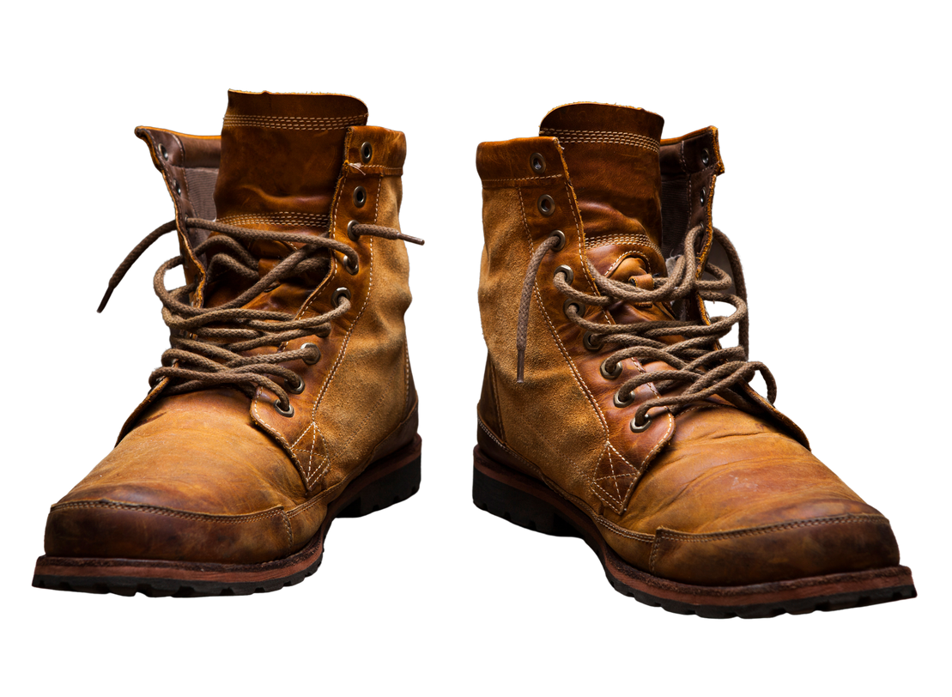
NLRS: AT HOME
SWCDS are the boots on the ground leading local efforts to implement the NLRS strategy and improve water quality at home.
Nutrient runoff poses threats to public health, harms aquatic wildlife, and diminishes recreational opportunities such as fishing, boating, swimming.
SWCD Directors serve unpaid and help to set
local conservation policies.

Slide 50
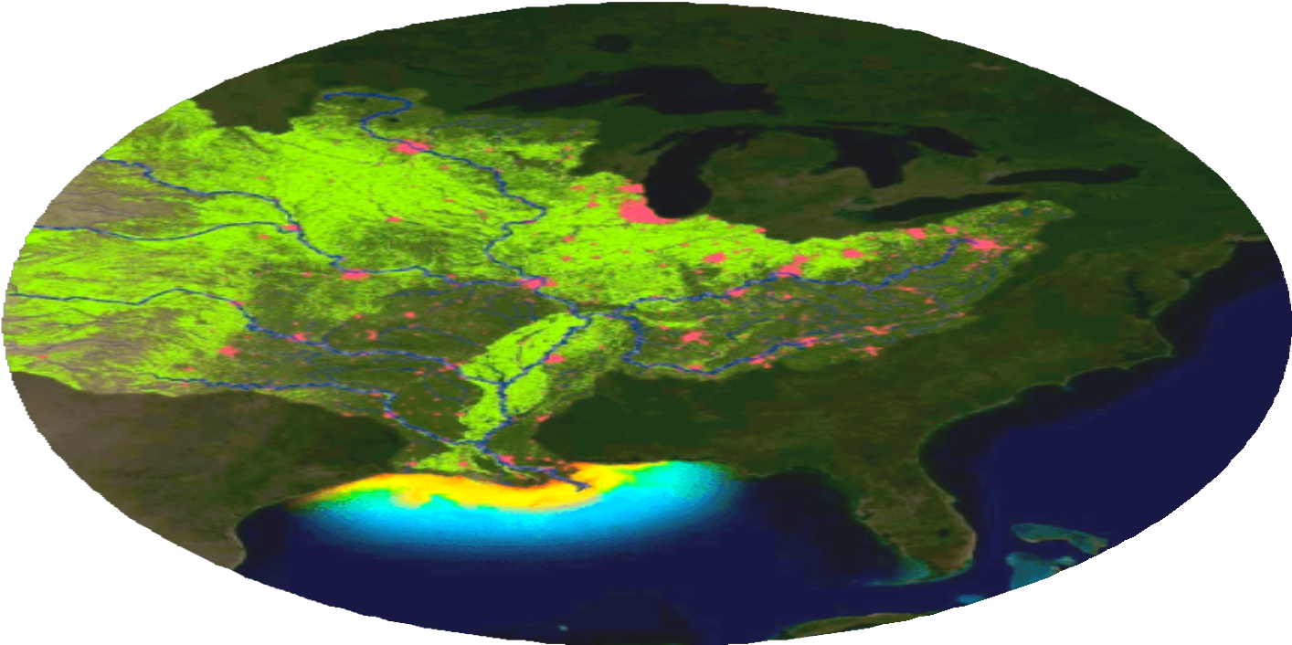


NLRS: IMPACTS DOWNSTRE AM
The Gulf of Mexico dead zone is primarily caused by nutrient runoff from urban and rural areas throughout the Mississippi River watershed.
The 2021 Gulf of Mexico “dead zone” is approximately 6,334
square miles, or equivalent to more than four million acres of habitat.
SWCD Directors serve unpaid and help to set
local conservation policies.

Slide 51
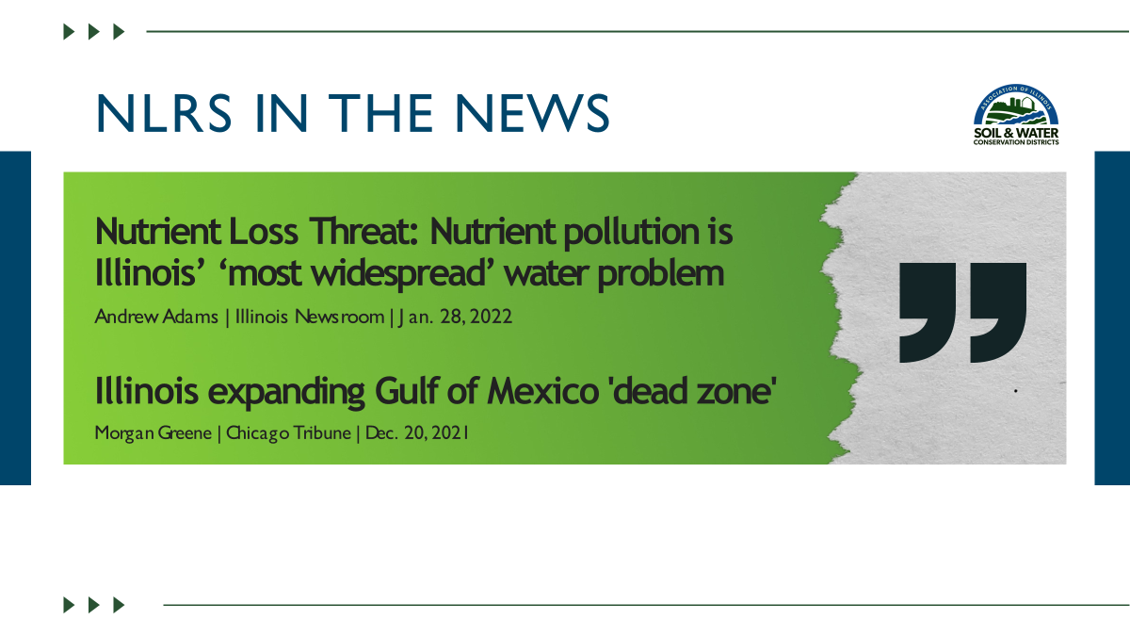

NLRS IN THE NEWS
Nutrient Loss Threat: Nutrient pollution is Illinois’ ‘most widespread’ water problem
Andrew Adams | Illinois Newsroom | Jan. 28, 2022
Illinois expanding Gulf of Mexico 'dead zone'
Morgan Greene | Chicago Tribune | Dec. 20, 2021
SWCD Directors serve unpaid and help to set
local conservation policies.

