Slide 1
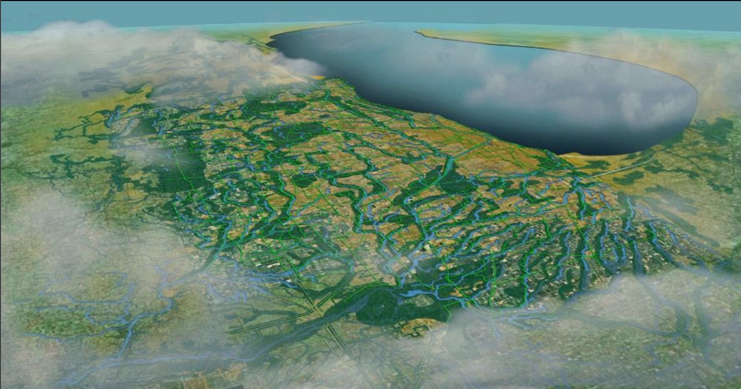
Chicago Wilderness & 30x30
Mobilizing a Green Region…

Slide 2
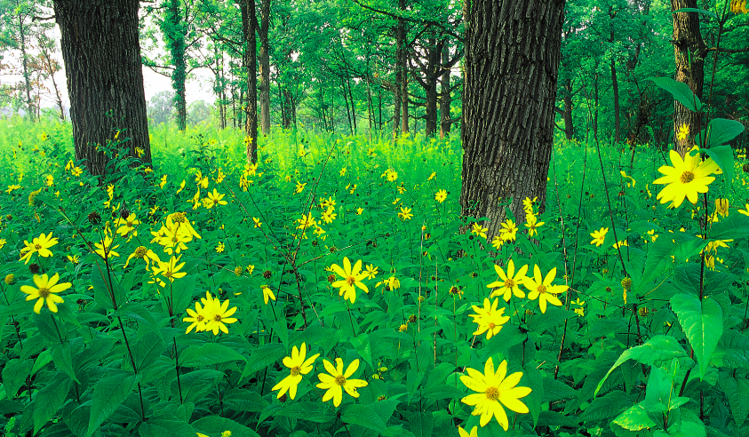
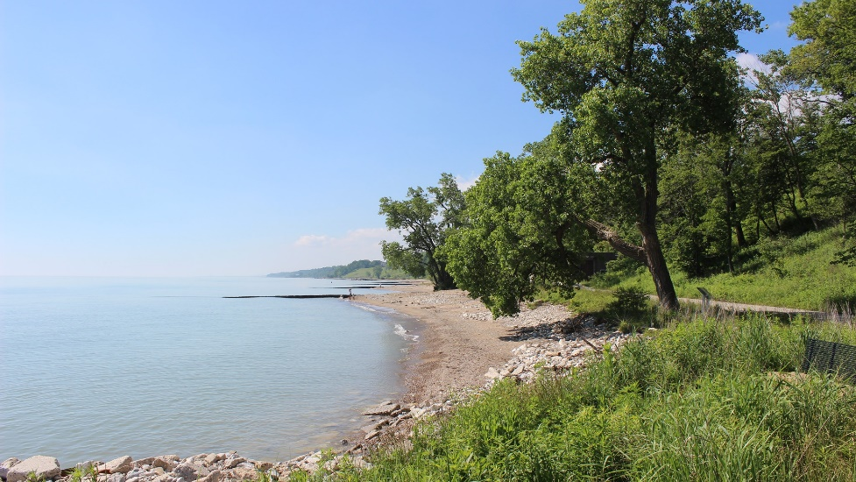
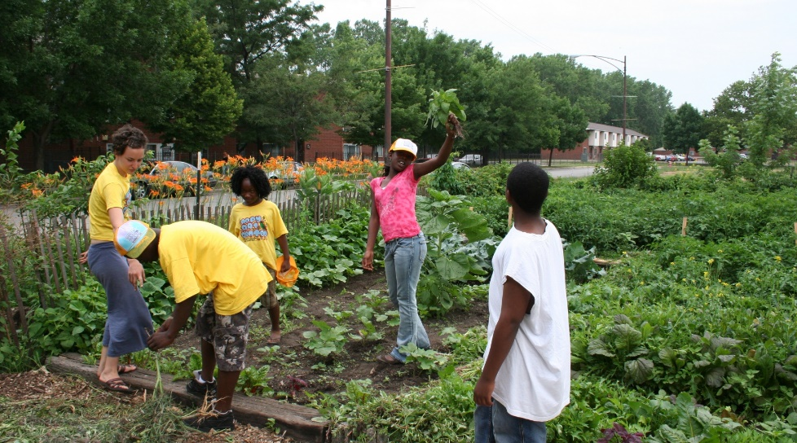
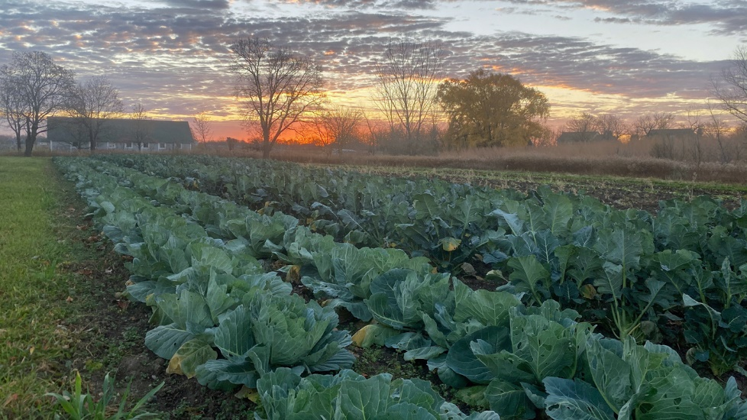
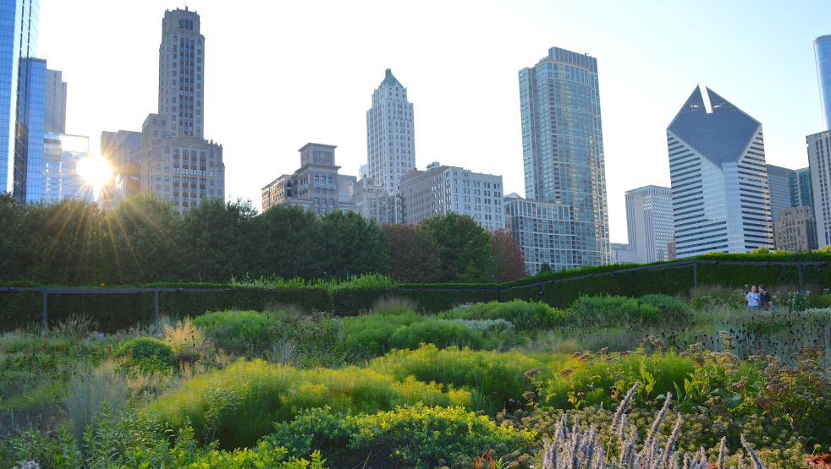
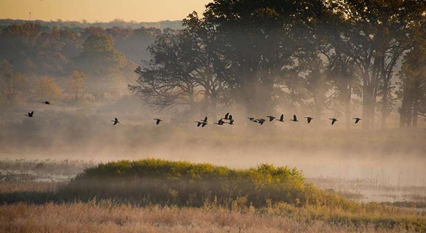
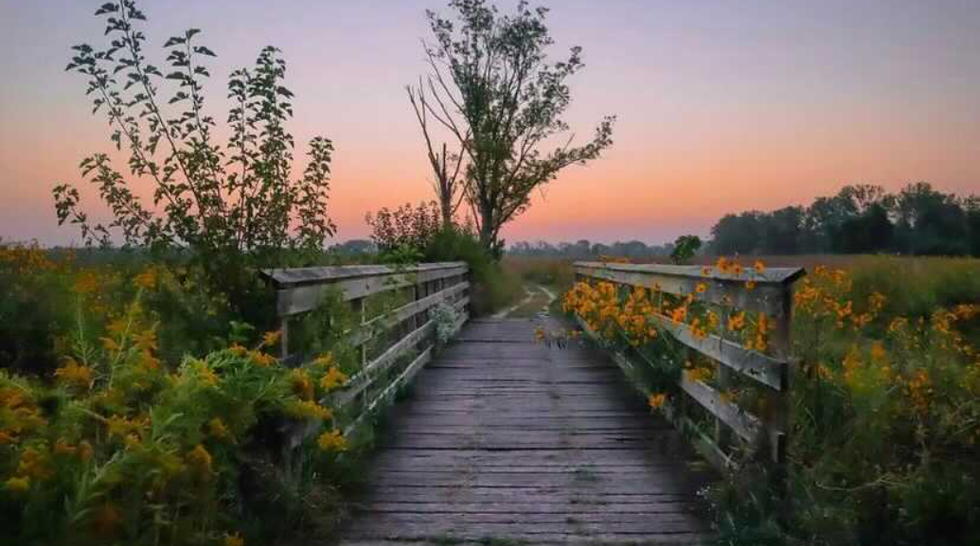
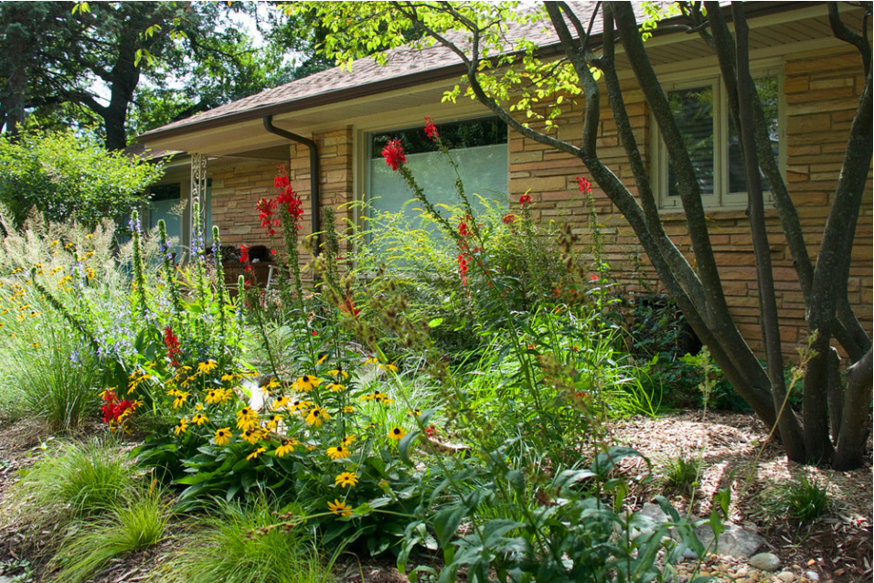
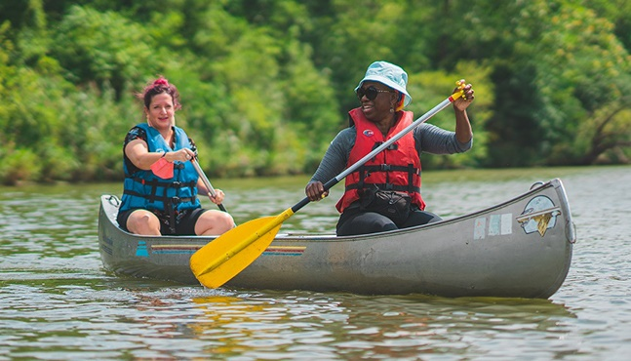
For
All…
For All…
@nature.by.michelle
@redstemlandscaping

Slide 3
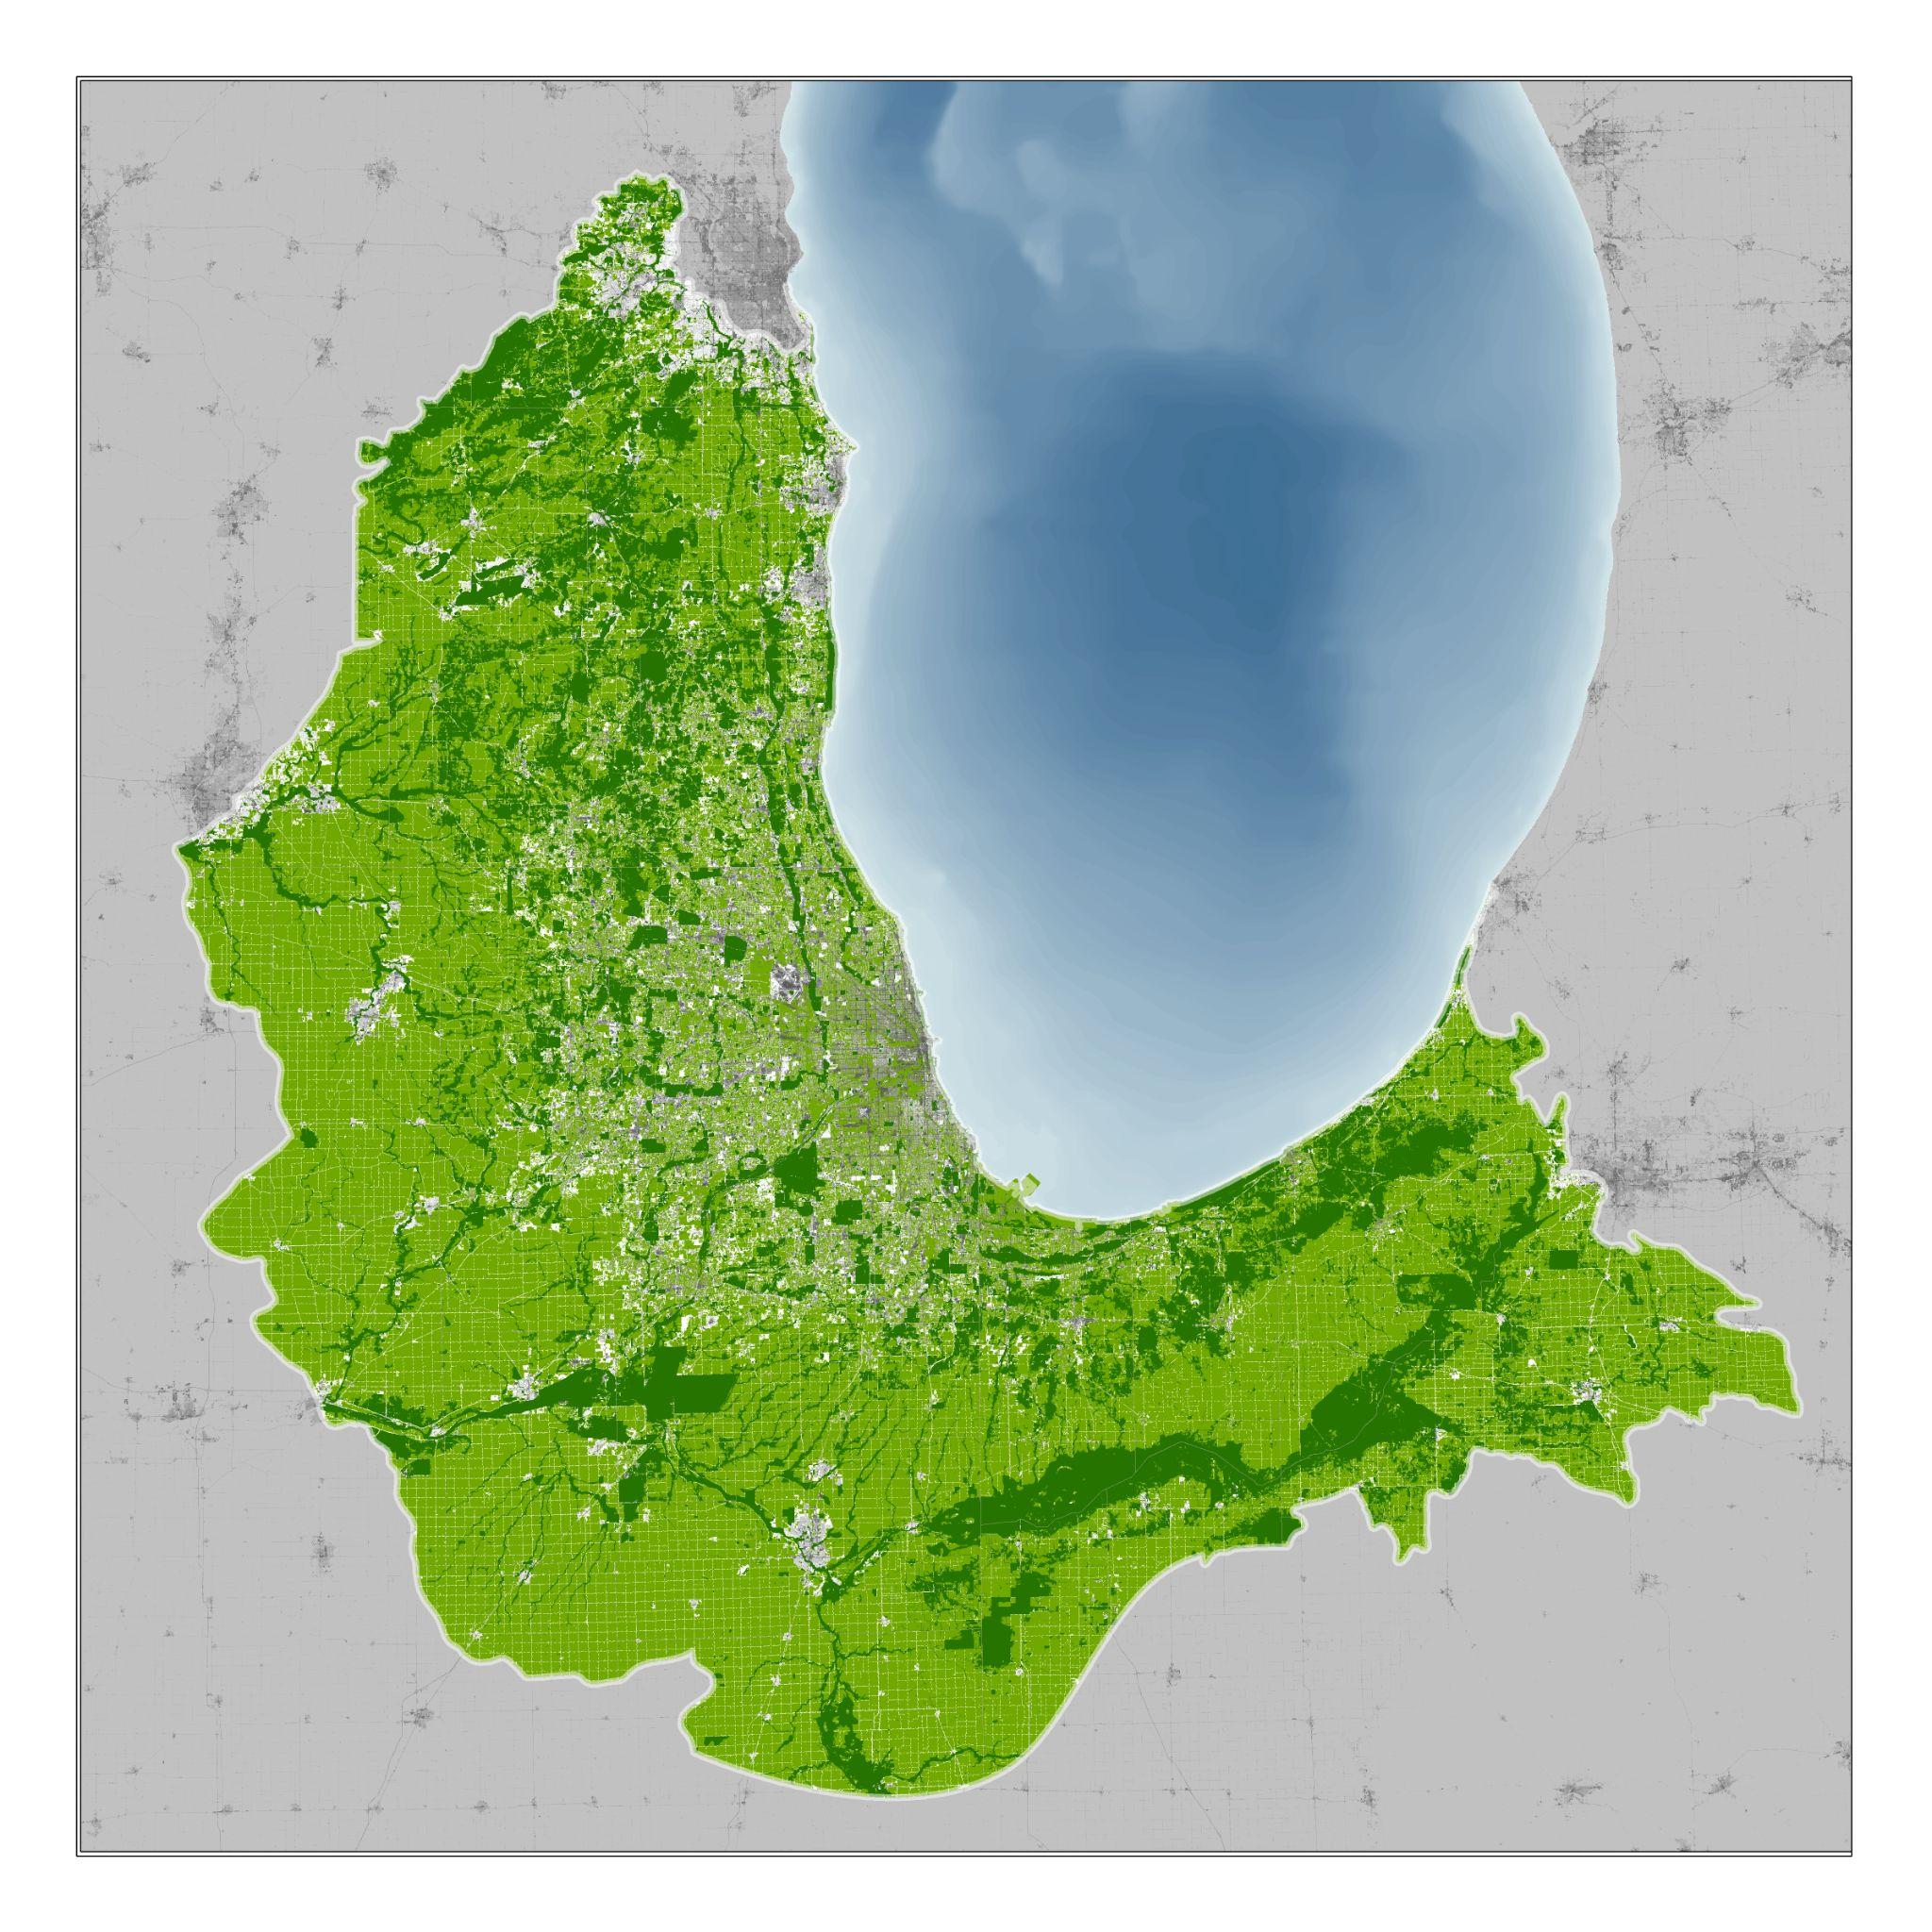
Chicago
Wilderness
Collaborate
Convene
Learn
Listen

Slide 4
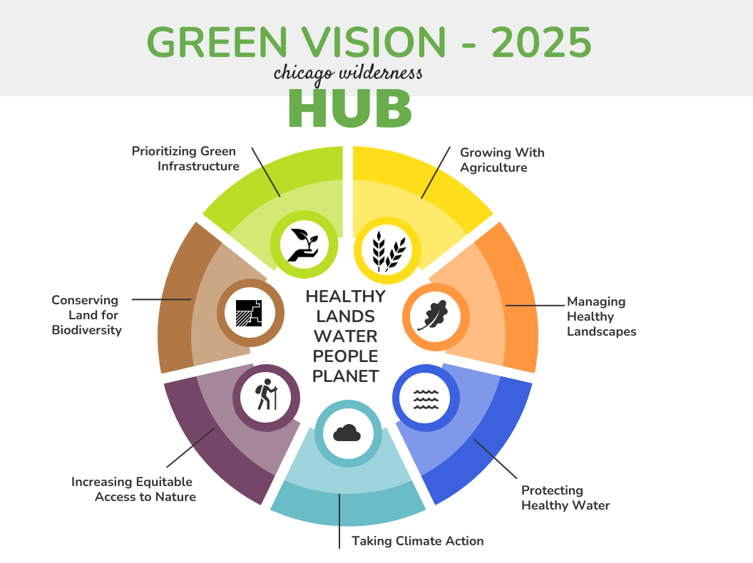

Slide 5
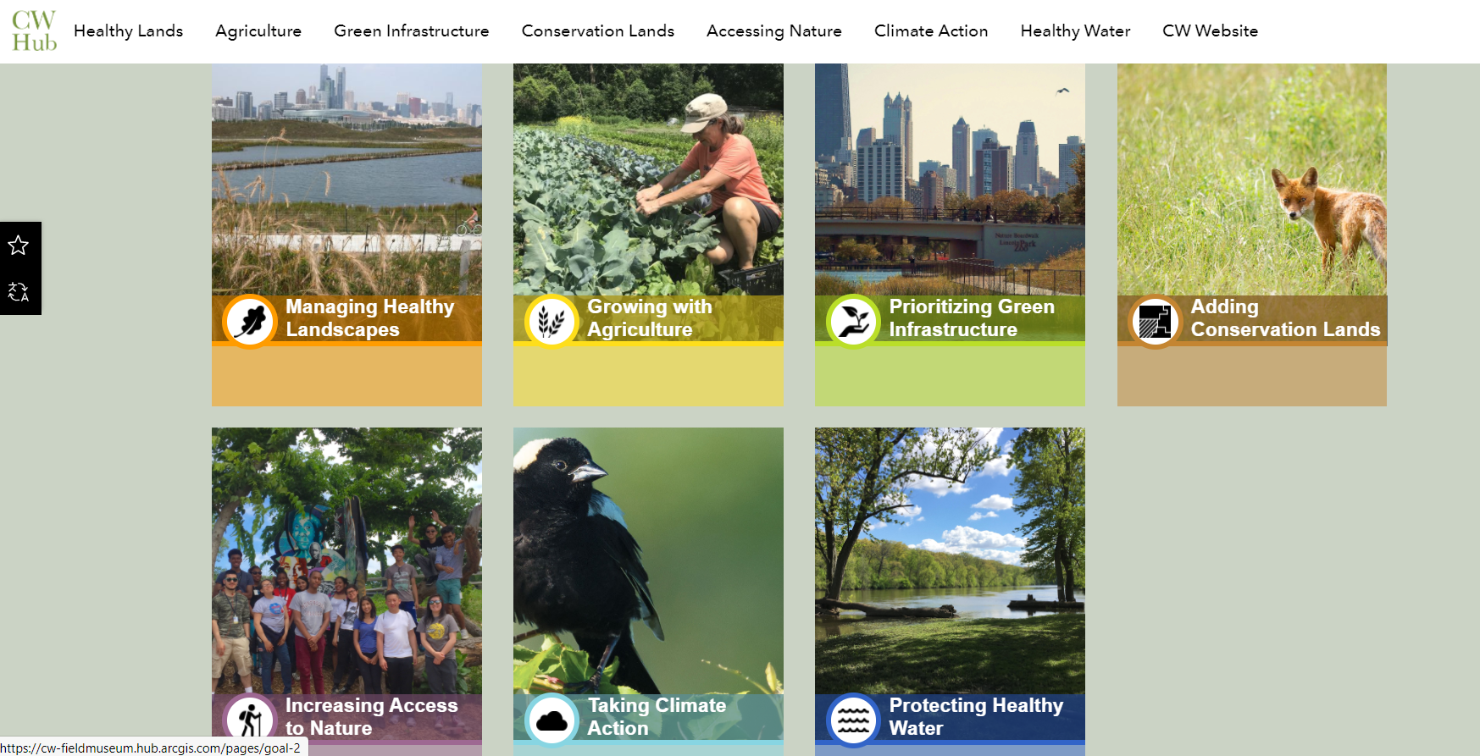

Slide 7
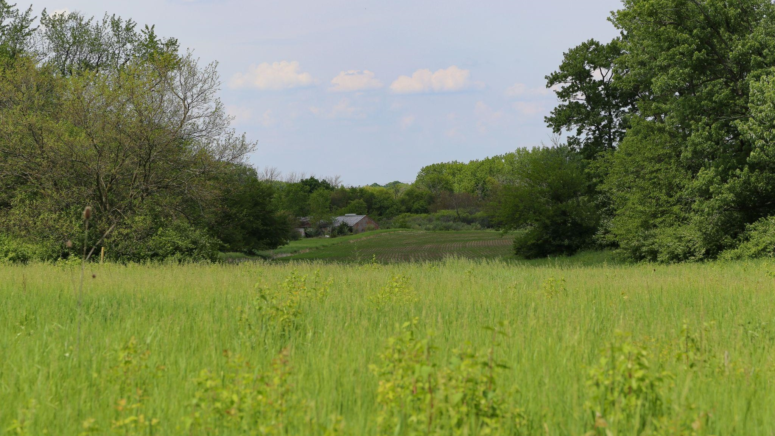
Illinois Baseline
30% of land and water in Illinois: 10.9 million acres
4.15% of public/private protected natural land: 1,496,000 acres
To move to 5% in IL protected lands: ≈305,000 acres
(Shawnee National Forest + Midewin National Tallgrass Prairie)
75% of Illinois land is in agriculture: 23 million acres
≈ 2.5% of agricultural land is in CRP: 594,000 acres
Maintenance and green jobs are vital to keep what we protect
*Thanks to David Holman and iView (Prairie State Conservation Coalition) for
many of the above statistics.

Slide 8
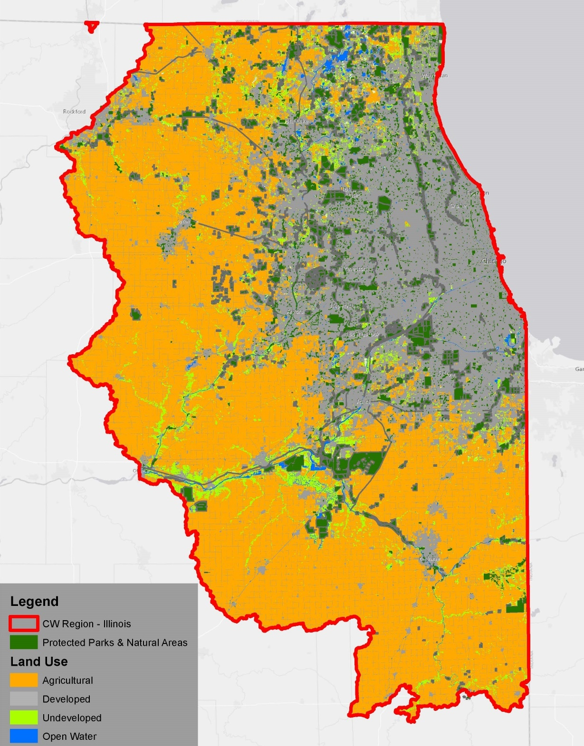
Chicago Wilderness
Illinois Portion
Total Area
Protected Parks and
Natural Areas
30% of Total Area
Additional Protection
Needed
4,770,000 acres
375,000 acres
1,431,000 acres
1,056,000 acres

Slide 9
30% of Land Types Across the Illinois Portion of
the Chicago Wilderness Region
Landscape Type (Land Use) | Illinois Acreage in CW Region | 30% of Land Type | 30x30 Opportunity
Conservation Land | 312,000 | 94,000 | 93,600 acres under restoration
Local Parkland | 63,000 | 19,000 | 18,900 acres managed for plants, wildlife, and people
Agricultural Land | 2,690,000 | 80,700 | 807,000 acres in regenerative agriculture
Undeveloped Land | 185,000 | 56,000 | 55,500 acres added to conservation lands and waters
Built Land | 1,520,000 | 45,600 | 456,000 acres in green infrastructure practices (e.g. native plantings in yards, campuses, ROWs, gardens, green roofs, etc.)
Chicago Wilderness Total | 4,770,000 | 1,430,000

Slide 10
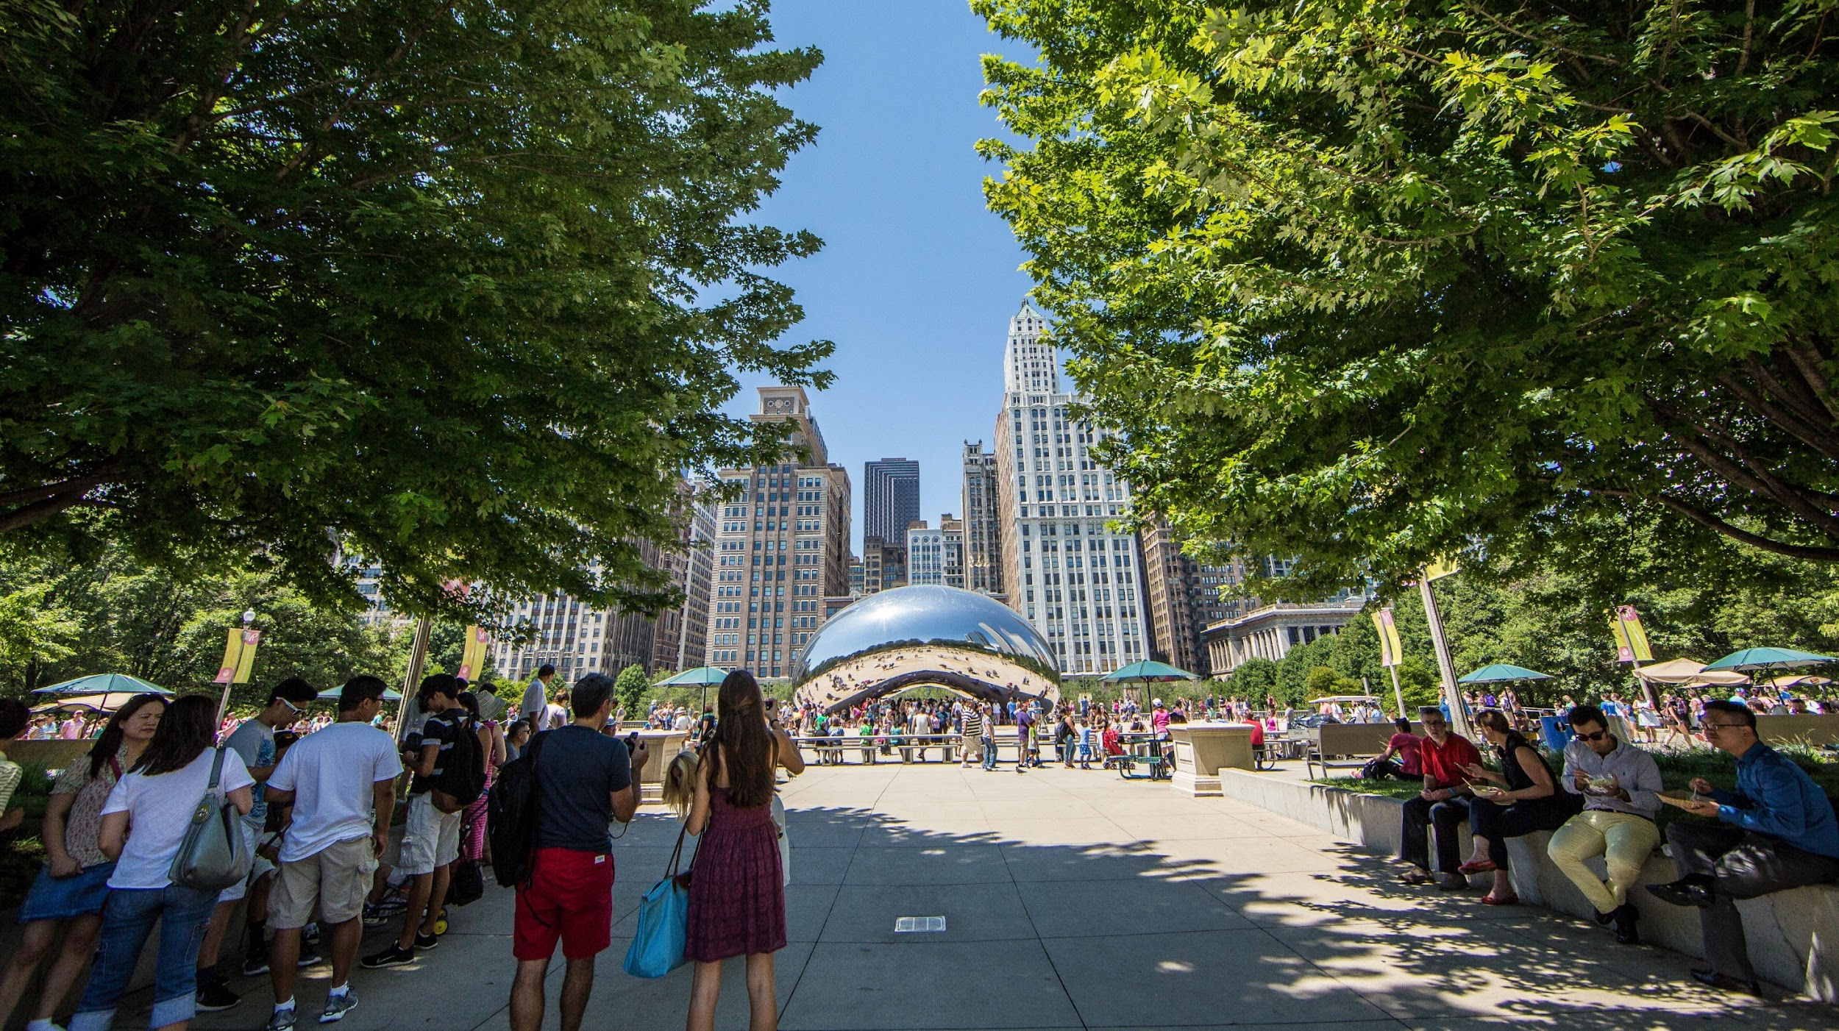
DJ Glisson

Slide 11
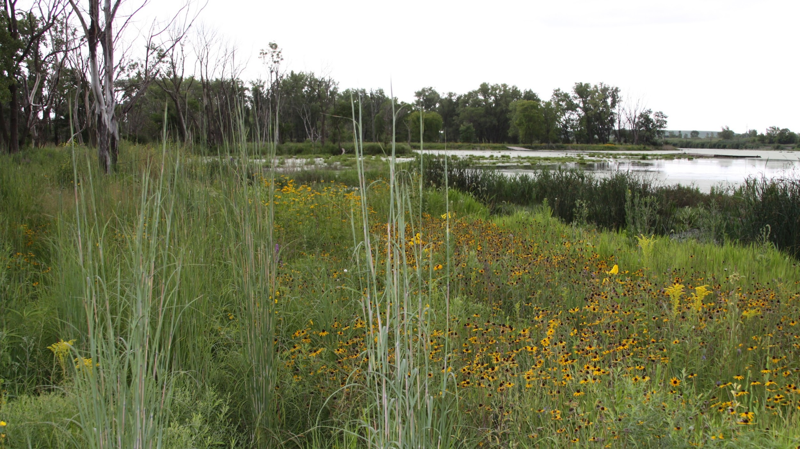
The Wetlands Initiative

Slide 12
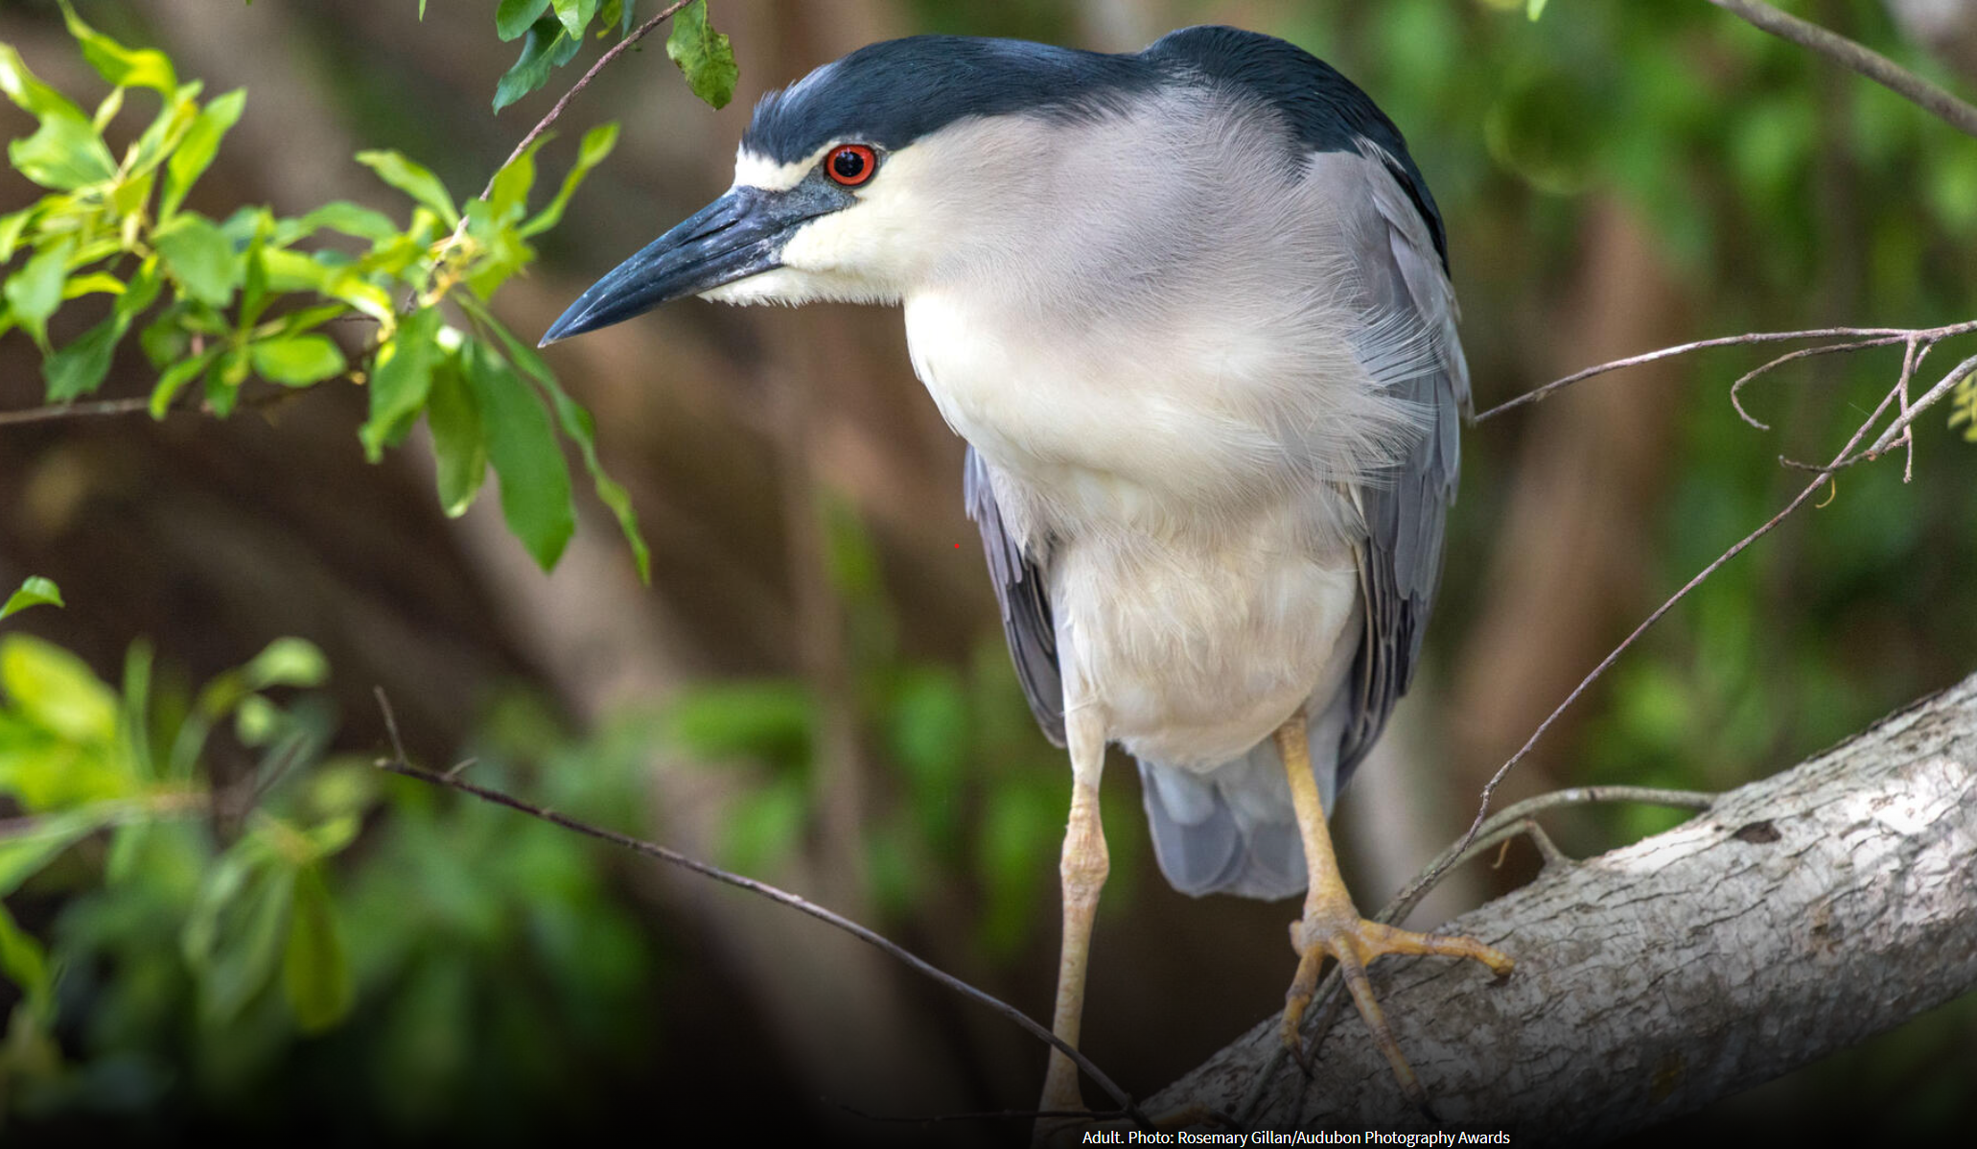

Slide 13
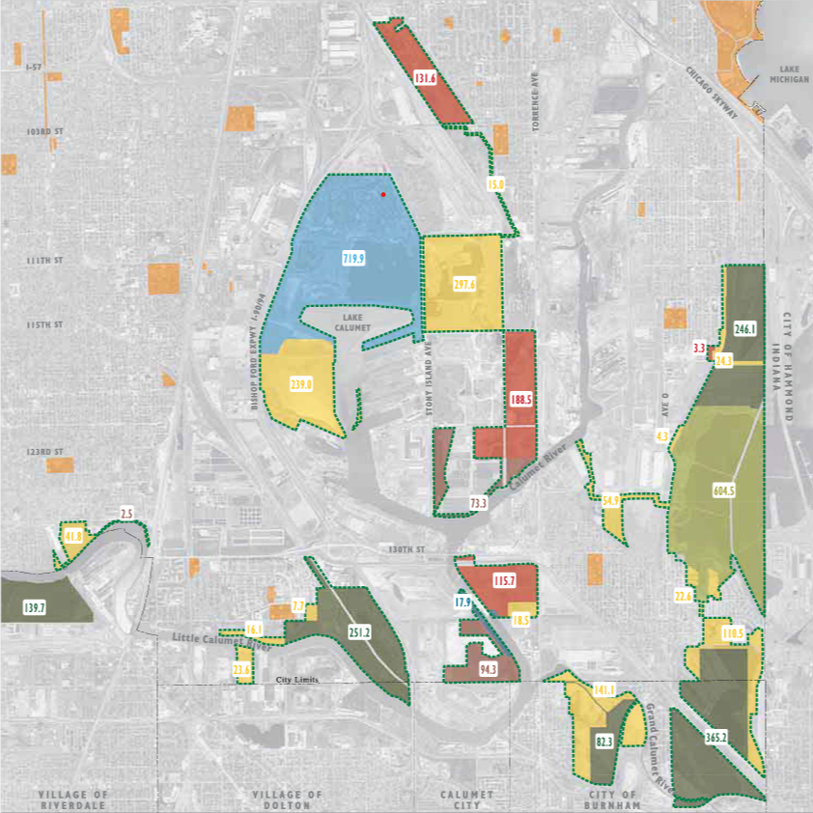
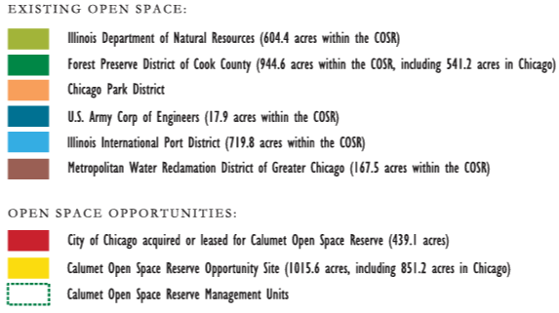
Calumet Open Space Reserve Map

Slide 14
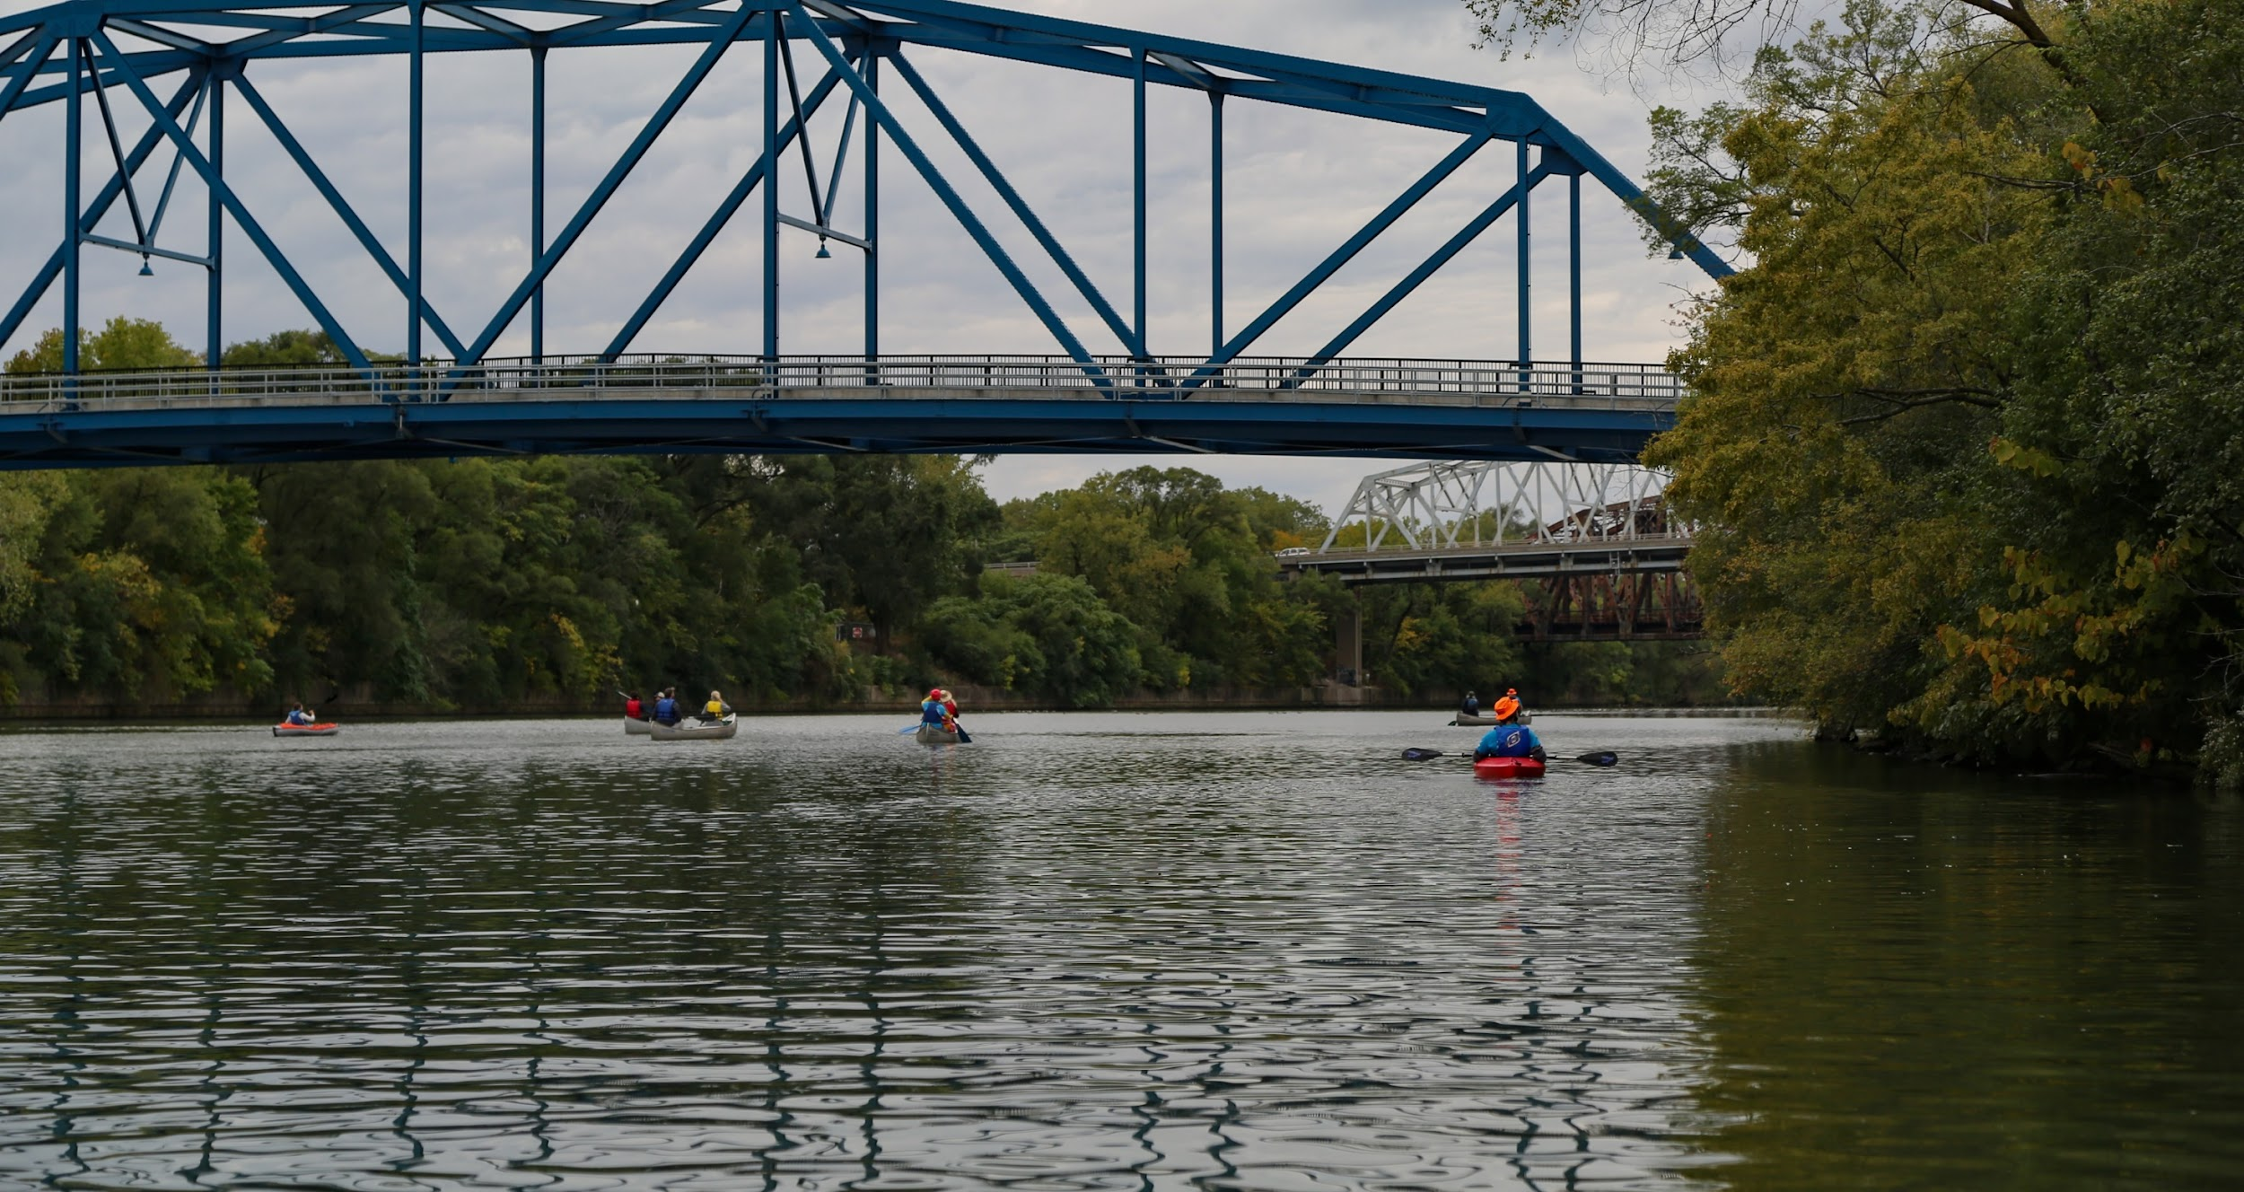

Slide 15
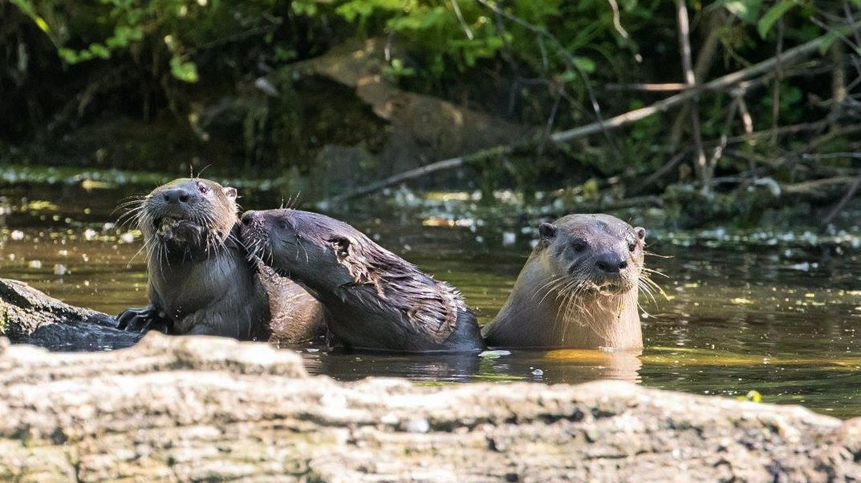
Peter Pekarek, Forest Preserves of Cook County

Slide 16
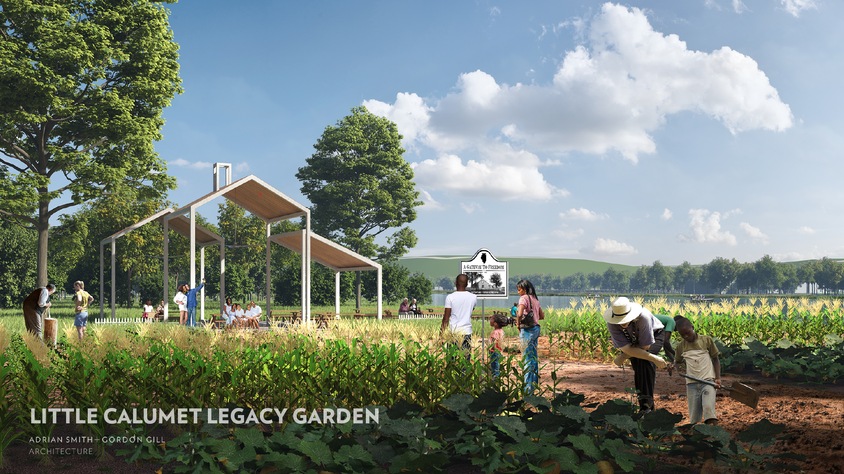

Slide 17
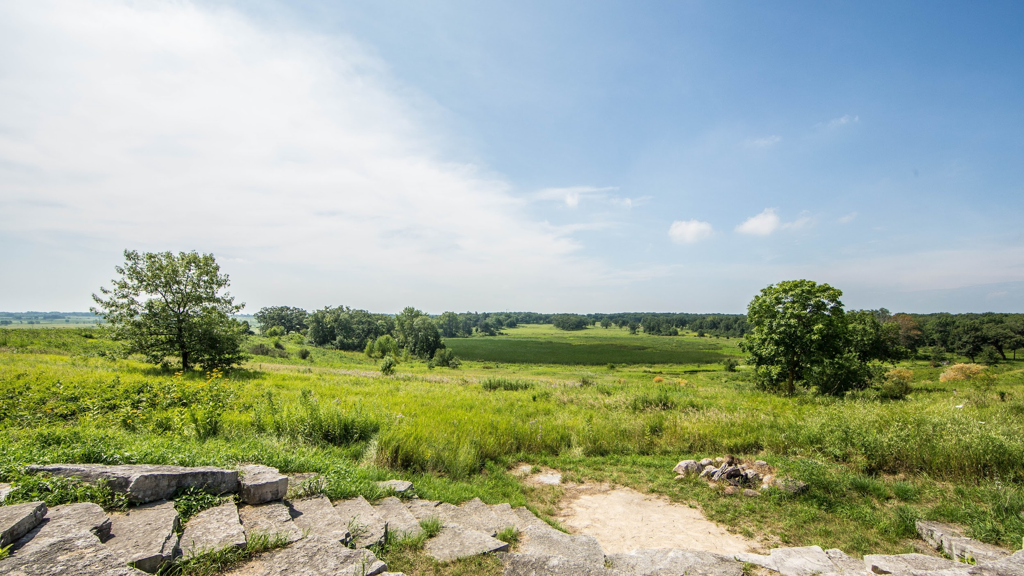

Slide 18
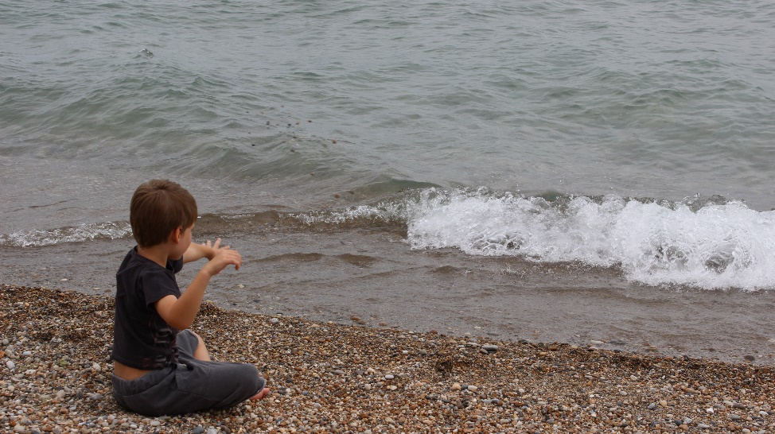
@nature.by.michelle
@redstemlandscaping

Slide 19
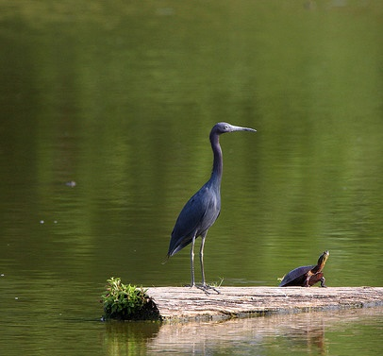
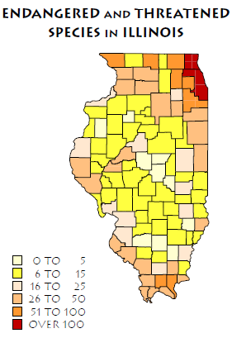
Biodiversity Concentration in Chicago Wilderness

Slide 20
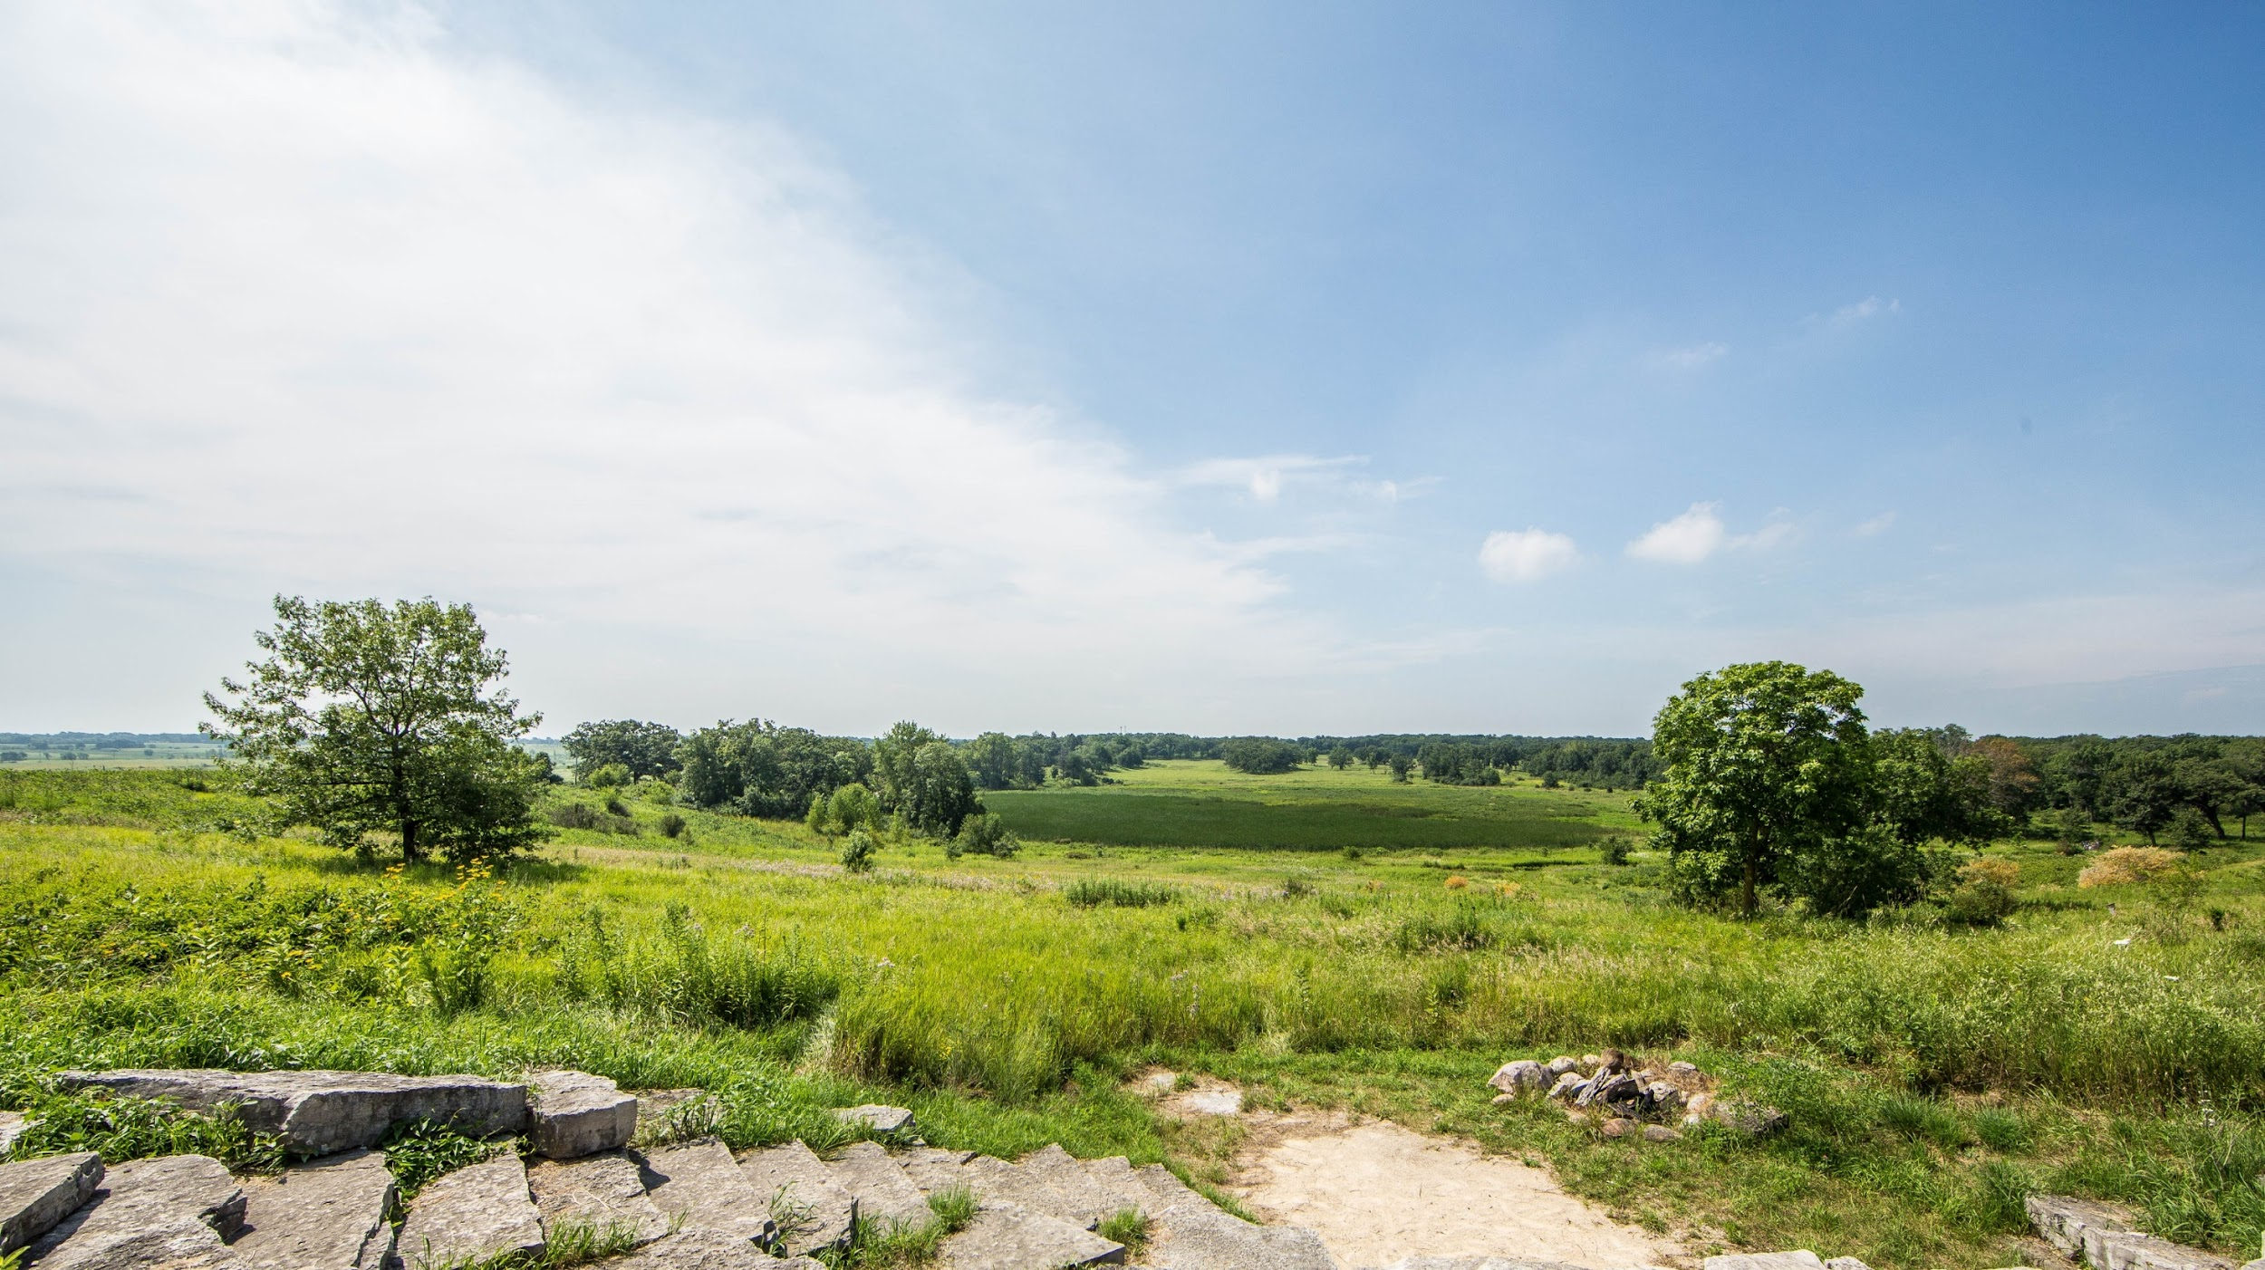
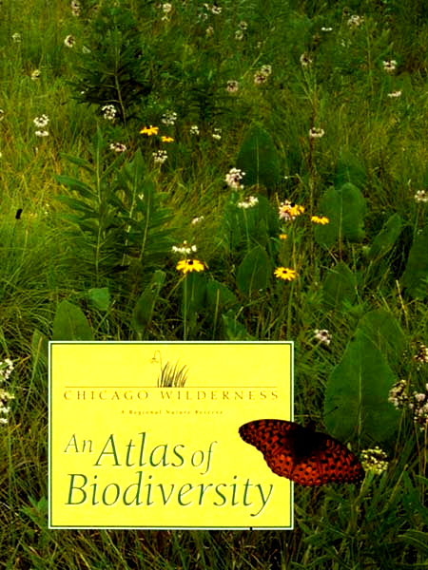
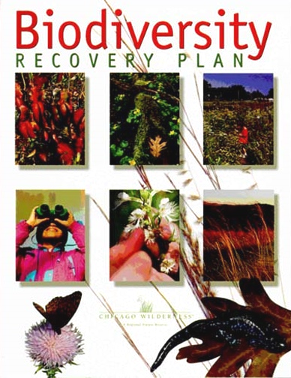
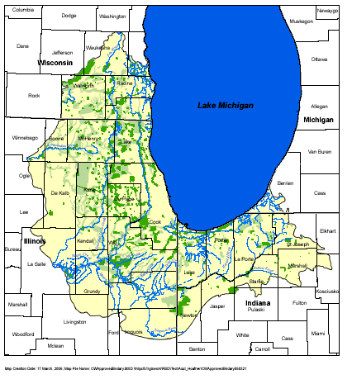
Biodiversity Recovery Plan, Atlas,
Green Infrastructure Vision

Slide 21
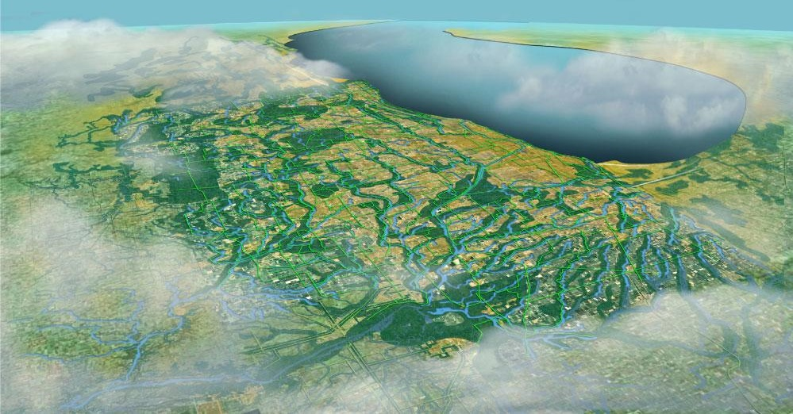
CMAP GoTo 2040 Plan
Increase conservation open space from 250,000 to 400,000 acres
Include green infrastructure connectivity in open space grant programs

Slide 22
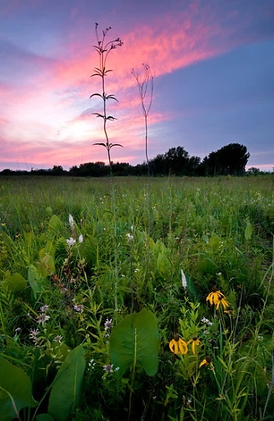
30x30 Opportunities: Metro Region
Parks, Gardens, and Urban Farms
Urban Tree Canopy
Creating Conservation Corridors
Preserving & Restoring Natural Lands
Transforming Backyards, Corporate Campuses, and Rights of Way
Regenerative Agriculture
Increasing Access to Nature for All People
Protecting & Restoring Waters
Green Infrastructure Solutions

Slide 23
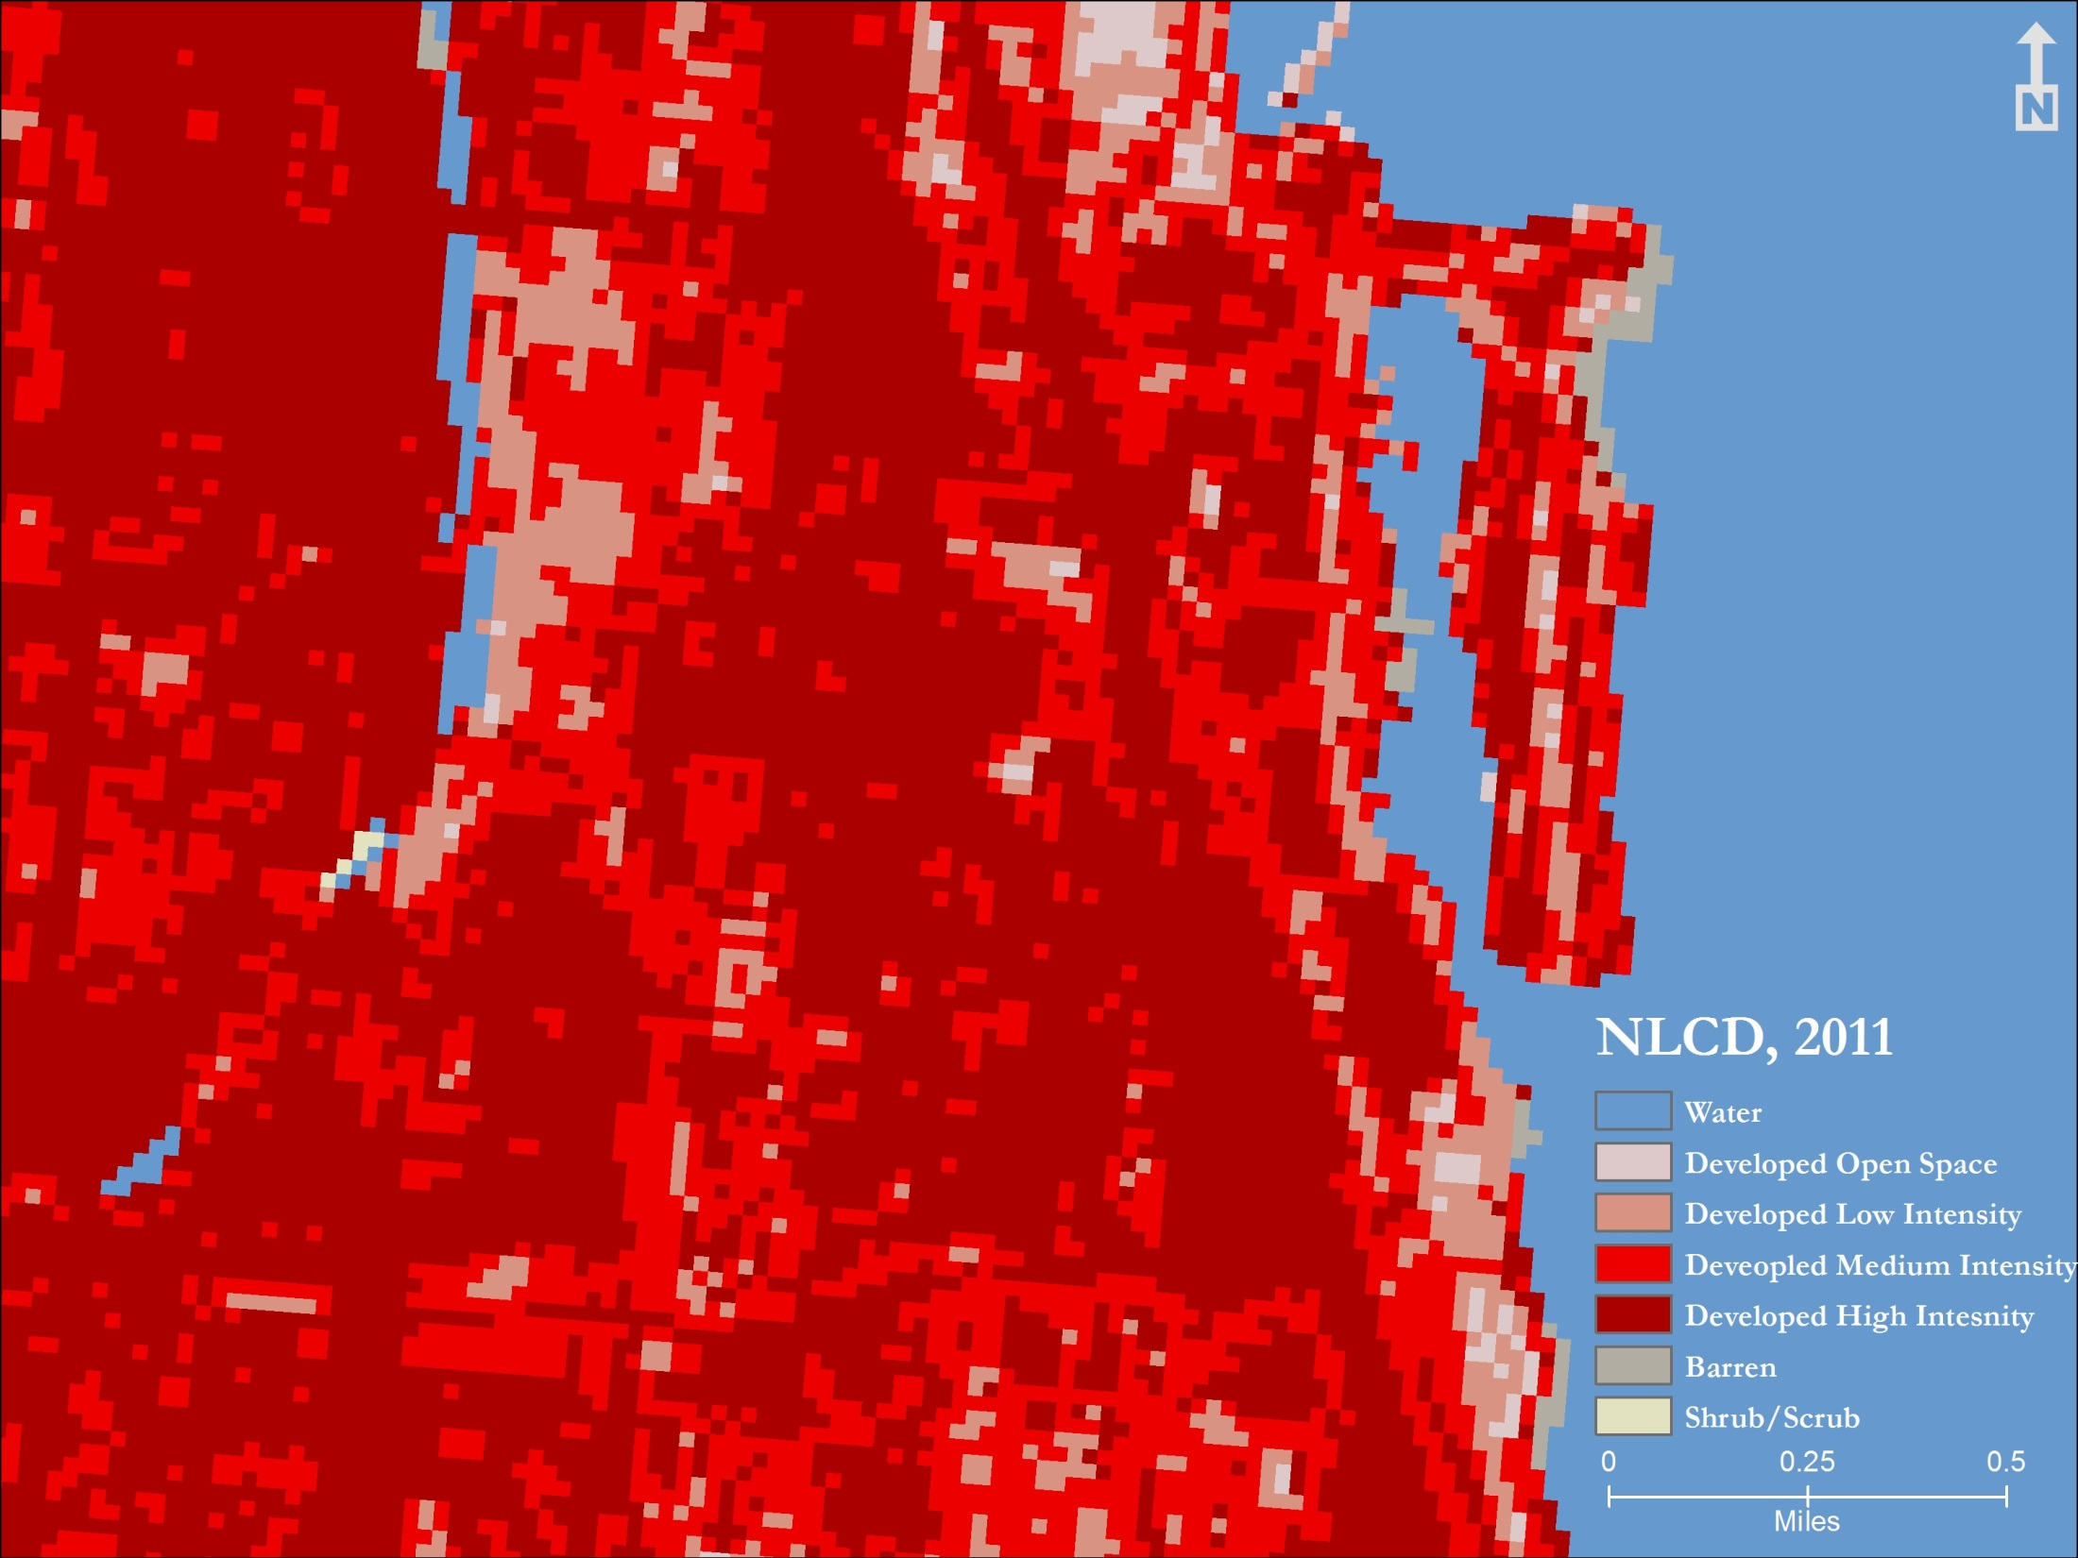

Slide 24
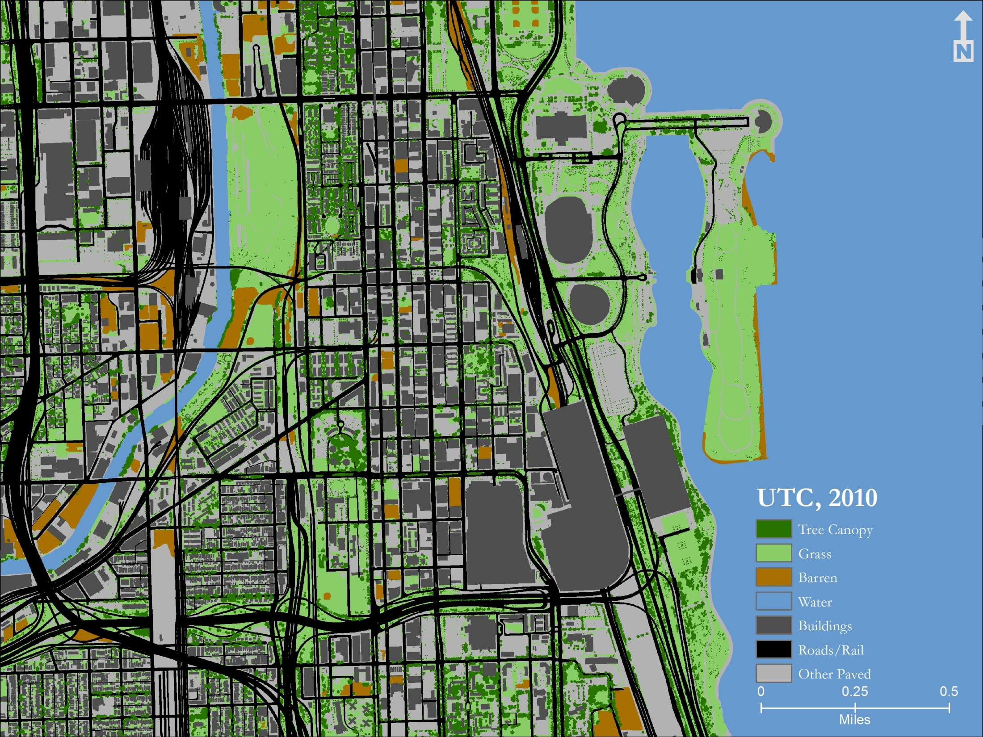

Slide 25
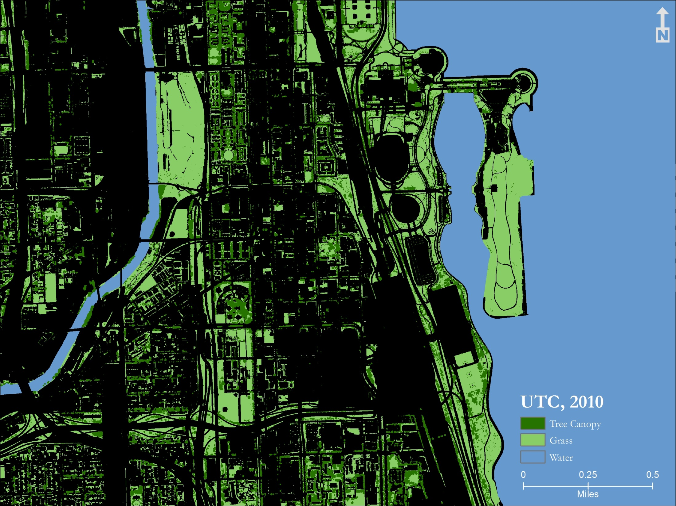

Slide 26
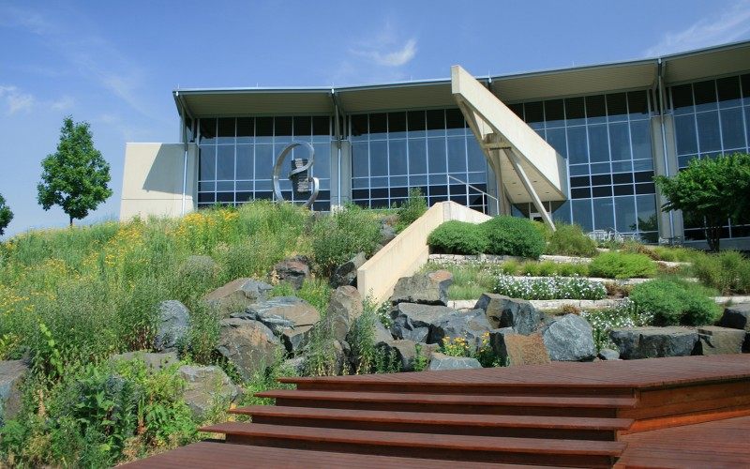
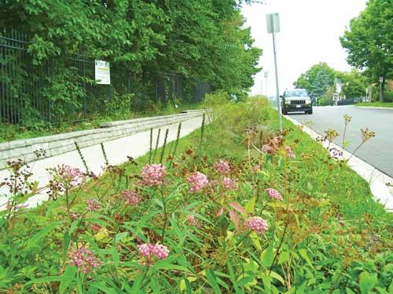
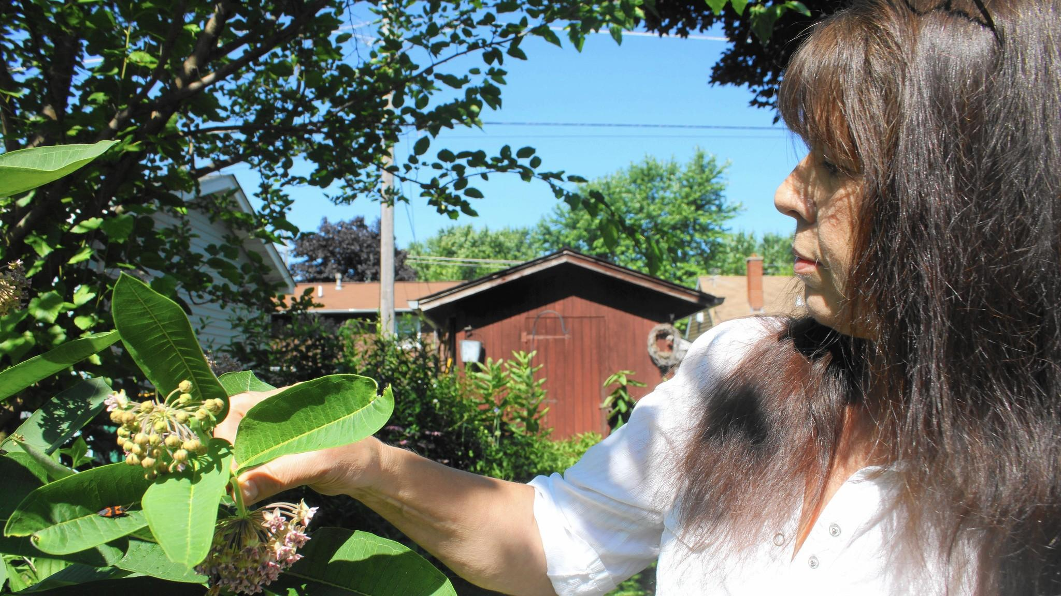
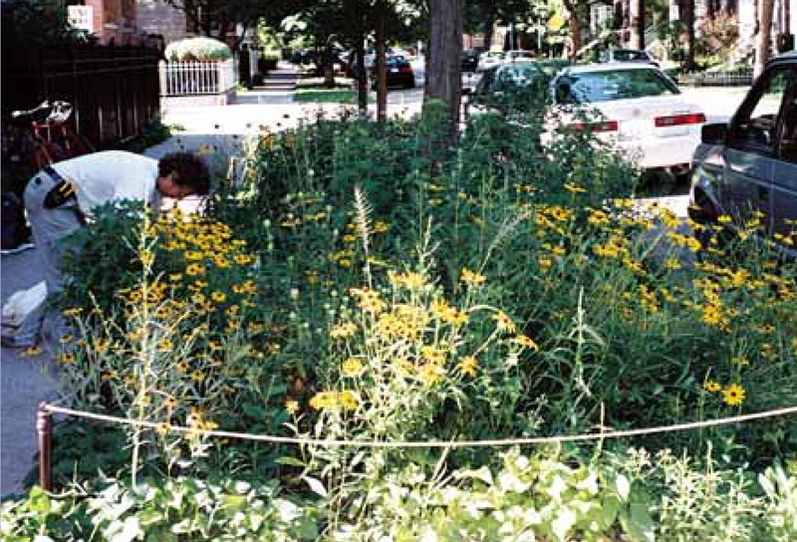
Commercial –Tuthill Corp
(Burr Ridge, IL)
Transportation R.O.W.
(Aurora, IL)
Single Family Backyard
(Lake County, IL)
Multi-Family Residential R.O.W.
(Chicago, IL)

Slide 27
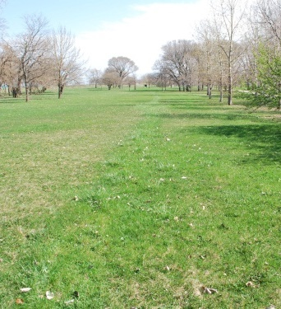
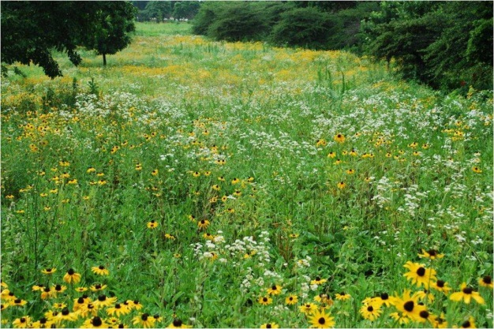
Burnham Wildlife Corridor
Before…
After…

Slide 28
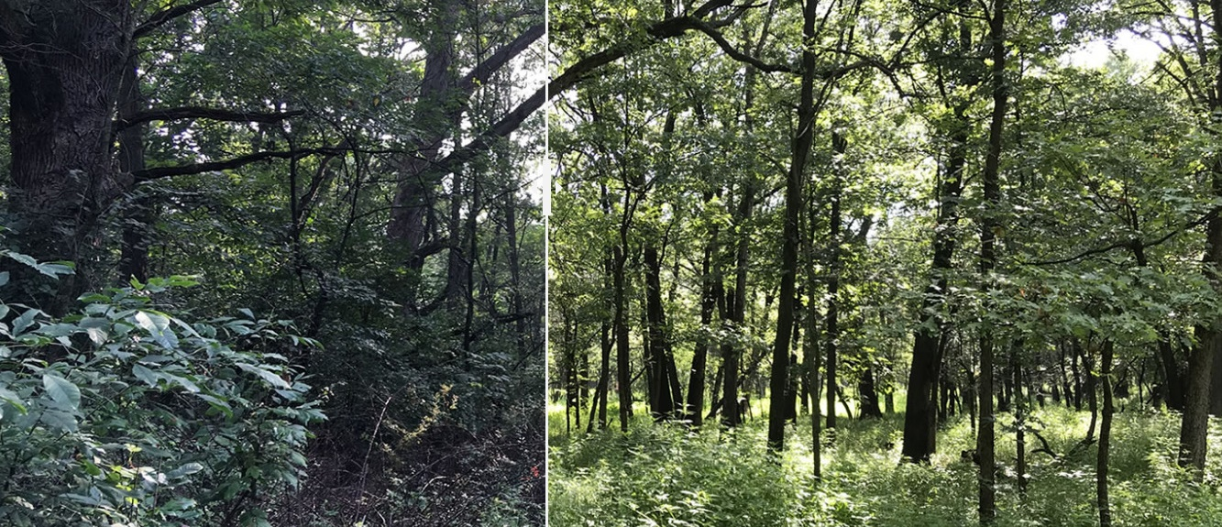
Success of Stewardship & Restoration
FPCC Website
Spear Woods before restoration
Spear Woods after one year of restoration

Slide 29
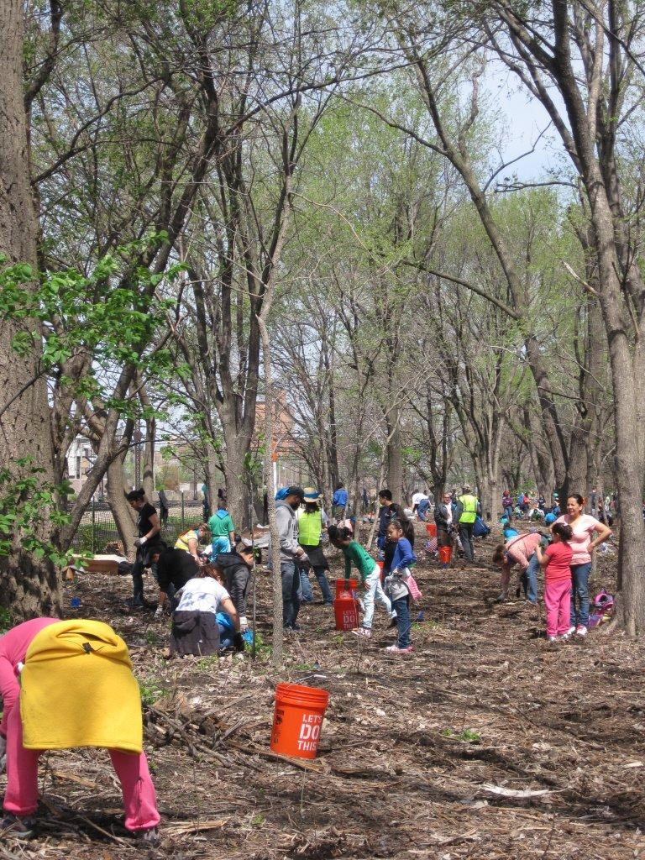
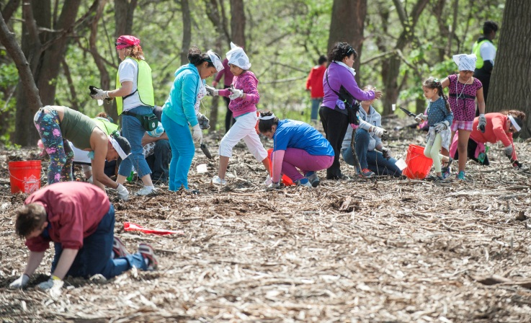

Slide 30
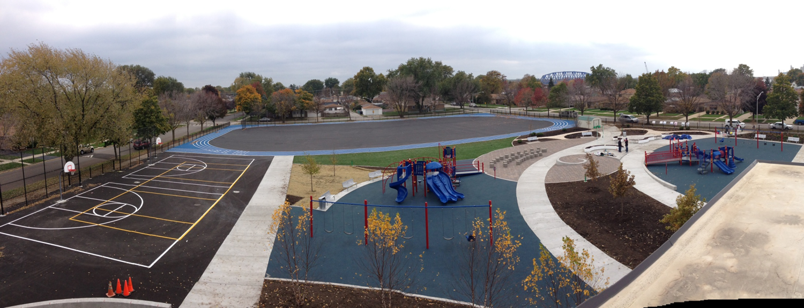
Multi-Benefit Green Infrastructure Solutions: SpacetoGrow

Slide 31
Potential Plantable Space by Land Use Type:
Chicago Metro Region

Slide 32
Chicago Wilderness & 30x30
Ben Haberthur, haberthurben@kaneforest.com
Stacy Meyers, smeyers@openlands.org

Slide 33
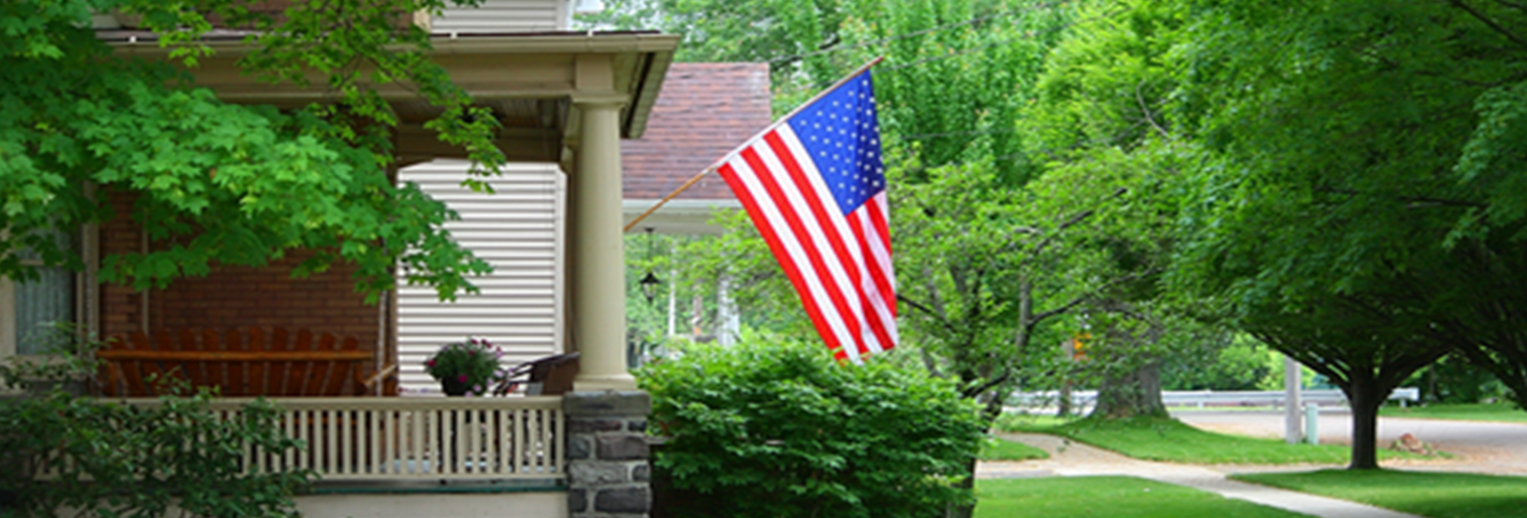
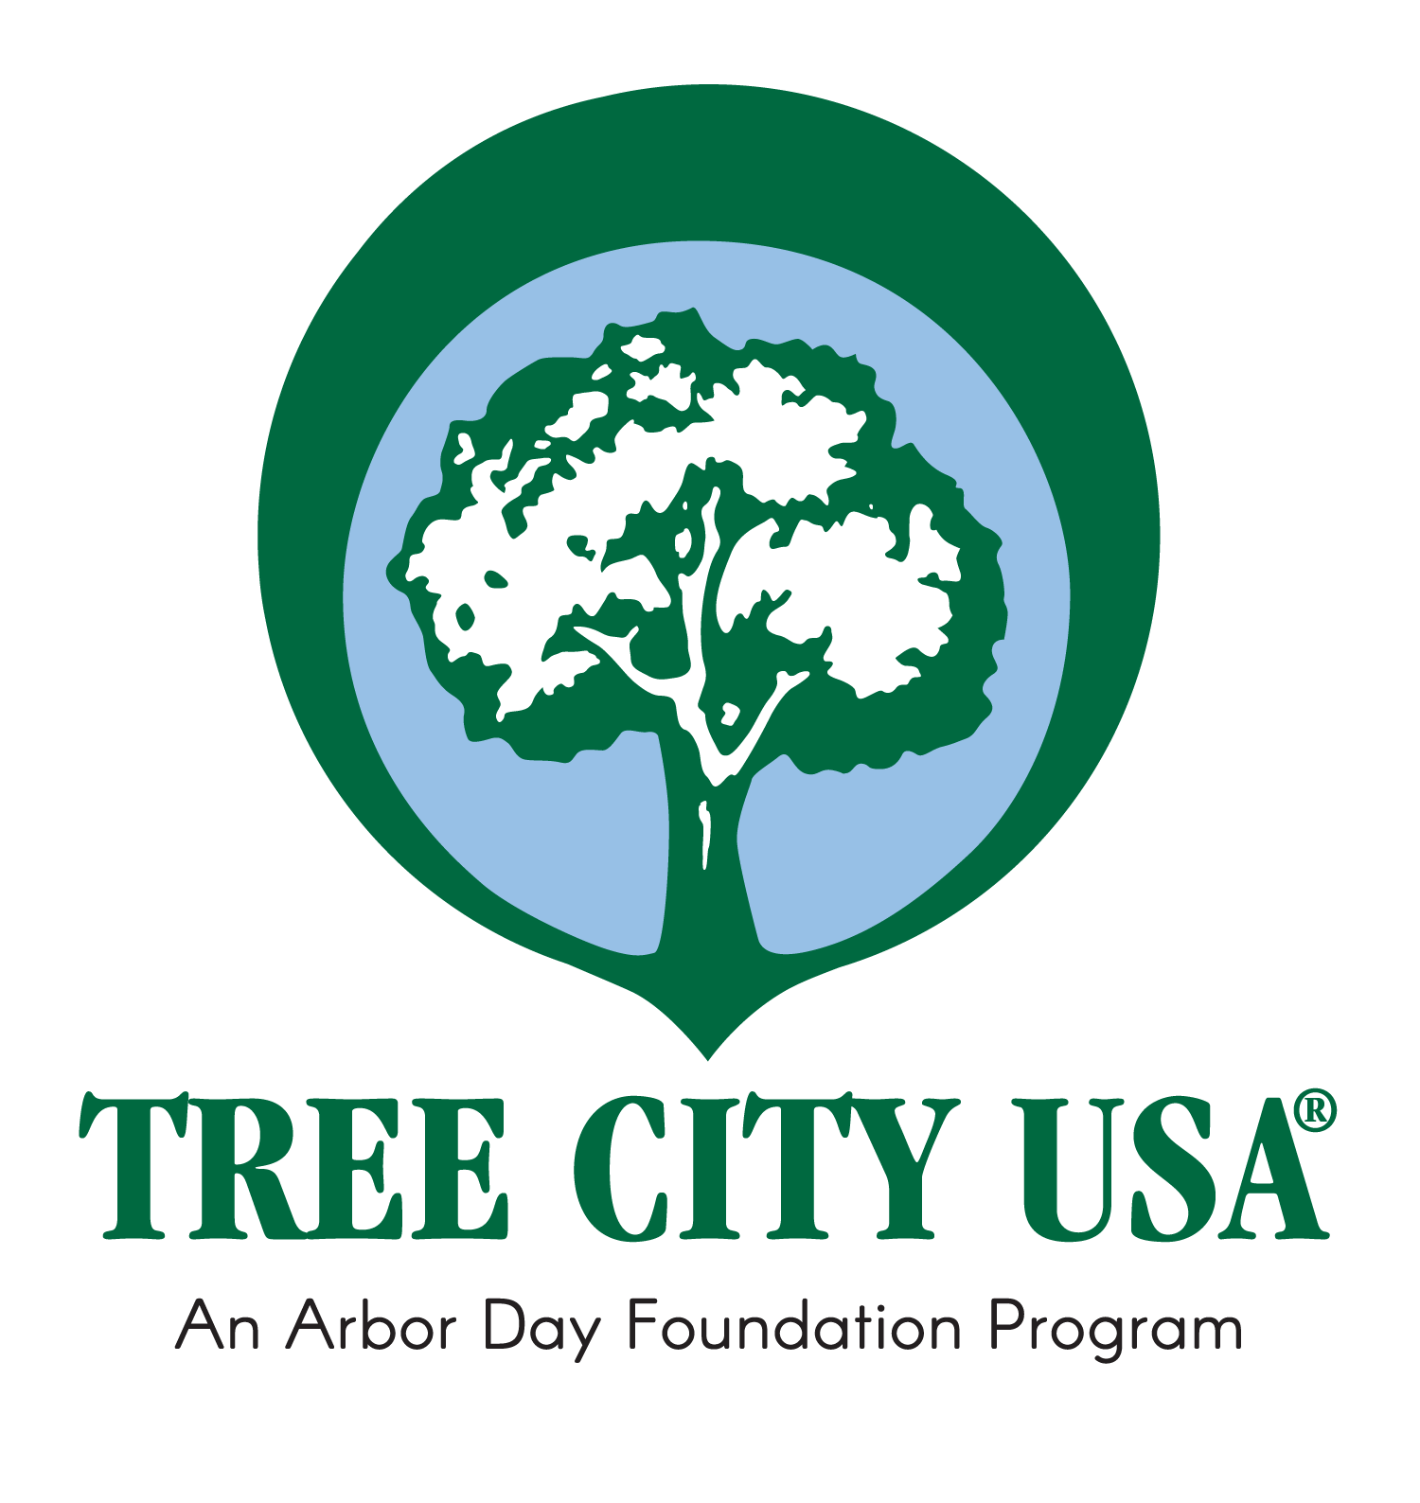
Tree City USA:
A Foundation for a Thriving Urban Forest
Michael Brunk
Illinois Urban and Community Forestry

Slide 34
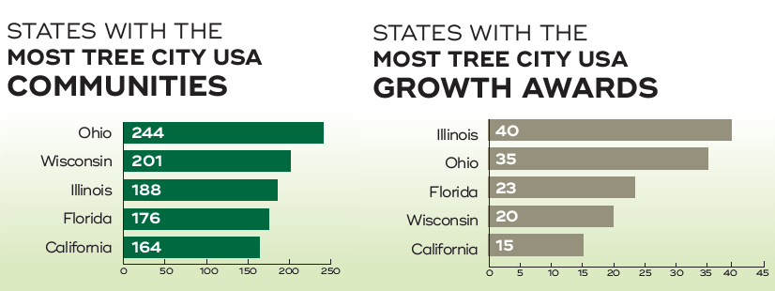

Slide 35
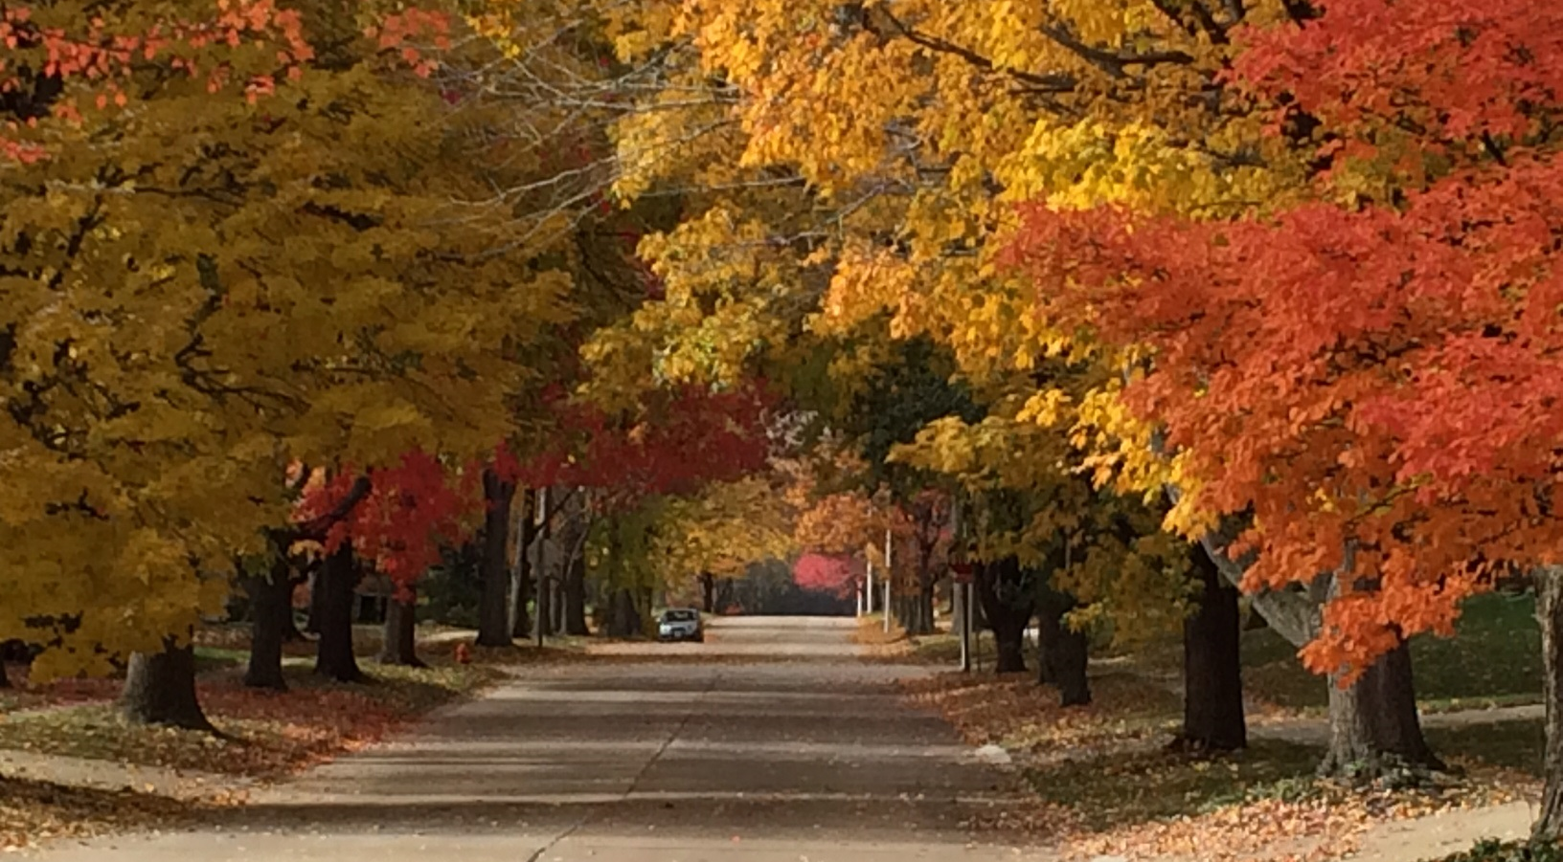

Slide 36
SEE THE FOREST FOR THE TREES
“A town is saved, not more by the righteous men in it than by the woods…that surround it.”
-Henry David Thoreau

