Slide 1
Copyright © 2000–2023 by Kalkomey Enterprises, LLC. All rights reserved. No part of this Boat Ed® PowerPoint® presentation may be reproduced or copied in any form or by any process without permission in writing from Kalkomey Enterprises, LLC.

Slide 3
Class Plan
Lesson One:
Lesson Two:
Lesson Three:
Lesson Four:
Lesson Five:
Lesson Six:
Know Your Boat
Before You Get Underway
Operating Your Boat…Safely
Legal Requirements of Boating
Boating Emergencies…What to Do
Enjoying Water Sports With Your Boat

Slide 4
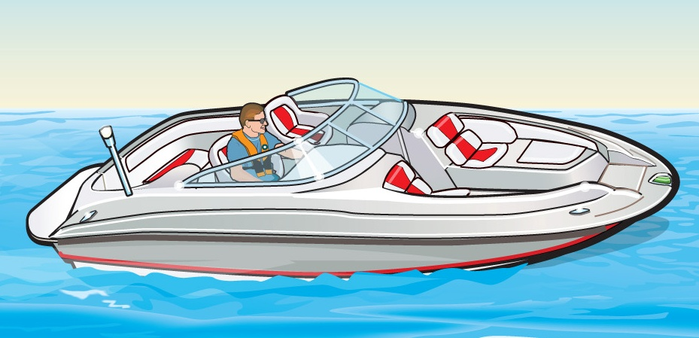
Lesson One
Know Your Boat

Slide 5
Key Topics
Parts of a Boat
Types of Boat Hulls
Length of a Vessel
Types of Engines and Drives
Personal Watercraft
Sailboats

Slide 6
Objectives
You should be able to…
Identify the basic parts of a boat, a personal watercraft, and a sailboat.
Identify the different types of hulls and their performance characteristics.
Identify the different kinds of engines commonly found in recreational vessels.

Slide 7
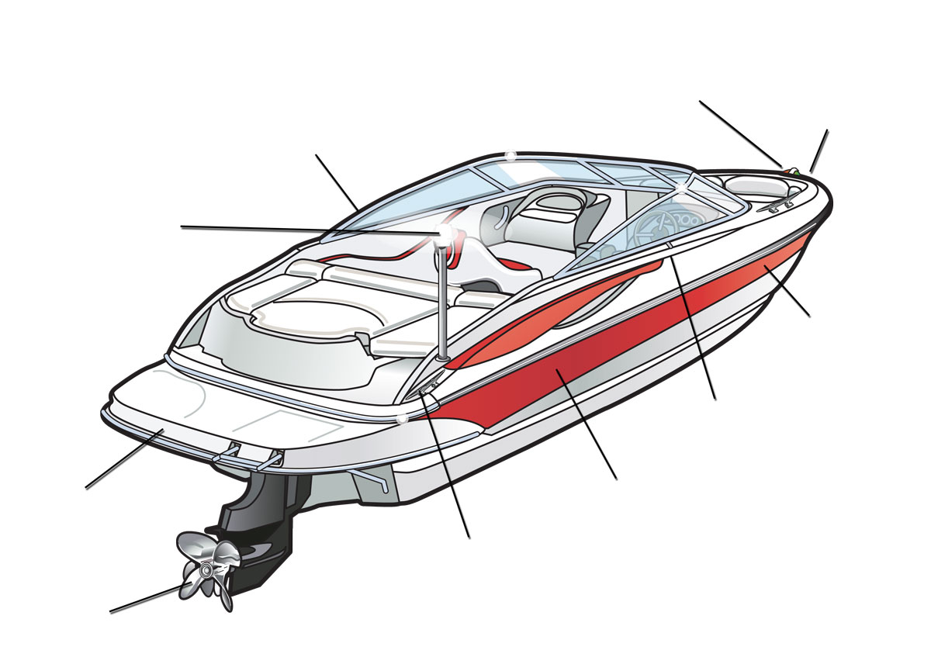
The Many Parts of a Boat
red and green sidelights
bow
port
all-round white light
hull
gunwale
stern
starboard
cleat
propeller

Slide 8
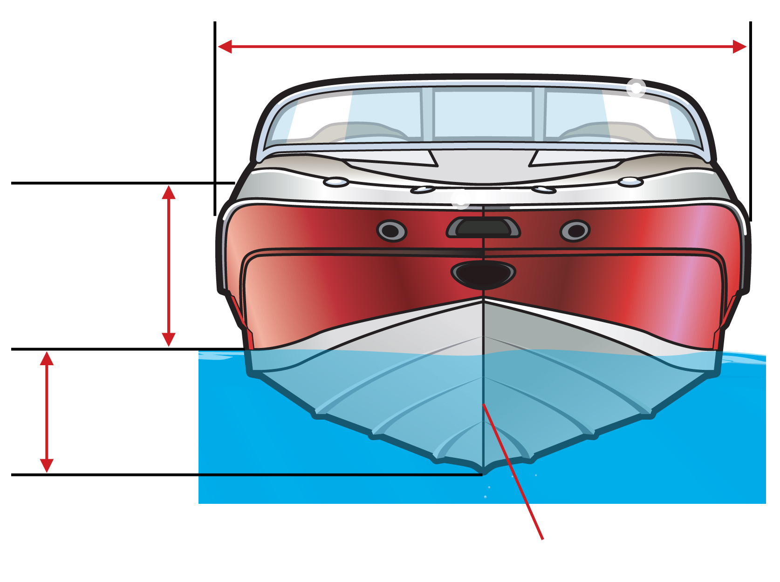
The Many Parts of a Boat
beam
freeboard
draft
keel

Slide 9
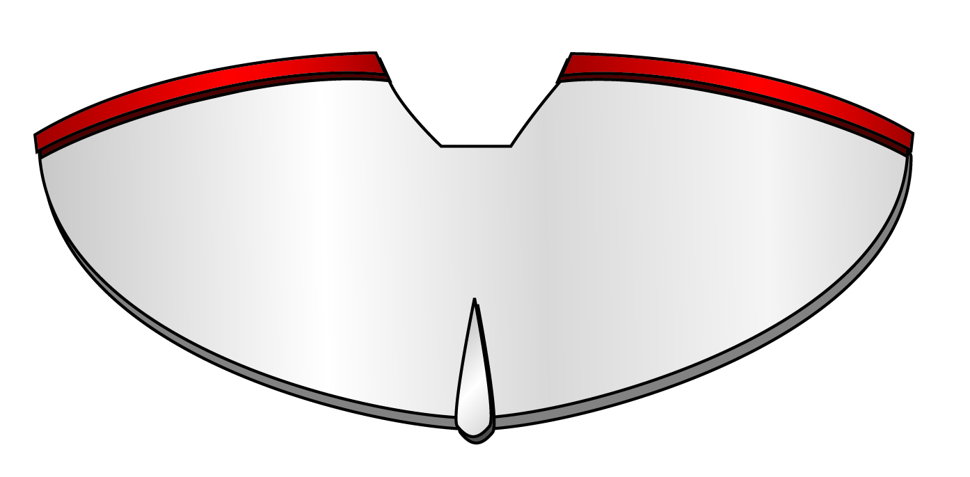
Types of Boat Hulls
Displacement Hulls
Round-Bottomed Hull
Round Bottom

Slide 10
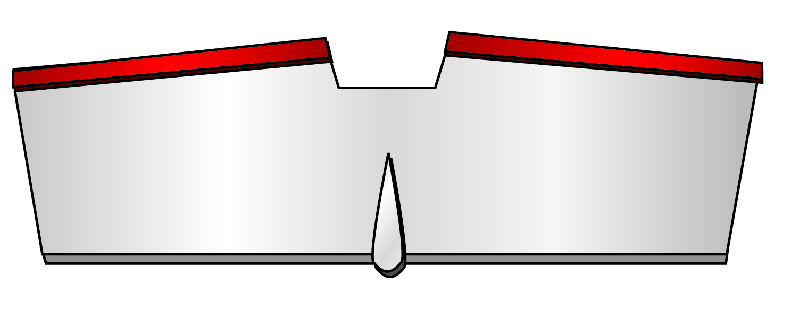
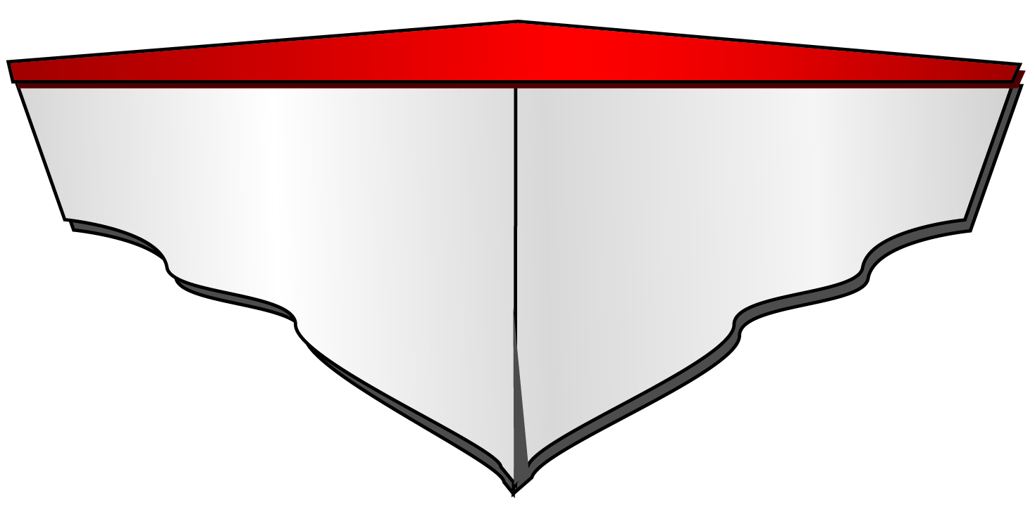
Types of Boat Hulls
Planing Hulls
Flat-Bottomed Hull
Vee-Bottomed Hull
Flat Bottom
Vee Bottom

Slide 11
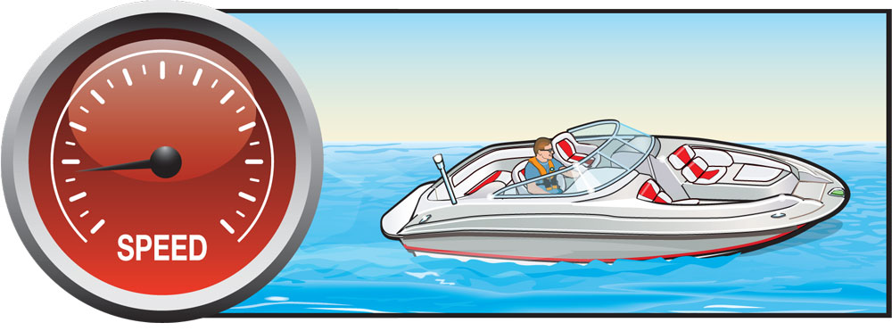
Types of Boat Hulls
How Planing Hulls Operate
Displacement Mode

Slide 12
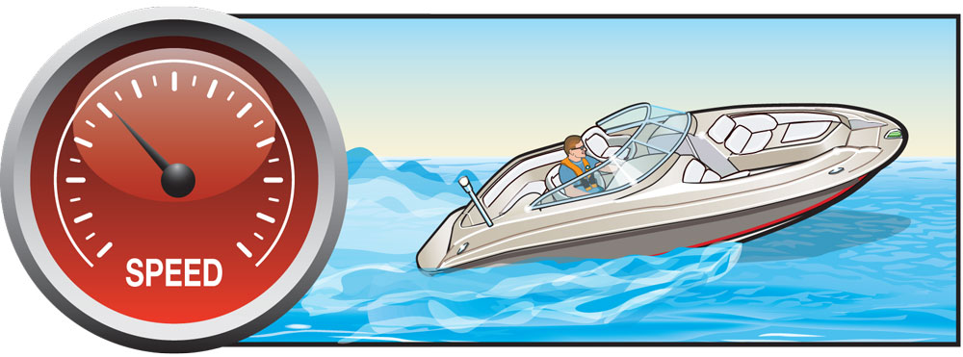
Types of Boat Hulls
Plowing Mode

Slide 13
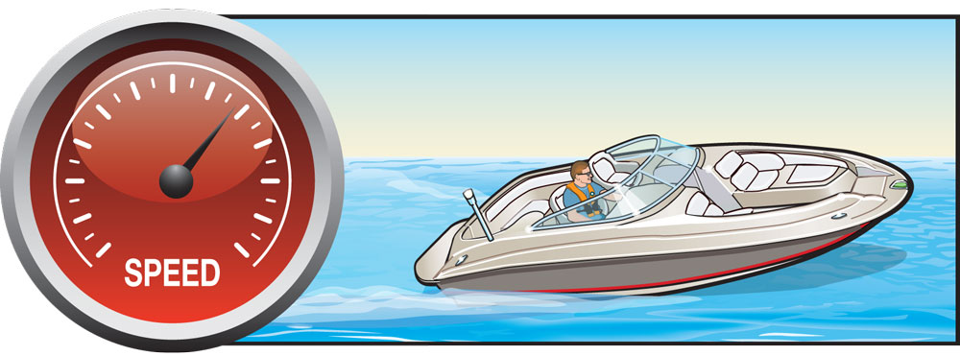
Types of Boat Hulls
Planing Mode

Slide 14
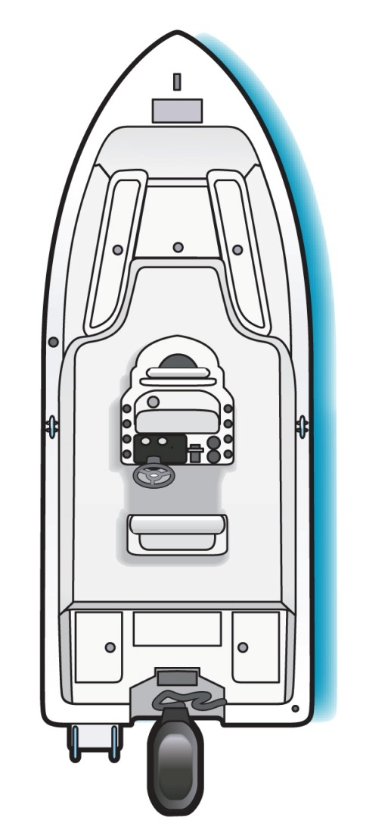
Length of a Vessel
Notes:
Ask a student to come up and show how he/she thinks the length would be measured on an outboard boat. Then ask the class if they agree.

Slide 15
Length of a Vessel
Notes:
Ask another student to come up and show how he/she thinks the length would be measured on an inboard boat. Then ask the class if they agree.

Slide 16
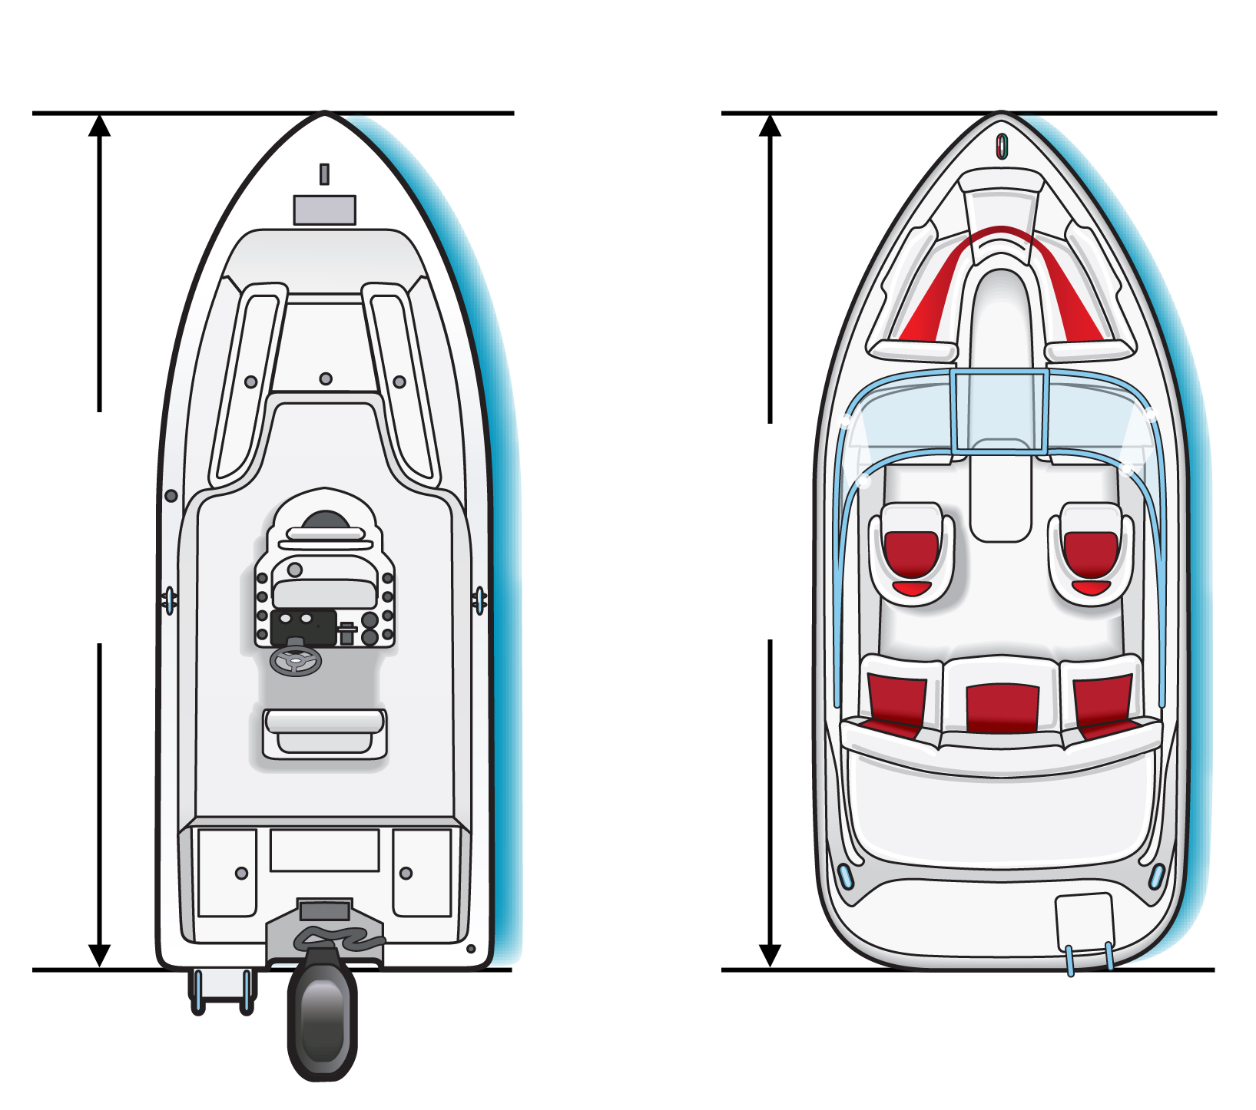
Length of a Vessel
Outboard
Inboard
Length
Length

Slide 17
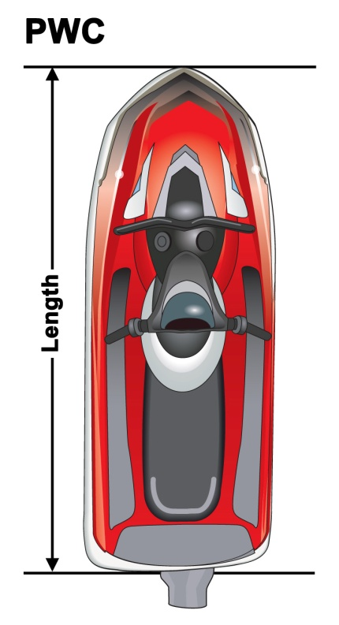
Length of a Vessel
Less than 16 feet (Class A)
16 feet to less than 26 feet (Class 1)
26 feet to less than 40 feet (Class 2)
40 feet to less than 65 feet (Class 3)

Slide 18
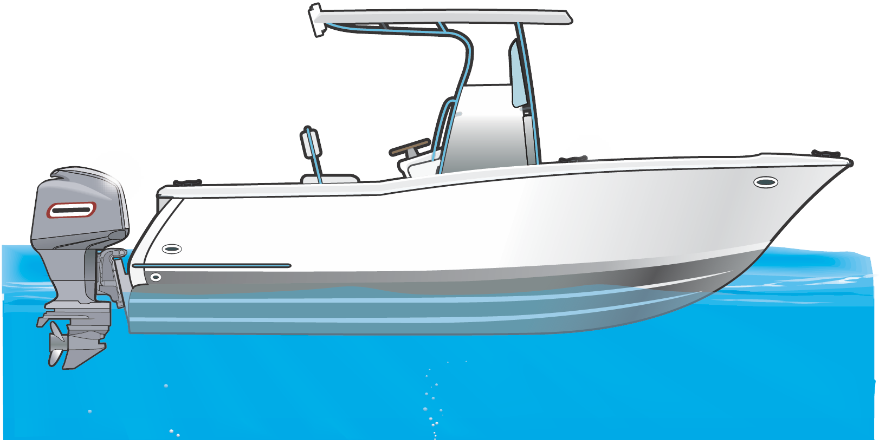
Types of Engines and Drives
Outboards

Slide 19
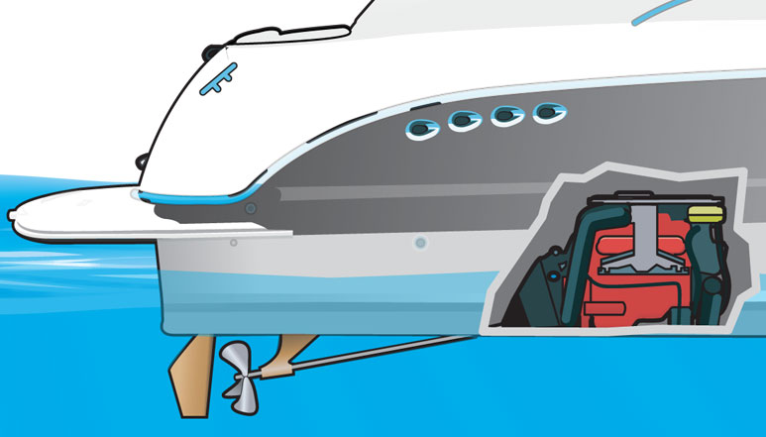
Types of Engines and Drives
Inboards

Slide 20
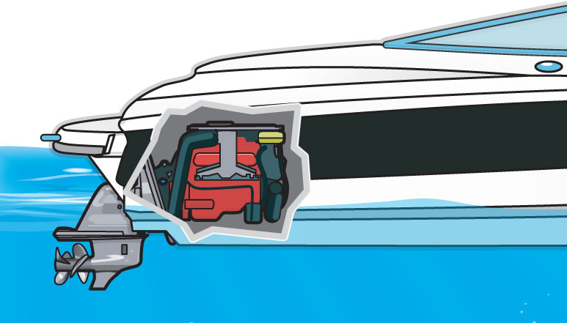
Types of Engines and Drives
Stern Drives

Slide 21
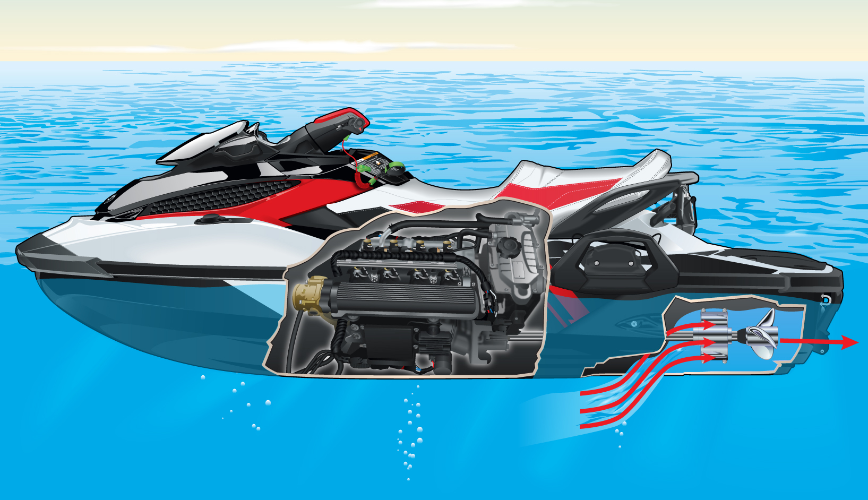
Types of Engines and Drives
Jet Drives

Slide 22
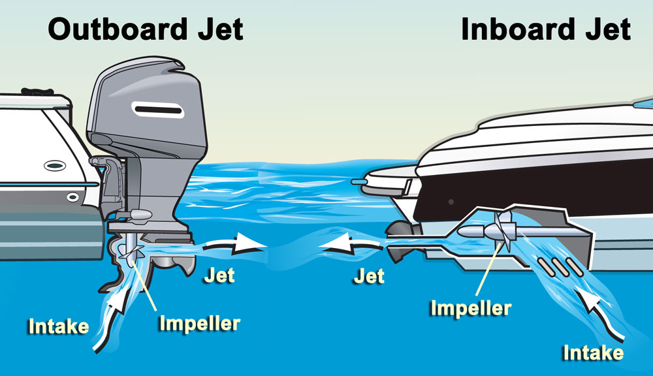
Types of Engines and Drives
Jet Drives

Slide 23
Personal Watercraft
Jet-propelled watercraft come in many sizes. The personal watercraft (PWC) is the most common for recreational boaters.
PWC:
Use an inboard jet drive as primary source of propulsion.
Are included in the group of inboard vessels less than 16 feet in length.
Are subject to the same laws and requirements of any other vessel plus some specific to PWC.

Slide 24
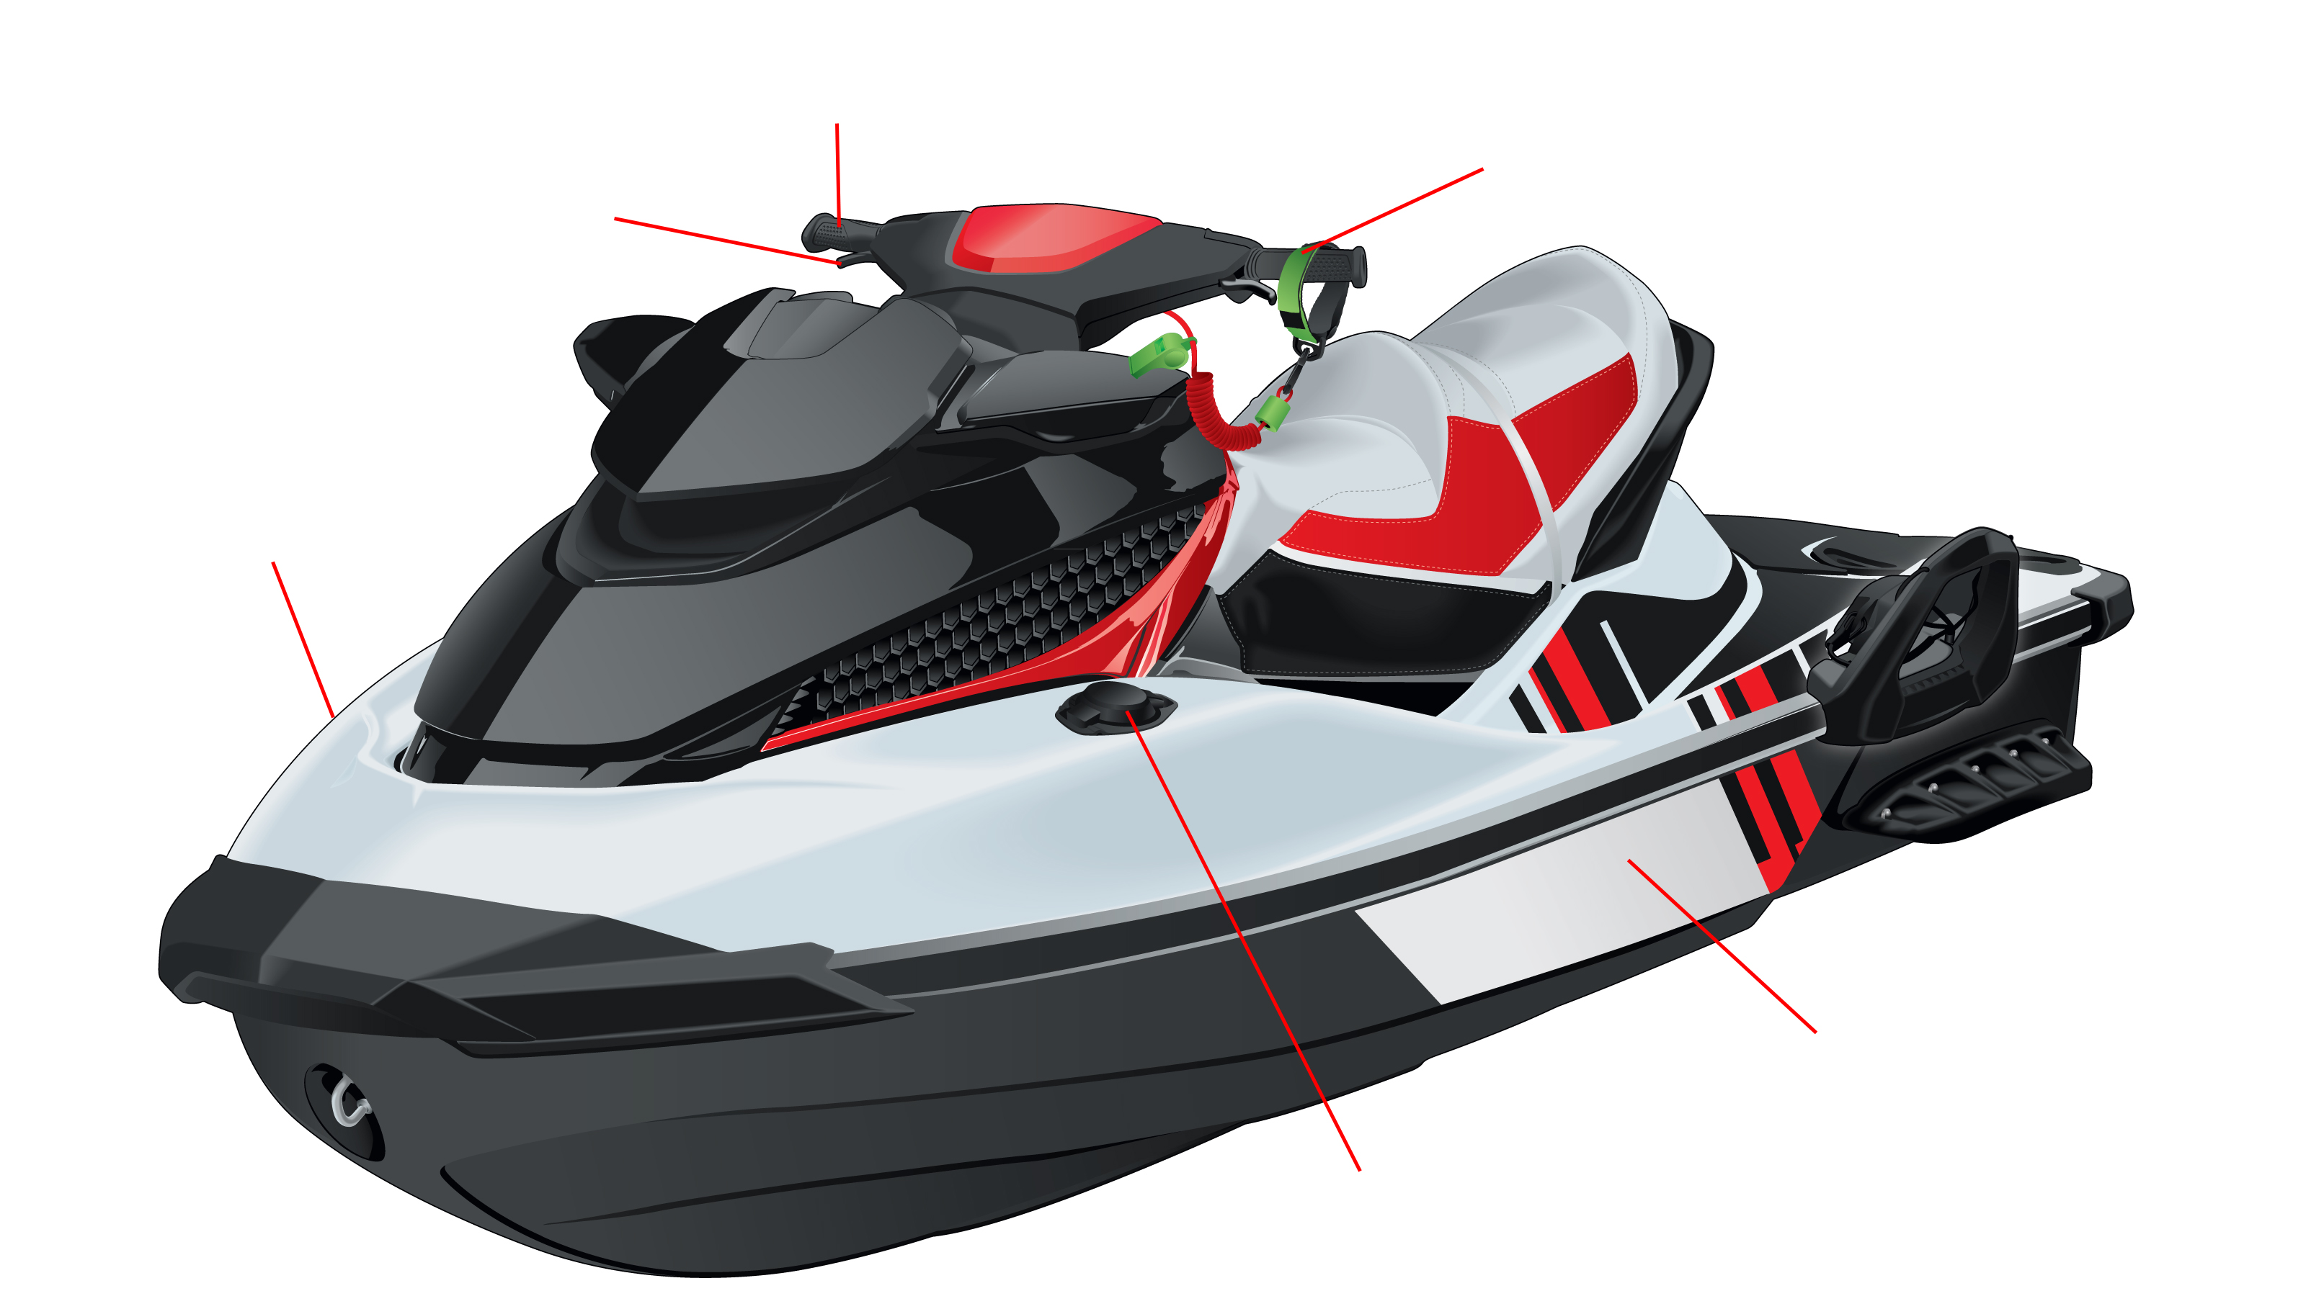
Personal Watercraft
steering control
safety lanyard
throttle lever
starboard
port
fuel cap

Slide 25
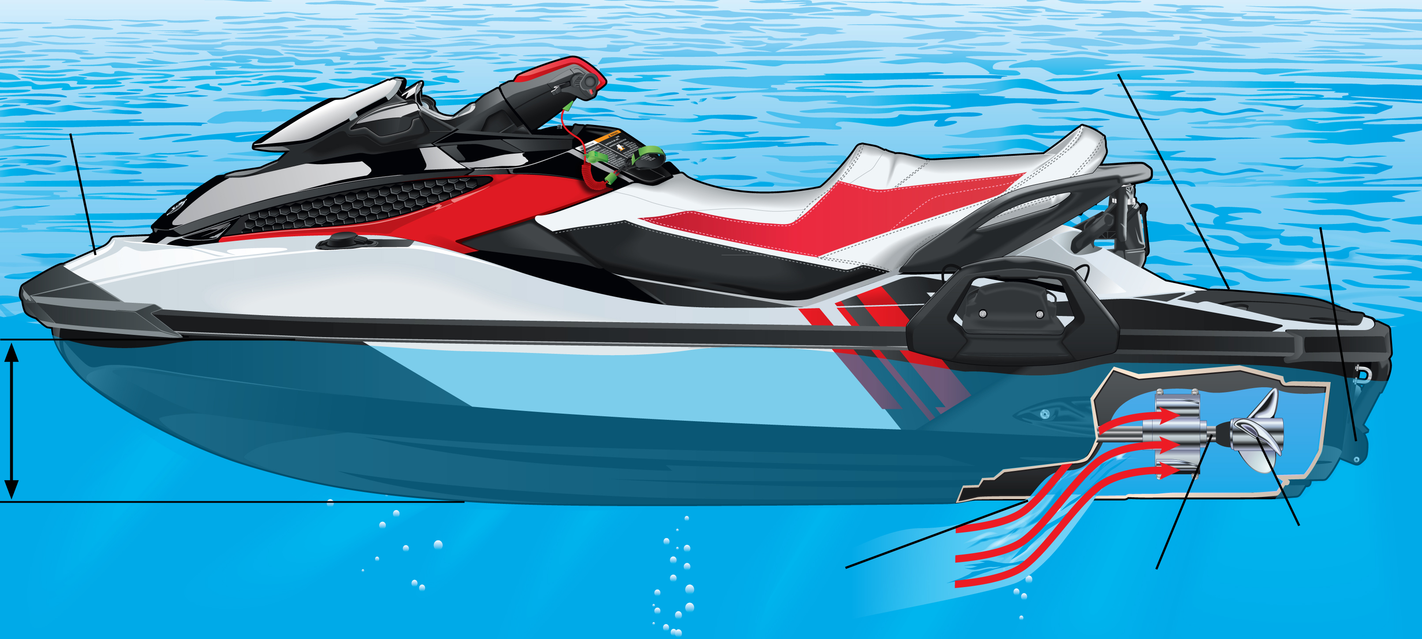
Personal Watercraft
stern
bow
steering nozzle
draft
impeller
jet pump intake grate
drive shaft

Slide 26
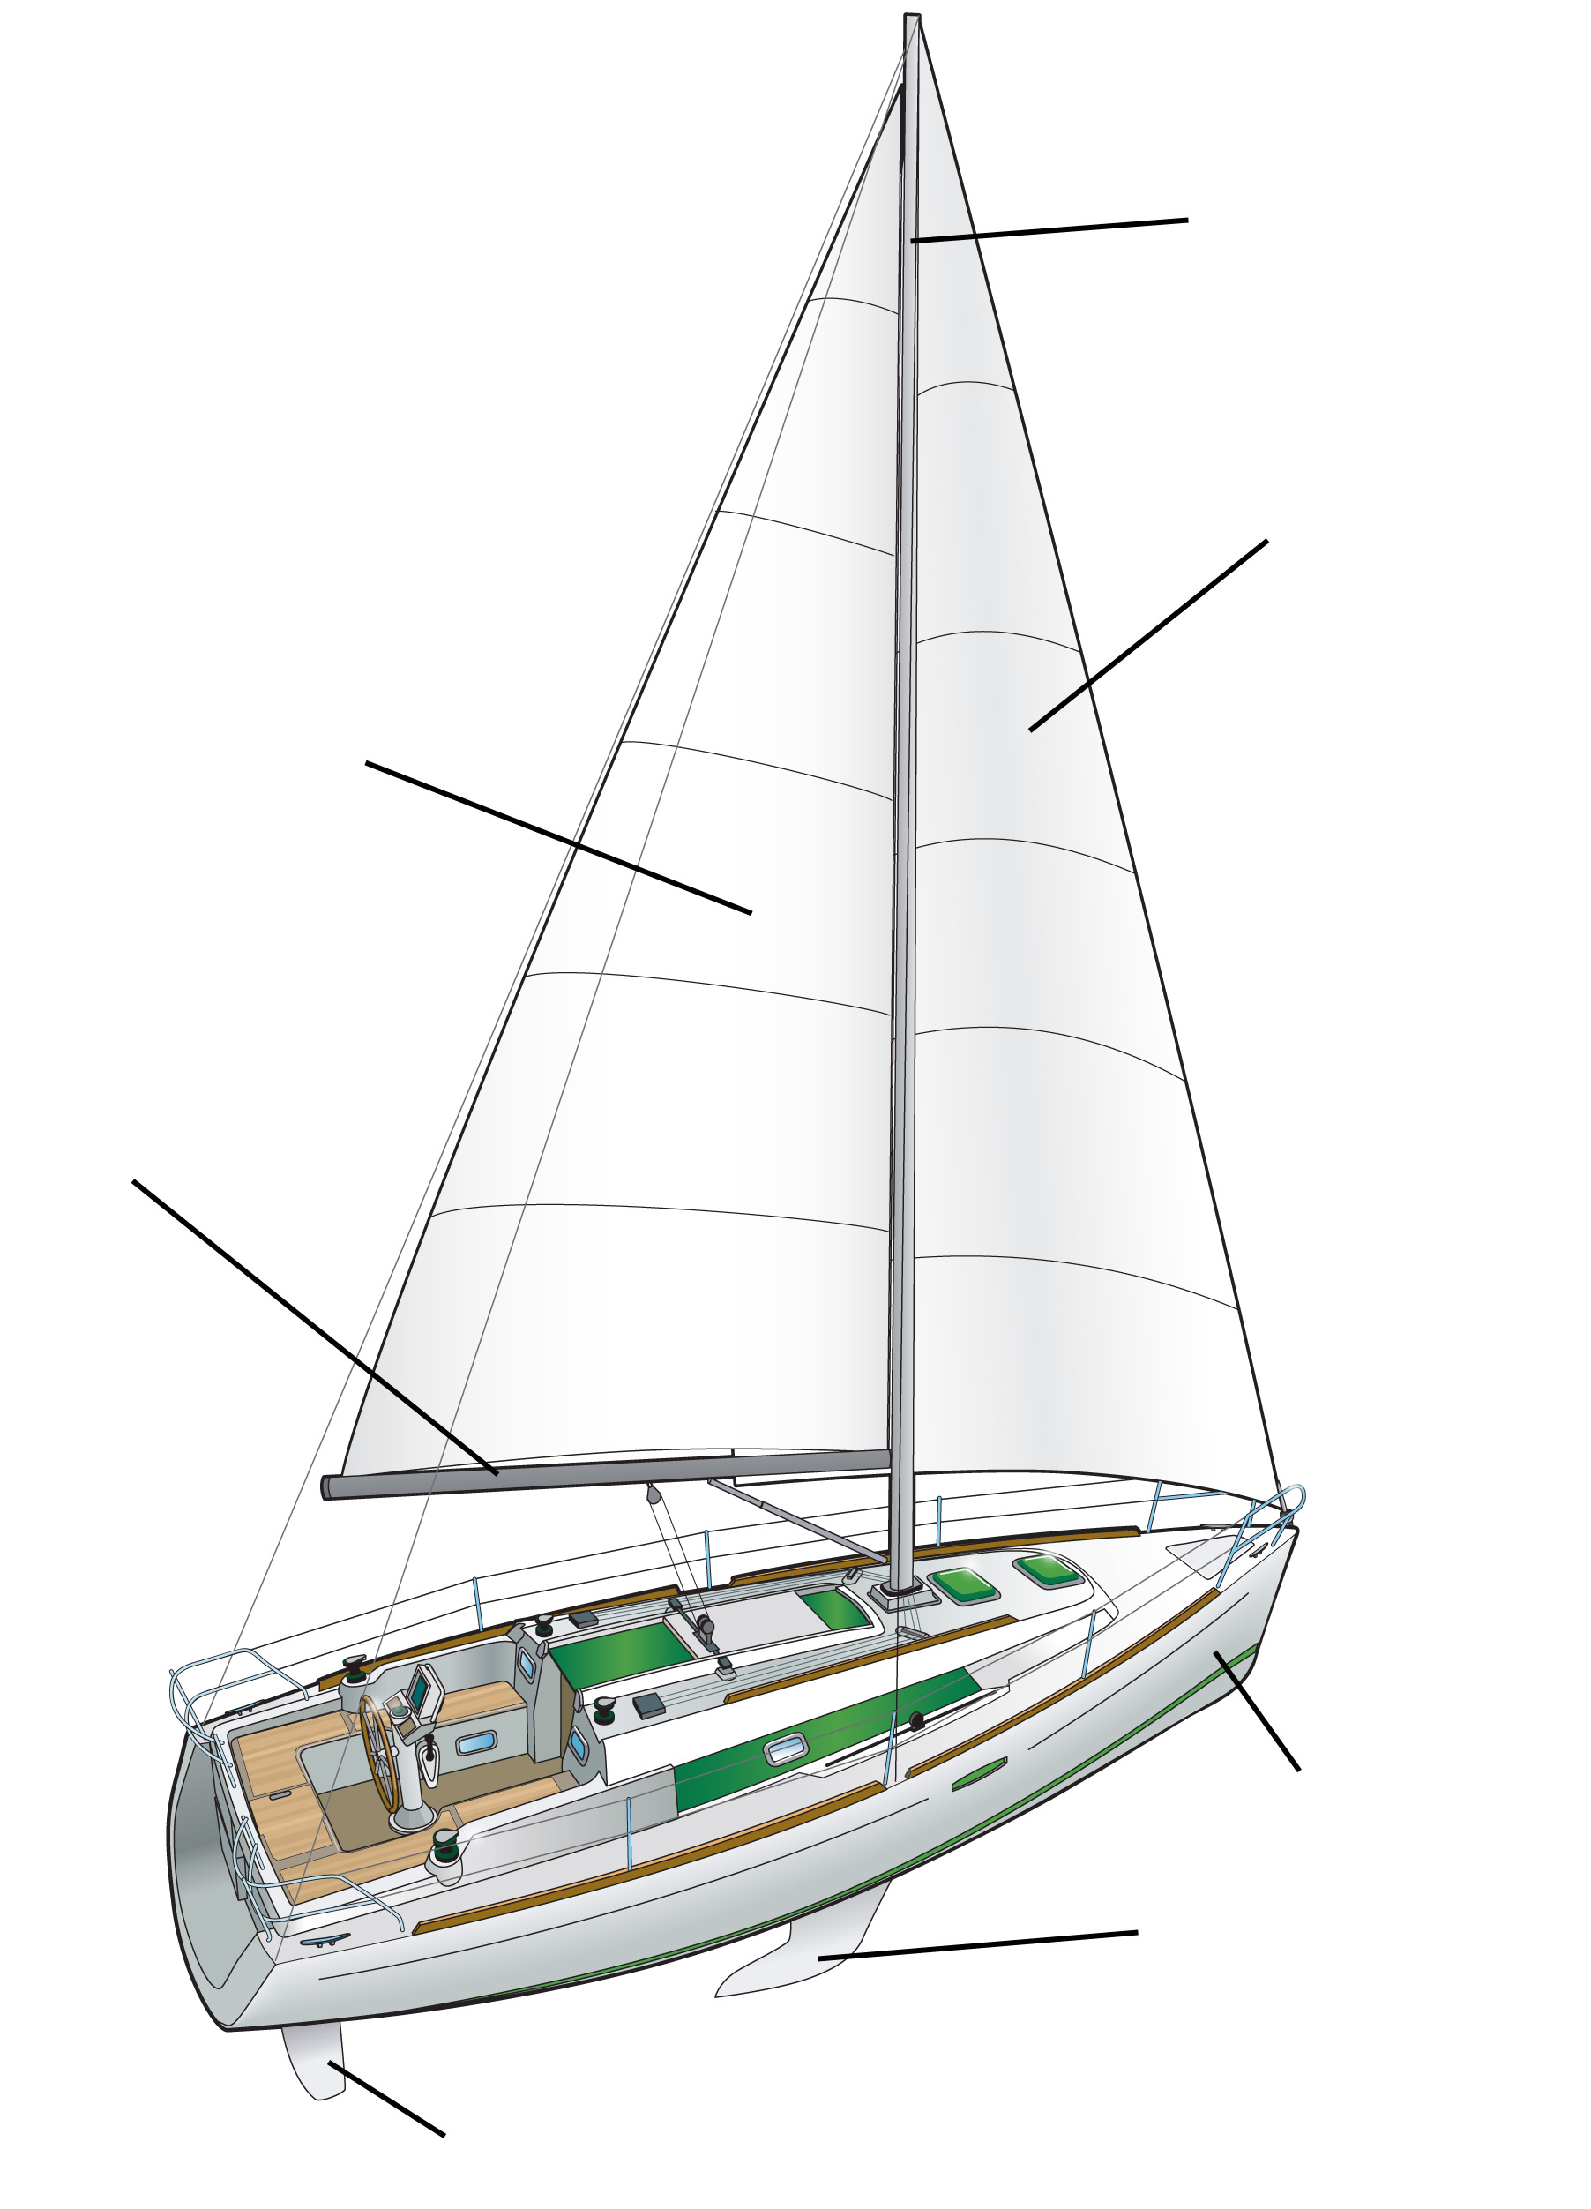
Sailboats
mast
halyards
headsail
(jib)
mainsail
sheets
boom
hull
keel
rudder

Slide 27
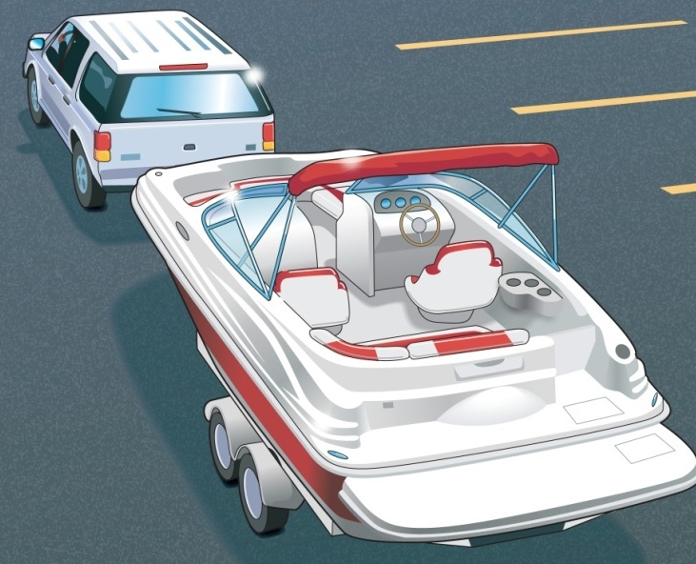
Lesson Two
Before You Get Underway

Slide 28
Key Topics
Boat’s Capacity
Float Plans
Fueling a Vessel and a Personal Watercraft
Trailering/Courtesy on the Boat Ramp
Vessel and Engine Maintenance

Slide 29
Objectives
You should be able to…
Locate and understand a boat’s capacity plate.
File a proper float plan.
Explain how to fuel a vessel safely.
Explain how to launch a vessel from a trailer and retrieve it from the water safely and courteously.
Give the basics of vessel and engine maintenance.

Slide 30
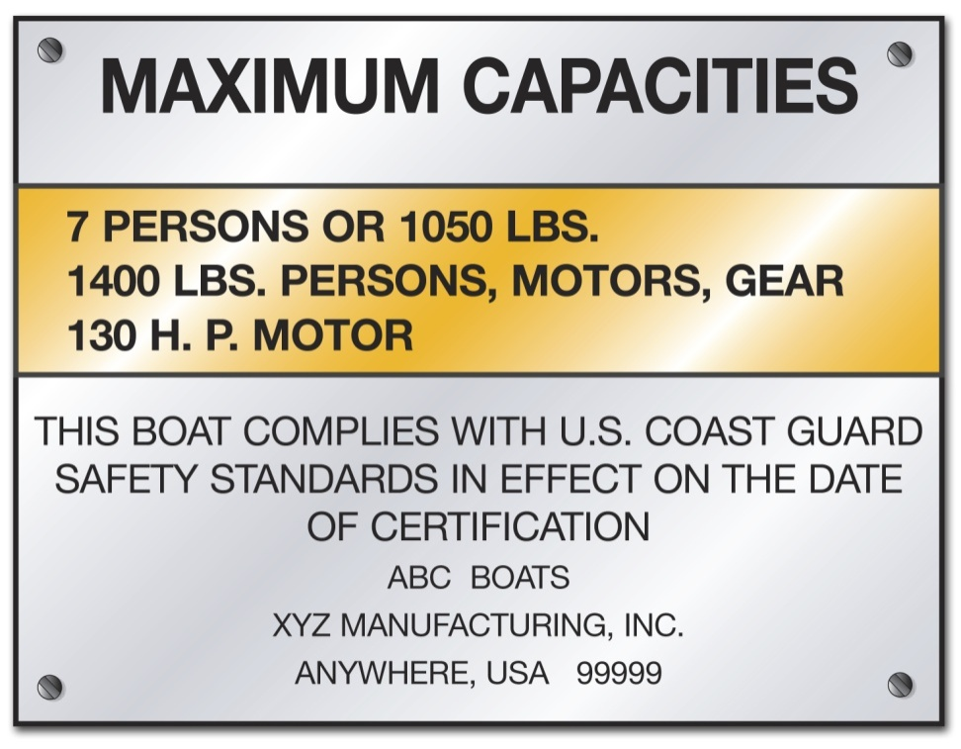
Boat Capacity
Maximum weight includes weight of:
Passengers
Gear
Motors

Slide 31
Boat Capacity
Do not exceed the recommended capacity found in the owner’s manual and on manufacturer’s warning decal.
On outboard boats, never exceed the maximum horsepower rating shown on the capacity plate.
On vessels less than 20 feet in length without a capacity plate:
Number of people = vessel length (ft.) X vessel width (ft.)
15

Slide 32
Boat Capacity
Example:
Vessel Length: 18 feet
Vessel Width: 6 feet
Number of people = 18 feet long X 6 feet wide
Number of people = 108
Number of people = 7.2
(no more than 7 people on board)
15
15

Slide 33
File a Float Plan
For short outings, inform a responsible person of:
WHERE you are boating
WHEN you are returning
WHO to call

Slide 34
File a Float Plan
For extended outings, include:
WHO is going
WHERE you are going
WHAT boat you are in
WHEN you are leaving and returning

Slide 35
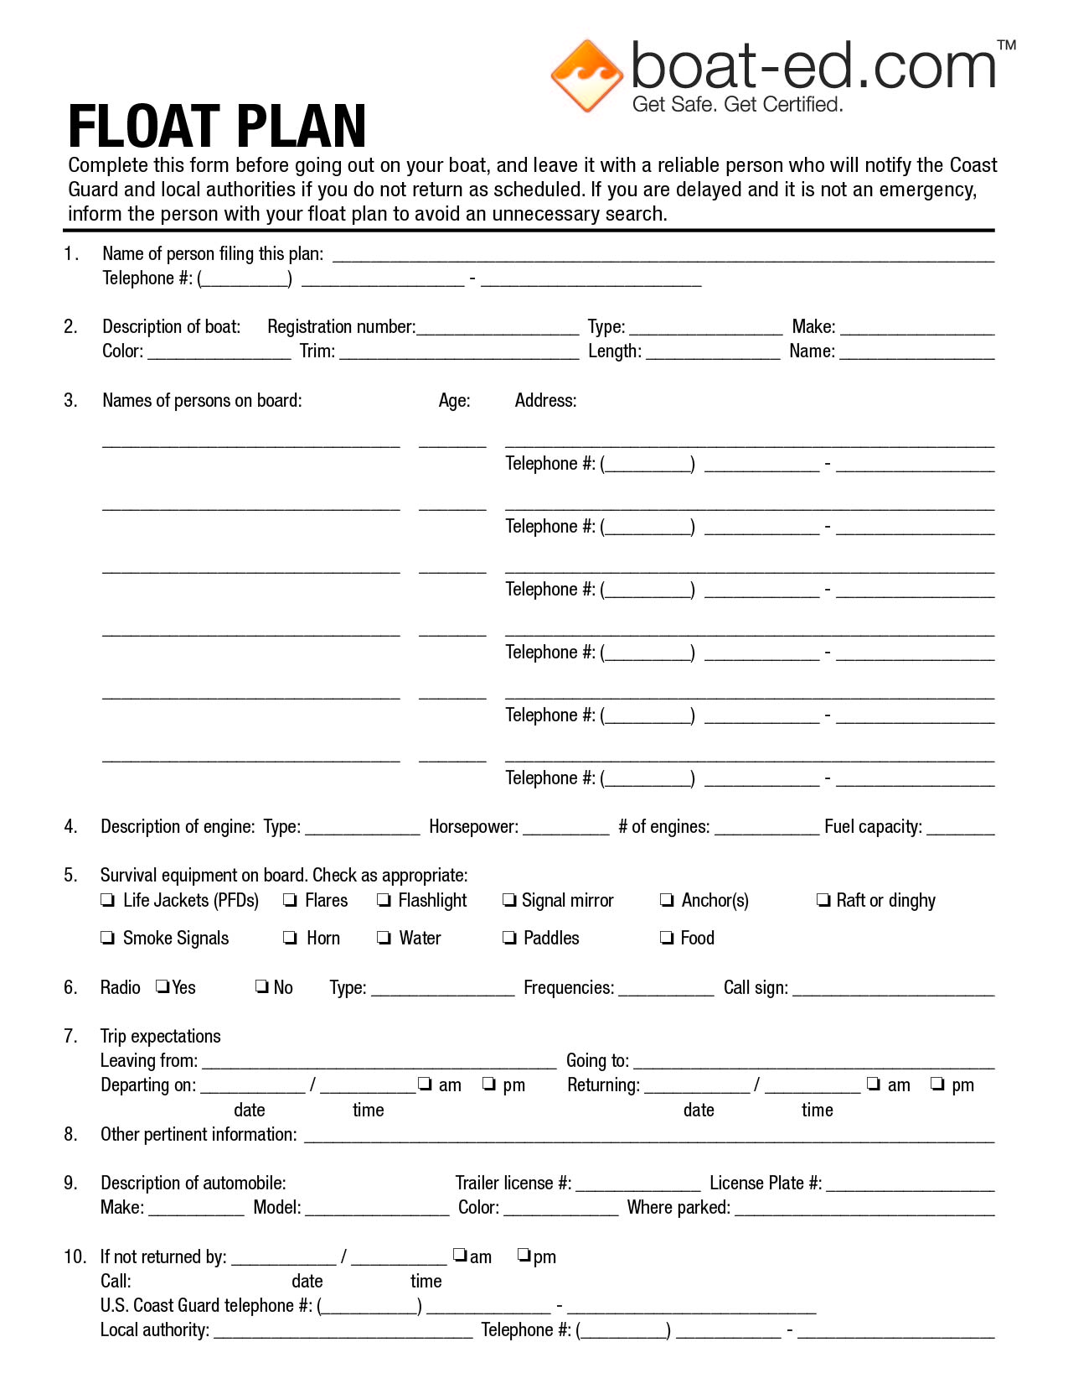
File a Float Plan

Slide 36
Fuel Your Vessel…Safely
Before fueling:
Refuel away from the water.
Tie up the boat.
Unload all passengers.
Turn off all sources that could result in a flame.
Close all windows, ports, and doors.
Unload portable fuel tanks.

Slide 37
Fuel Your Vessel…Safely
While filling the fuel tank:
Keep nozzle of fuel-pump hose in contact with tank opening.
Use caution and fill tank slowly.
Never fill tank to brim.
Wipe up any spilled fuel.

Slide 38
Fuel Your Vessel…Safely
After fueling:
Put fill cap on tightly.
Open all windows, ports, doors, and other openings.
Turn on exhaust blower for four minutes.
Sniff for fuel vapors.
Start engine and reload passengers.

Slide 39
Fuel Your Vessel…Safely
To make sure you do not run out of fuel, use this rule:
One-third to get out
One-third to get back
One-third in reserve

Slide 40
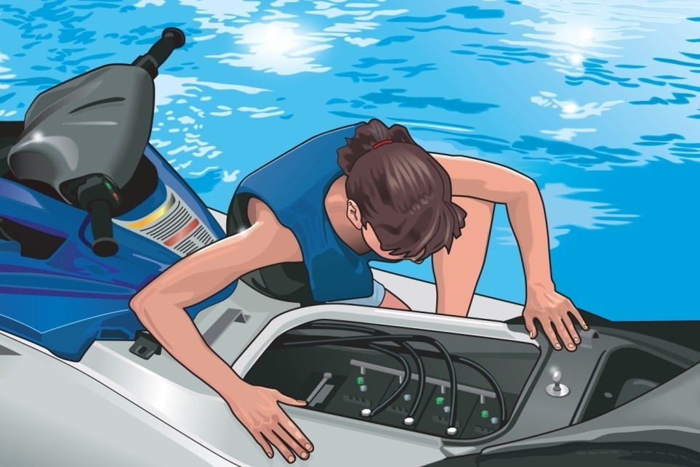
Fuel Your Vessel…Safely
Fueling Issues for a Personal Watercraft (PWC)
Check fuel system for leaks and inspect connections frequently.
Avoid fuel spills in or near water.
Do not tip PWC to fill all the way up.
After fueling, sniff to check for gas fumes.

Slide 41
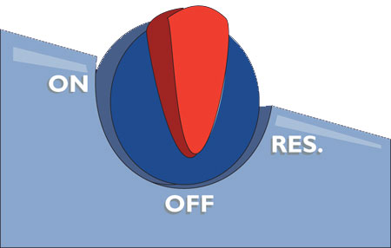
Fuel Selector Switch on a PWC
OFF
ON
RESERVE

Slide 42
Trailering Your Vessel
Choose the Right Trailer & Vehicle to Tow Your Vessel
The trailer and towing vehicle should be designed to fit your vessel.
Use the size of vessel to determine the trailer’s dimensions.

Slide 43
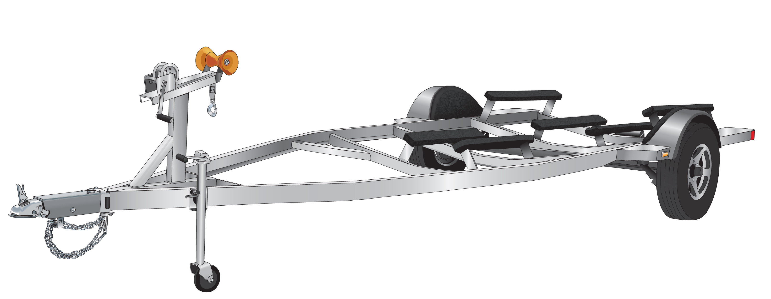
Trailering Your Vessel
Make sure the weight of the vessel and engine does not exceed 90% of trailer’s load capacity. The trailer must carry your:
Vessel
Engine
Fuel
Gear

Slide 44
Trailering Your Vessel
Example:
Vessel Size: 19 feet long
Weight of Vessel: 2600 lbs. (Includes weight of engine, fuel, and gear)
Which capacity trailer would you choose?
2300 lbs.
OR
3000 lbs.

Slide 45
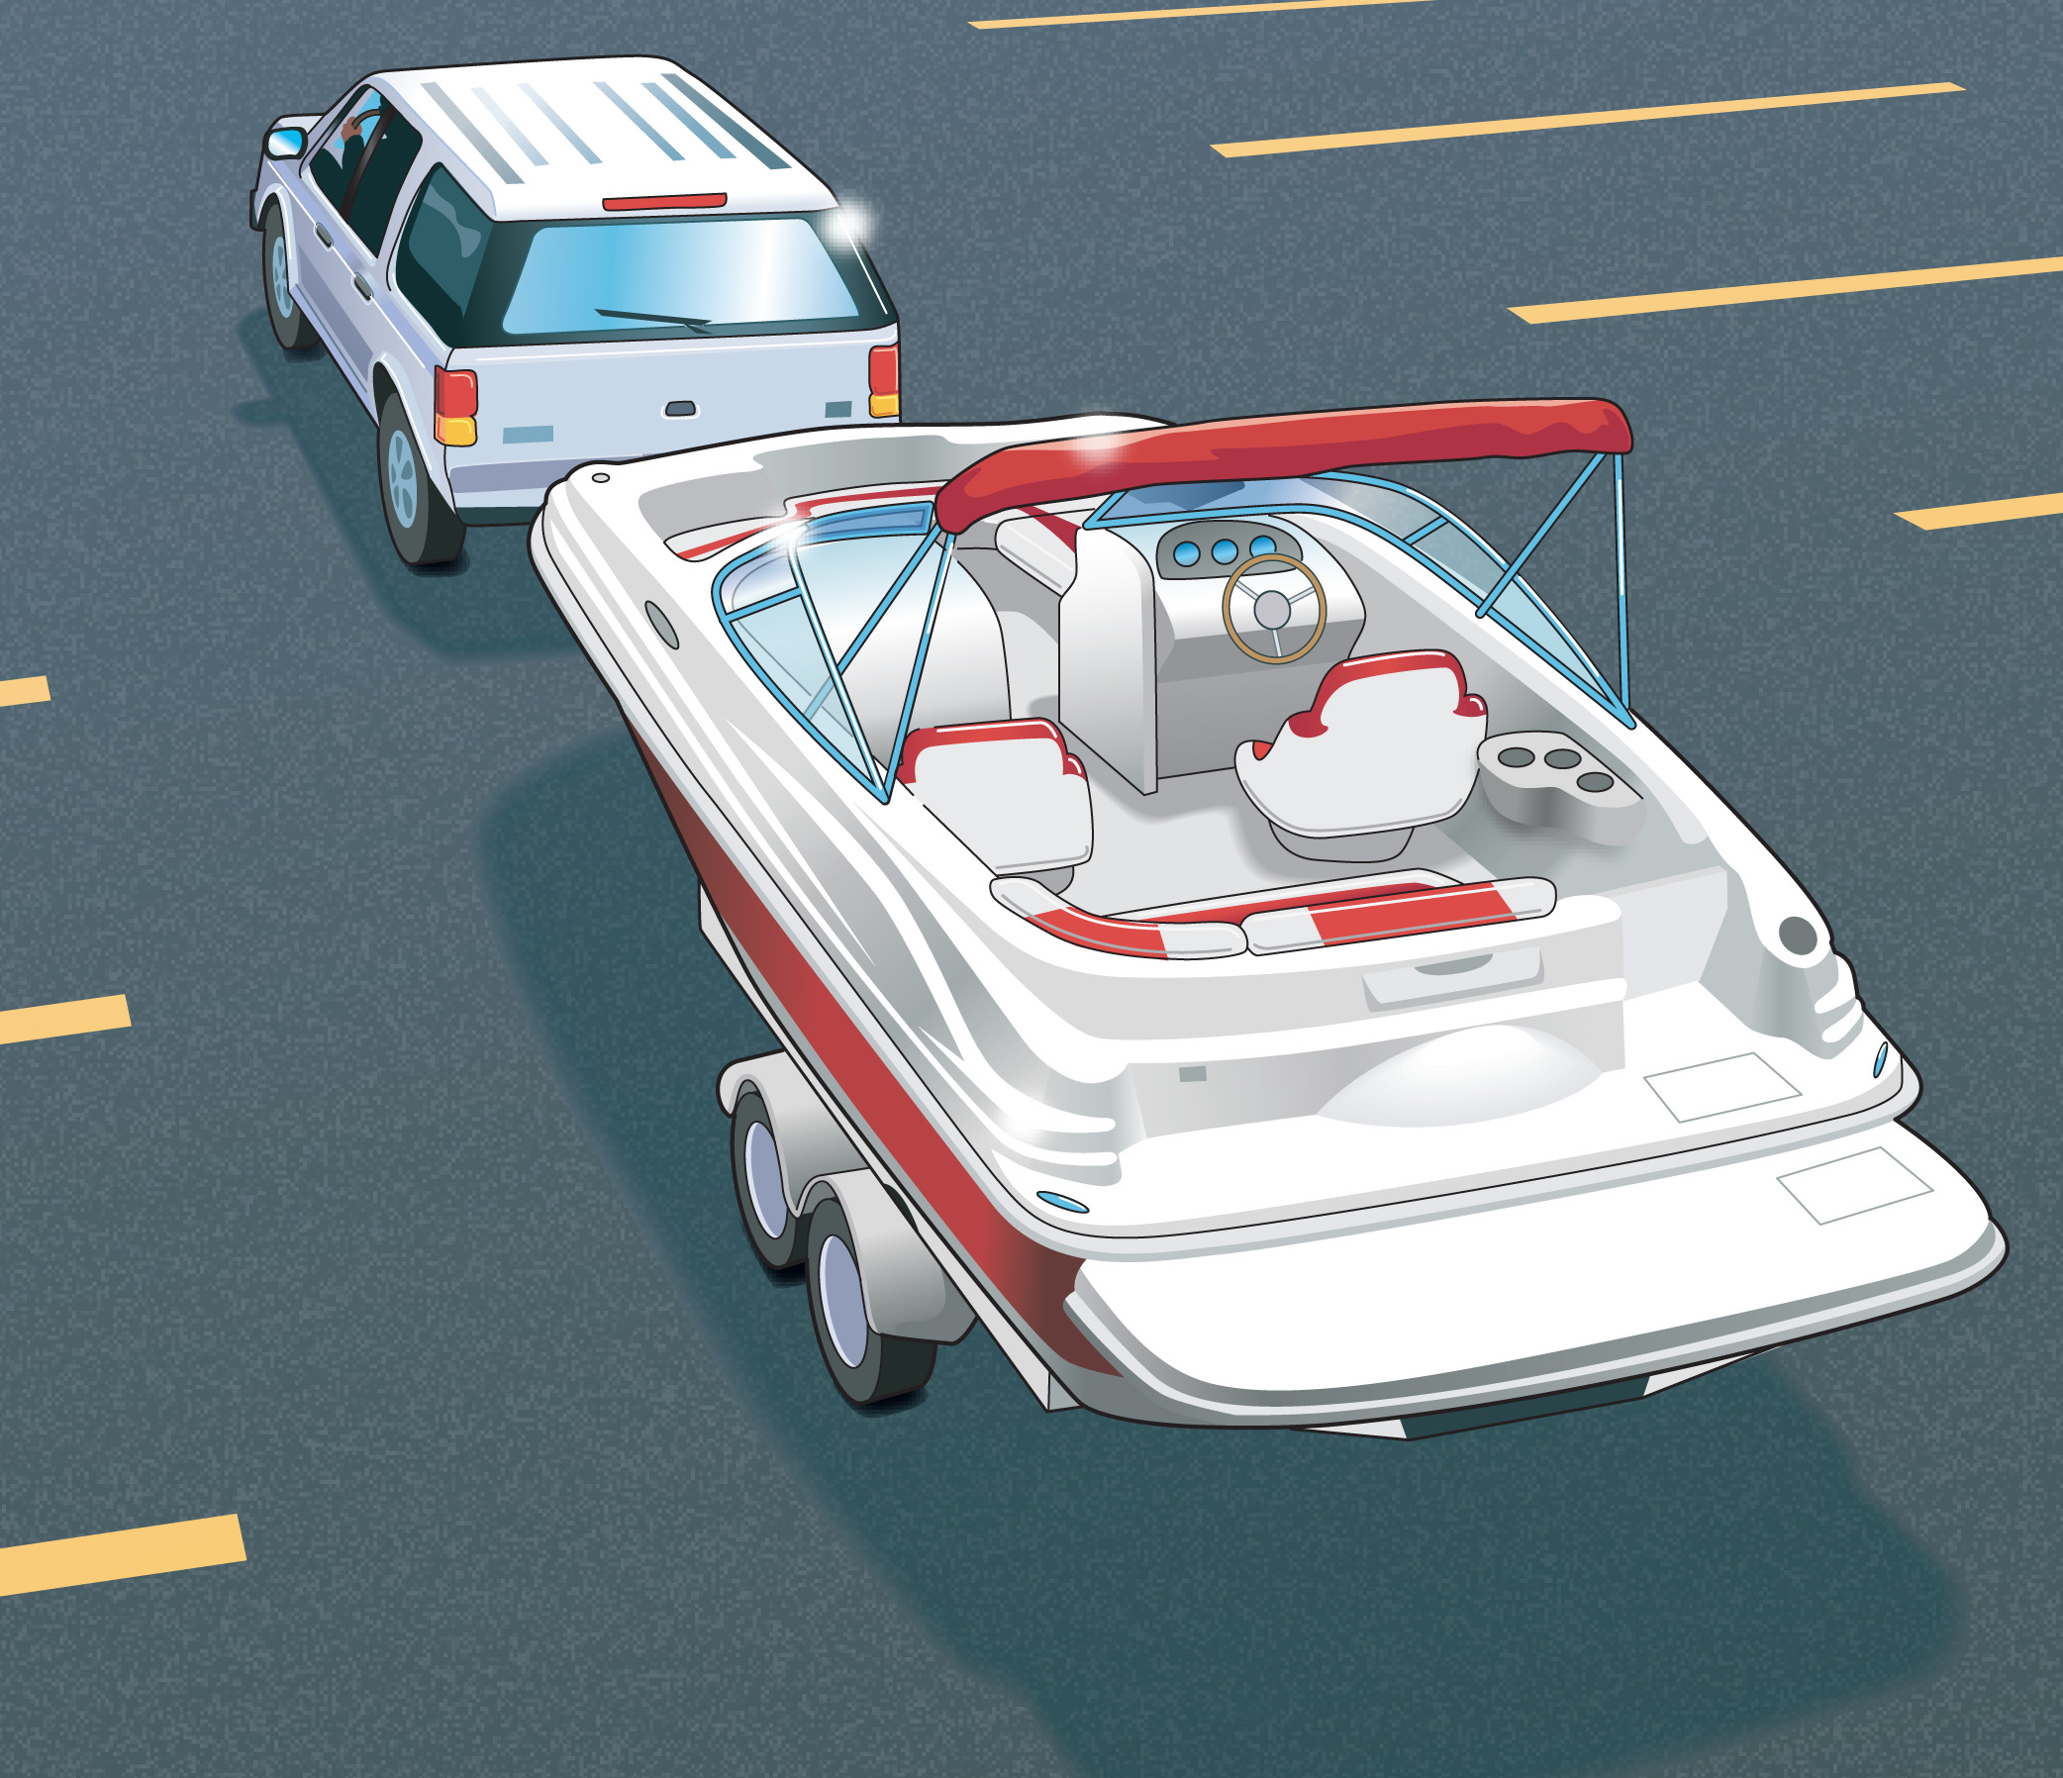
Trailering Your Vessel
Choosing the Right Vehicle
The towing vehicle must be rated to tow the combined weight of:
Vessel
Engine
Trailer

Slide 46
Trailering Your Vessel
Towing hitch must be appropriate for the loaded trailer.
Ball hitch
Coupler
Tongue weight

Slide 47
Trailering Your Vessel
Example:
The trailer for the vessel has a 2 5/16" coupler.
Which of the following sizes of ball hitch must be used on the towing vehicle?
2 ¼"
2 ½"
2 ⁵/₁₆"
2 ³/₈"

Slide 48
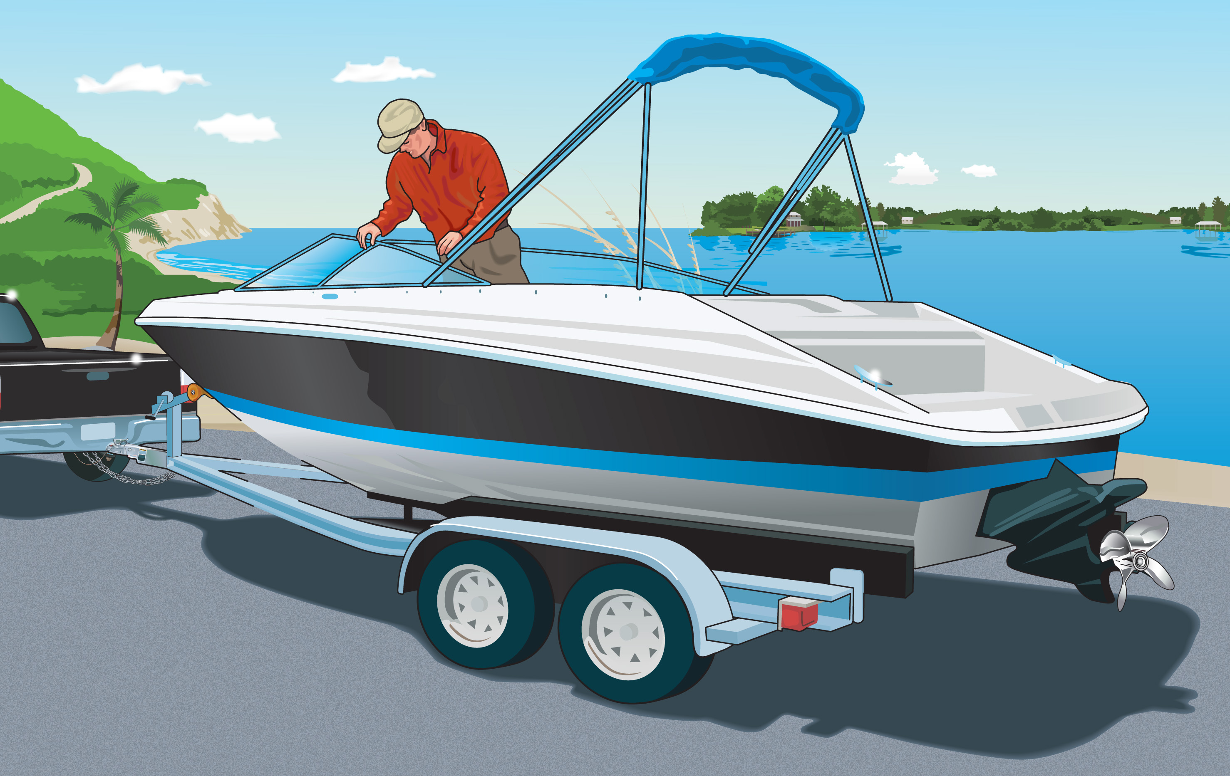
Trailering Your Vessel
Before leaving home:
Secure all gear in the vessel.
Secure the vessel to the trailer.
Secure engine.
Crisscross two safety chains under the trailer tongue.

Slide 49
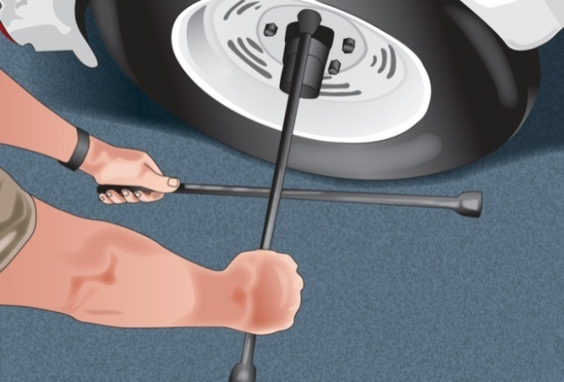
Trailering Your Vessel
Inspect and maintain trailering equipment.
Check tire pressure on all tires.
Tighten lug nuts.
Grease wheel bearings.
Check lights and brakes.
Check tie-down straps, lines, winch, safety chains, and hitch.

Slide 50
Trailering Your Vessel
On the Road With a Trailer
Drive cautiously.
Drive at moderate speeds.
On long trips, pull over every hour or so to check vehicle, trailer, and gear.
Allow for added length and weight of trailer.
Make wider turns at corners and curves.
Allow extra time and distance to stop and pass.

Slide 51
Trailering Your Vessel
Launching Your Vessel From a Trailer
Don’t block ramp traffic!
Transfer all gear to the vessel.
Disconnect trailer lights.
Leave the winch line secured to the vessel.
Remove tie-down straps.
Ensure drain plug is in place.
Tie a rope to the vessel’s bow.

Slide 52
Trailering Your Vessel
Back the trailer into the water.
Set the parking brake on the towing vehicle.
Lower the vessel’s engine or outdrive.
Start the engine.
Back the trailer into the water until the vessel floats.
Undo the winch line. Back the vessel off the trailer.

Slide 53
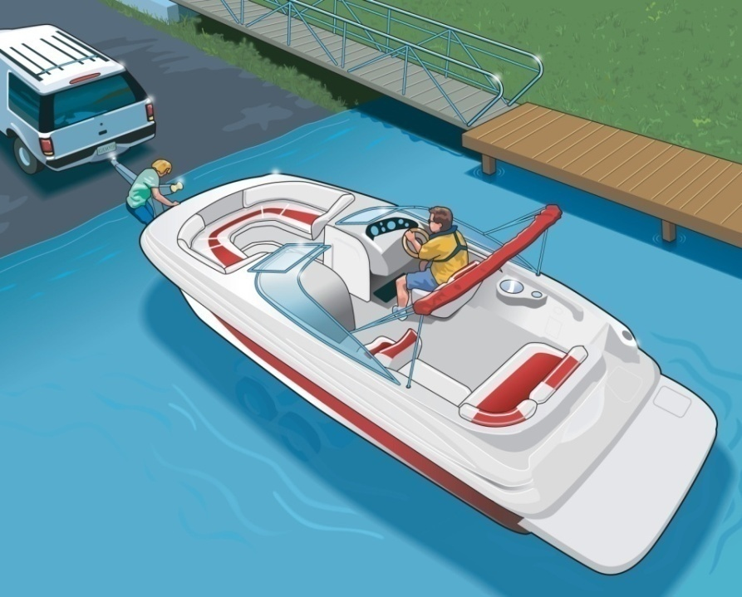
Trailering Your Vessel
Retrieving Your Vessel
Wait for your turn.
Back the trailer into the water.
Set parking brake.
Attach winch line.
Shut off engine.
Raise engine or outdrive.
Pull trailer out of the water.

Slide 54
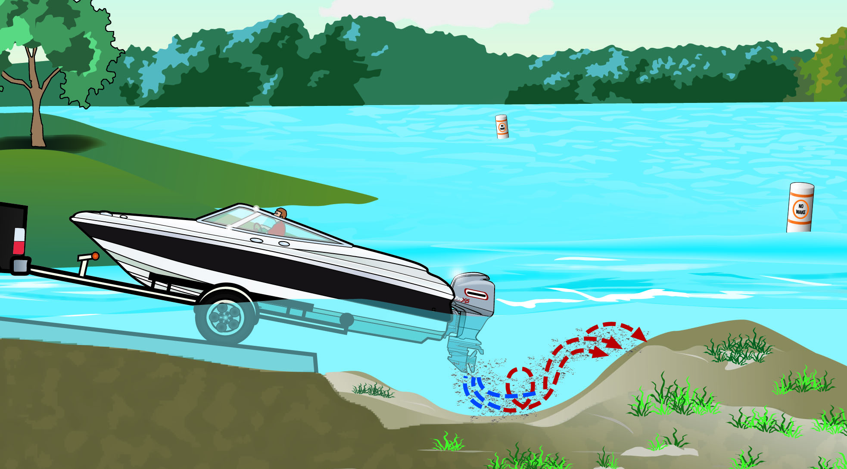
Trailering Your Vessel
Do not power load your boat. Propeller wash can create:
A large hole where trailer tires can get stuck
A mound where boats can run aground

Slide 55
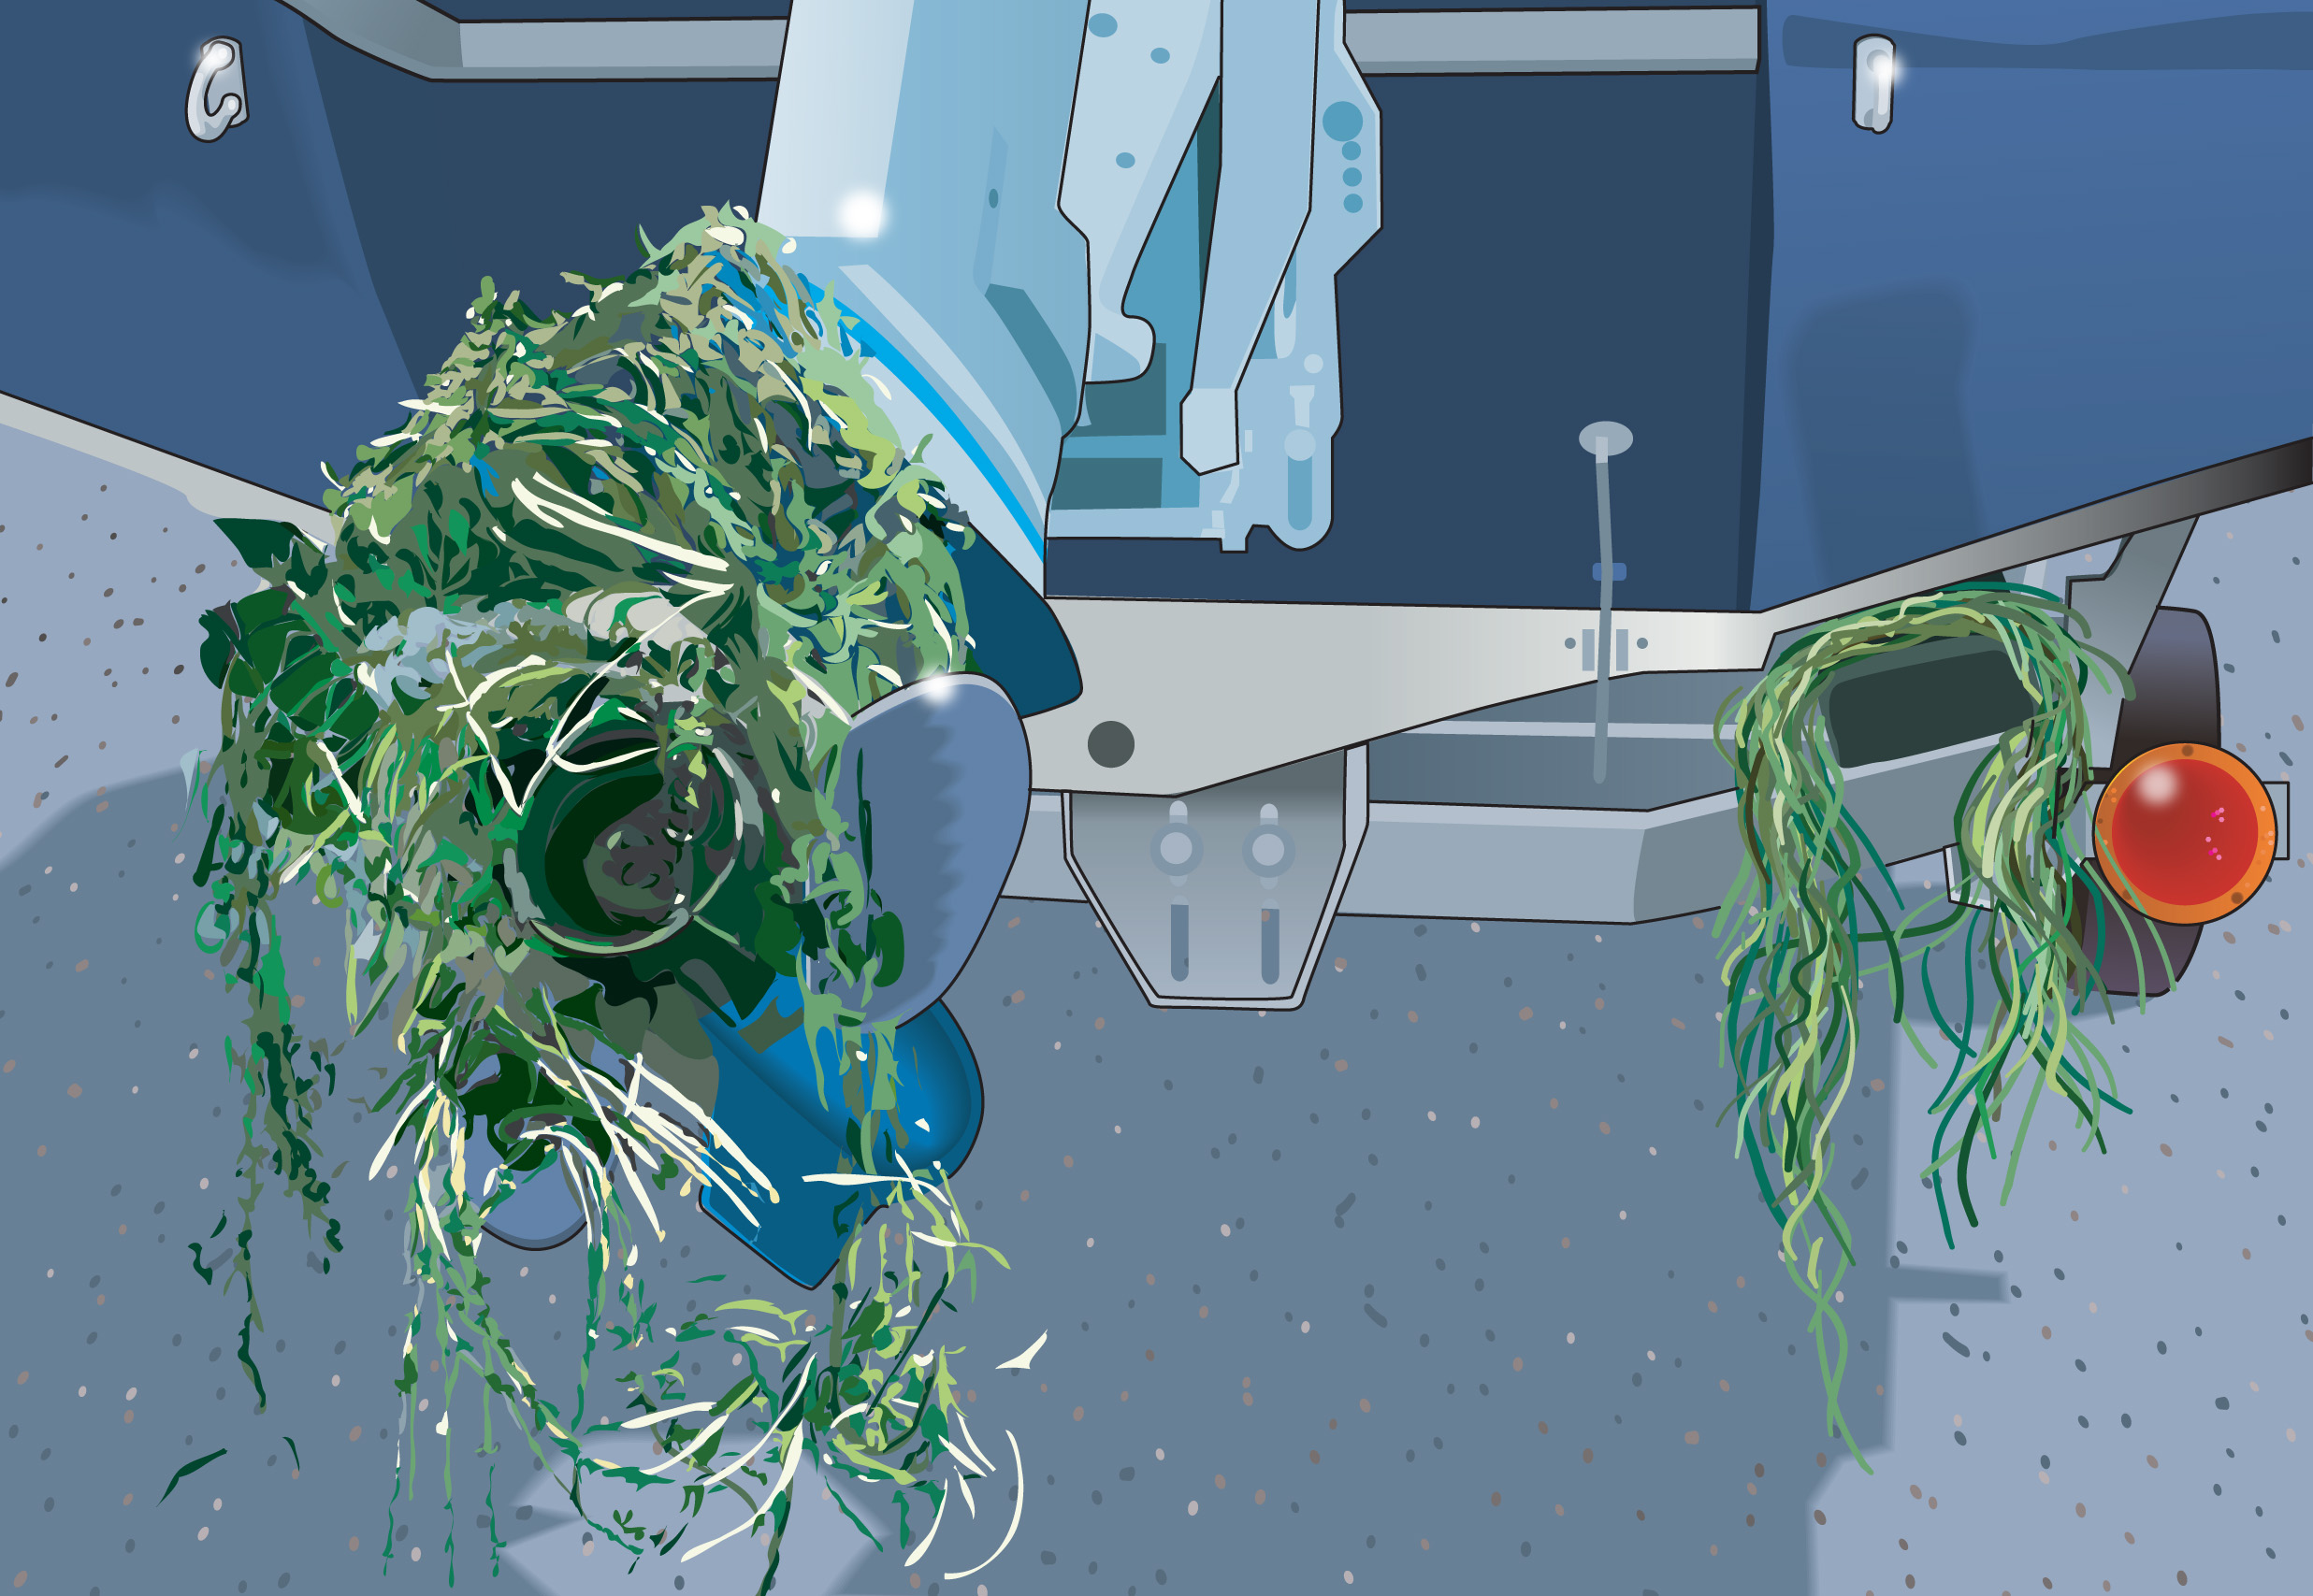
Trailering Your Vessel
Prepare for drive home well away from boat ramp.
Do not block ramp traffic.
Remove and dispose of all aquatic nuisance species.
Remove the drain plug.
Secure your vessel and gear.

Slide 56
Trailering Your Vessel
Courtesy on the Boat Ramp
Prepare your vessel for launching well away from the ramp.
Use at least two experienced people to launch and retrieve.
Never block ramp with unattended vessel or vehicle.

Slide 57
Trailering Your Vessel
When retrieving, do not pull vessel into launch lane until towing vehicle is at ramp.
After retrieving your vessel, pull well away from ramp before preparing for the drive home.

Slide 58
Vessel Maintenance
Examine the hull when it is out of the water.
Store vessels in a dry area out of the sun.
Clean all lines, and keep them out of the sun.
Clean sails, and make repairs.
Follow the maintenance schedule in the owner’s manual.

Slide 59
Engine Maintenance
Follow a regular maintenance program.
Keep engine clean and tuned properly.
Check oil and fluid levels before every outing.
Tighten battery connections. Clean battery terminals.
Inspect hoses, belts, and bolts.
Never use automotive electrical parts.

Slide 60
Preventing Theft
Store vessel so it is not easily accessed.
Chain and lock motor and fuel tanks to vessel.
Mark or engrave all equipment.
Photograph or videotape interior and exterior of vessel. Make a complete inventory.
Remove all valuables.
Cover vessel and remove keys.

Slide 61
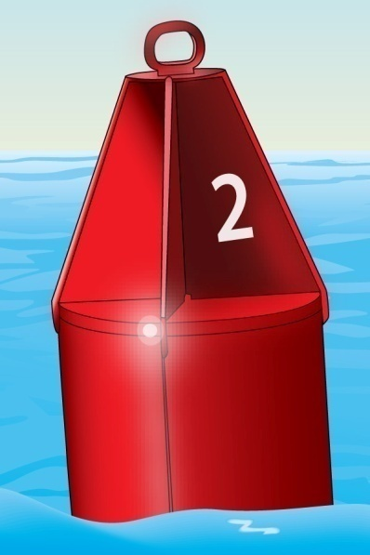
Lesson Three
Operating Your Boat…Safely

Slide 62
Key Topics
Casting Off and Docking
Navigation Rules
Navigation Lights
Night Navigation
Sound Signals
Navigational Aids

Slide 63
Key Topics
Anchoring
Dams, Locks, and Bridges
Changing Water Levels
Compasses and Charts
Jet-Propelled Watercraft Operation
Engine Cut-Off Switches
Avoiding Propeller Strike Injuries

Slide 64
Objectives
You should be able to…
Cast off and dock under different wind and current conditions.
Give three major responsibilities of a vessel operator.
Explain what to do when encountering another vessel.
List the types of nighttime navigation lights and explain how to interpret them.

Slide 65
Objectives
Use and understand sound signals.
Explain what to do when encountering buoys and markers of the U.S. Aids to Navigation System.
Anchor a vessel correctly.
Explain what to do when encountering various hazards—dams, locks, bridges, and changing water levels.

Slide 66
Objectives
Explain how to use a compass and read a nautical chart.
Operate a personal watercraft safely and courteously.
Explain how an engine cut-off switch works.
Explain how to avoid propeller strike injuries.

Slide 67
Casting Off
Before casting off:
Keep the boat tied to dock while the engine warms up.
Make sure everyone is seated and wearing a personal flotation device (PFD).
Check that the engine is running properly and the area is clear of traffic.

Slide 68
Casting Off
If there is no wind or current:
Cast off the bow and stern lines.
Shift into forward gear.
Slowly move forward, gradually turning the boat away from the dock.

Slide 69
Casting Off
If the wind or current direction is toward the dock:
Cast off the stern line. Move and secure the bow line to a mid-boat position on the dock. Make sure fenders are in place on the bow.
Put the boat into forward gear briefly, and turn the steering wheel hard toward the dock. Increase speed slowly until the stern is well clear of the dock.
Cast off the bow line. Back out slowly until you have room to shift into forward and turn away from the dock.

Slide 70
Casting Off
If the wind or current direction is away from the dock:
Cast off the bow and stern lines.
Use an oar or boat hook to keep the boat clear of the dock. Let the wind or current carry the boat away from the dock.
Once there is sufficient clearance, shift into forward gear and slowly leave the area.

Slide 71
Docking
As you approach the dock:
Slow down.
Wait for traffic to clear.
Get bow and stern lines ready.
Head into the wind or current—whichever is stronger.
Put boat fenders in place.

Slide 72
Docking
If there is no wind or current:
Approach the dock slowly at a narrow angle (about 20 degrees).
When close enough, have a passenger step on shore and secure the bow line.
Swing the stern in with a line or boat hook, and secure it.

Slide 73
Docking
If the wind or current direction is toward the dock:
Approach slowly, parallel to the dock.
Let the wind or current carry your boat to the dock. Shift into gear briefly if you need to adjust position.
Secure the bow and stern lines.

Slide 74
Docking
If the wind or current direction is away from the dock:
Approach the dock slowly at a sharp angle (about 40 degrees).
Use reverse to stop when close to the dock. Secure the bow line.
Put the boat in forward gear briefly, and slowly turn the steering wheel hard away from the dock—this will swing in the stern. Secure the stern line.

Slide 75
Navigation Rules
Three basic rules of navigation:
Practice good seamanship.
Keep a proper lookout.
Maintain a safe speed.

Slide 76
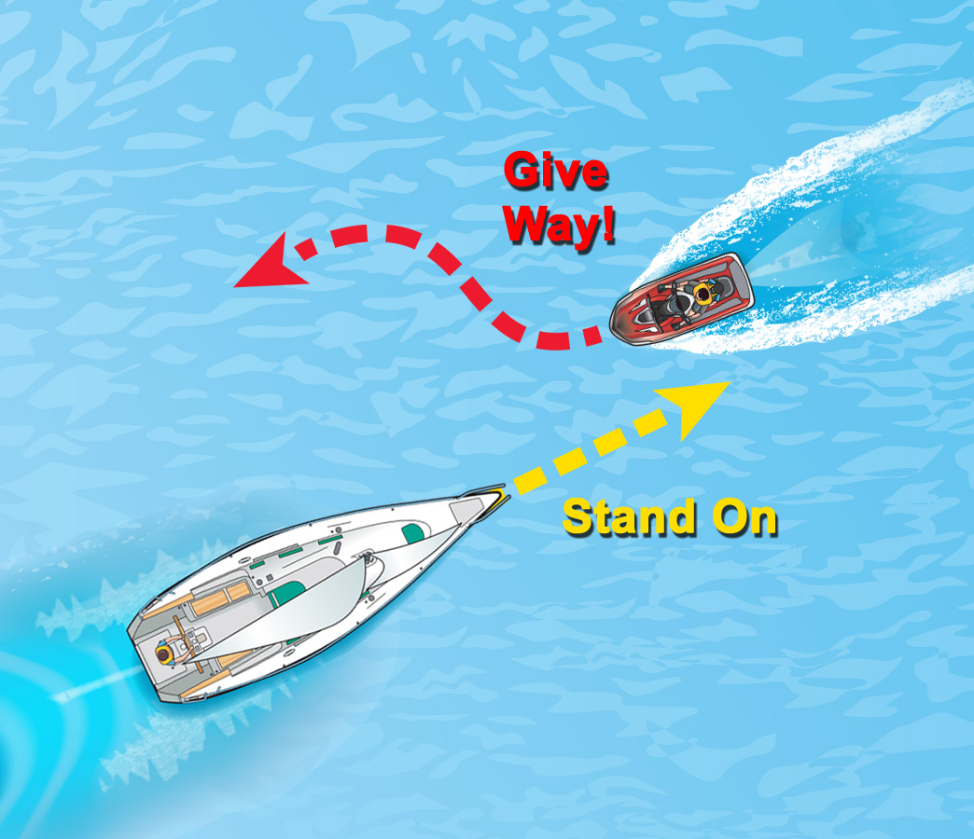
Navigation Rules
Two terms help explain what to do when encountering other vessels.
Give-Way Vessel
Stand-On Vessel

Slide 77
Navigation Rules
The action a vessel operator should take when encountering another vessel depends on:
How the two vessels are propelled
How the two vessels are approaching one another

Slide 78
Navigation Rules
Rules of Responsibility
All boaters are responsible for preventing collisions.
If you must make a departure from the navigation rules, make this decision based on:
All the dangers of navigation
The risk of a collision
Any special conditions

Slide 79
Navigation Rules
Always give way to:
Anchored or disabled vessels
Vessels restricted in their ability to maneuver
Vessels constrained by their draft
Commercial fishing vessels

Slide 80
Navigation Rules
Navigation During Restricted Visibility
Keep a safe speed for the conditions.
Slow down to avoid a collision.
Reduce speed to idle speed if necessary.

Slide 81
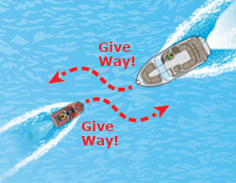
Navigation Rules
Power-Driven Vessel Encountering Power-Driven Vessel—Meeting Head-On
Neither vessel is the stand-on vessel. Both vessels should turn to starboard (the right).
TOOT
signals intent or agreement
TOOT
signals intent or agreement

Slide 82
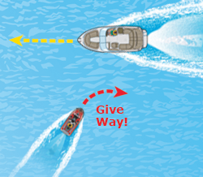
Navigation Rules
Power-Driven Vessel Encountering Power-Driven Vessel—Paths That Cross
The vessel on the operator’s port (left) is the give-way vessel. The vessel on the operator’s starboard (right) is the stand-on vessel.
TOOT
signals agreement
TOOT
signals intent

Slide 83
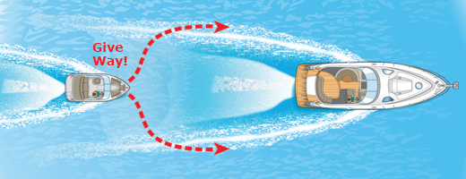
Navigation Rules
Power-Driven Vessel Overtaking a Power-Driven Vessel
The vessel that is overtaking another vessel is the give-way vessel. The vessel being overtaken is the stand-on vessel.
TOOT TOOT
signals intent to pass on give-way vessel’s starboard (right) side
TOOT
signals intent to pass on give-way vessel’s port (left) side

Slide 84
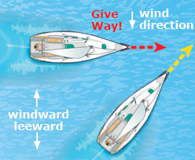
Navigation Rules
Sailing Vessel Encountering Sailing Vessel—Wind on Same Side
When two sailing vessels are approaching one another with the wind on the same side, the leeward sailing vessel is the stand-on vessel.
TOOT TOOT
signals intent
TOOT TOOT
signals agreement

Slide 85
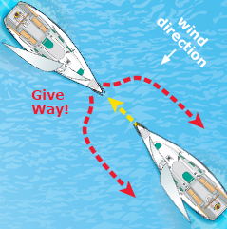
Navigation Rules
Sailing Vessel Encountering Sailing Vessel—Wind on Different Sides
When two sailing vessels are approaching one another with the wind on the different sides, the sailing vessel with wind on its starboard (right) side is the stand-on vessel.
TOOT TOOT
signals intent to go left
TOOT
signals intent to go right

Slide 86
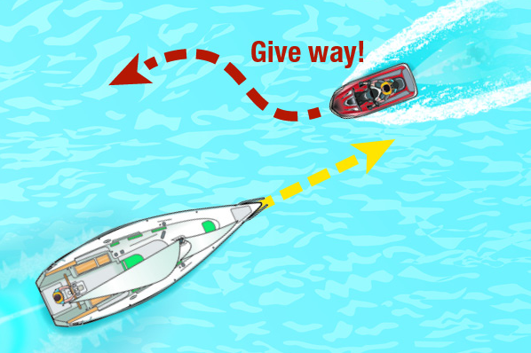
Navigation Rules
Power-Driven Vessel Encountering Sailing Vessel—Meeting Head-On
The power-driven vessel is the give-way vessel. The sailing vessel is the stand-on vessel.
TOOT
signals intent
TOOT
signals agreement

Slide 87
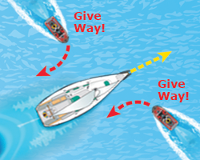
Navigation Rules
Power-Driven Vessel Encountering Sailing Vessel—Paths That Cross
The power-driven vessel is the give-way vessel. The sailing vessel is the stand-on vessel.
TOOT
signals intent to go right
TOOT TOOT
signals intent to go left

Slide 88
Navigation Rules
Power-Driven Vessel Overtaking a Sailing Vessel or Vice Versa
The vessel that is overtaking another vessel is the give-way vessel, regardless of whether it is a sailing vessel or a power-driven vessel. The vessel being overtaken is always the stand-on vessel.

Slide 89
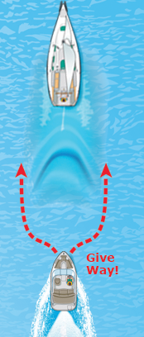
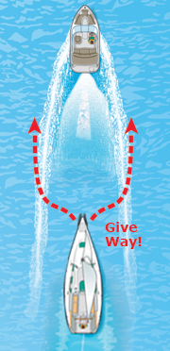
Power-Driven Vessel Overtaking a Sailing Vessel
TOOT TOOT
signals intent to pass on the give-way vessel’s starboard (right) side
TOOT
signals intent to pass on the give-way vessel’s port (left) side
TOOT TOOT
signals intent to pass on the give-way vessel’s starboard (right) side
TOOT
signals intent to pass on the give-way vessel’s port (left) side

Slide 90
Night Navigation
Boats must use navigation lights:
From sunset to sunrise
When visibility is restricted
Lights tell you:
If the other vessel is power-driven or under sail
Which way the other vessel is going
Follow the same navigational rules used in the daytime.

Slide 91
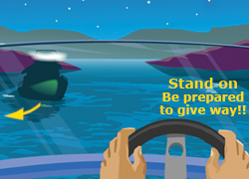
Night Navigation
When you are in a power-driven vessel and you see a green and a white light, you are the stand-on vessel. You should remain alert, however, in case the other vessel operator does not see you or does not know navigational rules.

Slide 92
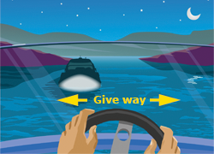
Night Navigation
When you are in a power-driven vessel and you see only a white light, you are overtaking another vessel or it is anchored. It is the stand-on vessel, whether underway or anchored. You may go around it on either side.

Slide 93
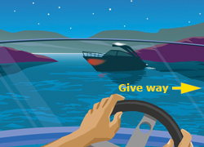
Night Navigation
When you are in a power-driven vessel and you see a red and a white light, you must give way to the other vessel. Slow down and allow the vessel to pass, or you may turn to the right and pass behind the other vessel.

Slide 94
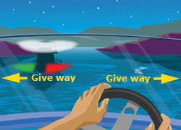
Night Navigation
When you are in a power-driven vessel and you see a red, a green, and a white light, you are approaching another power-driven vessel head-on and both vessels must give way.

Slide 95
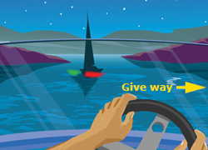
Night Navigation
When you are in any type of vessel and you see a red and a green light but no white light, you are approaching a sailing vessel head-on and you must give way.

Slide 96
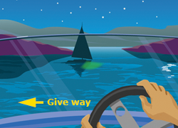
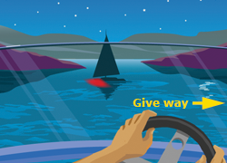
Night Navigation
When you are in any type of vessel and you see only a green light or only a red light, you may be approaching a sailing vessel and you must give way. A sailing vessel is always the stand-on vessel except when it is overtaking.

Slide 97
Night Navigation
Towing Lights
When commercial vessels are towing, they display one or more yellow lights in place of a sternlight.

Slide 98
Sound Signals
Sound signals use short and prolonged blasts. They must be audible for at least one-half mile.
Short blast—about one second in duration
Prolonged blast—4–6 seconds in duration

Slide 99
Sound Signals
Change in Direction
One short blast
Two short blasts
Three short blasts

Slide 100
Sound Signals
Poor Visibility
One prolonged blast every two minutes
One prolonged blast + two short blasts every two minutes

Slide 101
Sound Signals
Danger
One prolonged blast
Five or more short, rapid blasts

Slide 102
U.S. Aids to Navigation System
Lateral Markers
Can Buoys: Green With Odd Numbers
Nun Buoys: Red With Even Numbers

Slide 103
U.S. Aids to Navigation System
Lighted Buoys
Green Colors and Lights
Red Colors and Lights

Slide 104
U.S. Aids to Navigation System
Daymarks (on a fixed post or piling)
Reflective Green, Odd Numbers
Reflective Red, Even Numbers

Slide 105
U.S. Aids to Navigation System
“Red Right Returning”

Slide 106
U.S. Aids to Navigation System
Lateral Markers—(ICW)
Keep on your starboard (right) side
Keep on your port (left) side

Slide 107
U.S. Aids to Navigation System
Western Rivers System Marker
Indicates 73.5 miles from the river’s mouth

Slide 108
U.S. Aids to Navigation System
Non-Lateral Markers
Information
Danger Area

Slide 109
U.S. Aids to Navigation System
Non-Lateral Markers
Controlled Area
Exclusion Area

Slide 110
U.S. Aids to Navigation System
Other Non-Lateral Markers
Safe Water Markers
Inland Waters Obstruction Marker

Slide 111
U.S. Aids to Navigation System
Other Non-Lateral Markers
Mooring Buoys

Slide 112
U.S. Aids to Navigation System
Special Markers—Yellow Can Buoys
Found on Lake Erie, west of Port Clinton, at the Erie Proving Grounds/Camp Perry Firing Range.
Firing Range 2 is marked by 12 yellow can buoys with the letters A–L.
Firing Range 1 is marked by danger buoys, which are white with orange diamonds.
Yellow cans also mark the border between Canada and the U.S.

Slide 113
Anchoring
Even though anchors are used most often by recreational boaters to “park” their boats while swimming or fishing, anchors are also critical equipment in times of emergency. Anchoring may be a safety measure if your boat becomes disabled.

Slide 114
Anchoring
Choose an anchor that fits your boat and the boating conditions.
Plow-Style Anchor
Good for most boats and gets its holding power by plowing into bottom sediments.
Fluke-Style Anchor
Similar to plow style but is more lightweight. It is also good for most boats and gets its holding power from its pointed flukes digging into bottom sediments.

Slide 115
Anchoring
Mushroom-Type Anchor
Gets its holding power by sinking into bottom sediments.
Should not be used to anchor boats larger than a small canoe, rowboat, small sailboat, or inflatable boat because the holding power is weak.
Never depend on a mushroom anchor to hold your boat in rough water or weather.

Slide 116
Anchoring
Prepare Your Anchor Before Setting Out
Attach 7–8 feet of galvanized chain to the anchor.
Length of line should be at least 7–10 times the depth of the water where the anchor will be set.
Because an anchor can be a safety device in an emergency situation, store the anchor and its lines in an accessible area.
If the engine breaks down, you may need to anchor quickly to avoid drifting aground.

Slide 117
Anchoring
Steps to Anchor Your Boat
Select an area with plenty of room. Ideally, a well-protected area with adequate water depth and a sandy or muddy bottom.
Head slowly into the wind or current to a position upwind or upcurrent of where you actually want to end up.
Stop the boat, and slowly lower the anchor over the bow to the bottom. Never anchor from the stern as this can cause the boat to swamp.

Slide 118
Anchoring
Slowly back the boat away downwind or downcurrent. Tie off the line around a bow cleat, and pull on the anchor line to make sure the anchor is set.
After anchoring, take visual sightings of onshore objects or buoys in the water to help you know where your boat is positioned.
Periodically check connecting knots on your anchor line. When possible, use splices instead of knots. Knots weaken a line more than splices.

Slide 119
Anchoring
Steps to Retrieve Your Anchor
Move the boat directly over the anchor while pulling in the line. Pulling the anchor straight up should break it free.
If the anchor is stuck, turn your boat in a large circle while keeping the anchor line pulled tight.
When the anchor breaks loose, stop the boat, and retrieve the anchor. Never drag the anchor behind the boat.

Slide 120
Dams, Locks, and Bridges
Dams
Pose danger both above and below the dams.
Low-head dams:
Most dangerous type of dam and named the “drowning machine.”
Cannot be easily spotted because the top of a low-head dam is several feet below the water’s surface.
On large rivers or during high water, the backroller or boil may be located more than 100 feet downstream of the dam. Avoid low-head dams.

Slide 121
Dams, Locks, and Bridges
Dams
Large-structure dams:
More easily spotted because of their powerhouses and spillways.
Can be dangerous to boaters both below and above the dam.
Areas are usually off-limits.
Obey all warning signs and signals.

Slide 122
Dams, Locks, and Bridges
Locks
Lock attendants are present at most locks to help you through safely.
As a result of a dam, there will be two levels of water at the dam site—one level above the dam and a different one below. Locks safely transport boats from one water level to another, like an elevator.

Slide 123
Dams, Locks, and Bridges
Approaching the Dock
Be aware that commercial traffic always has priority over recreational boats. Wait at least 400 feet away from the lock for the signal to enter the lock.
Sound one prolonged blast followed by one short blast of your boat’s whistle to alert the lock attendant that you wish to go through the lock.
Enter the lock only after you’ve been signaled to enter by the lock’s traffic lights.

Slide 124
Dams, Locks, and Bridges
When using locks, boaters should…
Have fenders and at least 100 feet of rope to use in securing a boat inside the lock.
Follow the lock attendant’s instructions and proceed slowly.
Avoid passing another boat when inside the lock, unless directed to do so by the lock attendant.
Wait for the lock attendant’s signal to exit the lock.

Slide 125
Dams, Locks, and Bridges
Bridges
Reduce speed and proceed with caution.
Check clearance before passing under a bridge.
For drawbridges, contact the bridge operator.
Watch for debris that collects around pilings.

Slide 126
Changing Water Levels
Be aware that water levels can change rapidly and cause hazards.
Running aground
Docking to a fixed pier
Learn about the tides when boating on coastal waters.
Fluctuating water levels
Strong tidal currents

Slide 127
Compasses and Charts
Steering Compass
Can be invaluable in bad weather at night.
Mount it away from iron, magnets, and electrical wiring and equipment.

Slide 128
Compasses and Charts
Nautical Charts
In bays or large lakes, charts give:
Water depths
Locations of channels, sand bars, rocks, and vegetation
Most direct course possible

Slide 129
Compasses and Charts

Slide 130
Operating a Personal Watercraft
Steering and Stopping a PWC
Most PWC (and other jet-drive vessels) must have power to maintain control.
The operator is holding down the throttle lever and steering the PWC straight ahead.

Slide 131
Operating a Personal Watercraft
The operator releases
the throttle lever.
The PWC may continue to go straight ahead even though the operator is trying to turn.
Newer PWC allow for off-throttle steering.

Slide 132
Operating a Personal Watercraft
Environmental Considerations
Make sure that the water you operate in is at least 30 inches deep. Riding in shallow water can cause bottom sediments or aquatic vegetation to be sucked into the pump, damaging your PWC and the environment.
Avoid causing erosion by operating at slow speeds and by not creating a wake when operating near shore or in narrow streams or rivers.

Slide 133
Operating a Personal Watercraft
Environmental Considerations
Do not dock or beach your PWC in reeds and grasses. This could damage fragile environments.
Take extra care when fueling your PWC in or near the water. Oil and gasoline spills are very detrimental to the aquatic environment. Fuel on land if possible.
Never use your PWC to disturb, chase, or harass wildlife.

Slide 134
Operating a Personal Watercraft
Other PWC Considerations
Know the PWC regulations for your state.
Wear a PFD.
Make sure passenger can hold on securely.
Do not seat a passenger in front of the operator.

Slide 135
Operating a Personal Watercraft
Keep hands, feet, loose clothing, and hair away from the pump intake area.
Wear a wetsuit or clothing that provides equivalent protection.
Do not board PWC if operator is applying the throttle.

Slide 136
Operating a Personal Watercraft
Inspect your electrical systems and perform “sniff test” after fueling.
Avoid overloading.
Know your limits and ride according to your abilities.

Slide 137
Operating a Personal Watercraft
Look over both shoulders before making turns.

Slide 138
Engine Cut-Off Switch (ECOS)
Safety switch
Lanyard
Self-circling feature
Beginning April 2021, a new federal rule requires operators of recreational vessels less than 26 feet in length to use the ECOS if the vessel is equipped with such a device.

Slide 139
Avoiding Propeller Strike Injuries
Turn off the engine when:
Passengers are boarding or disembarking.
Someone is in the water near the boat.
Prevent passengers from being thrown overboard accidentally.
Never start with the engine in gear.
Never ride on the seat back, gunwale, transom, or bow.
Make sure all passengers are properly seated.
Assign someone to watch children.

Slide 140
Avoiding Propeller Strike Injuries
Maintain a proper lookout for people in the water.
Slow down when approaching congested areas and anchorages.
Learn to recognize warning buoys.
Keep the boat away from marked swimming and diving areas.

Slide 141
Avoiding Propeller Strike Injuries
Devices That Reduce Propeller Strikes
Guards
Propulsion
Interlocks
Sensors

Slide 142
Lesson Four
The Legal Requirements of Boating

Slide 143
Key Topics
Numbering and Documentation
Hull Identification Number
Age and Education Requirements
Unlawful Operation
Alcohol and Drugs
Obstructing Navigation

Slide 144
Key Topics
Homeland Security
Personal Flotation Devices
Fire Extinguishers
Flame Arrestors, Ventilation, and Mufflers
Navigation Lights
Visual Distress Signals
Sound-Producing Devices

Slide 145
Key Topics
Other Equipment and Regulations
Personal Watercraft Laws
Laws Relating to Towing Persons
Waste, Oil, and Trash Disposal
Protecting the Environment
Reporting Accidents
Enforcement

Slide 146
Objectives
You should be able to…
Tell which vessels need to be registered and how to do so.
Place certificate numbers and validation decals on a vessel correctly.
Find the hull identification number (HIN) on a vessel.
Explain the age and education restrictions on vessel or personal watercraft (PWC) operation.

Slide 147
Objectives
List the reckless or negligent behaviors that should be avoided when operating a vessel.
Explain the dangers of consuming alcohol or drugs while boating and the penalties for doing so.
Tell the laws pertaining to obstructing navigation.
Explain your role in keeping waterways safe and secure.

Slide 148
Objectives
Identify the classifications and uses of personal flotation devices (PFDs), and state the legal requirements.
Tell the legal requirements for fire extinguishers, backfire flame arrestors, ventilation systems, and mufflers.
Tell the legal requirements for navigation lights, visual distress signals, and sound-producing devices.

Slide 149
Objectives
Tell the requirements for other equipment such as diver-down flags or state-required equipment.
List the legal requirements specific to PWC.
List the legal requirements for towing a person behind a vessel.
Explain how to dispose of waste, trash, and oil properly and how to use marine sanitation devices (MSDs) properly.
Tell when and how to report a boating accident.

Slide 150
Certificate of Number and Decal
You must have a Certificate of Number and a validation decal(s) to operate your vessel legally.
Registration card must be carried on board whenever the vessel is being operated.

Slide 151
Certificate of Number and Decal
State laws vary. Check with your state’s boating agency for specific requirements.
Placement of decals
Expiration

Slide 152
Other Facts About Titling and Registration
In your state:
Is a title required for a vessel?
Is a title required for an outboard motor?
When do the Certificate of Number and validation decal expire?
What should you do if a vessel is transferred, destroyed, abandoned, lost, stolen, or recovered?

Slide 153
Other Facts About Titling and Registration
In your state:
What should you do if a Certificate of Number or validation decal is lost or destroyed?
What should you do if your address changes?
How do you apply for a U.S. Coast Guard “Certificate of Documentation” for a larger recreational vessel?

Slide 154
Hull Identification Number
The Hull Identification Number (HIN) is a 12-digit
number that uniquely identifies a vessel.

Slide 155
Who May Operate a Vessel
In your state:
How old must a person be to operate a boat, personal watercraft (PWC), or vessel with a specific horsepower?
Which persons must take a boating safety education course?

Slide 156
Who May Operate a Vessel
In your state:
Which persons must have an adult on board the vessel?
Are operators required to carry the boater education certificate on board?
Which persons are exempt from the boating safety education course?

Slide 157
Unlawful Operation of a Vessel
Reckless operation means boating in a way that could endanger someone’s life, safety, or property.

Slide 158
Unlawful Operation of a Vessel
In your state, does operating recklessly include:
Weaving through congested traffic?
Operating in swimming areas or other restricted areas?
Jumping wakes close to another vessel?
Swerving at the last moment to avoid collision?
Chasing or harassing wildlife?

Slide 159
Alcohol and Drugs
In your state:
How is boating while intoxicated (BWI) defined?
What determines if a person is intoxicated, including the blood alcohol concentration percentage?
What are the penalties for BWI?
When have you consented to be tested?

Slide 160
Obstructing Navigation
It is illegal to:
Operate in a way that keeps other vessels from navigating safely.
Anchor in a river or channel in a place that is in the way of other vessels passing through.
Moor or attach vessel to buoy, beacon, light, or any other navigational aid.
Move, damage, or destroy any navigational aid.
Block access to a pier, wharf, boat ramp, or any facility.

Slide 161
Homeland Security Restrictions
Slow to minimum speed within 500 yards of any U.S. Naval vessel. Do not approach within 100 yards.
Observe and avoid all security zones.
Observe and avoid restricted areas near dams, power plants, etc.
Do not stop or anchor beneath bridges or in channels.
Do your part to keep our waterways safe and secure.

Slide 162
Personal Flotation Devices (PFDs)
All vessels must have one wearable USCG–approved personal flotation device (PFD), sometimes called life jacket, of a proper size for each person on board.
Type II: Wearable Near-Shore Vests
Type I: Wearable Offshore Life Jackets

Slide 163
Personal Flotation Devices
Type III: Wearable Flotation Aids
Type IV: Throwable Devices
Type V: Special-Use Devices

Slide 164
PFD Types Descriptions
Types I to V appear on old-style (legacy) labels. PFDs with these labels may still be used in the country where they are approved as long as they are in good condition.
Type I has the greatest required inherent (built-in) buoyancy. This wearable device turns most unconscious persons in the water from a face-down position to a vertical and slightly backward position. Therefore, it greatly increases a person’s chance of survival.

Slide 165
PFD Types Descriptions (cont.)
Type II is a wearable device that can turn some unconscious persons from a face-down position in the water to a position where the person’s respiration is not restricted.
Type III can support a conscious person in the water in an upright position. This wearable device is not required to turn an unconscious person in the water from a face-down position to a position where the person’s respiration is not restricted.

Slide 166
PFD Types Descriptions (cont.)
Type IV is a device designed to be thrown to someone in trouble. It should not be used for rough waters or for persons who are unable to hold onto it.
Type V is approved for restricted uses or activities such as commercial whitewater rafting. This wearable device may not be suitable for other boating activities. It must be used in accordance with its label.

Slide 167
PFD Performance Level Descriptions
Performance levels appear on new-style labels. They typically range from 50 to 150. PFDs with these labels are approved for use in both the U.S. and Canada.
Level 50 is for those who are competent swimmers near shore and who have help and a means of rescue close at hand.

Slide 168
PFD Performance Level Descriptions (cont.)
Level 70 is for those near shore where a means of rescue is close at hand. Some of these devices are designed and intended for specific activities such as paddling or water-skiing. This style of device is not required to turn an unconscious person in the water from a face-down position to a position where the person’s respiration is not restricted.
Level 100 is for use in sheltered waters where rescue may not occur immediately. Higher performance-rated devices are recommended for rough waters.

Slide 169
PFD Performance Level Descriptions (cont.)
Level 150 is for general application or for use with foul-weather clothing. It will turn an unconscious person into a safe position and requires no subsequent action by the person to maintain this position.

Slide 170
PFD Label
Not all PFDs are USCG approved. Regardless if the PFD label is in the old or new style, there must be a USCG approval number, and the PFD must be used in accordance with the labeling information to meet the legal requirements.

Slide 171
Personal Flotation Devices
In your state:
What are the laws regarding PFDs?
What types must be carried on board?
Which vessels must have a Type IV throwable device on board?

Slide 172
Personal Flotation Devices
In your state:
What are the PFD requirements in these situations?
Children
Persons on PWC
Persons being towed behind a vessel

Slide 173
Fire Extinguishers
Classification of Fires
Type A fires are of combustible solids such as wood. On Type A extinguishers, the number relates to how many gallons of water the extinguisher is equal to for a Type A fire.
Type B fires are of flammable liquids such as gasoline or oil. On Type B extinguishers, the number tells you the square footage of the fire the extinguisher can put out.
Type C fires are electrical fires. Type C extinguishers do not use numbers.

Slide 174
Requirements to Carry Fire Extinguishers
Federal law requires all vessels to have a Type B fire extinguisher on board if one or more of the following conditions exist:
Inboard engine
Closed compartments under seats where portable fuel tanks may be stored
Double bottoms not sealed to the hull or which are not filled completely with flotation material
Closed living spaces
(continued on the next slide)

Slide 175
Requirements to Carry Fire Extinguishers (cont.)
Closed storage compartments in which flammable or combustible materials may be stored
Permanently installed fuel tanks

Slide 176
Fire Extinguishers
The following information is effective April 20, 2022.
Any non-rechargeable (disposable) fire extinguisher that is older than 12 years should be removed from service. Refer to the date of manufacturing stamped on the bottle; for example, "05" means "2005.”
Vessels that have a model year of 2018 and newer may carry only 5-B or 20-B rated fire extinguishers with date stamp.
(continued on the next slide)

Slide 177
Fire Extinguishers (cont.)
Vessels with a model year between 1953 and 2017 may carry either:
Unexpired 5-B or 20-B rated fire extinguishers or...
B-I or B-II rated fire extinguishers that are in good and serviceable condition.
Model year: The period beginning June 1 of a year and ending on July 31 of the following year and being designated by the year in which it ends

Slide 178
Fire Extinguishers
When required by the USCG, fire extinguishers must be on board a vessel and readily accessible—where they can be easily reached. When deciding on a place to store a fire extinguisher, make sure to consider how easy it is to reach in the event of a fire. It is recommended that the fire extinguisher be conspicuously and securely mounted on its intended hanger or bracket.

Slide 179
Fire Extinguishers (cont.)
Extinguishers must not be expired or appear to have been previously used. They must be maintained in good and serviceable condition. Good and serviceable condition means that the fire extinguisher on board:
Is charged and indicates it is charged if the extinguisher has a pressure gauge reading or indicator and…
Has a pin lock that is firmly in place and… (continued on next slide)

Slide 180
Fire Extinguishers (cont.)
Does not show visible signs of significant corrosion or damage and…
Has a discharge nozzle that is clean and free of obstructions.
In your state, are any vessels exempt from the fire extinguisher requirement?

Slide 181
Fire Extinguisher Requirements
Use this chart to determine the type and quantity of fire extinguishers required for your vessel.
Length of Vessel | Without Fixed System | With Fixed System
Less than 26 feet | one 5-B | none
26 feet to less than 40 feet | two 5-B (or one 20-B) | one 5-B
40 feet to less than 65 feet | three 5-B (or one 20-B and one 5-B) | two 5-B (or one 20-B)

Slide 182
Fire Extinguisher Requirements (cont.)
Note: One 20-B portable fire extinguisher may be substituted for two 5-B portable fire extinguishers. For vessels with a model year between 1953 and 2017, one 20-B/B-II portable fire extinguisher may be substituted for two 5-B/B-I portable fire extinguishers.

Slide 183
Backfire Flame Arrestors
Prevent ignition of gasoline vapors if engine backfires.

Slide 184
Backfire Flame Arrestors
Must be:
On each carburetor.
In good working condition.
USCG–approved.
Should be cleaned periodically and checked for damage.

Slide 185
Ventilation Systems
Gasoline-powered vessels built to trap fumes must have a natural ventilation system.
If your vessel has a power ventilation system, let it run for at least four minutes before starting the engine.

Slide 186
Mufflers and Noise Level Limits
In your state:
What type of muffling system is required?
What are the noise level limits?
What modifications are prohibited?

Slide 187
Navigation Lights
Vessel must be equipped with proper navigation lights.
Lights must be used:
Between sunset and sunrise
When visibility is limited

Slide 188
Navigation Lights
Power-Driven Vessels Less Than 39.4 Feet

Slide 189
Navigation Lights
Power-Driven Vessels Less Than 65.6 Feet

Slide 190
Navigation Lights
Unpowered Vessels Less Than 65.6 Feet

Slide 191
Navigation Lights
Unpowered Vessels Less Than 23 Feet

Slide 192
Navigation Lights
All Vessels When Not Underway

Slide 193
Visual Distress Signals
Visual distress signals (VDSs) are classified as:
Day signals
Night signals
Both day and night signals
VDSs are either:
Pyrotechnic
Non-pyrotechnic

Slide 194
Visual Distress Signals
Vessels on federally controlled waters must carry USCG–approved VDSs.
All vessels must carry night signals when operating at night.
Most vessels must carry day signals also.

Slide 195
Visual Distress Signals
Pyrotechnic VDSs
Orange Smoke
Red Meteor
Red Flare
Day Signal
Day & Night Signal
Day & Night Signal
Non-Pyrotechnic VDSs
Electric Light
Orange Flag
Arm Signal
Night Signal
Day Signal

Slide 196
Visual Distress Signals
If pyrotechnic VDSs are used:
You must carry a minimum of three on board.
They must be dated. Expired VDSs may be carried on board, but a minimum of three unexpired VDSs must be carried in the vessel.

Slide 197
Visual Distress Signals
Example Combinations
3 handheld red flares
1 handheld red flare
2 red meteors
3 orange smoke signals
1 electric light

Slide 198
Sound-Producing Devices
Are essential when visibility is limited.
Let other boaters know what you plan to do.

Slide 199
Sound-Producing Devices
Types of Sound-Producing Devices
Whistle
Horn
Bell

Slide 200
Sound-Producing Devices
Requirements for federally controlled waters:
Vessels less than 39.4 feet (12 meters) in length, which includes PWC, must have some way of making an efficient sound signal. Examples are a handheld air horn, an athletic whistle, an installed horn, etc. A human voice is not acceptable.
Vessels that are 39.4 feet (12 meters) or more in length must have a sound-producing device that can produce an efficient sound signal. The sound signal should be audible for one-half mile and should last for 4 to 6 seconds.

Slide 201
Sound-Producing Devices
In your state:
Are sound-producing devices required on your state’s waters?
What types of devices are required based on the length of the vessel?
How far away must the sound signal be audible?

Slide 202
Other Equipment and Regulations
Two types of flags may be used to indicate diving activity:
What flags are required in your state?
How far must a vessel stay from a diver-down flag?
Divers Flag
red-and-white
Alfa Flag
blue-and-white

Slide 203
Other Equipment and Regulations
In your state:
Are permits required for marine events?
Are you required to license and/or register your vessel’s trailer?
Are you required to have certain equipment on your trailer?
Is any other equipment required?
What are the local regulations for specific waterways?

Slide 204
Requirements Specific to PWC
In your state:
What are the requirements for PFDs?
Are you required to have a lanyard-type engine cut-off switch? What about a self-circling feature?
During what hours may you operate a PWC legally?
What are the age restrictions for operating a PWC?

Slide 205
Requirements Specific to PWC
In your state, do illegal activities include:
Jumping another vessel’s wake?
Weaving through traffic?
Operating above “slow, no wake speed” in certain areas?
Chasing, harassing, or disturbing wildlife?
Any others?

Slide 206
Towing a Person Legally
In your state:
What are the requirements for PFDs?
During what hours may you tow a person legally?
Are you required to have an observer on board? What about a wide-angle rearview mirror?

Slide 207
Towing a Person Legally
In your state:
What activities are illegal?
Are you required to have a skier-down flag?

Slide 208
Waste, Oil, and Trash Disposal
Discharge of Sewage and Waste
It is illegal to discharge waste, oil, or trash into any state or federally controlled waters.
Sewage carries disease.
Trash thrown into water can cause injuries.
Pollution is unsightly.
The Refuse Act prohibits throwing, discharging, or depositing any refuse matter into U.S. waters.

Slide 209
Waste, Oil, and Trash Disposal
Discharge of Sewage and Waste
Recreational vessels with an installed toilet must have a marine sanitation device (MSD).
Types I and II MSDs treat waste.
Type III MSDs do not treat waste.

Slide 210
Waste, Oil, and Trash Disposal
Discharge of Sewage and Waste
Vessels 65 feet or less in length may use a Type I, II, or III MSD.
Vessels over 65 feet in length must install a Type II or III MSD.
All MSDs must have USCG certification.
Are there other requirements in your state?

Slide 211
Waste, Oil, and Trash Disposal
Discharge of Trash
It is illegal to dump garbage or plastics into any state or federally controlled waters.
Many forms of litter can kill birds, fish, and marine mammals.

Slide 212
Waste, Oil, and Trash Disposal
Discharge of Trash
On federal waters, display a 4” x 9” garbage disposal placard on any vessel 26 feet or longer.

Slide 213
Waste, Oil, and Trash Disposal
Discharge of Oil and Other Hazardous Substances
Do not discharge hazardous substances into U.S. waters.
Do not dump oil into the bilge.
Store and dispose of oil waste properly.

Slide 214
Waste, Oil, and Trash Disposal
Discharge of Oil and Other Hazardous Substances
Notify the National Response Center immediately if your vessel discharges oil or hazardous substances in water.
Call 1-800-424-8802 to notify the National Response Center.
What is the contact information in your state?

Slide 215
Waste, Oil, and Trash Disposal
Discharge of Oil and Other Hazardous Substances
On federal waters, vessels 26 feet or longer must display a 5” x 8” placard.

Slide 216
Waste, Oil, and Trash Disposal
Waste Management Plan
Oceangoing vessels 40 feet or longer must have written Waste Management Plan.
The plan should tell how to discharge:
Sewage and hazardous waste
Garbage and food waste
Plastics, bottles, and cans
Oil or diesel fuel

Slide 217
Stop Spread of Nuisance Species
Aquatic nuisance species include zebra mussels, quagga mussels, milfoil, and hydrilla.
Introducing these species can upset the ecosystem and hurt the environment.

Slide 218
Stop Spread of Nuisance Species
Prevent spread of aquatic nuisance species:
Inspect your vessel and trailer. Remove any plants and animals.
Drain your motor, live well, and bilge on land.
Empty your bait bucket on land.
Rinse your vessel, propeller, trailer, and equipment.
Air-dry your vessel and equipment.
Stop the spread of nuisance species by following the above points.

Slide 219
Boating Accidents and Casualties…What the Law Requires You to Do
If you are involved in a boating accident, you must:
Stop immediately and…
Assist injured persons, if it is safe to do so and…
Give your name, address, and vessel identification.

Slide 220
Boating Accidents and Casualties…What the Law Requires You to Do
In your state:
What types of accidents must be reported?
How do you report an accident?
How soon must it be reported?
Do you report it in writing or by some other means?
To whom do you report it?

Slide 221
Boating Accidents and Casualties…What the Law Requires You to Do
Sample Boating Accident Report Form

Slide 222
Enforcement
Law enforcement officers have the right to stop a vessel.
Who can stop your vessel on federal waters?
Who can stop your vessel on state waters?
In your state, what must boaters do if they are signaled to stop?

Slide 223
Lesson Five
Boating Emergencies…What to Do

Slide 224
Key Topics
Risk Management
Boating Accidents
Personal Injuries
Weather Emergencies
Summoning Help

Slide 225
Objectives
You should be able to…
Explain how to practice risk management while boating.
Describe the effects of boating stressors.
Explain how dehydration occurs and how to recognize and prevent it.
Explain the increased effects of alcohol on the body when on the water.

Slide 226
Objectives
Find the personal flotation device (PFD) that is the proper size for the wearer and check a PFD’s condition.
Explain how to handle situations involving capsizing, swamping, or falling overboard.
Avoid collisions.
Respond properly to a fire emergency.
Take the proper steps if a vessel runs aground.

Slide 227
Objectives
Explain the danger and stages of cold water immersion and what to do to survive.
Recognize the symptoms of carbon monoxide poisoning and explain how to prevent it.
Obtain weather forecasts, recognize weather warnings, and explain what to do if caught in severe weather.
Summon help quickly if a serious boating emergency occurs.

Slide 228
Risk Management
Profile of a Typical U.S. Boating Fatality
PFDs are on board but not in use
Vessel is small boat of open design
⅓ of time alcohol is involved
Daylight, good weather
Operator is male, 26 to 50, with boating experience
Nearly all accidents are preventable

Slide 229
Risk Management
Risk management is:
Recognizing dangerous situations and reducing chance that they will happen.
Lessening effects of accidents if they do happen.

Slide 230
Risk Management
Increased Risk Due to Boating Stressors
Stressors such as sun’s glare and heat, motion, and engine noise and vibration increase the risk of a boating accident.
Stressors weaken your body and mind enough to make the risk of an accident greater.

Slide 231
Risk Management
Increased Risk Due to Dehydration
Boating causes you to generate more body heat.
This makes you sweat more.
Dehydration makes you tired and increases risk for an accident.
The result can be dehydration.

Slide 232
Risk Management
Increased Risk Due to Dehydration
To prevent dehydration, drink some water every 15–20 minutes.
If dehydration occurs, drink plenty of water and get out of the sun.

Slide 233
Risk Management
Blood Alcohol Concentration (BAC)
Avoiding Alcohol
Alcohol increases natural stressors.
It takes less alcohol to make a person legally intoxicated on water.

Slide 234
Risk Management
Drinking while boating increases likelihood of accidents.
Make sure everyone wears a PFD.
Designate non-drinking boaters to operate the vessel.

Slide 235
Risk Management
To minimize the risk of an accident–Don’t drink and boat!

Slide 236
Risk Management
Minimize Risk of Drownings—Wear PFDs
Have everyone on board wear a PFD.
Follow the requirements:
Readily accessible
Proper size
Good and serviceable condition

Slide 237
Minimize Risk of Drowning
Inflatable PFDs
Come in two styles.
Inflate if wearer falls into the water.
Are approved for 16 or older.
Come with operating instructions.

Slide 238
Rescue Technique: Reach, Throw, Row, and Go
If you are on a dock when someone falls in, you should try to “talk” the victim to safety. If he or she is unable to get to the dock, you should:
REACH: Extend a fishing rod, branch, oar, towel, or other object to REACH out to the victim and pull him or her to safety.
Notes:
This slide will go after the slide titled ”Risk Management: Minimize Risk of Drowning—Wear PFDs” (Slide 275).

Slide 239
Rescue Technique: Reach, Throw, Row, and Go
THROW: If the victim is too far away to reach and a boat isn’t handy, THROW the victim a PFD or anything else that will float.
ROW: If a rowboat is available, ROW to the victim and then use an oar or paddle to pull the victim to the stern.
GO: Swimmers without lifesaving training should not swim to a victim. Instead, GO for help. If you must swim, take along anything that floats to keep between you and the victim.

Slide 240
Boating Accidents
Capsizing, Swamping, or Falling Overboard
Capsizing―boat turns on its side or turns completely over.
Swamping―boat stays upright and fills with water.

Slide 241
Boating Accidents
Capsizing, Swamping, or Falling Overboard
For safety:
Ask everyone to wear a PFD.
Attach engine cut-off switch lanyard to wrist, clothes, or PFD.
Don’t allow anyone to sit on any area not designed for seating.

Slide 242
Boating Accidents
Don’t overload your boat.
Keep centered in the boat with your center of gravity low.
Don’t let anyone lean a shoulder beyond gunwale in a small boat.
Slow down when turning.
Don’t boat in rough water or bad weather.
Secure anchor line to the bow.

Slide 243
Boating Accidents
If you capsize or swamp your boat or fall overboard:
Stay with the boat.
Put a PFD on. Have your passengers do the same.
Take a head count.
Signal for help.

Slide 244
Boating Accidents
If your boat is still floating, try to reboard or climb onto it.
If your boat sinks or floats away, look for other items to help support you.

Slide 245
Boating Accidents
If boat sinks or floats away:
Don’t panic―remain calm and wait for help.
Make sure your PFD is securely fastened, or find something to help you float.

Slide 246
Boating Accidents
If someone falls overboard:
Slow down.
Toss the victim a PFD.
Slowly pull alongside the victim.
Stop the engine.

Slide 247
Boating Accidents
Avoiding Collisions
Follow the rules of navigation.
Pay attention to navigation aids.
Keep a sharp watch and appoint a lookout.
Maintain a safe speed.

Slide 248
Boating Accidents
Look in all directions before turning.
Use caution when traveling into the sun’s glare.
Never operate when fatigued or stressed, or while consuming alcohol.
Watch for floating debris.

Slide 249
Boating Accidents
Dealing With Fire Emergencies
To prevent a fire:
Don’t mix fuel, oxygen, and heat.
Make sure ventilation systems are working.
Maintain the fuel system.
Use safe fueling procedures.

Slide 250
Boating Accidents
If a fire starts:
Stop the boat.
Position the fire downwind.
Shut off fuel supply, if fire is in the engine.
Use the fire extinguisher (remember PASS).
Summon help.

Slide 251
Boating Accidents
Running Aground
To prevent:
Know your boating environment.
Find out the location of shallow water and submerged objects.
Learn to read nautical charts.

Slide 252
Boating Accidents
If you run aground:
Make sure no one is injured.
Check for leaks.
Try to get loose.
Signal for help if needed.

Slide 253
Personal Injuries
Cold Water Immersion and Hypothermia
Kill in several ways.
Can cause a reaction in water as warm as 77°F.
Understand how your body reacts to cold water to respond appropriately and increase your chance of survival.

Slide 254
Cold Water Immersion
Stages of Cold Water Immersion
Stage 1
Initial “cold shock”
Occurs first 3–5 minutes
Stage 2
Short-term “swim failure”
Occurs 3–30 minutes following immersion
Stage 1
Stage 2

Slide 255
Cold Water Immersion
Stage 3
Long-term immersion hypothermia
Sets in after 30 minutes
Stage 4
Post-immersion collapse
Occurs during or after rescue
Stage 3
Stage 4

Slide 256
Personal Injuries
Cold Water Immersion and Hypothermia
Survival depends on:
Keeping your head above water
Controlling your breathing
Having timely rescue by yourself or others
Retaining body heat

Slide 257
Personal Injuries
When boating in cold water conditions:
Always wear a secured PFD.
Wear layered clothing.
Equip your boat with a means for re-entry.

Slide 258
Personal Injuries
Try to avoid capsizing or falling overboard.
If you do fall into cold water:
Don’t panic.
Put on a PFD.
Do not take off your clothes.
Try to reboard your boat.
Stay as still as possible.
Adopt a position to prevent heat loss.
Send out emergency distress signals.

Slide 259
Personal Injuries
Reducing Heat Loss in Cold Water
H.E.L.P.
Huddle
If alone
With others

Slide 260
Personal Injuries
When treating victims of cold water immersion:
Get the victim out of the water quickly and gently.
Prevent further heat loss.
Be prepared to provide basic life support.
Seek medical help immediately.

Slide 261
Personal Injuries
Carbon Monoxide Poisoning
Carbon monoxide (CO) is an invisible, odorless, tasteless gas.
Symptoms of CO poisoning:
Irritated eyes
Headache
Nausea
Weakness
Dizziness

Slide 262
Personal Injuries
To prevent carbon monoxide poisoning:
Allow fresh air to circulate.
Keep away from engine and generator exhaust outlets.
Never sit on the back deck, “teak surf,” or hang on the swim platform.
Ventilate immediately if you detect fumes.
Install marine-rated CO detectors.

Slide 263
Personal Injuries
Never enter areas under swim platforms as air in these areas could be fatal if breathed in.

Slide 264
Personal Injuries
Before each boating trip:
Know the location of exhaust outlets.
Educate passengers about CO poisoning.
Check operation of exhaust outlets.
Listen for any change in exhaust sound.
Test each CO detector.

Slide 265
Personal Injuries
Monthly:
Make sure exhaust clamps are secure.
Look for leaks in the exhaust system.
Inspect rubber hoses for damage.
Annually:
Have a qualified technician check the engine and exhaust system.

Slide 266
Personal Injuries
Responding to Other Serious Injuries
Shock
Bleeding
Burns
Broken Bones
Head, Neck, or Spinal Injury

Slide 267
Weather Emergencies
How to Avoid Severe Weather
Tune a radio to a station with weather updates.
Be alert to weather conditions.
Track changes in barometer readings.
Watch for wind shifts, lightning, and rough water.

Slide 268
Weather Emergencies
Be aware of weather to the west.
Watch for fog.
Head toward nearest safe shore.

Slide 269
Weather Emergencies
What to Do if Out in Severe Weather
Prepare the boat.
Slow down.
Close hatches, windows, and doors.
Stow unnecessary gear.
Turn on all navigation lights.
Keep bilges free of water.
Disconnect electrical equipment if there is lightning.

Slide 270
Weather Emergencies
Prepare your passengers for severe weather.
Make sure everyone is wearing a PFD.
Have passengers sit on floor close to centerline.
Decide whether to go to shore or ride out the storm.
Head for nearest safe shoreline.
Steer bow of boat into waves.
Keep sharp lookout for other vessels or hazards.
If engine stops, drop an anchor.

Slide 271
Summoning Help
Useful items:
Visual distress signals
VHF marine radio
Mobile phone
Emergency Position-Indicating Radio Beacon (EPIRB)
Personal Locator Beacon (PLB)

Slide 272
Lesson Six
Enjoying Water Sports
With Your Boat

Slide 273
Key Topics
Responsibilities of a Vessel Operator
Small Boats and Paddlecraft
Water-Skiing
Scuba Diving and Snorkeling
Windsurfing and Sailing
Fishing and Hunting

Slide 274
Objectives
You should be able to…
Explain a vessel operator’s responsibility to his or her passengers.
Explain a vessel owner’s responsibility when allowing others to use his or her vessel.
Explain the boater’s responsibility to the environment.

Slide 275
Objectives
Explain a vessel operator’s responsibility to others using the waterways.
List the safety guidelines for small boat operators.
Properly tow skiers and recognize skier hand signals.
Explain how to fish or hunt safely from a boat.

Slide 276
Responsibilities of a Vessel Operator
Responsibility to Your Passengers
Pre-Departure Checklist
Check the weather forecast.
Check the steering and throttle controls.
Check all lights.
Check for any fuel or oil leaks.
Check hose connections and clamps.
Drain all water from the engine compartment.

Slide 277
Responsibilities of a Vessel Operator
Be sure the bilge plug is replaced and secure.
Make sure you have enough fuel.
Make sure your engine battery and fire extinguishers are fully charged.
Attach the engine cut-off switch and lanyard.
Make sure you have the required number of personal flotation devices (PFDs).
Leave a float plan.

Slide 278
Responsibilities of a Vessel Operator
Before casting off, discuss safety.
Where is the emergency equipment?
Who needs a PFD?
What are the laws for:
Reckless operation?
Required equipment?
Waste disposal?

Slide 279
Responsibilities of a Vessel Operator
Conducting Emergency Drills
Do you know what to do:
In case of a fire?
If someone falls overboard?
In case of a storm?
How do you:
Signal for help or make a MAYDAY call?
Anchor the vessel and handle lines (ropes)?

Slide 280
Responsibilities of a Vessel Operator
Responsibility to Others You Allow to Operate Your Vessel
Before allowing others to operate your vessel, make sure they:
Meet the minimum age and boater education requirements.
Know basic boating safety and navigation rules.

Slide 281
Responsibilities of a Vessel Operator
Know how to use lanyard with the engine cut-off switch.
Understand the importance of speed restrictions.
Understand the need to keep a proper lookout.

Slide 282
Responsibilities of a Vessel Operator
Before allowing others to drive your PWC, make sure they:
Meet the minimum age and boater education requirements.
Know they have the same responsibilities as any other vessel operator.

Slide 283
Responsibilities of a Vessel Operator
Take their first rides in an uncrowded area.
Know how to steer and control the personal watercraft (PWC).
Know to check carefully before turning.

Slide 284
Responsibilities of a Vessel Operator
Responsibility to the Environment
Keep waters clean and disease-free by disposing of waste and litter properly.
Practice the three “Rs”— Reduce, Reuse, and Recycle.
Reduce throttle to “no wake” speed when close to a shoreline.
Don’t use toxic substances on your vessel or around water.

Slide 285
Responsibilities of a Vessel Operator
Responsibility to Others Using the Waterways
Stay aware of others in or on the water.
Control the noise of your boat or PWC.

Slide 286
Small Boats and Paddlecraft
Includes canoes, kayaks, and rafts.
To prepare for safety:
Always wear a PFD.
Never paddle alone.
Never overload your craft.
Keep low center of gravity.
Be alert and aware of surroundings.

Slide 287
Small Boats and Paddlecraft
Practice reboarding in water.
Dress properly for the weather.
Check your craft for leaks.
Map a general route and timetable when embarking on a long trip.
Know conditions before you head out.
Watch the weather. Keep close to shore.

Slide 288
Small Boats and Paddlecraft
Be alert for river hazards:
Low-head dams
Rapids
Strainers
If you capsize:
Do not try to stand or walk in swift-moving water.
Float on your back on the upstream side of your craft.
Point your feet downstream.
Take precautions to avoid hypothermia.

Slide 289
Water-Skiing
Before towing a skier, the operator should:
Have an observer on board.
Review hand signals with skier.
Make sure skier is wearing an approved PFD.
Be familiar with area and any hazards.
Make sure tow lines are same length for multiple skiers.
Never tow a skier at night.

Slide 290
Water-Skiing
While towing a skier, the operator should:
Start engine after making sure no one is near the propeller.
Go slowly until ski rope is tight.
Keep skier at a safe distance from the shoreline.
Avoid congested areas.
Watch for other vessels and obstructions.
Always respond to skier’s signals.

Slide 291
Water-Skiing
When a skier falls, circle slowly to return the towline.
If required, display red or orange flag to alert others that skier is down.
Shut off engine before skier reboards.

Slide 292
Water-Skiing
When in the water, the skier should:
Wear a PFD.
Use hand signals.
Never ski under the influence of drugs or alcohol.
Never spray swimmers, vessels, or other skiers.
Never wrap tow rope around your body.
Hold ski up out of the water after falling.
Not approach the back of the boat until the engine is off.

Slide 293
Water-Skiing
Hand Signals for Skiers
Stop
Skier OK
Skier down

Slide 294
Water-Skiing
Hand Signals for Skiers
Turn left
Turn right
Speed up
Slow down
Speed OK

Slide 295
Scuba Diving and Snorkeling
Vessel operators should:
Be able to recognize a diver-down flag.
Stay the legal distance away from a flag.
Look for bubbles.

Slide 296
Scuba Diving and Snorkeling
Divers should:
Display the diver-down flag and stay close to it.
Select a suitable boat.
Avoid overloading the vessel.
Never dive or snorkel alone.

Slide 297
Windsurfing
Dress appropriately.
Tell someone your plans.
Do not become fatigued.
Watch for vessels.
Don’t go too far from shore.

Slide 298
Sailing
Sailboats are usually the stand-on vessel.
Small sailboats are prone to capsizing and swamping.
Falling overboard is common. Always wear a PFD.
Sailors should always be aware of water temperature.
A certified sailing course is recommended.

Slide 299
Sailing
For safety:
Stay off water during storms or high winds.
Carry a flashlight.
Make sure sailboats with an engine have red, green, and white navigation lights.
Be aware of mast clearance when passing under power lines and bridges.

Slide 300
Fishing
Anglers using a vessel to fish should:
Know and follow all safe boating laws and requirements.
Not overload the vessel.
Wear a PFD.
Recycle or toss used fishing line into receptacles on shore.
Take care of the fishing boat.

Slide 301
Fishing
Operators of other vessels should:
Slow down when approaching fishing boats or give them wide berth.
Never run over fishing lines.
Never make a large wake near a fishing boat.

Slide 302
Hunting
If using a vessel to hunt, you should:
Obey all boating laws.
Take extra precautions to avoid capsizing or swamping.
Wear a PFD at all times.
Dress in several layers under your PFD on cold water.

Slide 303
Hunting
Check the weather and stay close to shore.
Not fire shots or release arrows until vessel is stopped and secured. Remain seated when shooting.
Take these steps while transporting a firearm:
Obey all laws.
Keep firearms unloaded with the safety on and in a gun case.

