Slide 1
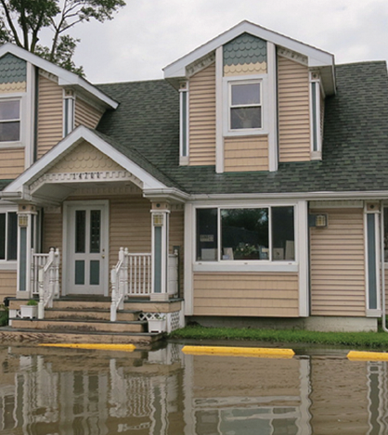
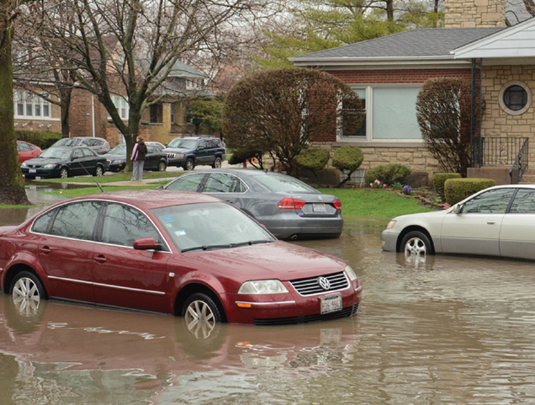

IDNR Floodplain Ordinance Updates
IAFSM Conference
March 8, 2022

Slide 2
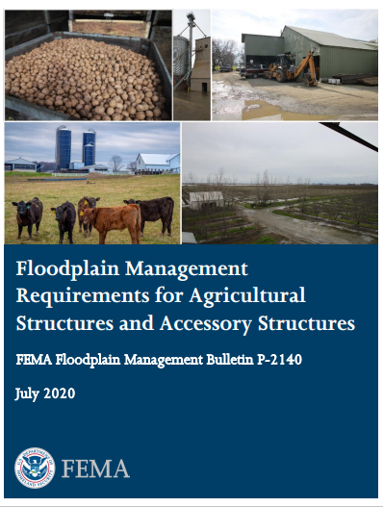
Catalyst
New FEMA Guidance

Slide 3
Add Floodplain Manager duties including substantial damage/improvement procedures
Clarify Critical Facility review
BFE in A Zones
Add CLOMR requirement for fill in Floodway
Add references to Technical Bulletins for flood openings and building on fill
Link Start of Construction definition to permitting process
Add Stop Work order to Penalties
Expand variance section to outline process
Additional Changes

Slide 4
New or Amended Definitions
Accessory Structure
Agricultural Structure
Conditional Letter of Map Revision (CLOMR)
Critical Facility
Dam
Development
IDNR /OWR Jurisdictional Stream
LOMA and LOMR
Start of Construction
Violation

Slide 5
New Definitions
Accessory Structure - A non-habitable building, used only for parking of vehicles or storage, that is on the same parcel of property as the principal building and which is incidental to the use of the principal building.
Agricultural Structure - A walled and roofed structure used exclusively for agricultural purposes or uses in connection with the production, harvesting, storage, raising, or drying of agricultural commodities and livestock, including aquatic organisms. Structures that house tools or equipment used in connection with these purposes or uses are also considered to have agricultural purposes or uses.

Slide 6
Definition Change – Critical facility
Critical Facility - Any facility which is critical to the health and welfare of the population and, if flooded, would create an added dimension to the disaster. Damage to these critical facilities can impact the delivery of vital services, can cause greater damage to other sectors of the community, or can put special populations at risk.
Examples of critical facilities where flood protection should be required include: emergency services facilities (such as fire and police stations), schools, hospitals retirement homes and senior care facilities, major roads and bridges, critical utility sites (telephone switching stations or electrical transformers, and hazardous material storage facilities (chemicals, petrochemicals, hazardous or toxic substances).

Slide 7
Definition Change - Development
OLD Exceptions
“Development” does not include routine maintenance of existing buildings and facilities, resurfacing roads, or gardening, plowing, and similar practices that do not involve filing, grading, or construction of levees.
NEW Exceptions
“Development” does not include resurfacing of pavement when there is no increase in elevation; construction of farm fencing*; or gardening, plowing, and similar practices that do not involve filing, grading, or construction of levees.
* Outside of NE Illinois 6 counties

Slide 8
Text changes – BFE determination
Remove references to Illinois State Water Survey as a depository.
Removes record flood plus 3 feet.

Slide 9
Text changes – Development Permit
Expanded list of what must be submitted
Provides for an overall permit expiration and requires work on new buildings to start in 180 days or permit expires (Start of Construction)
As-built documentation expanded, allowing Elevation Certificates, Floodproofing certificates to be required.
Requires a sign-off on the floodplain development permit before an occupancy permit can be issued
Expanded to include an optional fees section for communities without a fee ordinance or a building permit process
Explains that a LOMR-Floodway is required if floodway needs to be corrected

Slide 10
Text changes - Critical Facility
No “feasible alternative site” language removed.
FPA required to compare a site’s ground elevation for critical facility to the 0.2% annual chance flood elevation.
Clarifies that buildings must have lowest floor elevated to 0.2 % flood elevation or 1% elevation plus 3 feet.
Adequate parking for staffing of facilities must be provided above the BFE required.
Access routes to be reviewed and “should” be above the BFE.
Critical facilities list in body of the ordinance.
Floodproofing and sealing measures listed as a protection measure.

Slide 11
Text changes – LOMRs/ CLOMRs
CLOMR required for BFE increases due to floodway. encroachments or BFE increases in a Zone A.
Clarifies that grading permits may be issued but no permits for buildings before the LOMR is issued.
Clarifies LOMR-Based on Fill and gives communities opportunity to outright prohibit basements in any fill used to elevate a site above the BFE.
If basement allowed, calls out TB 10-01 and explains Reasonably Safe responsibilities of the local FPA.

Slide 12
Text changes – Start of Construction
Per the NFIP federal code all permits must expire in 180 days if the “start of construction” has not begun.
Start of construction definition is concerned with buildings – not grading or utilities. Pouring of the slab, installation of piles, foundations, etc.
To provide for new maps or LOMRs where the BFE increases.
Some communities allow permits to last for 2 or 3 years.

Slide 13
Start of Construction and Permit Expiration
A development permit or approval shall become invalid unless the actual Start of Construction, as defined, for work authorized by such permit, is commenced within 180 days after its issuance, or if the work authorized is suspended or abandoned for a period of 180 days after the work commences. All permitted work shall be completed within (*Insert twelve (12) months, eighteen (18) months or a local permit expiration period) after the date of issuance of the permit or the permit shall expire. Time extensions, of not more than 180 days each, may be granted, in writing, by the _____________. Time extensions shall be granted only if the original permit is compliant with this ordinance and the FIRM and FIS in effect at the time the extension is granted.

Slide 14
Text changes – Accessory Structures
Maximum size 600 sq. ft. in keeping with FEMA guidance.
No value limit listed, difficult with inflation and differences across the state in construction costs
Permanent openings on at least 2 walls instead of all 4 walls, in keeping with TB 1.
Does not restrict to residential properties

Slide 15
Text changes – Agricultural Structures
Entire subsection under Variances.
Must be exclusive for agriculture production, harvesting ,storage, etc. No farm stands, wedding venues, or wine tasting rooms.
State floodway permit required if in the floodway.
Permanent openings on at least 2 walls, in keeping with TB 1.
Restricts manure storage or livestock confinement.

Slide 16
Text changes – Variances
Specifies that all records must be maintained:
Technical justifications submitted by the applicant.
Staff report and recommendations submitted by the floodplain administrator.
The notification to property owner for increases in flood insurance.

Slide 17
Text changes – Penalties
Provides for a stop work order to suspend the development and provides for a hearing.
Requires the notice of violation to be recorded.

Slide 18

Questions?
Marilyn Sucoe
NE Illinois Floodplain Advisor
(847) 608-3181
Marilyn.sucoe@Illinois.gov
Ashley Reimann
FEMA Regional Specialist
(312) 408-5563
Ashley.reimann@fema.dhs.gov

